Slide 1

IB Discuss
Company Name: Interview Bit
Presented By: Som Gupta (EN16CS301264)
Yusra Zaidi (EN16CS301299)
Presented To: Prof. (Dr.) Ruchi Patel
Prof. Sachin Solanki

Slide 2
Project Description
IB Discuss Portal provides user the facility to add and read coding blogs on the website.
The platform allows user to add questions, description, code snippets, solutions, doubts, approaches, etc.
A user can also comment on a particular blog and read other comments too.

Slide 3
Project Description
The IB Discuss system needs to be authenticated.
A user can also edit the blog & the comment.
A user can also delete the blog as well as the comment.
There is a need of RestFul Routing.

Slide 4
Technology Used
Technology used
We have used nodejs language and express framework and mongodb, a non-relational database, as the database.
Along with EJS, CSS & bootstrap for front end.
We have used different libraries from npm.

Slide 5
My
My role in the project
Designed the system for actual user and a guest user (login & signup page).
A guest user can view blogs and comments but cannot add his own blog or comment.
Designed a non-relational database and handled JSON data to get the of the system.
Creating blogs and displaying it to the landing page.

Slide 6
My
My role in the project
Designed the system with OOPS concepts so that further versions can be connected.
Limiting the actions of users with an alert.
Restful Routing done on the server end.
Optimized various task to get less computation so that it lead to less costing on the cloud.
Designed a non-relational database and handled JSON data to get the of the system.
Creating comments and adding comments.

Slide 7
My role in the project
Users can view all the blogs with their specific comments.
Users can only modify their comments and blogs.
Designed a non-relational database for the comment section.
Users must be authorized that while going on different browsers they need to login first.

Slide 8
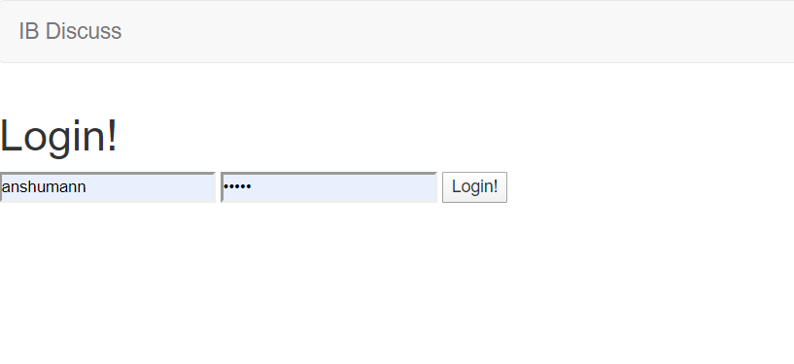
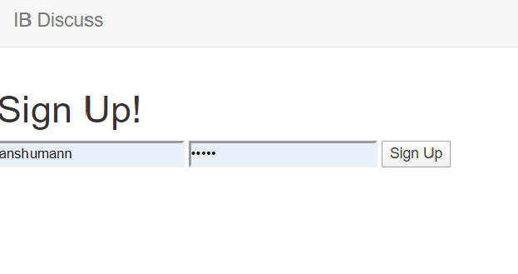
Login and Sign up page

Slide 9
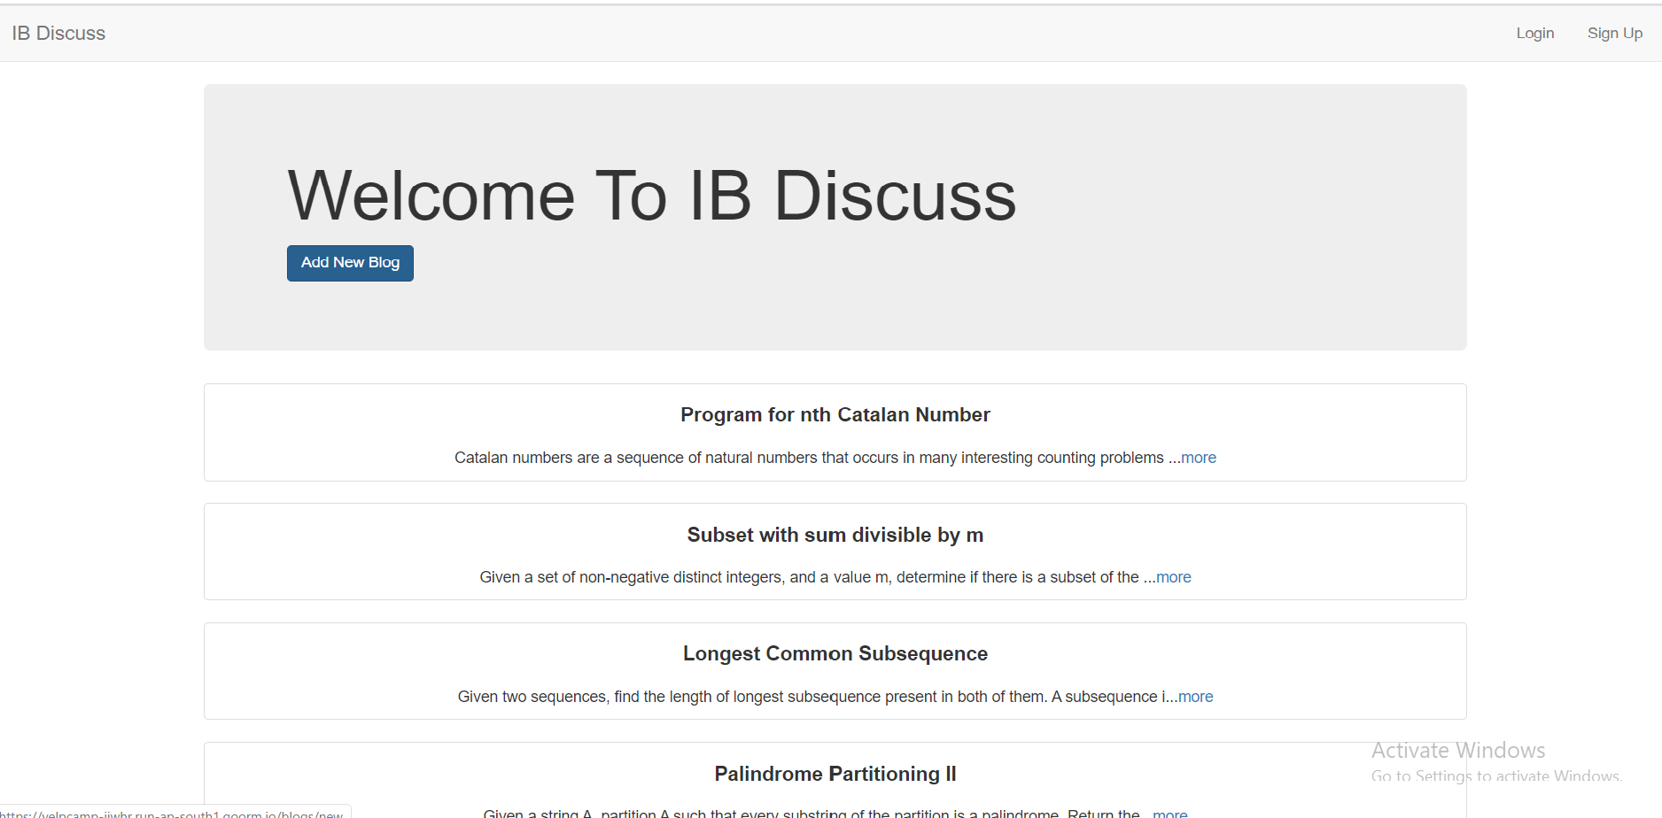
Guest user Landing page

Slide 10
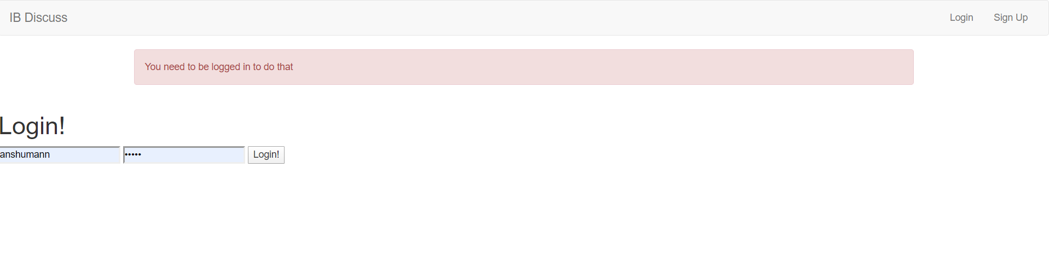
If the guest user wants to add blog,
he is directed to login page with a message.

Slide 11
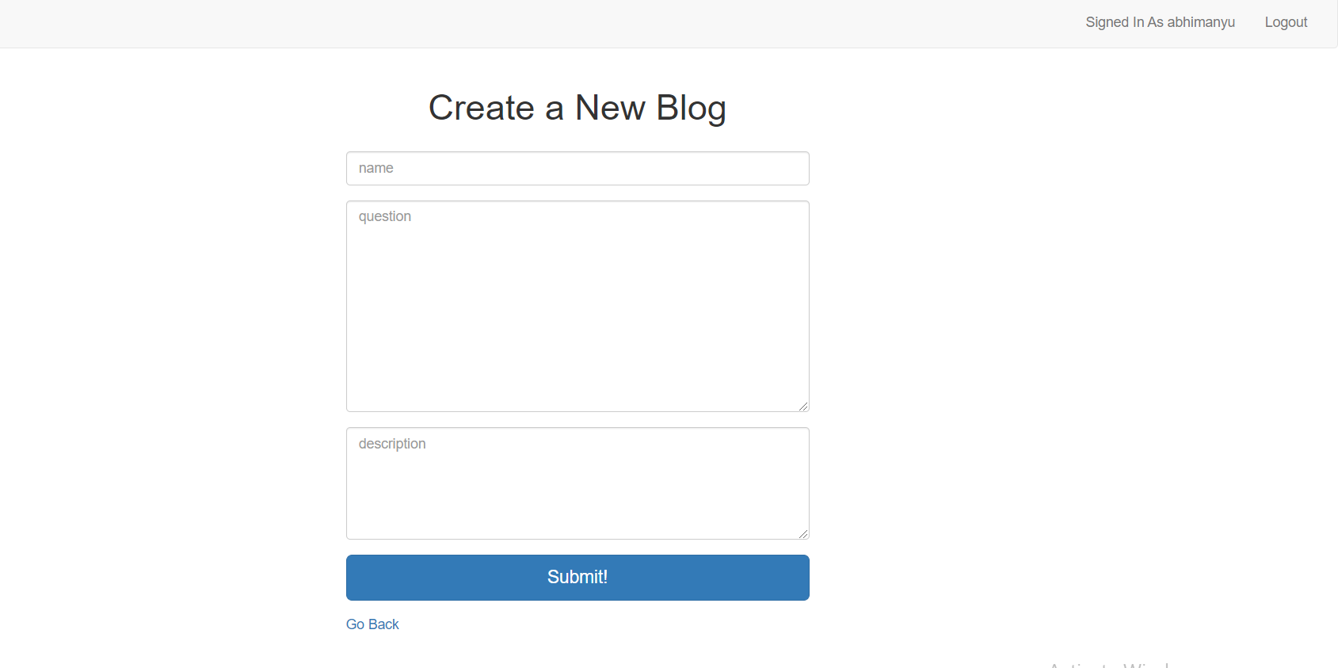
User can create new blog

Slide 12
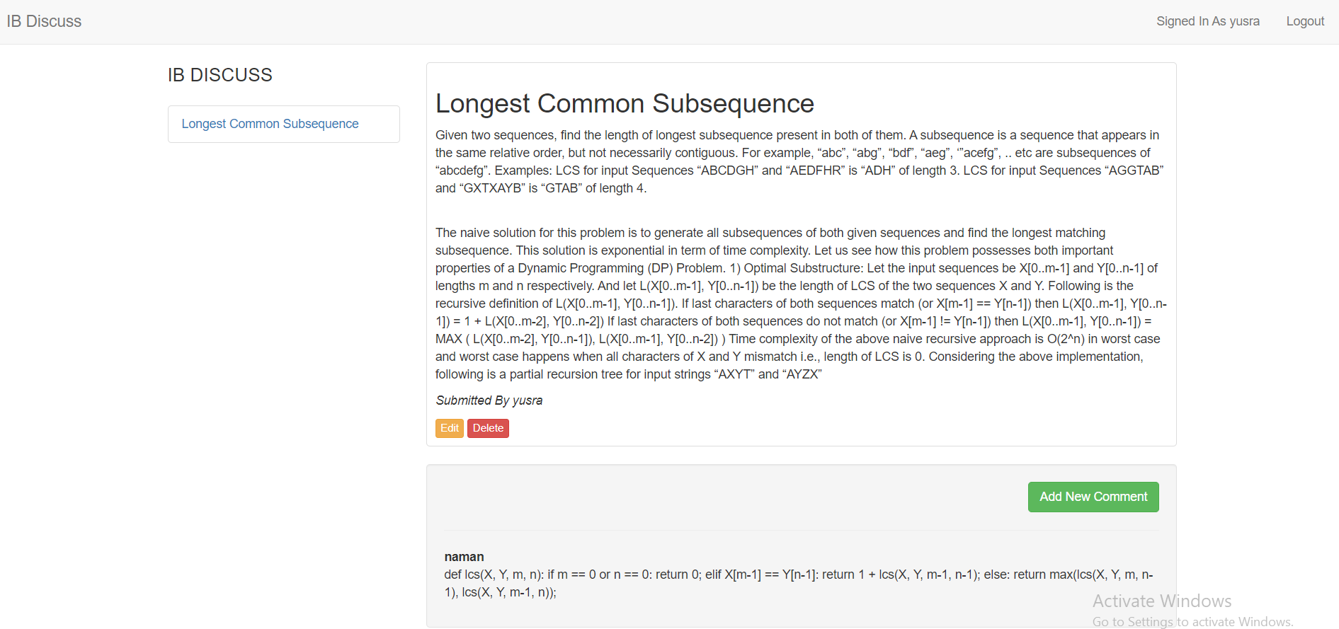
User can edit and delete his blog

Slide 13
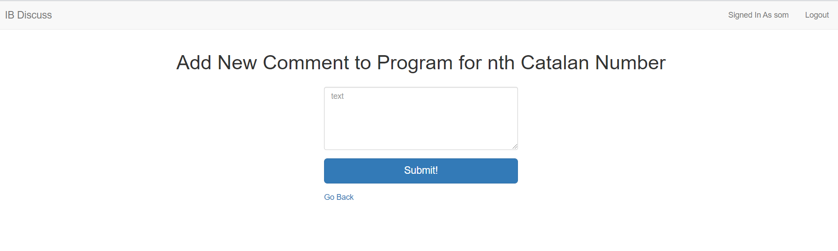
Adding a comment to blog

Slide 14
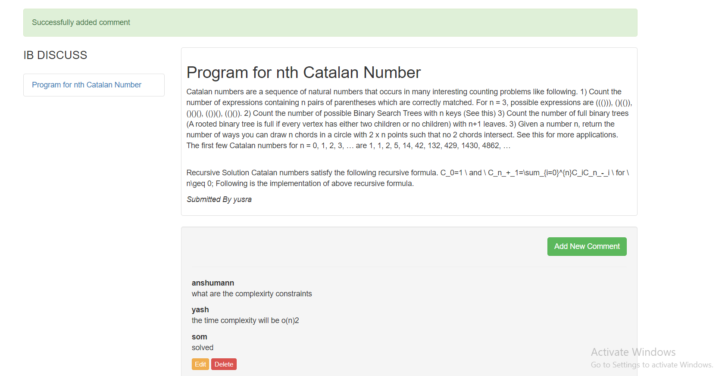
When a comment is added a message is shown and the user can delete or edit his/her comment.

Slide 15
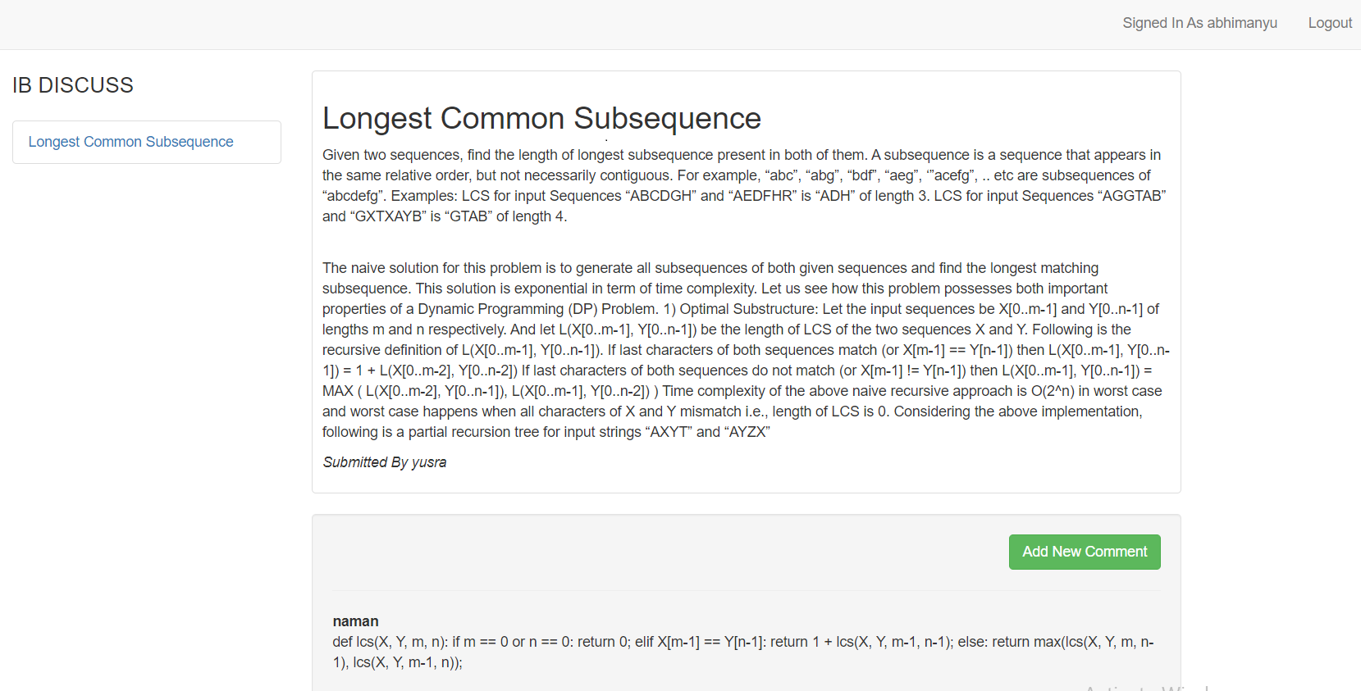
User can view blogs of multiple users

Slide 16
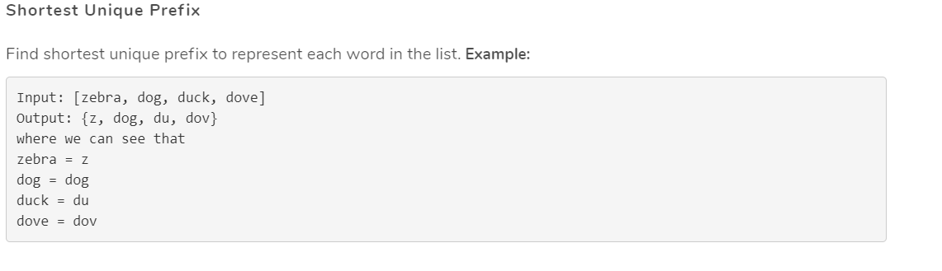
Task: Work with Trie
Designing a search feature, which auto-completes the search based on the previous searches.

Slide 17
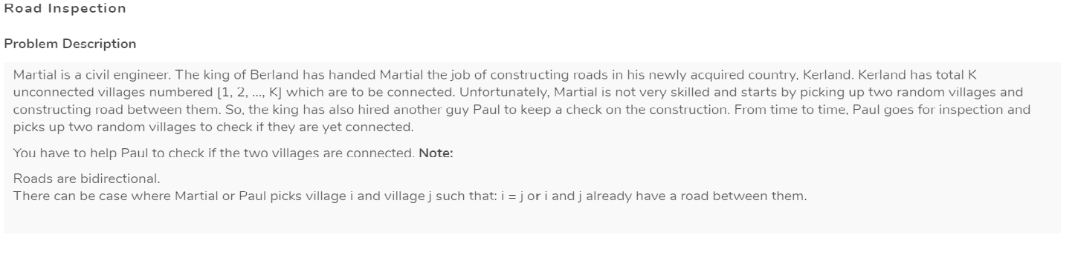
Task: Work with graphs
Social graphs, path optimization graphs, physical networks

Slide 18
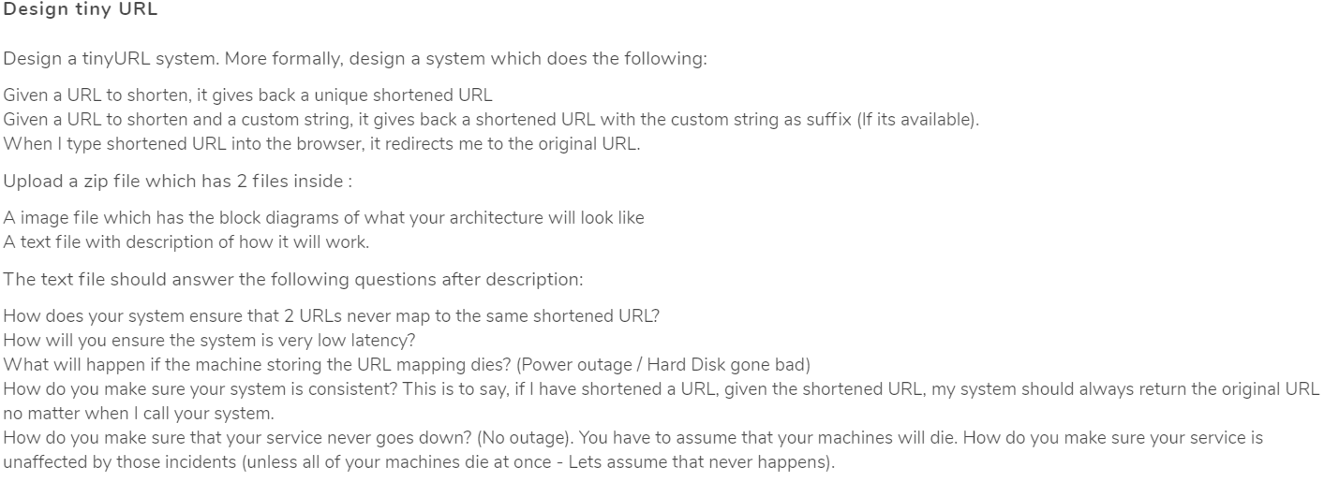
Task: Design tiny URL
Designing a unique short URL
The shortened URL should be reversible

Slide 19
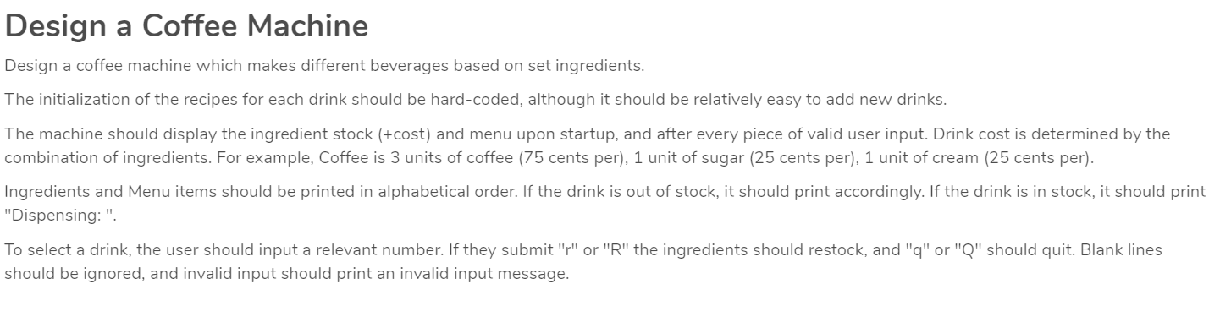
Task: Design a Coffee Machine

Slide 20
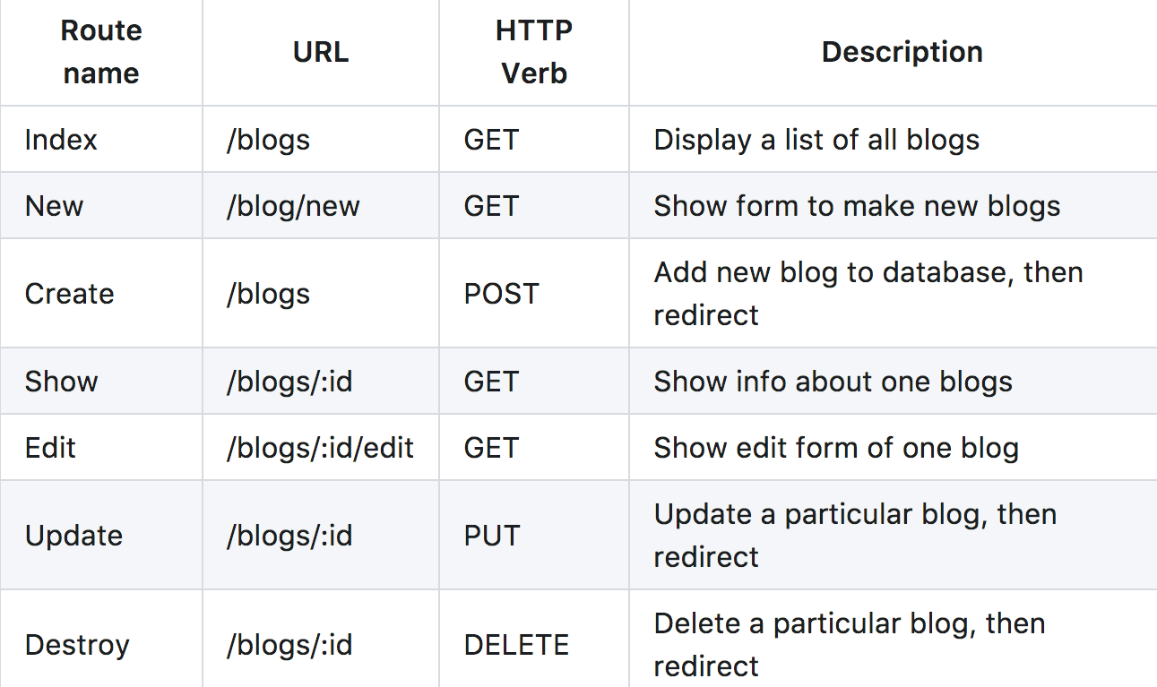
Restful Routing
What we are learning?

Slide 21
What we are learning?
Data structure & algorithm: Tries, segment trees, graphs & dynamic programming.
Designing concepts: low level design & high level design.
Working with NodeJS (library), expressJs (framework) & mongodb(non-realtional database).
Working with npm and other libraries.

Slide 22
Thank You

