Slide 1

Project Work - II
MEDICAPS UNIVERSITY
Presentation by:
Shruti Jain
EN16CS301251
CSE
Presentation by:
Shruti Jain
EN16CS301251
CSE
Project Title : Development of unsupervised and semi-supervised algorithms for clustering of protein sequences
Organization : Indian Institute of Technology Bombay
Internal Guide : Prof. Ruchi Patel

Slide 2

Indian Institute of Technology
Bombay
Research Internship Awards 2019-20
Industrial Engineering and Operations Research Department
Project Description
Project Title: Development of unsupervised and semi-supervised algorithms for clustering protein sequences
Principal Investigator: Prof N. Hemachandra

Slide 3
Intent of the project
The size of protein database is increasing steadily. This presents a major challenge of assigning function to the sequences.
The project aims to develop methods for clustering protein sequences.
This is expected to facilitate protein function annotation.
This will also help to know shared ancestry between proteins.

Slide 4
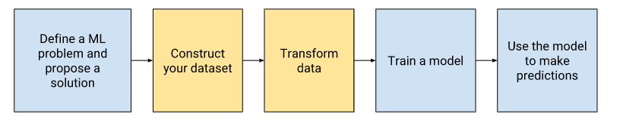
Machine Learning
A computer program is said to learn from experience E with respect to some class of tasks T and performance measure P, if its performance at tasks in T, as measured by P, improves with the experience E.
-Tom Mitchel
Machine learning is programming computers to optimize a performance criterion using example data or past experience. ^{[1]}
[1] Ethem Alpaydm, ``Introduction to Machine Learning’’, The MIT Press
Image source: Google Developers Course on Machine Learning

Slide 5
Primary Structure of Protein
Protein molecule is made from a long chain of twenty amino acids, each linked to its neighbour through a covalent peptide bond.
Proteins also known as polypeptides.
Each type of protein has a unique sequence of amino acids
The final protein structure ultimately depends on this sequence. It plays role in determining the function of a protein.
FASTA for insulin(Homo Sapien)
>AAA59179.1 insulin [Homo sapiens]
MALWMRLLPLLALLALWGPDPAAAFVNQHLCGSHLVEALYLVCGERGFFYTPKTRREAEVGQVELGGGPG
AGSLQPLALEGSLQKRGIVEQCCTSICSLYQLENYCN
Source: https://www.ncbi.nlm.nih.gov/protein/?term=insulin
Image source:https://www.123rf.com/photo_13207592_human-insulin-stylized-chemical-structure-.html

Slide 6
Similarity Measures
A distance metric takes a pair of sequences and returns a real number which denotes the distance between the given sequences. Once all pairwise distances among a set of sequences are found, the similarity information can be encoded in a matrix or in a graph.
Alignment based similarity
Keyword based similarity
Kernel based similarity
Model based similarity^{[1]}
[1]Charu C Aggarwal, Chandan K Reddy, “Data Clustering Algorithms and Applications”, Chapman & Hall/CRC

Slide 7
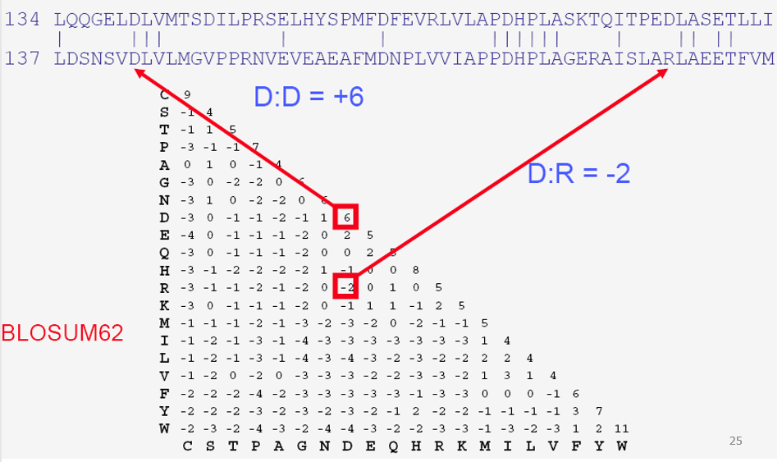
Aligning sequences
Given two strings, S and T, Find their best arrangement (global Alignment) or two largest substrings, s and t, with maximum similarity(local alignment)
Required: A scoring scheme for similarity and alignment algorithm
For scoring scheme biological substitution matrices are used which are BLOSUM and PAM

Slide 8
Sequence Alignment
Needleman-Wunsch Algorithm
Smith-Waterman Algorithm
Used for Global Alignment
The final step in the algorithm is the trace back for the best alignment. By continuing the trace one would reach to the 0th row, 0th column
Used for Local Alignment
The final step for the appropriate alignment is trace backing, prior to that one needs to find out the maximum score obtained in the entire matrix for the local alignment of the by scoring it.
M_{i,j}=MAX[M_{i-1,j-1}+S_{i,j}, M_{i,j}-1+W, M_{i-1,j}+W]
i,j describes row and columns. M is the matrix value of the required cell S is the score of the required cell (S_{i, j}) W is the gap alignment
M_{i,j}=MAX[M_{i-1,j-1}+S_{i,j}, M_{i,j}-1+W, M_{i-1,j}+W, 0]
i,j describes row and columns. M is the matrix value of the required cell S is the score of the required cell (S_{i, j}) W is the gap alignment
*Score can be calculated using scoring matrices. Some of the scoring matrices used are PAM and BLOSUM.
Ref. Valerie Guralnik and George Karypis,” A Scalable Algorithm for Clustering Sequential Data”
Ref. http://vlab.amrita.edu/

Slide 9
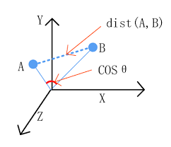
Alignment and cosine similarity
Alignment of proteins
A sequence alignment is a way of arranging the sequences of proteins to identify regions of similarity that may be a consequence of functional, structural, or evolutionary relationships between the sequences.
Here we used pairwise alignment
Example:-
SSSVPSQKTYQGSYGFRLGFLHSGTAKSVTCTYSPALNKMFCQLAKTCPVQL-WVDSTPP
P-GTRV-RAMAIYKQSQHMTEVVRRCPHHERCS-D--SDGLAPPQHLIRVEGNLRVEYLD DRNTFRHSVVVPYEPPEVGSDCTTIHYNYMCNSSCMGGMNRRPILTIITLEDSSGNLLGR NSFEVRVCACPGRDRRTEEENL
SCAVPSTDDYAGKYGLQLDFQQNGTAKSVTCTYSPELNKLFCQLAKTCPL-LVRVES-PP
PRGS-ILRATAVYKKSEHVAEVVKRCPHHER-SVEPGEDA-APPSHLMRVEGNLQAYYME DVNSGRHSVCVPYEGPQVGTECTTVLYNYMCNSSCMGGMNRRPILTIITLETPQGLLLGR RCFEVRVCACPGRDRRTEEDNY
It measures the cosine of the angle between two vectors projected in a multi-dimensional space
Smaller the angle, higher the similarity.

Slide 10
Keyword Based
N-grams are taken as features
Frequency of a particular n-gram of characters is considered in a sequence
Used tf-idf
Used cosine similarity
Sequence number | MKV | KVL | VLI | LIF | ACM | IFA | MKL
1 | 0.14 | 0.14 | 0.14 | 0.14 | 0.14 | 0.14 | 0.00
2 | 0.16 | 0.16 | 0.00 | 0.00 | 0.00 | 0.00 | 0.16
3 | 0.12 | 0.10 | 0.10 | 0.10 | 0.10 | 0.10 | 0.00
4 | 0.00 | 0.00 | 0.00 | 0.16 | 0.16 | 0.16 | 0.16
5 | 0.12 | 0.12 | 0.12 | 0.12 | 0.12 | 0.12 | 0.00
Frequency of three letter amino acids for the sequences:
MKVLIFACM; MKLCMKVL; ACMKVLIFAC; MKLIFACM; CMKVIFACM.
Source: Muhammad Javed Iqbal et al, “Efficient Feature Selection and Classification of Protein Sequence Data in Bioinformatics”; 2014

Slide 11
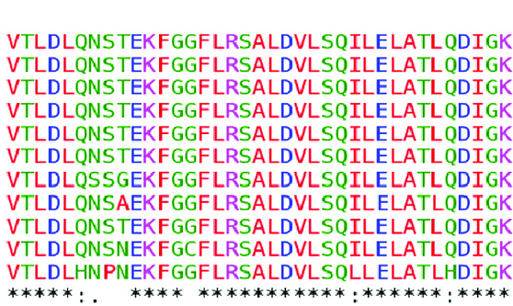
Clustering Sequential Data
Protein sequences are seen as sequential data.
Sequential data is the one where each object is represented as a sequence of set of items called item sets. Such sequence is called sequence data.
Clustering - finding groups of data sequences similar to each other
Similarity between two sequences can be based on sequence alignment
Set of features can capture sequential nature and project each data-sequence into a new space whose dimensions are these features.
Fig. Protein sequence alignment

Slide 12
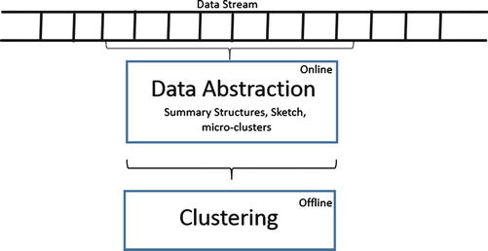
Clustering for Data Stream
An ordered sequence of points x₁……x_{n} that must be accessed in order
Can be read only once or a small number of times.
Continuous inﬂow of data objects which is potentially inﬁnite
The stream clustering has a variety of algorithms such as
Stream , CluStream, DenStream, Dstream, FlockStream, MuDi- Stream^{[1]}
Some of the algorithms “transfer” the conventional clustering algorithms to the stream scenario ^{[2]}
[1]Erini Ntotutsi, Yannis Theodoridis,
`` An Evaluation of data stream clustering algorithms’’
[2]Charu C Aggarwal, Chandan K Reddy, ``Data Clustering Algorithms and Applications’’, Chapman & Hall/CRC

Slide 13
Data stream clusters formed

Slide 14
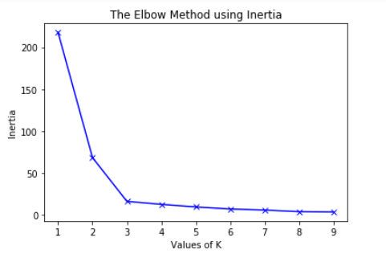
Evaluation of clusters
Elbow method: It is used to calculated sum of squared distances in clusters. Using inertia measure of kmeans it can also be used to determine optimal number of clusters required in clustering.

Slide 15
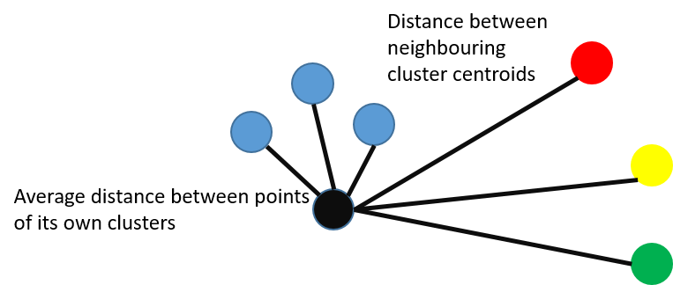
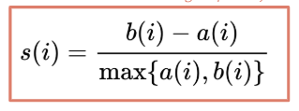
Silhoeutte score: Silhouette analysis can be used to study the separation distance between the resulting clusters. The range of Silhouette score is [-1, 1]. Its analysis is as follows −
+1 Score − Near +1 Silhouette score indicates that the sample is far away from its neighboring cluster.
0 Score − 0 Silhouette score indicates that the sample is on or very close to the decision boundary separating two neighboring clusters.
-1 Score − 1 Silhouette score indicates that the samples have been assigned to the wrong clusters.
Silhouette score= s(i)
a(i) - the mean distance between point i and all other points in its own cluster.
b(i) - the distance between point i and its next nearest cluster centroid.

Slide 16
Progress
Studied and analysed various research papers and survey papers on
Bayesian models
Bayesian Methods
Approximation methods for k-medians problem
Clustering algorithms
State-of-the-art algorithms for stream clustering
Clustering of sequential data
Studied the advantages and disadvantages of various Data stream clustering algorithms.
Implemented K-means clustering for mathematical dataset and protein sequences
Implemented the sequence alignment algorithms for sequence similarity and used them in sklearn-clustering library using the matrices obtained as similarity matrices.
Co-ordinated with bio-sciences team to understand the protein primary structure and protein database.
Used cosine similarity to measure similarity as well

Slide 17
List of papers and books read
Adi L. Tarca, Vincent J. Carey, Xue-wen Chen, Roberto Romero, Sorin Draghici, “Machine Learning and Its Applications to Biology”, A tutorial in PLoS Computational Biology, vol.3, June 2007.
Antje Krause, Jens Stoye, Martin Vingron, “Large Scale Hierachical clustering of protein sequences”, BMC Bioinformatics 2005,6:15. DOI 10.1186/1471-2105-6-15.
Charu Aggarwal, Chandan Reddy, Data Clustering, CRC Press, Taylor and Francis Group, 2014.
A. Sharaf Eldin, S. AbdelGaber, T. Soliman, S. Kassim, and A. Abdo, “A Comparative Study of Protein Sequence Clustering Algorithms”, DOI: 10.1007/978-481-9112-3_63.
S. Guha, N. Mishra, R. Motwani, and L. O’Callaghan. Clustering data streams. In Proceedings of the 41st Annual Symposium on Foundations of Computer Science. IEEE Computer Society, 2000.
Dan Gusfield, Algorithms on Strings, Trees and Sequences, 1997.
Alexander Etz et el, “How to become a Bayesian in eight easy steps: An annotated reading list”,A report in Crossmark, 2018
Eirini Ntoutsi, Nikos Pelekis, Yannis Theodoridis, “An evaluation of data stream clustering algorithms”, DOI: 10.1002/sam.11380.
Ahmed Sharaf Eldin, Sayed Abdelgaber, Taysir Soliman, “A comparative study of Protein Sequence Clustering Algorithms”, January 2009, DOI: 10.1007/978-90-481-9112-3-63.
Kamal Jain, Vijay Vazirani, “Primal-Dual Aprroximation Algorithms for Metric Facility Location and k-Median Problems”
Valerie Guralnik, George Karypis, “A Scalable Algorithm for Clustering Sequential Data”

Slide 18
THANK YOU

