Slide 1

Employee Management System

Slide 2




TEAM UNITY
Saikat Hussain
CSE06307459
Rishad Istiak Sachcha
CSE06307451
Md. Arafat Rahman
CSE06307434

Slide 3
Objectives
interview questions
case diagram
data flow diagram
Information Gathering & Interview

Slide 4
Interview Structure
Interview structure was Funnel type
7 open ended question in beginning.
3 close ended question after that.

Slide 5
Selection Of Interviewe
Interviewee

Slide 6
Question 01: How (company name) operates their program?
Question 02: What kind of employees do you have in your company?
Question 03: How did you manage the Employees Management System at the beginning of the company?
Question 04: How do you currently manage the employees management system of the company?
Question 05: Which is better than the employment management system you had before and the management system you have now?
Question 06: What features do you currently have with your software running the Employee management System?
Question 07: Which adding key features will make your employee management system more convenient?

Slide 7
Interview Question
8. Can the employee get the current information of the activity through the web?
Answer: No, currently we do not have that.
9. What method is used by the main branch to collect the information from the local branches?
Answer: It is an automated process. We collect the information on a monthly basis.
10. Which program of (company name) has the most employee?
Answer:

Slide 8
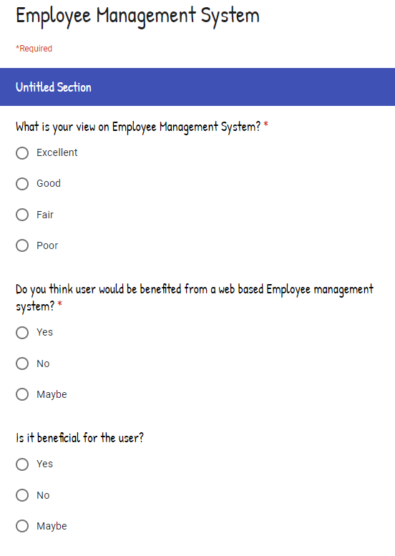
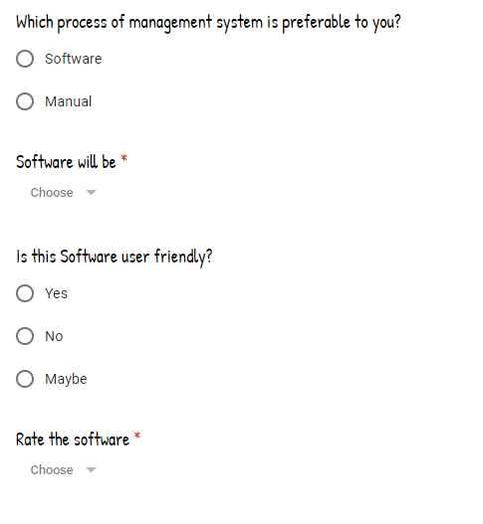
Questionnaires

Slide 9
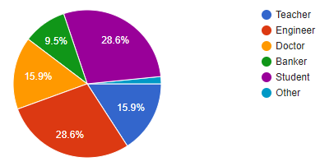
Count of Occupation
Questionnaires

Slide 10
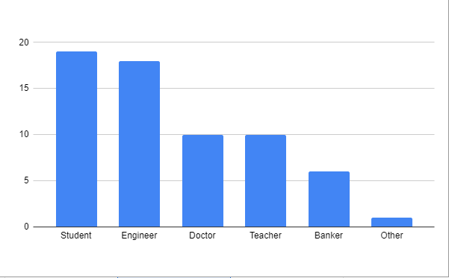
Count of Occupation
Questionnaires

Slide 11
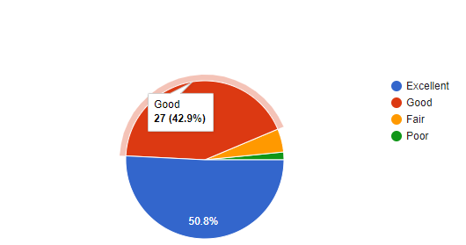
view on Employee Management System
Questionnaires

Slide 12
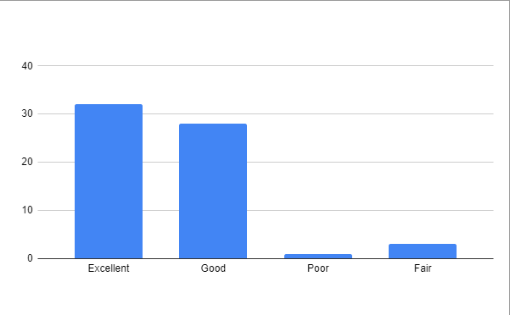
Count of view on employee management system
Questionnaires

Slide 13
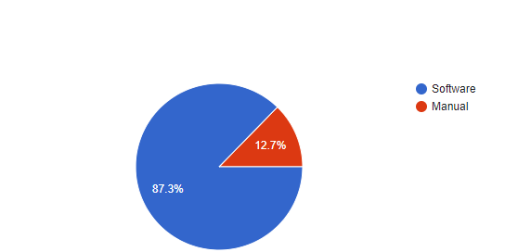
Which process of management system is preferable
Questionnaires

Slide 14
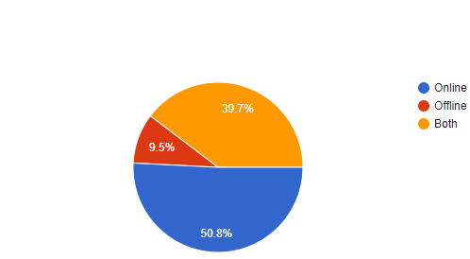
View on software will be
Questionnaires

Slide 15
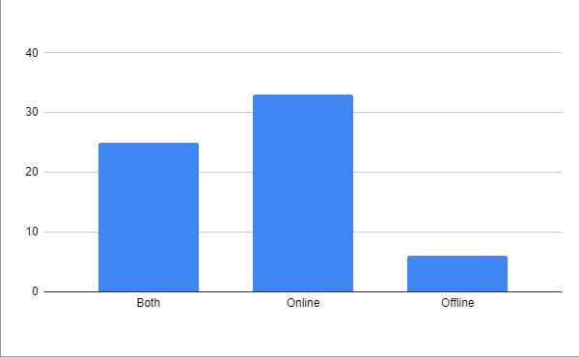
Count of software will be
Questionnaires

Slide 16
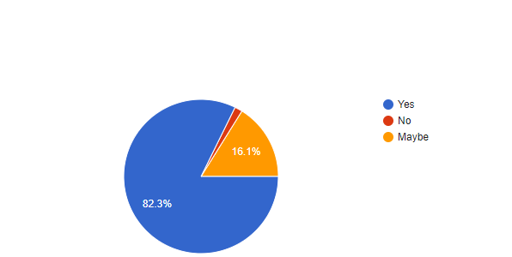
Benefite of Web Based Employee Management System
Questionnaires

Slide 17
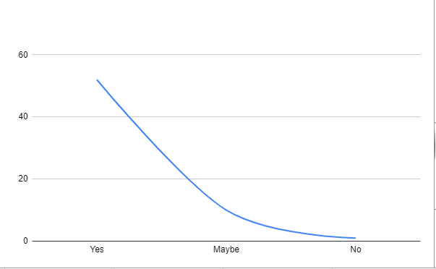
Count of Web Based Employee Management System
Questionnaires

Slide 18
Top use of employee management system -
Business company
School
College
Hospital
93.5% agree that software base employee management system is effective.

Slide 19




THANK YOU!
TEAM_UNITY
team_unity@example.com
678-555-0100

