Slide 1
Employee Management System
By Team Unity

Slide 2
Summary
Web based application
Attendance tracking
Update records.

Slide 3
Requirements
Programming language:html, css, bootstrap, javascript,php.
IDE:PhpStorm
Database:mysql
OS:windows
Server:wamp

Slide 4
Activity
Attendance track
Information update or delete
Delete available only for admin
HR can only update,no delete permission is given.

Slide 5
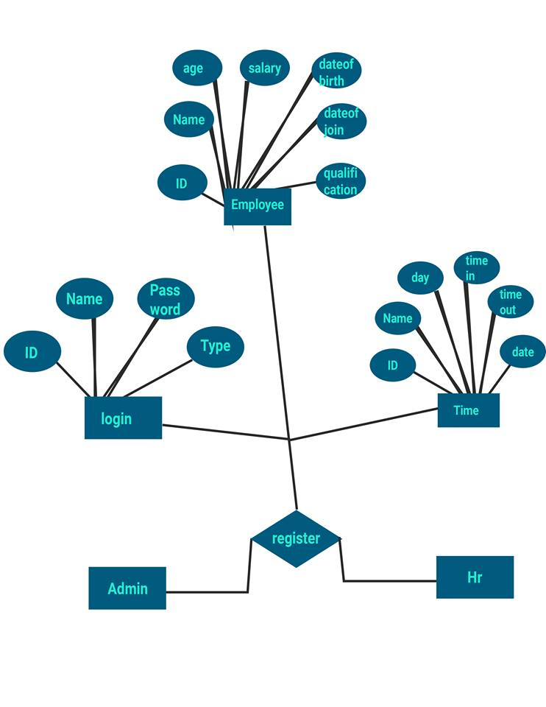
ER Diagram

Slide 6
Future plan
Completion of the software
Add feature of employees to connect directly
Implement biometrics attendance
Create payment gateway

Slide 7
THANKS

