Slide 1

Employee Management System

Slide 2




TEAM UNITY
Saikat Hussain
CSE06307459
Rishad Istiak Sachcha
CSE06307451
Md. Arafat Rahman
CSE06307434

Slide 3
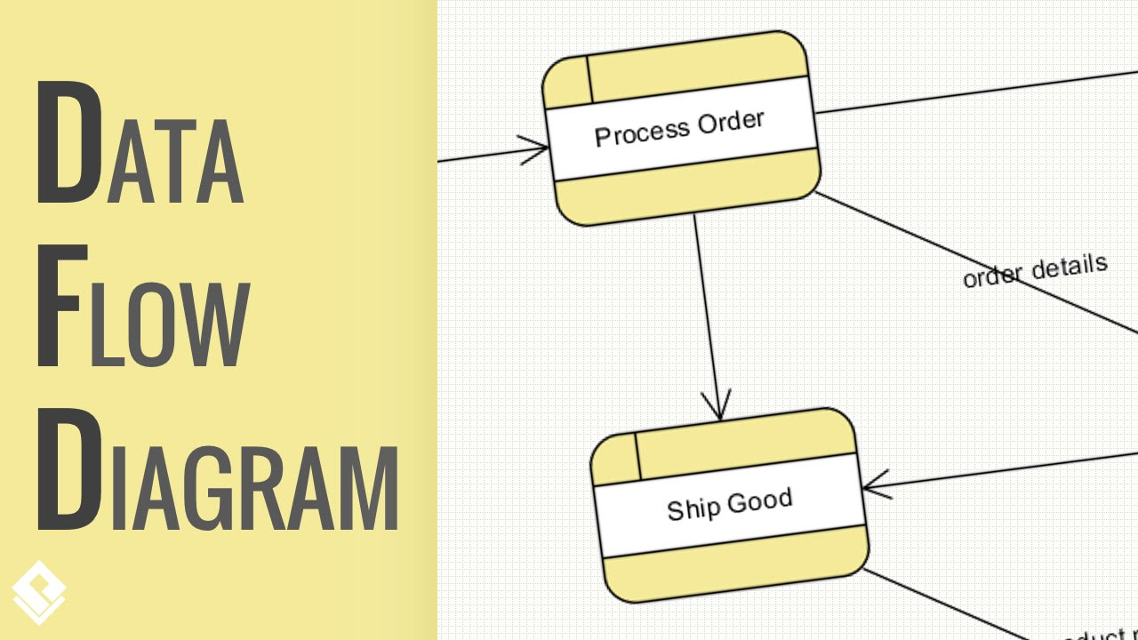
Data Flow Diagram
Topic

Slide 4

Content Modification (add/delete/modify)
Task assignment for Employee
Keeping Track of Employees’ Work
Activity List (Administration)

Slide 5

Login
Response
Keep Attendance
Activity List (Attendance)

Slide 6

Pay for Employee
Employee Salary Calculation
Work rate of Employee
Activity List (Payroll)

Slide 7
Decomposition of DFD
Context Level | Level -0 | Level-1
Employee Management System | 1.0 Administration | 1.1 Content Process
 |  | 1.2 Employee Work Process
 | 2.0 Attendance | 2.1 Login Process
 | 3.0 Payroll | 3.1 Pay to Employee

Slide 8
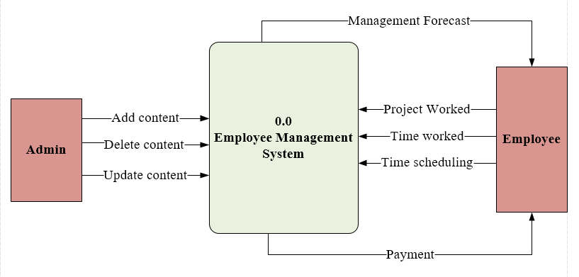
Context Level

Slide 9
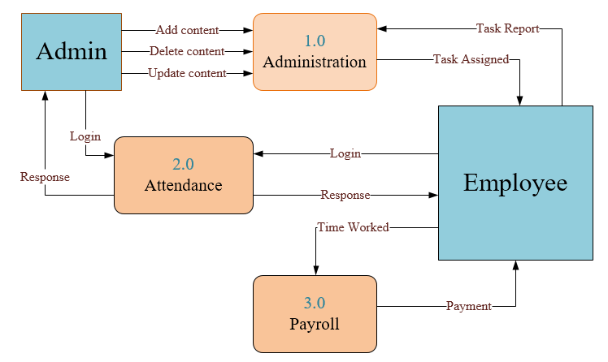
Level- 0

Slide 10
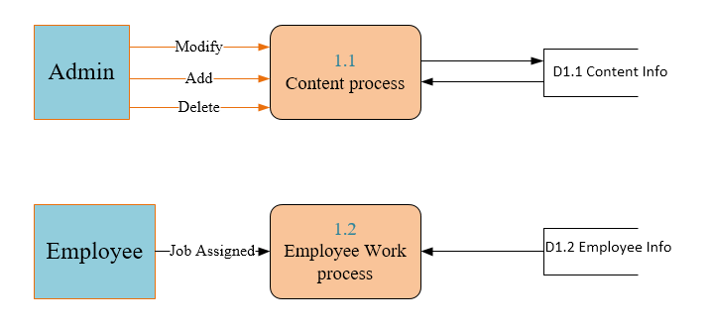
DFD Level 1

Slide 11
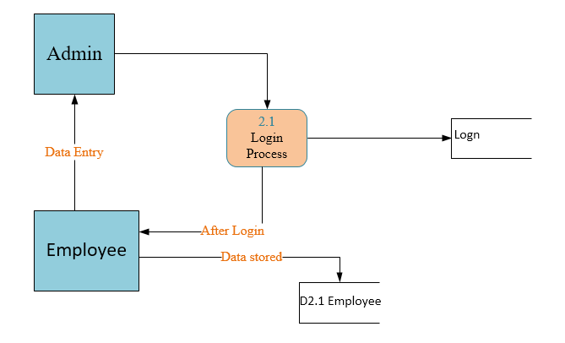
DFD Level 1

Slide 12
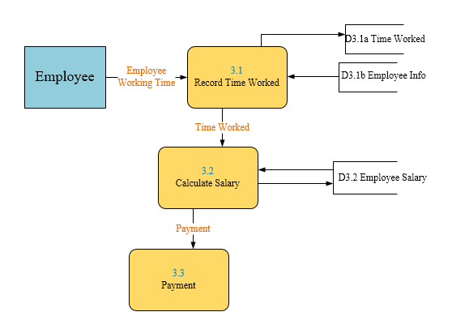
DFD Level 1

Slide 13




THANK YOU!
TEAM_UNITY
team_unity@example.com
678-555-0100

