Slide 1

Programming AES in C

Slide 2
Programming AES in C
Step 1:
Write a simple program that will print “HELLO world!” and compile it with the following command line
./gcc –Wall first.c –lcrypto –o first
In your program add the following libraries
#include <stdio.h>
#include <openssl/evp.h>
#include <openssl/aes.h>
#include <openssl/err.h>
#include <string.h>
int main(int arc, char *argv[])
{ printf (“Hello WORLD\n”);
return 1;
}

Slide 3
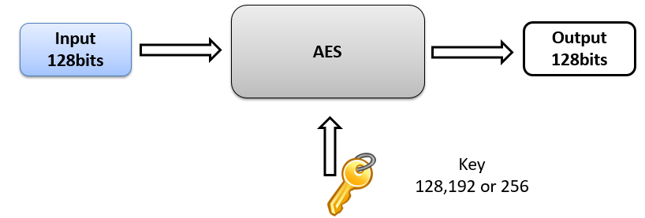
Advanced Encryption Standard

Slide 4
Initialization
int main(int arc, char *argv[])
{
OpenSSL_add_all_algorithms(); //load all cipher algorithms
ERR_load_crypto_strings(); //load human readable errors
//the above two lines are needed for initialization and to be able to use the libcrypto library

Slide 5
Calling encrypt() function
What do we need for the encrypt function?
Plaintext
Length of the plaintext
Key
IV?
Encrypting consists of the following stages:
Setting up a context
Initializing the encryption operation
Providing plaintext bytes to be encrypted
Finalizing the encryption operation

Slide 6
Calling Encrypt() function
int main(int arc, char *argv[])
{ OpenSSL_add_all_algorithms();
ERR_load_crypto_strings();
/* A 256 bit key */
static const unsigned char key[] = "01234567890123456789012345678901";
unsigned char plaintext[] = "CS475 is an awesome course about computer security in the University of Cyprus.";
/* Buffer to store the ciphertext. The size may be different due to padding. */
unsigned char ciphertext[128];
/* Buffer for the decrypted text for verifying decryption. */
unsigned char decryptedtext[128];
int decryptedtext_len = 0, ciphertext_len = 0;

Slide 7
calling encrypt() function
/* Encryption. */
ciphertext_len = encrypt(plaintext, strlen((char *)plaintext), key, ciphertext);
printf("Ciphertext is:\n");
BIO_dump_fp(stdout, (const char *)ciphertext, ciphertext_len);
}

Slide 8
Function: encrypt() internals
int encrypt(unsigned char *plaintext, int plaintext_len, const unsigned char *key, unsigned char *ciphertext)
{
EVP_CIPHER_CTX *ctx = NULL;
int len = 0, ciphertext_len = 0;
/* Create and initialize the context and returns a pointer for success and null for failure*/
if(!(ctx = EVP_CIPHER_CTX_new()))
handleErrors();
/* Initialize the encryption operation. */
if(1 != EVP_EncryptInit_ex(ctx, EVP_aes_128_ecb(), NULL, key, NULL))
handleErrors();

Slide 9
Function: encrypt()
/* Initialize the encryption operation. */
if(1 != EVP_EncryptInit_ex(ctx, EVP_aes_128_ecb(), NULL, key, NULL))
handleErrors();

Slide 10
Function: EVP_EncryptUpdate
/* Provide the message to be encrypted, and obtain the encrypted output.
* EVP_EncryptUpdate can be called multiple times if necessary*/
if(plaintext)
{
if(1 != EVP_EncryptUpdate(ctx, ciphertext, &len, plaintext, plaintext_len))
handleErrors();
ciphertext_len = len;
}
encrypted version
actual number of bytes written

Slide 11
Function: EVP_EncryptFinal_ex
if(1 != EVP_EncryptFinal_ex(ctx, ciphertext + len, &len)) handleErrors();
ciphertext_len += len;
Encryptfinal_ex encrypts the final data that is any data that remains in a partial block.
encrypted final data is written
number of bytes written

Slide 12
Function: EVP_CIPHER_CTX_free
/* Clean up */
EVP_CIPHER_CTX_free(ctx);
return ciphertext_len;
}
EVP_CIPHER_CTX_FREE clears all information from a cipher context and free up any allocated memory associate with it, including ctx itself.

Slide 13
Resources
https://www.openssl.org/docs/man1.1.0/crypto/EVP_EncryptInit.html
https://wiki.openssl.org/index.php/Libcrypto_API

