Slide 1
Euro Power Plant Simulator
Task: Paneuropa
(Educational ideas that help spread knowledge)
Partner: European Commission – Representation in Poland
Team:
MMŁ
Marcin Purzycki
Marcin Zagórski
Łukasz Zagórski
HackYeah 2023, Kraków

Slide 2
Euro Power Plant Simulator the original idea
an educational game in which the player takes on the role of an architect of an energy network throughout Europe
it is possible to arrange various types of power plants and design connections between countries
the network is to be built within a specific budget and in the shortest possible time - so as to meet the energy needs of the regions while optimizing costs, environmental pollution and incurring contractual penalties for failure to meet the needs

Slide 3
Euro Power Plant Simulator
MVP scope
for the needs of a 24-hour project for a team of 3, the scope of work was limited to MVP in the form of an interactive simulation
the simulation aims to spread knowledge about the impact of electricity production on environmental pollution, both locally and throughout Europe as a coherent area of our existence, for the condition of which each resident is individually responsible.
provides the opportunity to design an energy network for the whole of Europe and compare the impact of the location and types of power plants on energy demand, construction costs and pollution levels in individual regions and whole Europe

Slide 4
Euro Power Plant Simulator user input
type of power plant: nuclear, coal, hydro, wind, solar
the number of power plants of each type in the region

Slide 5
Euro Power Plant Simulator simulation output
energy demand by regions and total
meeting energy demand by regions and in total
volume of electricity production by regions and total
the impact of constructed power plants on environmental pollution by region and total
cost of building a power plant network by region and total

Slide 6
Euro Power Plant Simulator simulation models
energy demand, transfer of surplus production to neighboring regions
degree of pollution depending on the type of power plant and its location
construction cost depending on the type of power plant
variable efficiency of individual types of power plants depending on the construction region (impact of environmental factors, availability of raw materials, availability of a sufficient number of qualified personnel in a given region)
variable power plant efficiency depending on the number of power plants built and the size of the region

Slide 7
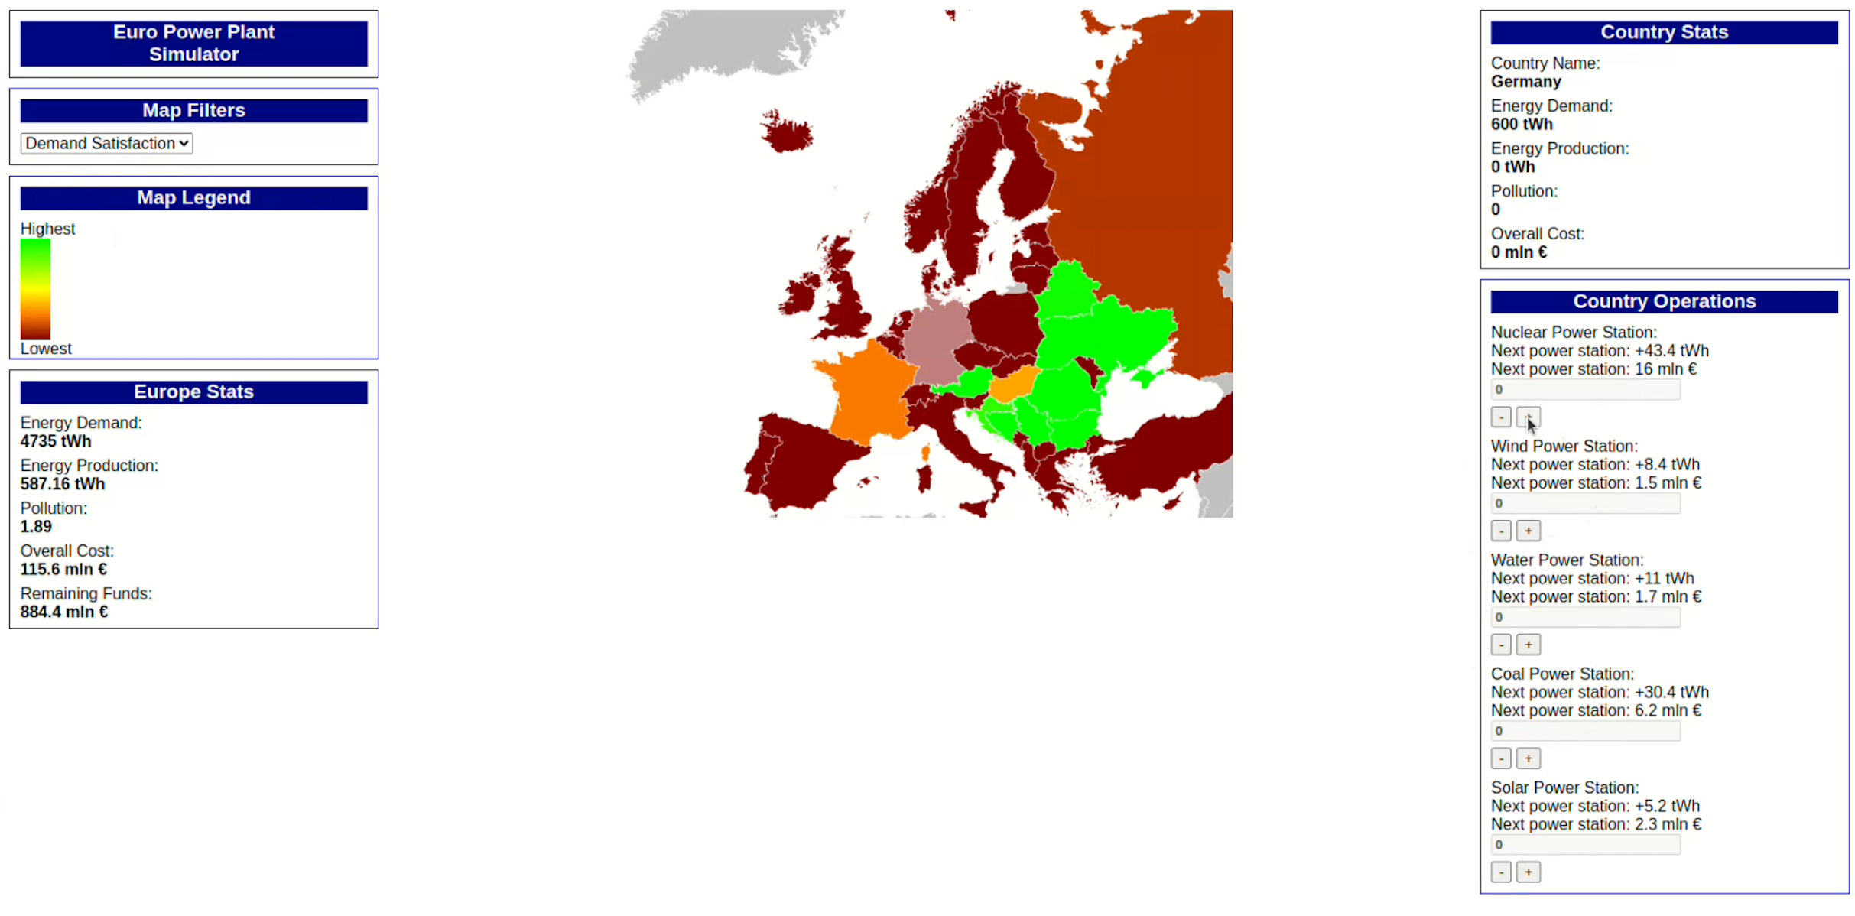
Euro Power Plant Simulator demo

Slide 8
Euro Power Plant Simulator tech stack and sources
Java script
P5js
SVG
Statistical journals
Power plant projects and public procurement
https://challengerocket.com/hackyeah-2023/works/euro-power-plant-simulator-fcbbbb
https://github.com/csecluki/hackyeah2023

