Slide 1
Software Project Management

Slide 2
SYLLABUS: Module-1
Convention of Software Management:
The waterfall model, conventional software management performance.
Evolution of Software Economics:
Software economics. Pragmatic software cost estimation improving software economics.
Improving Software Economics:
Reducing software product size, improving software processes, improving team effectiveness, improving automation, achieving required quality, peer inspections.

Slide 3
Conventional Software Management
Conventional software performs specific, well-defined tasks.
Waterfall model:
The waterfall model describes a development method that is linear and sequential. Waterfall development has distinct goals for each phase of development.
Waterfall model phases:
Requirements
Planning
Design
Implementation
Testing
Verification

Slide 4
Waterfall Model Phases:
Clearly gather and document what the system must do.
Requirements
Decide the project schedule, resources, and overall strategy.
Planning
Create the architecture and blueprint of how the system will work.
Design
Write the actual code based on the design.
Implementation
Check the system for errors, bugs, and functionality issues.
Testing
Ensure the final product meets all requirements and works as expected.
Verification

Slide 5
Advantages of waterfall model:
Simple and easy to understand.
Easy to manage because each phase is clearly defined.
Works well for small projects with clear requirements.
Phases are completed one at a time (no overlap).
Disadvantages of waterfall model:
Hard to go back and make changes after testing begins.
Working software appears very late in the cycle.
High risk and uncertainty.
Not suitable for complex or long-term projects.
Not good when requirements may change.

Slide 6
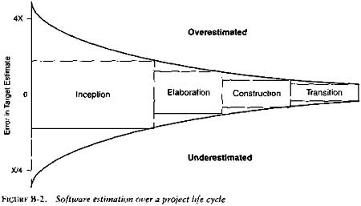
Conventional Software Management Performance
Software development is highly unpredictable; only 10% of projects meet original budget & schedule.
Management discipline impacts success more than technology.
High amount of software scrap & rework → industry still immature.
Overall software project success rate is very low.
Initial project vision, scope definition, business case development.
Architecture design, risk resolution, detailed planning, and building the core structure
Building the product features, iterative development, and component implementation
+4
Deployment to users, training, support transition, and final adjustments
-4

Slide 7
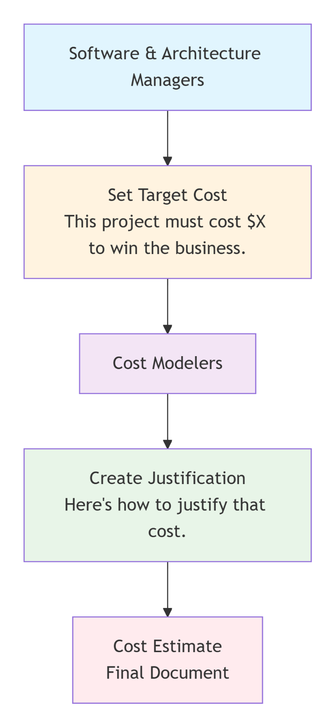

Slide 8
Important Points from Barry Boehm’s Top 10 Software Metrics
Fixing bugs after delivery costs 100× more than fixing them during design.
Software development schedules can be compressed only up to 25% — not more.
For every $1 spent on development, $2 is spent on maintenance.
Cost depends mainly on number of source lines of code (SLOC).
People differences create the biggest variation in software productivity.
Software cost ratio is increasing:
1955 → 15% software | 1985 → 85% software
Only 15% of development effort is actual programming.
Software systems cost 3×, and system-of-systems cost 9× more per SLOC.
Walkthroughs catch 60% of errors.
80% output comes from 20% contributors (Pareto Principle).

Slide 9
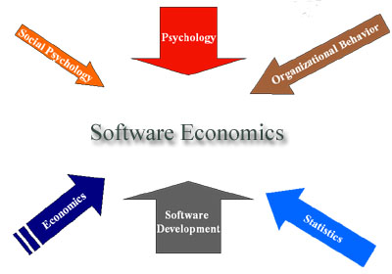
Software Economics:
The process of counting function points, gathering data, analyzing data is commonly referred to as Software Metrics, but in reality is a branch of economics which should be called Software Economics.

Slide 10
Software Economics examines the entire idea of software development and it includes many different disciplines.
Psychology - focuses on the study of behaviour and the reward/punishment model. "What get's rewarded gets done."
Social Psychology - focuses on how people behave in an organization, quality of work life, and peer pressures.
Organizational Behaviour - is the process of analyzing the structure of an organization to understand those structural issues impacting organizational productivity and quality.
Economics - the study of prices, costs, and scarcity.
Statistics - deals with quantitative and qualitative techniques for the collection of data, how data is analyzed, and how results are presented.

Slide 11
Software cost Model can be abstracted into a function of five basic parameters:
Size – measured in SLOC or function points.
Process – efficiency of the development process (less rework, fewer delays).
Personnel – skills and experience of developers.
Environment – tools and techniques supporting development.
Quality – features, performance, reliability, flexibility of the software.
These parameters determine the effort and cost of a project.
Cost estimation formula:
Effort = (Personnel) × (Environment) × (Quality) × (Size^Process)

Slide 12
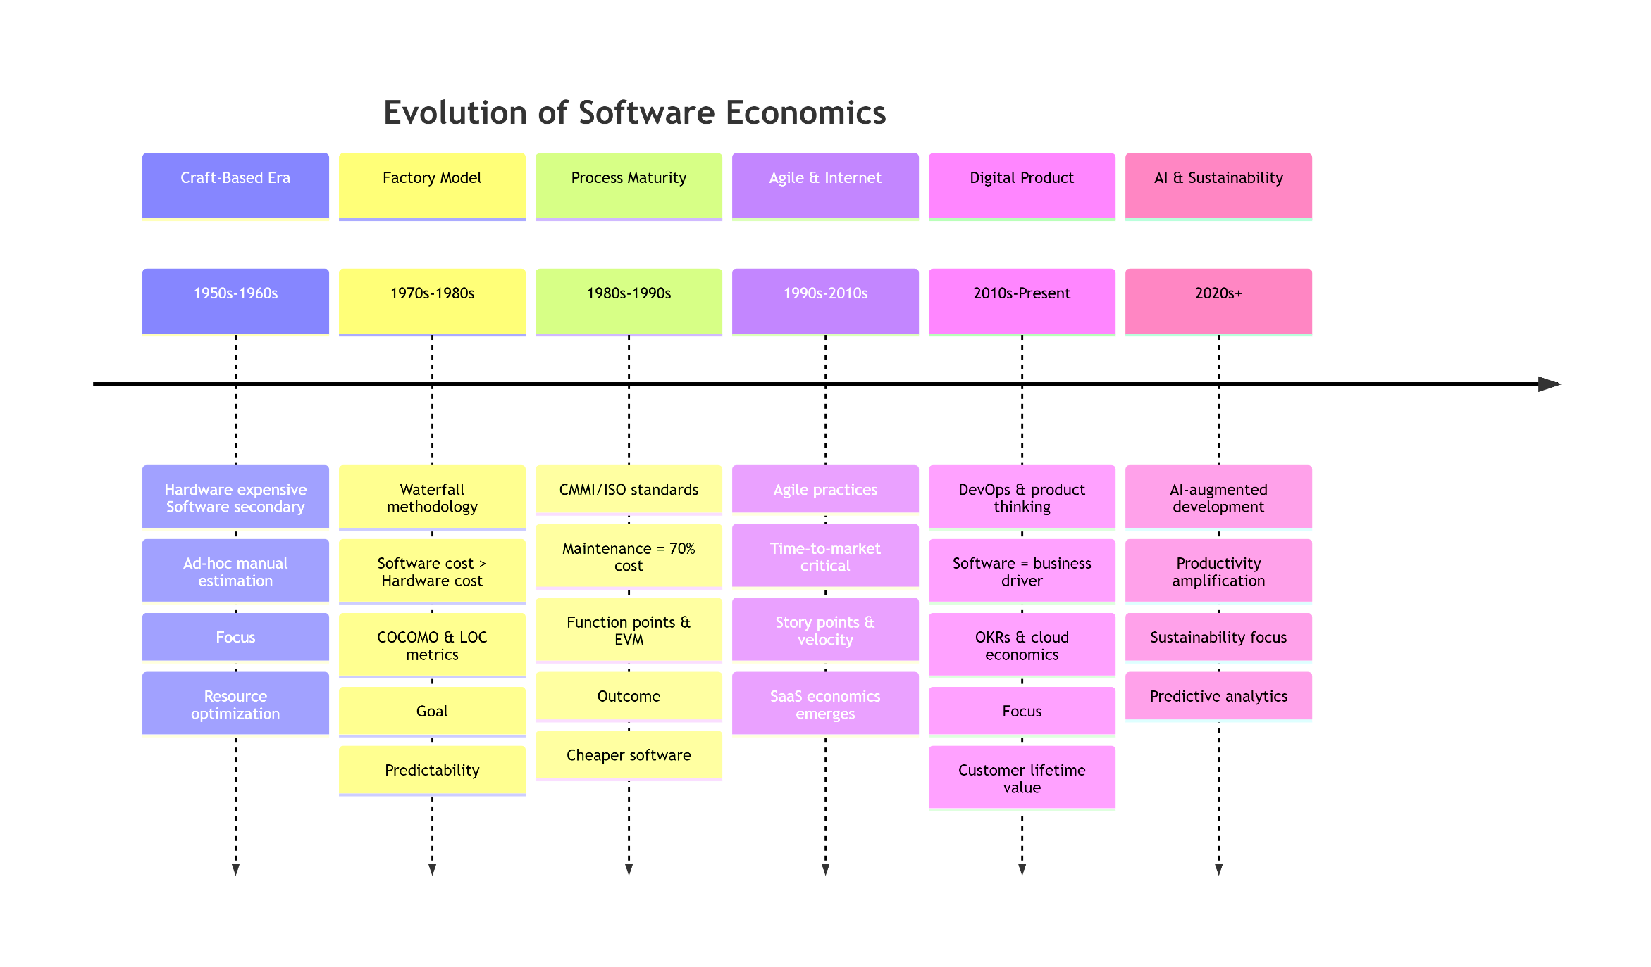
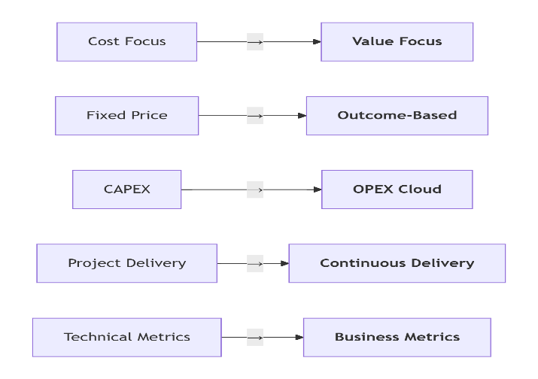

Slide 13
Pragmatic Software Cost Estimation
One critical problem in software cost estimation is a lack of well-documented case studies of projects that used an iterative development approach.
Selection of a Cost estimation Model to be used.
Selection of a Measuring Unit to Measure the Size of the software.
Selection of a Tool of Metric that will set up a Good Estimate.

Slide 14
1. Selection of Cost Estimation Model:
Choose the best estimation model → Waterfall model is widely used.
Waterfall model Steps
Requirements
→ Write down what the software should do.
Design
→ Plan how the software will be built.
Implementation
→ Write the code.
Testing
→ Check if it works correctly.
Deployment
→ Release it to users.
Maintenance
→ Fix issues and make updates.

Slide 15
2. Selection of Measuring Unit:
Software size can be measured using:
  Source Lines of Code (SLOC)
  Function Points
  Subjective / adhoc estimates
3. Selection of Tool or Metric:
Good estimation depends on:
  Project manager, architect, development & testing team input.
  Estimate accepted by stakeholders as realistic.
  A well-defined cost model.
  Past project experience.

Slide 16
Reducing software product size:
Reducing software product size means that minimizing code and features through techniques like component reuse, object-oriented programming, automatic code generation, and scope management.
Types of Software Size Metrics:
Functional Size Metrics:
Measures size based on functionality
Example: Function Point (FP)
Language-independent
2. Physical Size Metrics:
Measures size based on lines of code
Example: Source Lines of Code (SLOC)
Language dependent
3. Hybrid Metrics:
Combine FP and SLOC
Used to compare productivity across languages

Slide 17
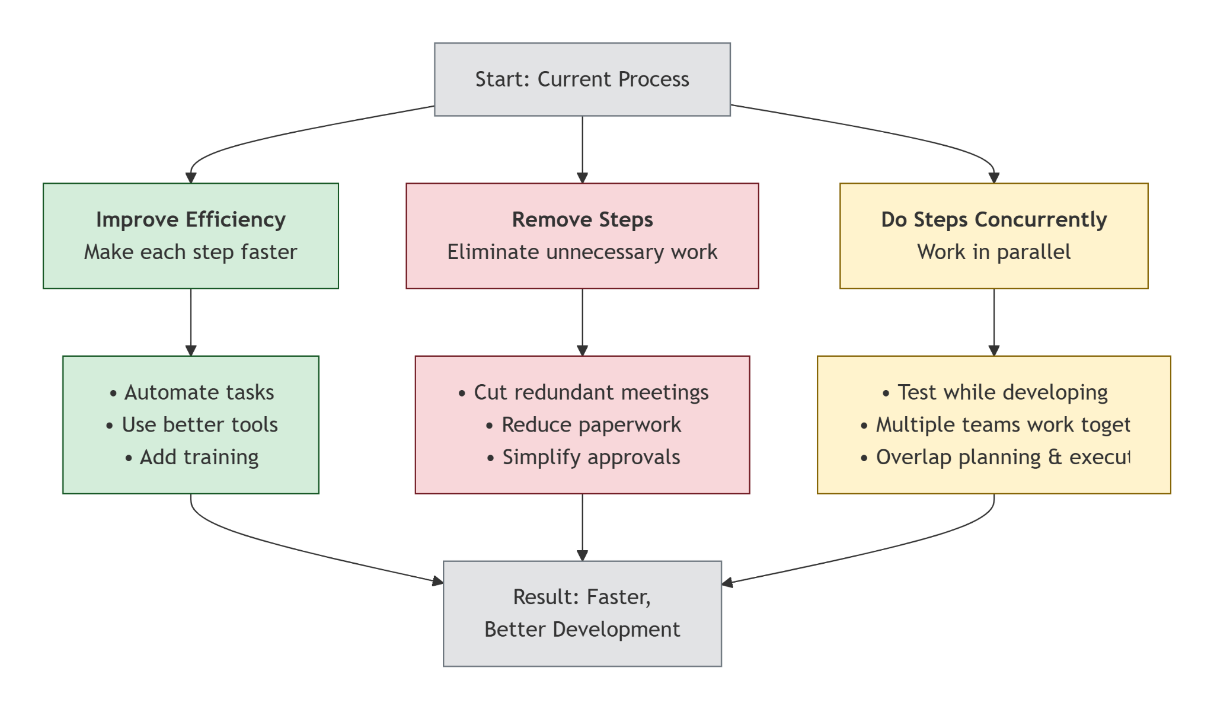
Improving Software Processes:
Improvement Software processes is a systematic approach to enhancing software development and maintenance by refining processes to boost quality, efficiency, and effectiveness.
Process:
1
2
3
te

Slide 18
Improving team effectiveness:
To improve software team effectiveness, set clear goals, define roles and responsibilities, and foster a collaborative and supportive environment with open communication.
Crowd, Group, Team:
Crowd: Random people with no common goal.
Group: People with a shared purpose but working mostly individually.
Team: People working together with coordination toward a common goal.
Improving Team Effectiveness:
1. People differences affect productivity
2. Best practical approach
Balance
Coverage

Slide 19
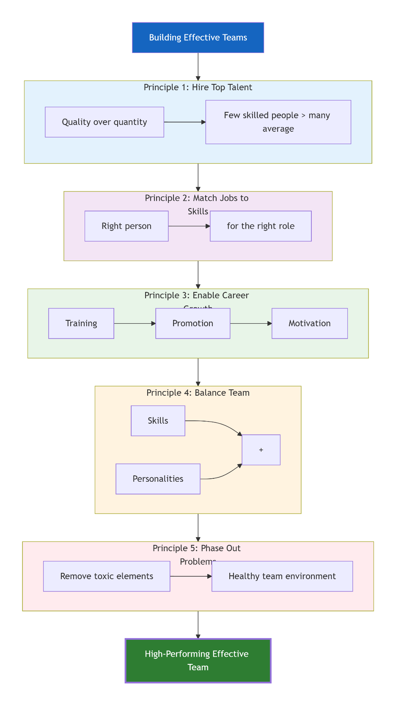

Slide 20
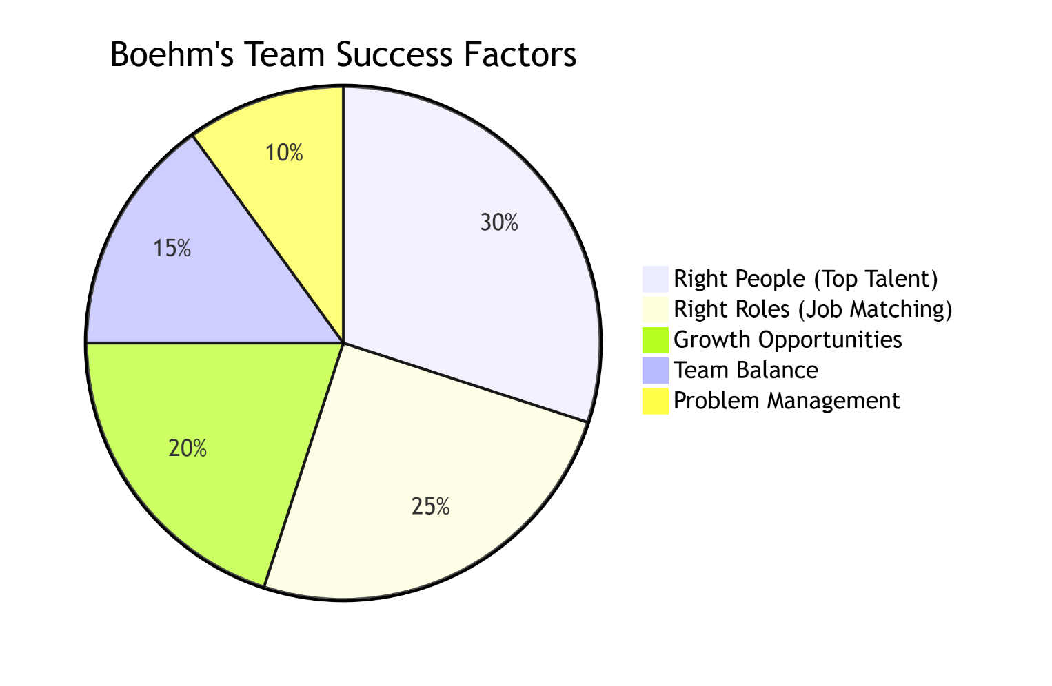
Build a team with the right people, in the right roles, with the right balance.
Good team management increases productivity and reduces project risks.
Removing weak or unfit team members keeps the team healthy and efficient.

Slide 21
Improving automation:
To improve automation in software project management, start small by automating repetitive tasks like reminders, reporting, and approvals, focusing on clear goals (efficiency, accuracy).
Tools and environments increase productivity:
Planning tools, modeling tools, compilers, debuggers, QA tools, testing tools. These tools help automate software engineering tasks and reduce manual effort.
Automation reduces effort significantly:
Tools and automation can improve productivity by 20% to 40%.
3. Main benefits of process automation
Reduce scrap and rework (fixing late mistakes).
Reduce number of iterations in the process.
Increase efficiency by automating error-prone or slow manual tasks.

Slide 22
4. Need for a mature, integrated environment
A mature environment helps manage:
  Concurrent activities
  Quality assessment
  Progress tracking
5. Semantic integration improves results:
When the environment understands the meaning of artifacts (requirements, models, code), it:
  Improves productivity
  Enhances software quality
6. Features of strong automated environments
Support incremental compilation
Automated builds
Automated regression testing

Slide 23
7. Typical resource consumption in projects (important)
These values show why automation is important:
Requirements + evolution → 40% of cost
Design → 50%+ resources
Coding + unit testing → 50% of development effort
Testing → up to 50% of project resources
Configuration management → up to 25%
Documentation → 30%+
Project management & admin → up to 30%

Slide 24
Achieving required quality:
Achieving software quality in project management means integrating Quality Planning, Assurance, and Control throughout the project lifecycle, focusing on clear requirements, continuous testing (especially automation).
Key practices that improve software quality:
Focus on requirements early and make sure they are complete and traceable.
Balance effort across requirements, design, evolution, and planning.
Use metrics and indicators to track architecture quality and project progress.
Use integrated life-cycle tools that support:
  Configuration management
  Change management
Use higher-level modeling languages that support:
  Abstraction
  Reliable programming
  Self-documentation

Slide 25
Peer inspections:
Peer inspection is a quality assurance practice in software project management where team members review each other's work to find defects, improve quality, and share knowledge. Primary Quality Mechanisms:
1. Transitioning engineering information:
Moving artifacts from one stage to another to check:
  Consistency
  Feasibility
  Understandability
  Technical constraints
2. Major milestone demonstrations:
Checking artifacts using real use cases and clear criteria.
3. Environment tools:
Using compilers, debuggers, analyzers, automated tests for:
  Rigor
  Completeness
  Consistency
  Change control

Slide 26
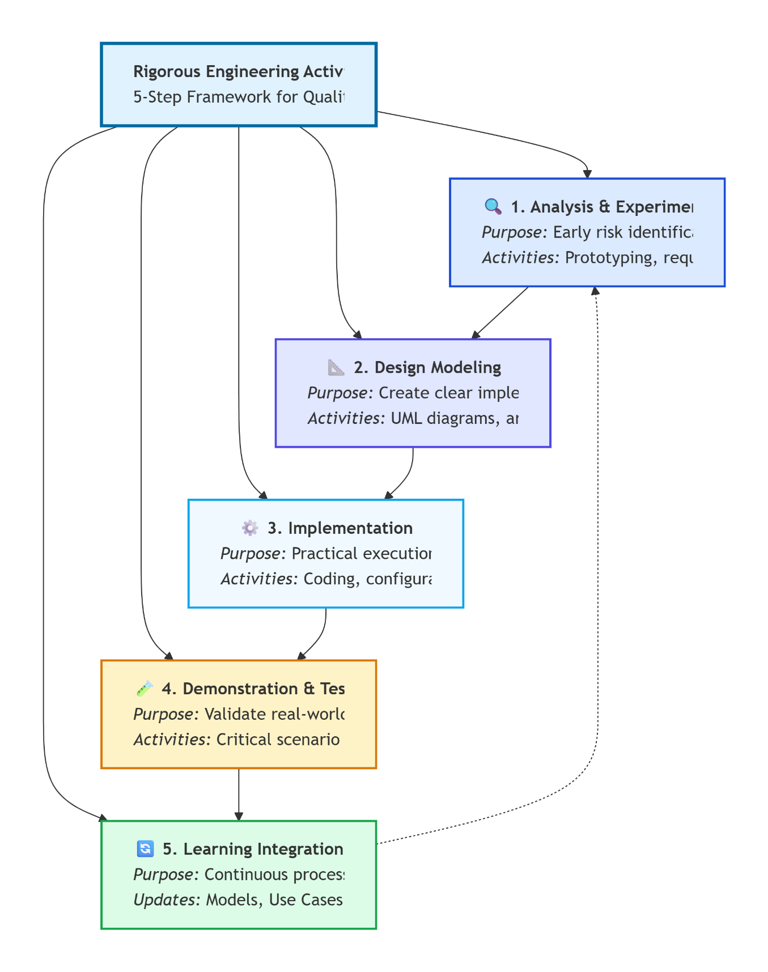
4. Life Cycle testing:
Deep testing understand:
Trade-offs.
Acceptance criteria.
Requirements compliance.
5. Change management metrics:
Tracking changes to ensure:
Quality trends.
Process stability.
Progress towards goals.

