Slide 1
MODULE-II

Slide 2
SYLLABUS: Module-2
The old way and the new:
The principles of conventional software Engineering, principles of moderns of tare management, transitioning to an iterative process.
Life Cycle Phases:
Engineering and production stages, inception, Elaboration, construction, transition phases.
Arte facts of the process:
Their artifacts, Engineering artifacts, programming artifacts

Slide 3
The principles of Conventional Software Engineering:
Conventional software engineering principles are basic rules and best practices that guide how software should be built so it works well, is easy to fix or improve, and lasts a long time.
Think of them like the "dos and don’ts" of building software — they help developers avoid common mistakes and make sure the final product is reliable and efficient.
1. Make Quality #1:
Quality must be planned, measured, and managed from the beginning.
2. High-Quality Software Is Possible:
Using customer involvement, prototypes, simple design, and inspections improves quality.
3. Give Products to Customers Early:
Provide early versions/demos so the customer can test and give feedback.
4. Determine the Problem Before Writing Requirements:
Understand the real problem instead of rushing to a solution.
Explore all alternatives before deciding.

Slide 4
Principles of Conventional Software Engineering (Davis's Principles):
1
6
Make Quality #1
Use an Appropriate Process Model
2
7
High-Quality Software Is Possible
Minimize Intellectual Distance
3
Give Products to Customers Early
8
Put Techniques Before Tools
4
Determine the Problem Before Writing Requirements
9
Inspect Code
5
10
Get it Right Before Making it Faster
Evaluate Design Alternatives

Slide 5
5. Evaluate Design Alternatives
After requirements, compare multiple architectures, algorithms, and designs. Don’t pick the first idea blindly.
6. Use an Appropriate Process Model
Choose the process based on project type, risks, culture, technology, and team. (No single model fits all projects.)
7. Minimize Intellectual Distance
Software design should match the real-world structure as much as possible.
Makes systems easier to understand and maintain.
8. Put Techniques Before Tools
Tools cannot replace skill.
Strong techniques + good tools = best results.
9. Inspect Code
Code inspections find more errors than testing alone. Helps maintain quality throughout the project.
10. Get it Right Before Making it Faster
First build correct software, then optimize it if required. Avoid premature optimization.

Slide 6
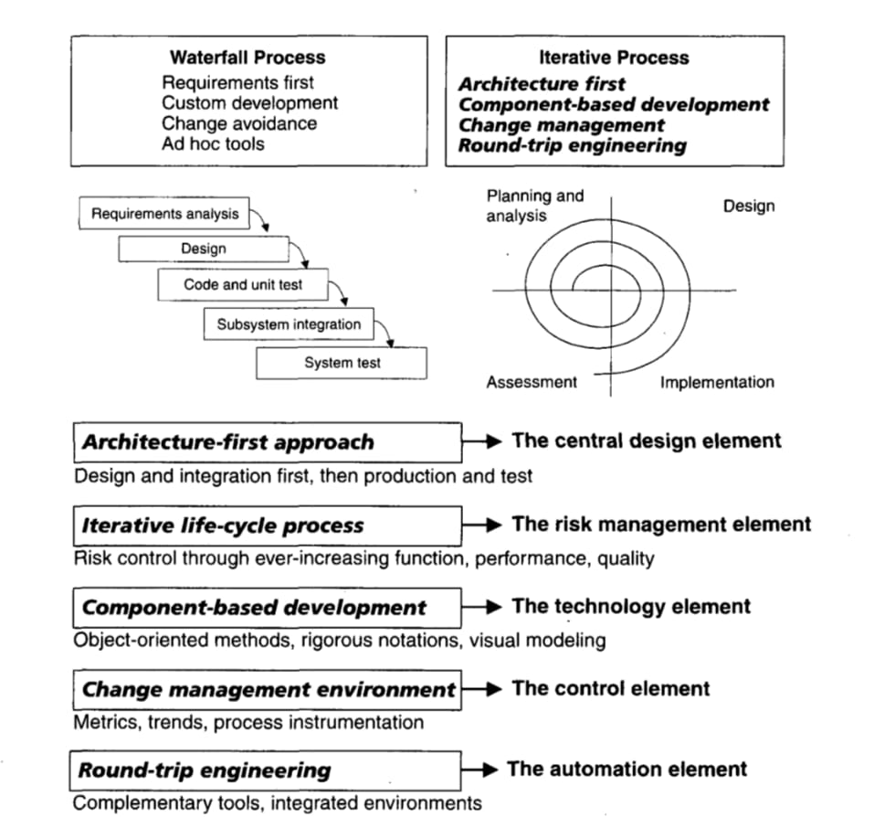
Principles of Modern Tare Management:
There are basically 10 principles for modern tare management:
1. Architecture-first approach:
Start the project focusing on architecture first and balance requirements, architecture, design, and planning before full development.
2. Use an iterative life-cycle:
Follow an iterative process that identifies and reduces risks early instead of doing everything in one sequence.
3. Component-based development:
Shift from line-of-code thinking to component-based design to reduce custom coding and improve reuse.
4. Strong change-management system:
Manage changes properly with controlled baselines, especially during iterative and parallel development.
5. Support change using round-trip engineering tools:
Use tools that keep requirements, design, code, and tests synchronized automatically.
6. Model-based notation:
Use standard models (like UML) to represent design clearly with graphical and textual diagrams.

Slide 7
7. Objective quality control:
Measure progress and quality continuously throughout the life cycle.
8. Demonstration-based assessment:
Use prototypes, architecture demos, or beta versions to check progress and expose design issues early.
9. Plan intermediate releases:
Deliver software in small increments with increasing detail to show real progress and validate use cases.
10. Configurable and scalable process:
Use a flexible process framework that can be adapted to different project types and sizes.

Slide 8
Transitioning to an Iterative Process:
Transitioning to an Iterative Process in Software Project Management (SPM) involves shifting from rigid, linear models like Waterfall to flexible, adaptive development cycles that emphasize continuous improvement and stakeholder feedback.
Top principles of a modern process:
1. Modern development moved away from Waterfall:
Waterfall is sequential and slow.
Modern development builds an early version quickly, focusing on high-risk areas, architecture, and refining requirements with user feedback.
COCOMO II Process Drivers (Mapped to Modern Principles):
2. Application Precedentedness:
Domain experience is very important.
For new (unprecedented) applications → early prototypes are needed to reduce risks.
This is why modern methods use iterative life cycles.
3. Process Flexibility:
Modern software development requires continuous changes because requirements and solutions evolve.
A strong change-management system is necessary to handle evolving artifacts, plans, and designs.

Slide 9
4. Architecture Risk Resolution
Architecture-first is a key principle.
Architecture must be stabilized early before building all components.
This early architectural focus guides:
  infrastructure decisions
  component make/buy decisions
  common mechanisms and control flows
5. Team Cohesion
Successful teams share common goals and priorities.
Poor communication causes project failures.
Relying only on document-based communication creates misunderstandings, so teamwork and interactive communication are essential.
6. Software Process Maturity
SEI’s CMM is a standard for measuring process maturity.
A mature software process helps avoid development risks and use organizational knowledge effectively.
Like domain experience improves application planning, process maturity improves development planning.

Slide 10
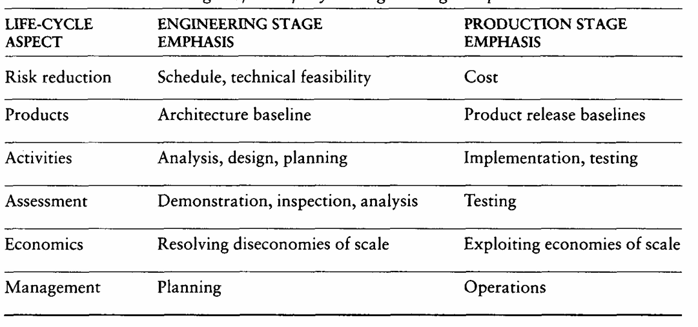
Engineering and production stages:
To boost ROI and achieve economies of scale, software development must embrace automation and component-based design. This shift enables a structured life-cycle with distinct engineering and production stages.
At the first order are the following 2 stages of the life cycle:
1. The engineering stage, driven by less predictable but smaller teams doing design and synthesis activities.
2. The production stage, driven by more predictable but larger teams doing construction, test, and deployment activities.

Slide 11
1. Engineering and Production Stages in Software Development:
Life-cycle description is based on economic principles to improve ROI.
Process automation and component-based development are essential for scalability and efficiency.
Two main stages:
  Engineering Stage: Small, less predictable teams focus on design and synthesis.
  Production Stage: Larger, more predictable teams handle construction, testing, and deployment.
2. Transition Between Engineering and Production:
Transition requires stakeholder agreement and shared understanding.
Critique of two-stage models: oversimplified and not suitable for complex projects.
Proposed four-phase model aligned with Boehm’s Spiral Model:
  Inception, Elaboration, Construction, Transition.
Spiral size reflects project inertia, which affects:
  Artifact consistency
  Regression testing
  Documentation
  Quality analysis
  Configuration control
High inertia complicates changes in architecture, requirements, planning, and organization.
Conventional life cycles are sequential, named after primary activities (e.g., requirements, design, coding, testing).

Slide 12
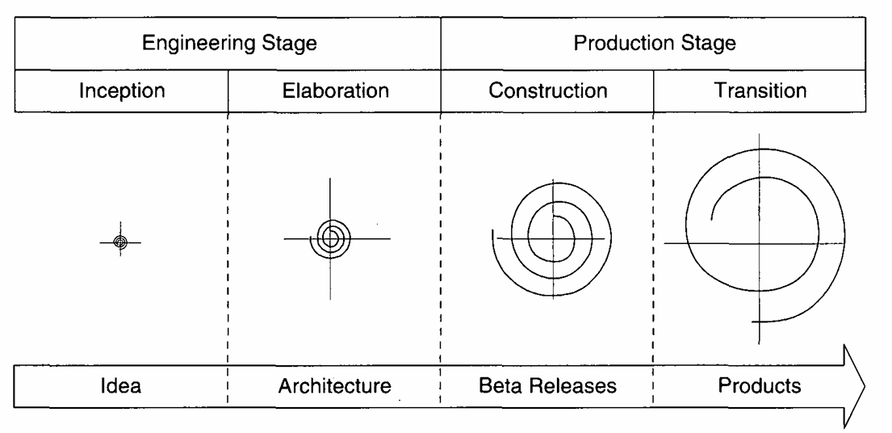

Slide 13
Inception Phase:
Get all stakeholders to agree on the project’s goals and life-cycle.
🎯 Primary Objectives
Define what the software will and won’t include.
Identify key use cases and main operating scenarios.
Show one possible system design (architecture).
Estimate total cost and schedule.
Spot major risks early.
Essential Activities
Define scope: Gather user needs and acceptance criteria.
Design architecture: Explore options and document one workable design.
Plan business case: Evaluate risks, staffing, tools, and profitability.
Primary Evaluation Criteria
Do all stakeholders agree on scope, cost, and schedule?
Are key requirements clearly understood?
Are estimates and plans realistic?
Does the prototype show the team can solve the problem?
Are actual costs close to planned costs?

Slide 14
Elaboration Phase – Main Goal:
Finalize architecture, requirements, and plans to decide whether to move into production.
Primary Objectives
Lock down the architecture and vision.
Create a detailed plan for the construction phase.
Prove the architecture supports the project goals within time and budget.
Essential Activities
Refine the vision: Deepen understanding of key use cases that affect design and planning.
Set up process and tools: Define construction methods, automation, and milestones.
Select and test components: Evaluate options, make buy/build decisions, and test architecture against main scenarios.
Primary Evaluation Criteria
Is the vision and architecture stable?
Does the prototype show major risks are resolved?
Is the construction plan detailed and realistic?
Do stakeholders agree the system can be built as planned?
Are actual costs close to planned costs?
Finalize architecture, requirements, and plans to decide whether to move into production.

Slide 15
Construction Phase – Main Goal
Build and test all components to create a working, deployable product.
Primary Objectives
Reduce development costs by using resources efficiently.
Achieve good quality quickly.
Deliver usable versions (alpha, beta, test releases) as soon as possible.
Essential Activities
Manage resources and processes: Control operations to stay on track with cost and schedule.
Develop and test components: Ensure all parts meet evaluation standards.
Review product releases: Check if they meet the original vision and acceptance criteria.
Primary Evaluation Criteria
Is the product ready and stable enough for users?
Are stakeholders prepared for deployment?
Are actual costs close to planned costs?

Slide 16
Transition Phase – Main Goal
Deliver the product to users and ensure it meets expectations with proper support and documentation.
Primary Objectives:
Help users become self-sufficient with the product.
Confirm that the product meets the original vision and evaluation criteria.
Finalize the product quickly and cost-effectively.
Essential Activities:
Integrate and synchronize releases: Combine all parts into a stable version for deployment.
Prepare for deployment: Handle packaging, training, and rollout planning.
Evaluate against vision: Ensure the final product matches the original goals and requirements.
Primary Evaluation Criteria:
Can users operate the system independently?
Are actual costs close to planned costs?

Slide 17
Their artifacts:
Artifact sets organize all the important information needed to build a complete software system.
Each set contains related documents or files in a consistent format (like text, code, templates, spreadsheets, or UML diagrams).
Artifact vs. Artifact Set
An artifact is a single piece of information (e.g., a document or diagram).
A set is a group of related artifacts that together describe one aspect of the system.
Artifact Set | Description
Management | Planning and control documents (usually informal text)
Requirements | Describes what the system should do (text and models of the problem space)
Design | Shows how the system will work (models of the solution space)
Implementation | Source code and related files (e.g., C++, Java, Visual Basic)
Deployment | Files for installing and running the system (machine-readable formats)

Slide 18
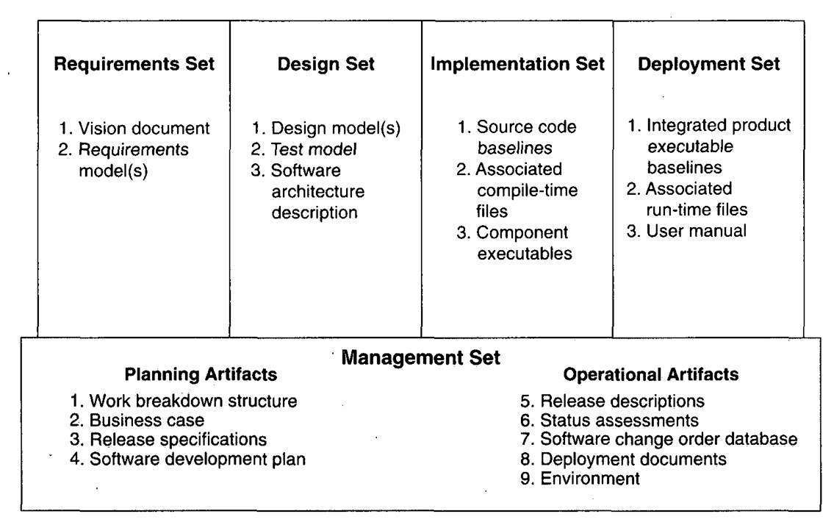
Overview of Artifacts Sets:

Slide 19
Engineering artifacts:
Composed of four sets: Requirements, Design, Implementation, and Deployment.
Quality is evaluated by transitioning information between sets to maintain consistency and understanding.
1. Requirements Set:
Uses structured text for vision statements and UML for models (use cases, domain models).
Includes supplementary specs, mockups, and prototypes.
Serves as the primary reference for evaluating other sets and forming test cases.
Evaluation methods:
  Consistency with release specs
  Alignment between vision and models
  Mapping to design, implementation, and deployment sets
  Tracking changes and trends (defects, rework)
  Subjective quality reviews

Slide 20
2. Design Set:
Uses UML notation to model solution components (identities, attributes, relationships, interactions).
Includes structural and behavioral models, test models, and architecture descriptions.
Can be translated into implementation and deployment artifacts.
Evaluation methods:
  Internal consistency and quality
  Consistency with requirements
  Translation accuracy to other sets
  Change analysis over versions
  Subjective quality reviews
Human analysis is currently essential due to limited automation.
3. Implementation Set:
Represents actual code and component implementations.
Includes source code, interfaces, dependencies, and executables for testing.
Covers custom, commercial (APIs), reusable, and legacy components.
Programming languages: Ada 95, C++, Visual Basic, Java, Assembly.

Slide 21
Programming artifacts:
Programming artifacts are the tangible outputs of the software development process, expressed in code and executable forms. Like engineering artifacts, they evolve over time and are evaluated for quality, consistency, and completeness.
Requirements:
Artifacts: Specs, mockups, UML models, test cases.
Evaluation: Consistency with scope, mapping to design/implementation, change tracking.
Design:
Artifacts: UML diagrams, architecture descriptions, test models, data models.
Evaluation: Internal consistency, alignment with requirements, translation accuracy, version analysis.
Implementation:
Artifacts: Source code, libraries/APIs, config files, build scripts, test scripts, executables.
Evaluation: Code quality, consistency with design, successful execution, test coverage.
Deployment:
Artifacts: Deployment scripts, installation packages, environment configs, monitoring/logs.
Evaluation: Consistency with implementation, correct setup, performance/reliability, feedback loop.

Slide 22
