Slide 1
Builderz

Slide 2
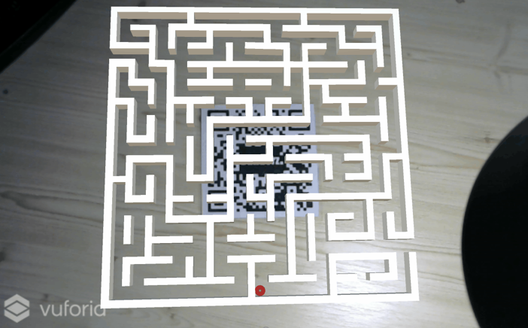
Labirintus

Slide 3



Vuforia Fejlesztői Eszközök
Notes:
Xcode
iOS developers can quickly add the Vuforia Engine to existing iOS projects to build AR experiences leveraging iOS rendering technologies.
Android Studio
Android developers can now easily add Vuforia experiences to existing apps using Java APIs. C++ APIs are no longer required, but are still available for use with the NDK.
Unity
If you're using Unity to build a game or high-fidelity 3D experience, a single application can be written to run on both iOS and Android with minimal changes. Vuforia is now compatible with Unity 5.

Slide 4






Vuforia Funkciók
Objektum
Henger
Kép
Szöveg
Felhasználó álltál készített kép
Doboz
Notes:
Objects
Recognize and track a broader set of objects so you can bring toys to life and add digital features to consumer products.
Images
Images with sufficient detail including magazines, advertisements, and product packaging can be recognized. The Vuforia Target Manager helps you analyze and improve your images to optimize your app's performance.
User-Defined Images
User-defined images give users the ability to create basic AR experiences that work anywhere. It's as simple as taking a picture of an everyday object, such as a book page, poster or magazine.
Cylinders
Cylinders such as bottles, cans, cups and mugs can be recognized.
Text
Supports English word recognition from a standard database of ~100,000 words or a custom vocabulary defined by the developer.
Boxes
Simple boxes with flat sides and sufficient visual details can be recognized.

Slide 5
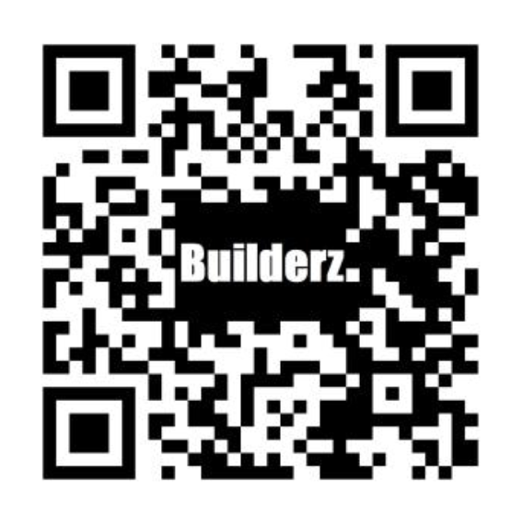
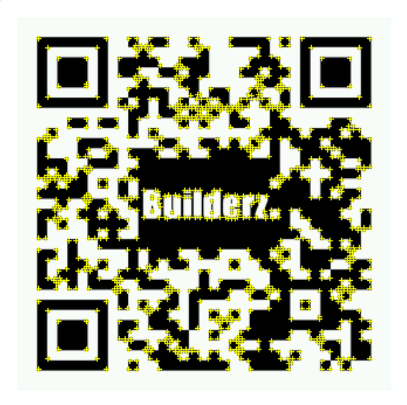
Objektum Követése
Notes:
Image Targets represent images that the Vuforia SDK can detect and track. Unlike traditional fiducial markers, data matrix codes and QR codes, Image Targets do not need special black and white regions or codes to be recognized. The SDK detects and tracks the features that are naturally found in the image itself by comparing these natural features against a known target resource database. Once the Image Target is detected, the SDK will track the image as long as it is at least partially in the camera’s field of view.

Slide 6
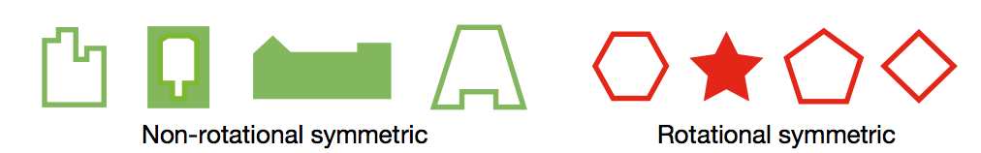


Támogatott objektumok
Notes:
Supported Targets
The Target Manager supports both image based targets and VuMarks. Target images for Image Targets, Multi-Targets and Cylinder Targets must be either 8 or 24 bit PNG or JPG files. JPG files must be RGB or greyscale. The maximum image file size is 2.25 MB. VuMarks must be SVG files created using the Vuforia Designer tool in Adobe Illustrator.
Supported Environments
Image Targets should be viewed under moderately bright and diffuse lighting. The surface of the image should be evenly lit.
Working with Image Targets
There are two phases to developing with Image Targets. You first need to design your target images and then upload them to the Vuforia Target Manager for processing and evaluation.
Designing Target Images
Image Targets can use any planar image that provides sufficient detail to be detected by the Vuforia SDK. The following articles will help you select appropriate target surfaces and provide guidelines on how to design and evaluate target images.

Slide 7


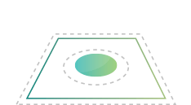

Vuforia Egyébb Funkciók
Háttér effekt
Videó Lejátszás
Virtuális Gomb
Akadályok kezelése
Notes:
Background Effects
Want to make your app look like an X-Ray machine? How about night vision? Create your own shaders to implement sophisticated visual effects.
Video Playback
Watch static images come alive in full motion video. Vuforia video playback makes it simple for videos to be played directly on target surfaces.
Virtual Buttons
Imagine a magazine page that acts like a touch screen. With Vuforia, that is possible. Create virtual buttons that your app can see and respond to on top of image targets in the real world.
Occlusion Management
Vuforia detects and tracks targets, even when they’re partially hidden behind everyday barriers, like your hand. Special occlusion handling allows apps to display graphics as if they appear inside physical objects.
Extended Tracking

Slide 8


Vuforia Adattárolás
Lokális Adattárolás
Felhő alapú adattárolás
Notes:
See a little, see a lot.
Some apps only need to see a few images. Others may need to recognize thousands of images or more while integrating with a content management system. The Vuforia Cloud Recognition Service leverages the power of the cloud to give you flexibility and scale.
Device Databases
Vuforia device databases enable your apps to rapidly recognize targets. Device databases can be included in your app at installation or updated dynamically from a server.
Cloud Databases
Vuforia Cloud Recognition Service allows your Vuforia-enabled application to recognize image targets through a cloud database, giving you the ability to update targets dynamically, integrate with your existing CMS, and manage more than one million image targets for a single app.

Slide 9

Vuforia Build

Slide 10
Projekthez szükséges Alapok

Slide 11
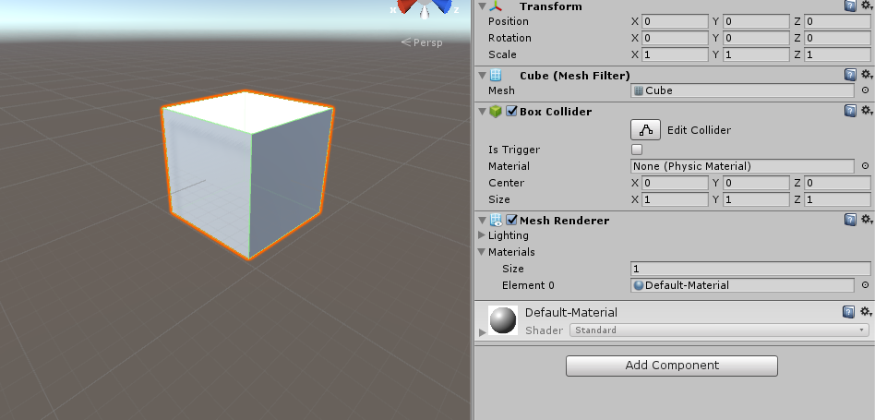
Transform

Slide 12
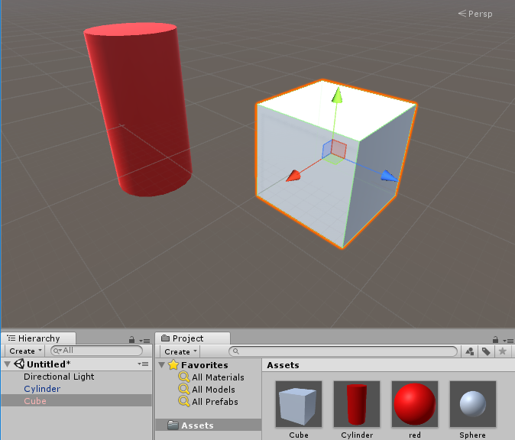
Prefab

Slide 13
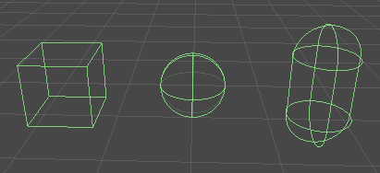
Collider

Slide 14
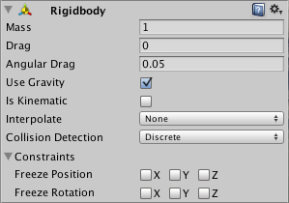
Rigidbody

Slide 15
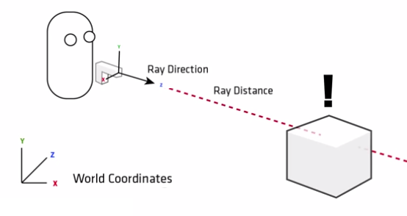
Raycast

