Slide 1


Slide 2


Slide 3
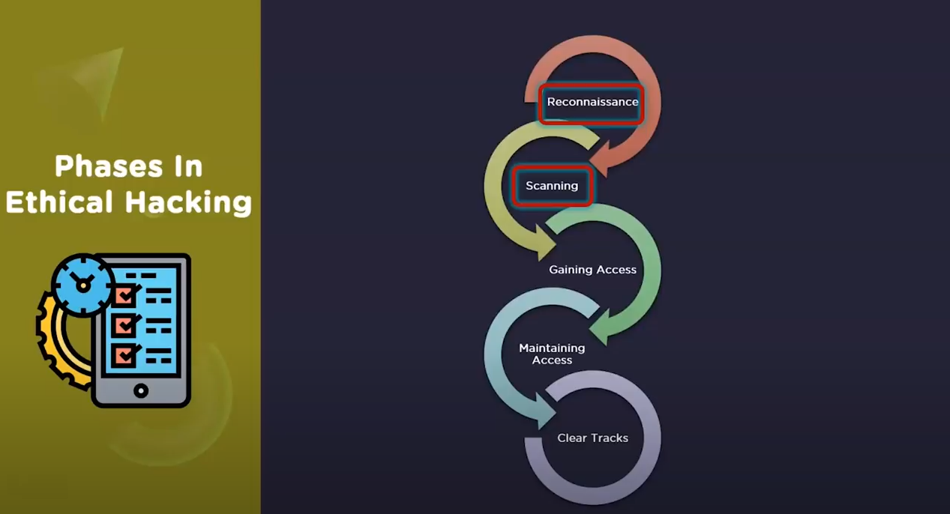

Slide 4
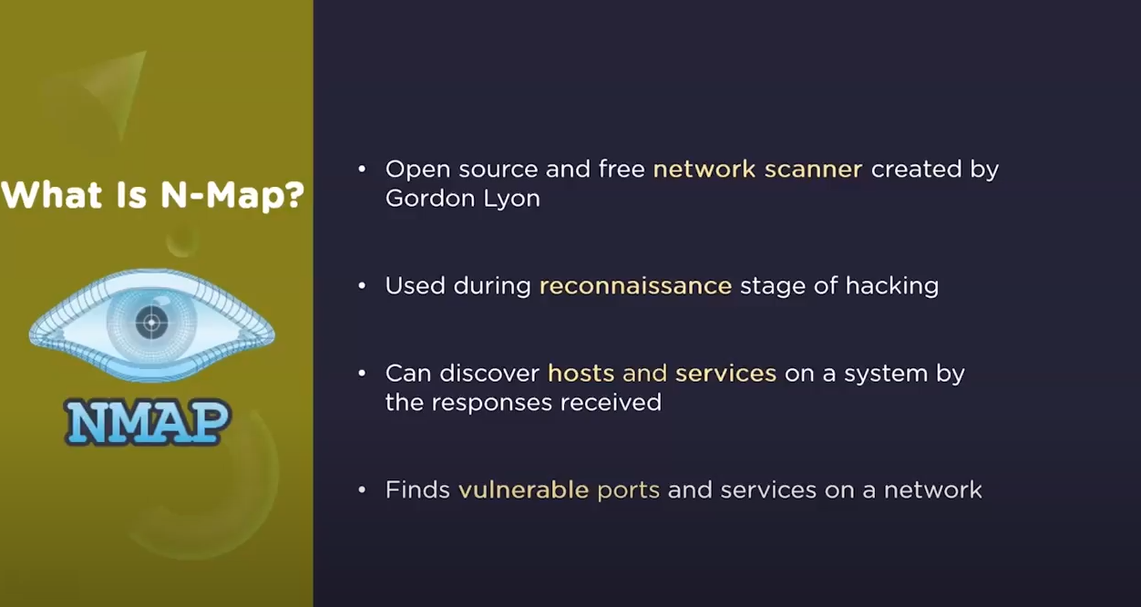

Slide 5
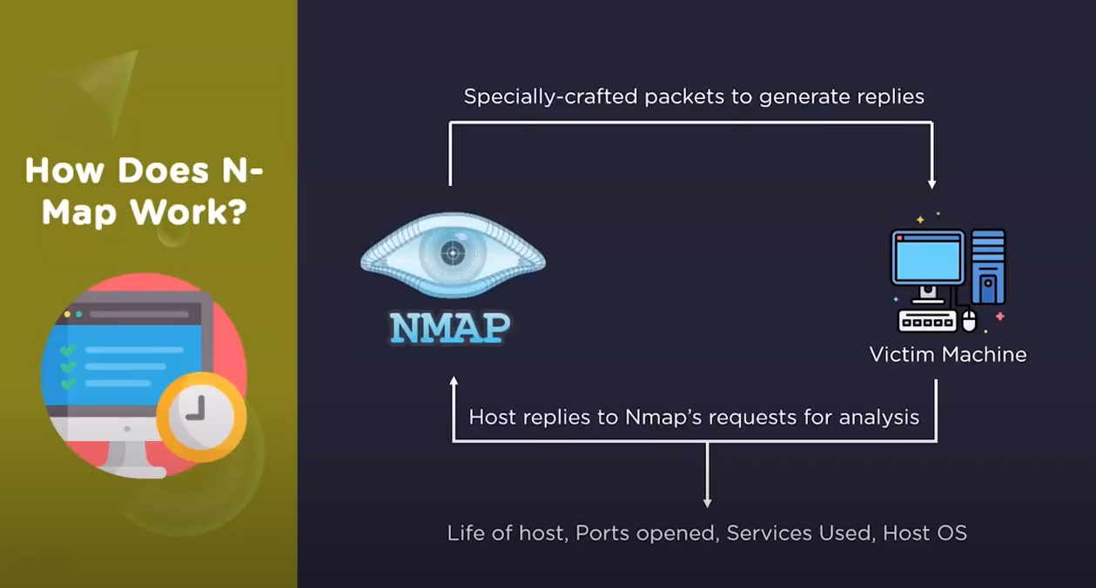

Slide 6
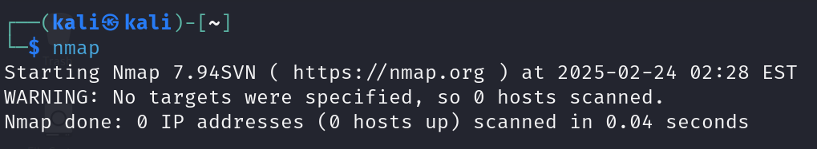
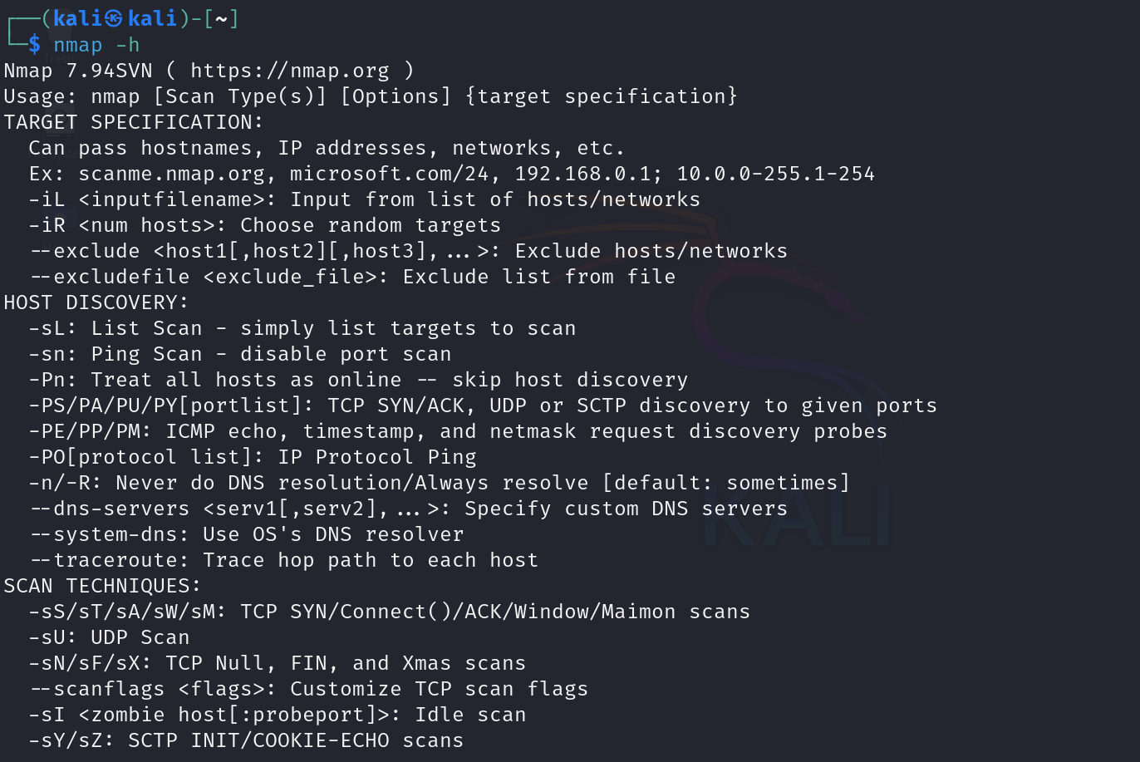
Nmap.org

Slide 7
Sl.No | Description(nmap scanme.namp.org) | Command
1 | Discover which hosts in a network | nmap -sP 10.0.2.15/24
2 | Port,State,Service example: Port 22/tcp is open and running SSH (used for remote access). Port 80/tcp is open and running HTTP (used for websites). Port 443/tcp is open and running HTTPS (secure version of HTTP). | nmap 10.0.2.15
3 | Operating System(-O) | Nmap –O 10.0.2.15
4 | Service version detection (-sV): This option attempts to determine the versions of the services running on the open ports. | nmap -sV 10.0.2.15
5 | Aggressive scan (-A): In-depth information-OS detection, service version detection, script scanning, and traceroute. | nmap -A 10.0.2.15
6 | Scan Entire Subnet | nmap 10.0.2.0/24
7 | Scan a specific port | nmap -p 80 10.0.2.15
8 | Run all scripts in a category (e.g., all vulnerability scans): | nmap --script=vuln 10.0.2.15
9 | TCP Connect Scan (-sT): The TCP Connect scan is a standard scan that uses the OS's networking functions to complete the TCP handshake and determine open ports. | nmap -sT 10.0.2.15
10 | SYN Scan (-sS): The SYN Scan is the most popular scan type, as it is faster and stealthier than the TCP Connect scan. It only sends SYN packets (the first part of the TCP handshake) and never completes the handshake, making it less detectable. | nmap -sS 10.0.2.15
11 | UDP Scan (-sU): This scan type is used to scan for open UDP ports. UDP scans are slower and less reliable than TCP scans but necessary for discovering services that run over UDP (e.g., DNS, SNMP). | nmap -sU 10.0.2.15
12 | Timing and Speed Control (-T<0-5>): You can adjust the timing of your scan for faster results (or more stealth). The -T option allows you to set the timing template. T0 (slowest, stealthiest) to T5 (fastest, most aggressive) | nmap -T4 10.0.2.15
13 | Save Output to a File: You can save Nmap scan results to a file in various formats (e.g., normal, XML, or HTML). | nmap -oN scan_results.txt 10.0.2.15 nmap -oX scan_results.xml 10.0.2.15 nmap -oX scan_results.html 10.0.2.15
14 | Detect Firewall and Filter Rules (-sA): The Ack Scan (-sA) is used to detect firewall and packet filter rules between your host and the target machine by sending ACK packets. | nmap -sA 10.0.2.15

Slide 8
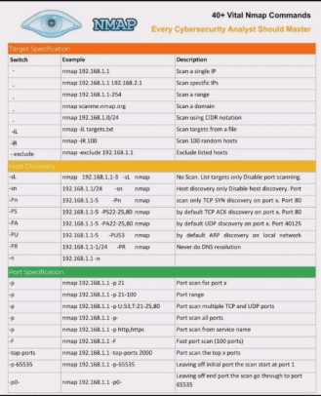
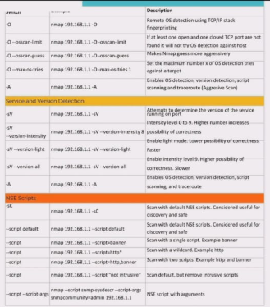
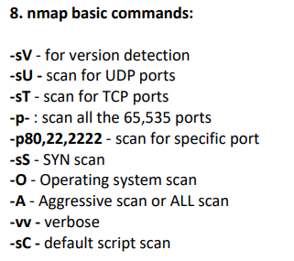

Slide 9
