Slide 1

Is Stephen Curry the greatest 3-point shooter in NBA History?
By Collin Seebeck

Slide 2

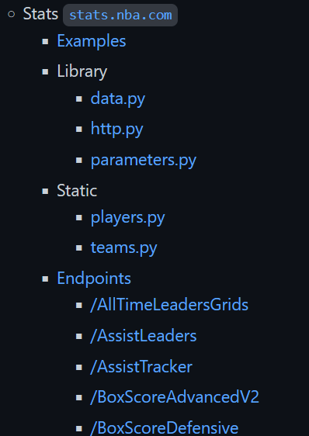
Collecting the Data
Two Main Methods of Collecting Data
Using splinter and BeautifulSoup in Python to scrape data from different websites
Websites Used
https://www.nba.com
https://www.landofbasketball.com
https://www.basketball-reference.com
Using nba_api to pull in NBA stats
User created python library
Description: “An API Client package to access the APIs for NBA.com”
https://github.com/swar/nba_api/blob/master/docs/table_of_contents.md

Slide 3
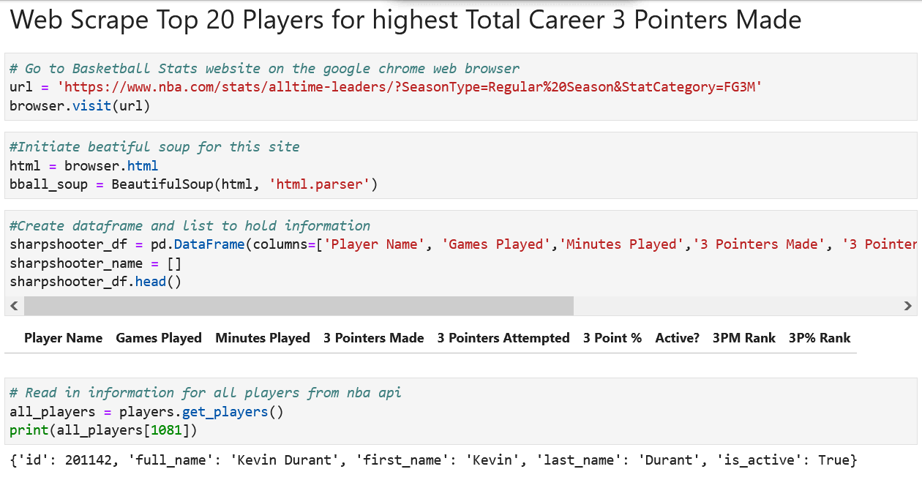
Sample Code 1

Slide 4
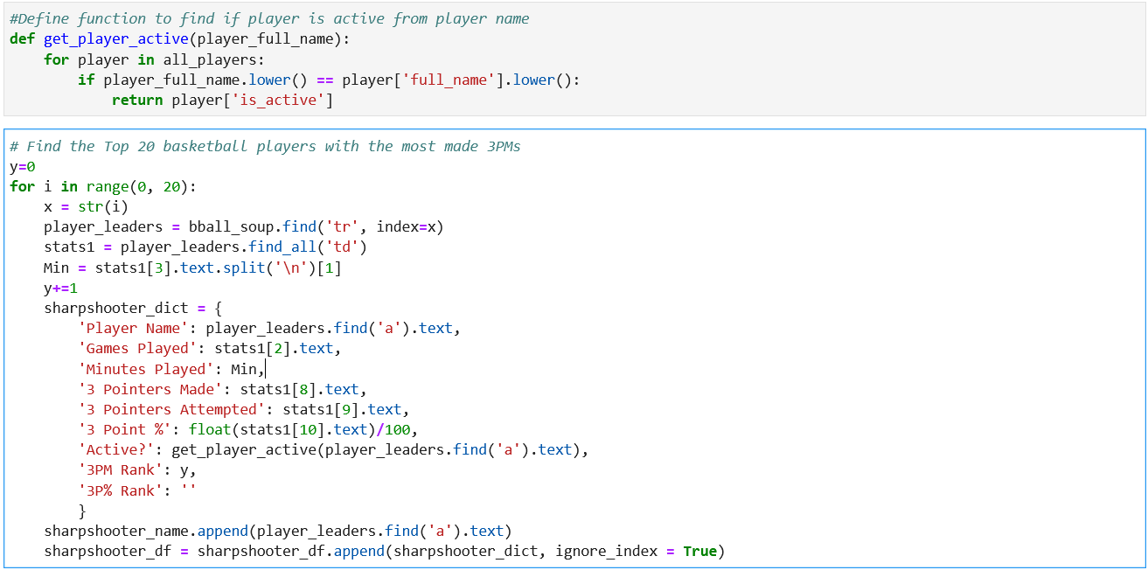
Sample Code 2

Slide 5
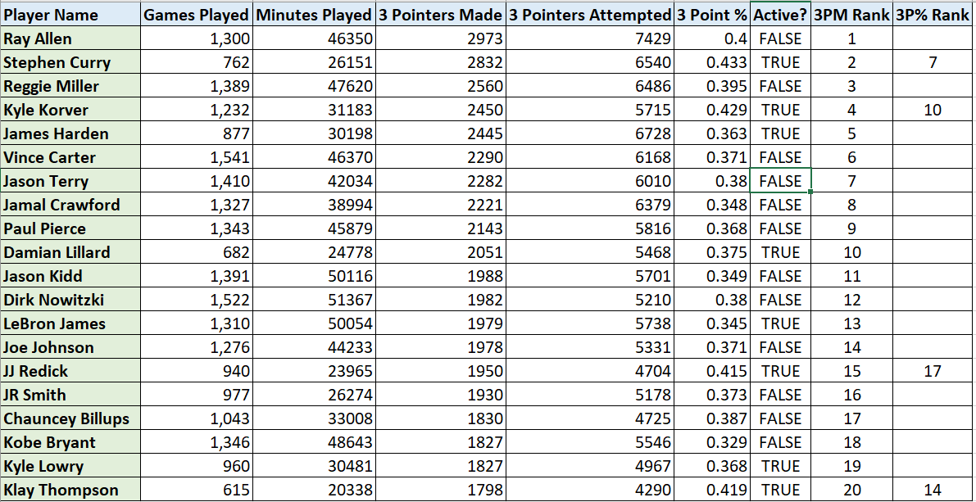
Resulting Code

Slide 6
Back to the Question: Is Stephen Curry the greatest 3-point shooter in NBA History?
How to answer this seemingly subjective question confidently?
Let’s go to Tableau to find out

