Slide 1
IBM University Engagement Project Submission
“Exploring the Power of Agentic AI with IBM Granite and LangFlow - Project LearnMate”

Slide 2

Project Tile – LearnMate - Agentic AI for Personalized Course Pathways.
Domain of Project – EdTech / AI in Education.
Student Name | Recent Passport Photo | Email ID | Mobile number [WhatsApp]
AAYUSH KUMAR |  | kumaraayush7501@gmail.com | 9709629025

Slide 3
Problem Statement -
Problem Statement : Agentic AI for Personalized Course Pathways
The Challenge
Students often struggle to identify the right learning path that aligns with their interests and long-term goals due to the overwhelming number of online courses and a lack of personalized guidance.
The Objective
LearnMate aims to solve this by acting as an Agentic AI coach that interacts with students, understands their interests (like Frontend Development, Cybersecurity, UI/UX Design, etc.), assesses their current skill level, and dynamically builds a personalized course roadmap.
Multi-Agent System:
• Skill Assessment Agent (Evaluates current tech knowledge).
• Roadmap Generator Agent (Creates custom step-by-step learning paths).
• Progress Tracking Agent (Monitors module completion and recalibrates).

Slide 4
Technology Used
Tech Stack (Mandatory)
Use any one of the following approaches:
LangFlow + IBM watsonx.ai + Granite Models
IBM Cloud Agentic Lab with IBM Granite Models
Replicate with LangChain + RAG + IBM Granite Models
I used LangFlow + IBM watsonx.ai + Granite Models

Slide 5
Proposed Solution - AI-Powered Course Pathways (LearnMate)
The proposed solution is a multi-agent AI-powered learning coach built using LangFlow, IBM watsonx.ai, and Granite Models to provide personalized, real-time educational guidance. The system addresses challenges in syllabus tracking, skill development, and career planning through an intelligent, modular architecture.
At its core, the solution uses a Retrieval-Augmented Generation (RAG) pipeline to fetch accurate syllabus structures, tech-stack prerequisites, and industry trends from trusted educational databases. This data is embedded and stored in a vector database, enabling the system to retrieve and summarize course details using Granite models.
The system consists of four key agents:
• Skill Assessment Agent: Interacts with the user to evaluate their current knowledge and understands their interests (like Frontend Development, Cybersecurity, UI/UX Design, etc.).
• Roadmap Generator Agent: Dynamically builds a personalized course roadmap that adapts over time based on progress and preferences.
• Resource Curator Agent: Retrieves specific reading materials, documentation, and practical exercises relevant to the current topic.
• Progress Tracking Agent: Monitors module completion, provides instant feedback, and recalibrates the upcoming syllabus if the learner faces difficulties.
The solution includes a user-friendly dashboard that visualizes the learning roadmap, tracks milestone completion, and highlights areas for skill improvement.
LangFlow is used to orchestrate agent workflows, while watsonx.ai ensures scalable model deployment, embeddings, and AI governance. Granite models power reasoning, summarization, and personalization. Overall, this solution delivers an end-to-end intelligent educational assistant that promotes continuous learning through dynamic pathways and real-time adaptation.

Slide 6
Langflow component Used -
1) Chat Input - Interface where students enter their current skills, learning goals, or preferred tech stack (e.g., "I know basic HTML/CSS and want to learn Node.js").
2) IBM watsonx AI Agent - Processes user input using Granite models to assess skill levels and dynamically generate personalized learning roadmaps.
3) Name of IBM Granite model - Granite-4.0-8B-Instruct → Fast, efficient, and highly capable of reasoning and structuring educational pathways.
4) Chat output - Displays AI-generated responses such as step-by-step course modules, study plans, and progress feedback.
5) File Component - Stores and retrieves course syllabi, user progress logs, and educational datasets for RAG-based analysis.
6) Prompt Template - Structures the core instructions to guide the AI, ensuring it acts strictly as an expert educational coach and career mentor.

Slide 7
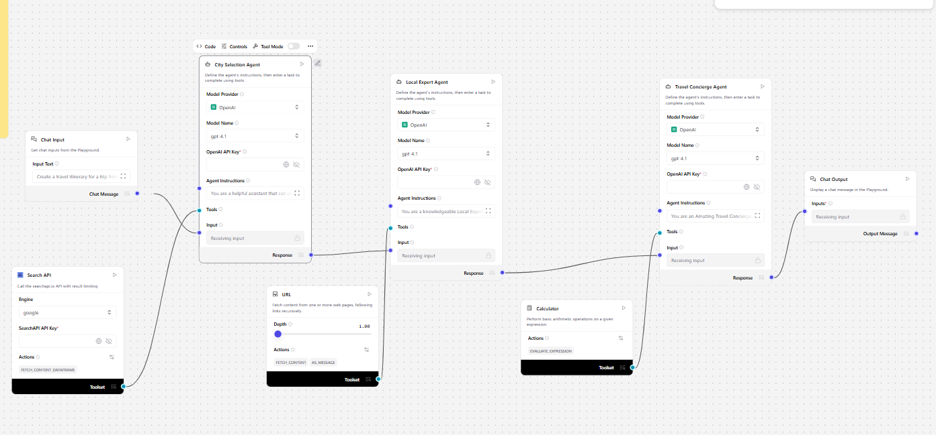
Langflow workflow -

Slide 8

Architecture Blueprint - LearnMate AI

Slide 9

Role of Agentic AI in the solution
Role of Agentic AI in LearnMate
• Agentic AI enables LearnMate to function as an intelligent, autonomous learning coach rather than a static syllabus generator.
• It interacts directly with students to understand their specific interests, such as Frontend Development, Cybersecurity, or UI/UX Design.
• The AI autonomously assesses the user's current skill level and uses this context to dynamically build a personalized course roadmap.
• Instead of following a rigid structure, the multi-agent system adapts the roadmap over time based on the student's progress and evolving preferences.
• This multi-agent approach ensures efficient task execution—one agent evaluates skills, while another curates resources and tracks performance.
• Overall, Agentic AI makes the system proactive and highly tailored, ensuring that students make confident, future-ready decisions with minimal manual intervention.

Slide 10
Technology Used
Langflow platform - For designing and orchestrating multi-agent workflows visually
IBM Grainte model – ( for eg – ibm-granite-3-2-8b ) – For natural language understanding, reasoning, and personalization.
IBM Cloud – It provides the infrastructure to build, deploy, and scale the LearnMate AI efficiently. IBM Cloud enables a reliable, secure, and scalable environment for deploying the educational agent.
RAG– RAG is used to fetch real-time educational data, course syllabi, and tech-stack requirements from trusted databases before generating an intelligent learning path.
IBM Watsonx.ai - For model deployment, embeddings, and AI governance.
Vector Database (FAISS/Chroma) – For RAG-based educational data and syllabus retrieval.

Slide 11
Novelty and Uniqueness
The proposed LearnMate system stands out by combining Agentic AI, RAG, and dynamic personalization into a single intelligent educational coach.
• Multi-Agent Intelligence: Instead of a single chatbot, multiple specialized agents collaborate (e.g., Skill Assessment, Roadmap Generation) to deliver accurate and context-aware learning pathways.
• Dynamic Adaptation: Unlike traditional platforms with static video playlists, the roadmap adapts over time based on the student's progress and changing preferences.
• RAG-Based Accuracy: Integrates real-time data retrieval with AI generation, ensuring the syllabus is built on current industry standards and not outdated theories.
• Hyper-Personalization: Tailors course roadmaps based on the student's current skill level and specific interests (like Frontend Development, Cybersecurity, UI/UX Design, etc.).
• Real-Time Feedback Loop: Continuously recalibrates the upcoming syllabus if a learner faces difficulties with a particular topic, providing a highly supportive learning environment.
• Goal-Oriented Focus: Goes beyond basic course suggestions to act as an Agentic AI coach that aligns learning paths with long-term career goals.
• Scalable & Enterprise-Ready: Built on IBM watsonx.ai with IBM Granite models, ensuring reliability, data privacy, and AI governance.
• Continuous Skill Evolution: Ensures that the learner’s skill set remains relevant by constantly updating the course roadmap with the latest industry trends and in-demand technologies.

Slide 12
GitHub Repository Link & Project Access
Project URL: https://github.com/csehackerofficial/learnmate
Files Uploaded for Evaluation: Please find the following mandatory artifacts in the public repository:
app.json (Exported LangFlow Workflow)
LearnMate_Problem_Statement.pdf (Project Documentation & Problem Details
LearnMate_Project_Presentation.pptx (Final Presentation Slide Deck)
src/app.py (Optional Frontend Code)

Slide 13
Future Scope
Integration with Learning Management Systems & Cognitive Monitoring: The LearnMate agent can be directly plugged into a college's internal LMS or advanced student monitoring platforms (such as an ASHP tracking system). This allows for deep cognitive monitoring, tracking real-time educational analytics, and dynamically adjusting course difficulty based on live student performance data.
Real-Time Developer API & IDE Integration: Future versions could integrate directly into code editors (like VS Code) or custom Node.js architectures. This would allow the AI to monitor a developer's logic-building in real-time and provide immediate, context-aware learning resources and documentation exactly when they are stuck on a specific tech-stack problem.
·

Slide 14


