Slide 1
Project 2: Implementing a Simple Database Application

Slide 2
Overview
JDBC를 이용해 MariaDB와 연동되는 응용 시스템 구현
대학교 원서 접수 시스템
학생 정보 입출력
학교 정보 입출력
원서 접수
Due : 12/11(수) 23:59

Slide 3
JDBC Tutorial

Slide 4
#1. Download JDBC Driver
Download from
https://downloads.mariadb.org/connector-java/
We use MariaDB 10.1
Download mariadb-java-client-1.3.1.jar
Add it to classpath

Slide 5
#2. Connect to Server DB
import java.sql.Connection;
import java.sql.DriverManager;
import java.sql.SQLException;
…
String serverName = "147.46.15.238";
String dbName = "DB-2015-12345";
String userName = "DB-2015-12345";
String password = "DB-2015-12345";
String url = "jdbc:mariadb://" + serverName + "/" + dbName;
conn = DriverManager.getConnection(url, userName, password);

Slide 6
#3. Querying Example
String sql = "SELECT * FROM student";
PreparedStatement stmt = conn.prepareStatement(sql);
ResultSet rs = stmt.executeQuery();
while(rs.next()) {
String id = rs.getString("id");
String name = rs.getString("name");
int age = rs.getInt("age");
}

Slide 7
#3. Querying Example
String sql = "INSERT INTO student VALUES(?, ?, ?)";
PreparedStatement stmt = conn.prepareStatement(sql);
stmt.setString(1, "2015-12345");
stmt.setString(2, "Jihun Choi");
stmt.setInt(3, 20);
int success = stmt.executeUpdate();
SELECT : executeQuery()
INSERT, UPDATE, DELETE : executeUpdate()

Slide 8
Simple Tutorial for HeidiSQL

Slide 9
HeidiSQL
Client for remote DBMS access
You can perform DBA job using it
Installation
MariaDB를 설치하면 자동 설치

Slide 10
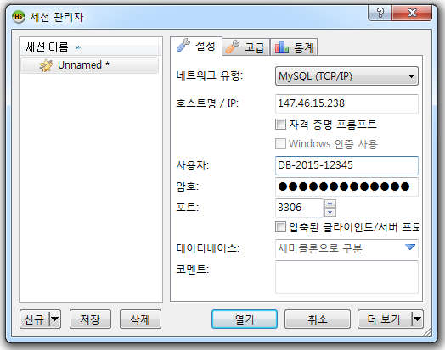
Connecting to DB

Slide 11
