Slide 1
JAVACC tutorial
Database (2015, fall)
Junghyuk Park

Slide 2
Term Project 1
Implement a simple DBMS that performs basic functions of SQL
create table, insert, delete, select, …
Project 1-1: SQL Parser
Build a SQL parser which parses SQL statements using JavaCC
Project 1-2: Implementing DDL
Build schema store and implement accessing function (create table, drop table, …) based on Project 1-1
Project 1-3: Implementing DML
Implement DML(insert, delete, …) of your simple DBMS based on Project 1-1 and 1-2

Slide 3
Java CC
Parsing Programming Language (ex. SQL)
Java-base
Exploit Regular Expression
“*.jj” file → “*.java” files → Run Java Files
We are going to use JavaCC via Eclipse.

Slide 4
How to install JavaCC Compiler
Install Eclipse Plug-in for JavaCC
http://bluexmas.tistory.com/229
Create new Java Project

Slide 5
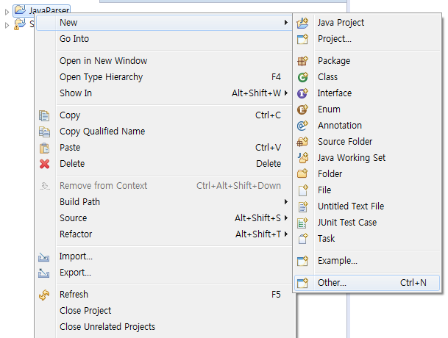
How to install JavaCC Compiler
Right click the Java project you created, then go to New -> Other

Slide 6
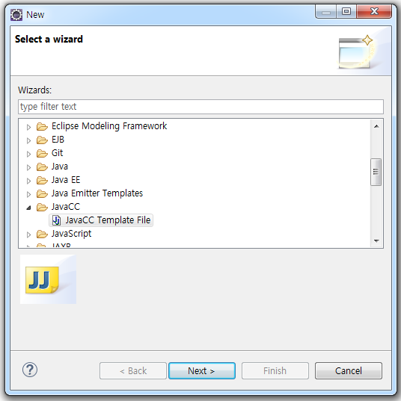
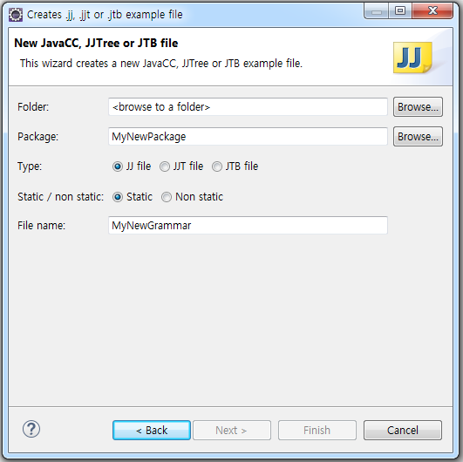
How to install JavaCC Compiler
Select JavaCC/JavaCC Template File and input Folder, Package, File name

Slide 7
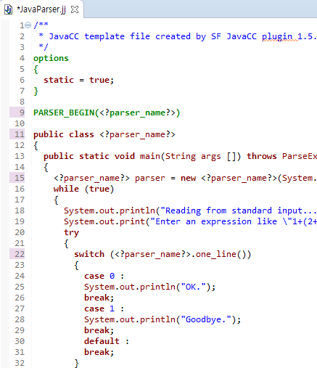
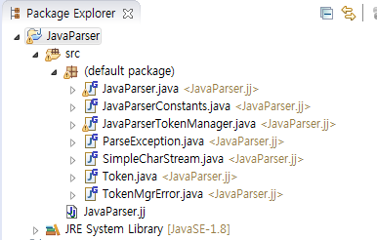
How to install JavaCC Compiler
Replace <?parser_name?> with your own parser name and save. Parser will be auto-generated.

Slide 8
Segments of *.jj files
Options
static, DEBUG_PARSER
PARSER_BEGIN( Name ) ~ PARSER_END( Name )
Token Definition
Regular Expression
Function Definition
Regular Expression

Slide 9
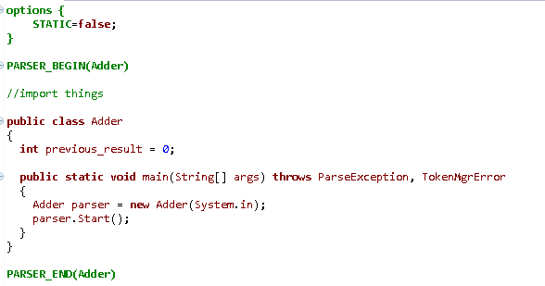
옵션들
https://javacc.java.net/doc/javaccgrm.html
시작 자바 코드

Slide 10
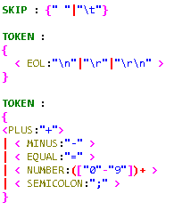
없는 토크 취급
Regular Expression

Slide 11
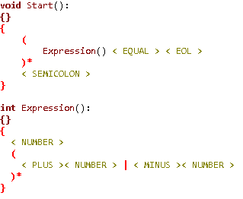
parser.Start()
32+2-3=
2-58+4+2-1=
…
;

Slide 12
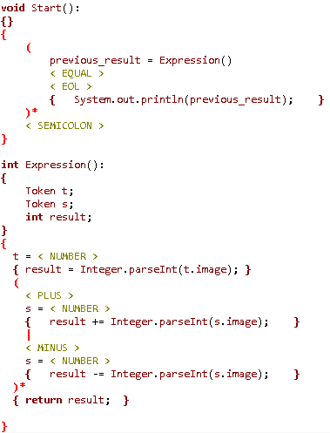
32+2-3=
31
2-58+4+2-1=
-51
…
;
String, Double, …

Slide 13
Example: “create table” query
public static void main(String args[]) throws ParseException
{
SimpleDBMSParser parser = new SimpleDBMSParser(System.in);
while (true)
{
try
{
System.out.print(“DB_2015-12345> ");
command();
}
catch (Exception e)
{
printMessage(PRINT_SYNTAX_ERROR);
SimpleDBMSParser.ReInit(System.in);
}
}
}

Slide 14
Example: “create table” query
SKIP : { " " | "\r" | "\t" | "\n" }
TOKEN : /* Keywords */
{
< EXIT : "exit" >
| < INT : "int" >
| < CHAR : "char" >
| < DATE : "date" >
| < CREATE_TABLE : "create table" >
| < NOT_NULL : "not null" >
| < PRIMARY_KEY : "primary key" >
| < FOREIGN_KEY : "foreign key" >
| < REFERENCES : "references" >
}
TOKEN :
{
< SEMICOLON : ";" >
| < LEFT_PAREN : "(" >
| < RIGHT_PAREN : ")" >
| < COMMA : "," >
| < UNDERSCORE : "_" >
| < SIGN : "+" | "-" >
| < DIGIT : [ "0"-"9" ] >
| < LEGAL_IDENTIFIER : < ALPHABET > (< ALPHABET > | < UNDERSCORE >)* >
| < ALPHABET : [ "A"-"Z", "a"-"z" ] >
| < INT_VALUE : (< SIGN >)? (< DIGIT >)+ >
}

Slide 15
Example: “create table” query
<Grammar Definition>
<COMMAND> ::= <QUERY LIST>
| exit<SEMICOLON>
<QUERY LIST> ::= <QUERY><SEMICOLON>
[{<QUERY><SEMICOLON>}…]
<JavaCC Implementation>
void command() :
{}
{
queryList()
| (
< EXIT >
< SEMICOLON >
{
System.exit(0);
}
)
}
void queryList() :
{
int q;
}
{
(
q = query()
< SEMICOLON >
{
System.out.print(“DB_2015-12345> ");
printMessage(q);
}
)+
}

Slide 16
Example: “create table” query
<Grammar Definition>
<PRIMARY KEY CONSTRAINT> ::= primary key
<COLUMN NAME LIST>
<REFERENTIAL CONSTRAINT> ::= foreign key
<COLUMN NAME LIST>
references
<TABLE NAME>
<COLUMN NAME LIST>
<JavaCC Implementation>
void primaryKeyConstraint() :
{}
{
< PRIMARY_KEY >
columnNameList()
}
void referentialConstraint() :
{}
{
< FOREIGN_KEY >
columnNameList()
< REFERENCES >
tableName()
columnNameList()
}

Slide 17
Notice
Due: 2015/10/07 (Wed), 11:59 PM
10% penalty for ~24hours late
20% penalty for 24~48hours late
no credit after 48 hours
Implementation of “create table” query is provided
You can build your parser on top of given source code
or you can build your own from scratch
Detailed description of the project will be uploaded in Lecture Homepage

