Slide 1
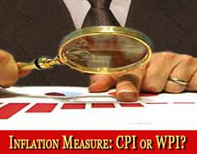
Whole sale price index & consumer price index

Slide 2
WHOLE SALE PRICE INDEX (WPI)
Wholesale price index ( WPI) is designed to measure the change of price in the primary and wholesale markets.

Slide 3
THE CONSUMER PRICE INDEX
The consumer price index (CPI) is a measure of the overall cost of the goods and services bought by a typical consumer.
The Bureau of Labor Statistics reports the CPI each month.
It is used to monitor changes in the cost of living over time.

Slide 4

Consumer Price Index
“ Consumer Price Index is the main measure of price changes at the retail level. It measures changes in the cost of buying a representative fixed basket of goods and services and is generally accepted as a measure of inflation in the country”.
When the CPI rises, the typical family has to spend more dollars to maintain the same standard of living.

Slide 5
Limitation of CPI
Coverage is limited
Only covers Urban Centres
Prices may have different trend in rural & urban centres.
Rent is computed through construction input items index instead of rent survey.
It measures partially inflation not total consumer’s expenditure.

Slide 6
Why Two Types of Indices?
CPI measures Inflation rate in the country
WPI measures the General Price level in the whole sale market.

Slide 7
WHAT CPI MEASURES?
It measures Price changes of fixed market basket of goods and services of constant quality and quantity.
It tells how much cost of living has risen or fallen due to price changes irrespective of changes in consumer behaviour or quality of goods.
It does not reflect the cost of living or in house hold consumption expenditure as such but only the influence of price fluctuation on the trend.

Slide 8
Selection of Markets/Outlets and Cities
Items are selected on the basis of Family Budget Survey
Markets are selected through retail and wholesale trade survey.
Outlets are selected on transaction value basis.
Cities are selected on population basis
Stratified sampling are used for selection of cities.

Slide 9
How the Consumer Price Index Is Calculated
Fix the Basket: Determine what prices are most important to the typical consumer.
  The Bureau of Labor Statistics (BLS) identifies a market basket of goods and services the typical consumer buys.
  The BLS conducts monthly consumer surveys to set the weights for the prices of those goods and services.

Slide 10
How the Consumer Price Index Is Calculated
Find the Prices: Find the prices of each of the goods and services in the basket for each point in time.
Compute the Basket’s Cost: Use the data on prices to calculate the cost of the basket of goods and services at different times.
Compute the inflation rate: The inflation rate is the percentage change in the price index from the preceding period

Slide 11
How the Consumer Price Index Is Calculated
Choose a Base Year and Compute the Index:
  Designate one year as the base year, making it the benchmark against which other years are compared.
  Compute the index by dividing the price of the basket in one year by the price in the base year and multiplying by 100.

Slide 12
How the Consumer Price Index Is Calculated
The Inflation Rate
  The inflation rate is calculated as follows:

Slide 13

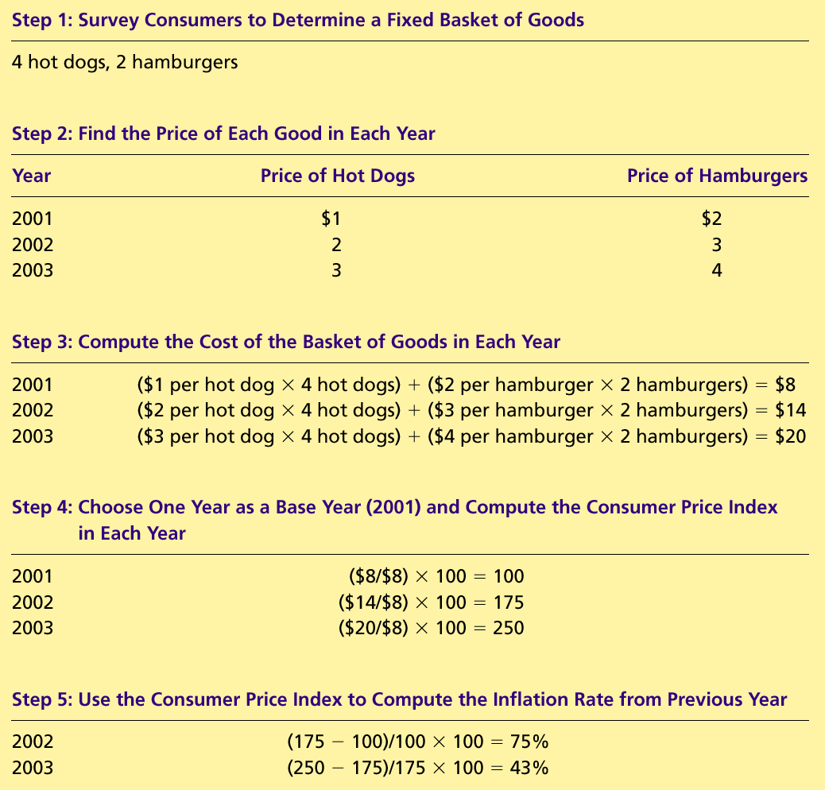
Table 1 Calculating the Consumer Price Index and the Inflation Rate: An Example
Copyright©2004 South-Western

Slide 14
Table 1 Calculating the Consumer Price Index and the Inflation Rate: An Example
Copyright©2004 South-Western

Slide 15
Table 1 Calculating the Consumer Price Index and the Inflation Rate: An Example
Copyright©2004 South-Western

Slide 16
Table 1 Calculating the Consumer Price Index and the Inflation Rate: An Example
Copyright©2004 South-Western

Slide 17
Table 1 Calculating the Consumer Price Index and the Inflation Rate: An Example
Copyright©2004 South-Western

Slide 18
How the Consumer Price Index Is Calculated
Calculating the Consumer Price Index and the Inflation Rate: Another Example
  Base Year is 2002.
  Basket of goods in 2002 costs $1,200.
  The same basket in 2004 costs $1,236.
  CPI = ($1,236/$1,200) × 100 = 103.
  Prices increased 3 percent between 2002 and 2004.

Slide 19

FYI: What’s in the CPI’s Basket?
16%
Food and
beverages
17%
41%
Transportation
Housing
Education and
6%
communication
6%
6%
4%
4%
Medical care
Other goods
Recreation
Apparel
and services
Copyright©2004 South-Western

Slide 20


