Slide 1
Topic 9:
Aggregate Demand I
(chapter 10)
Notes:
This chapter sets up the IS-LM model, which chapter 11 then uses extensively to analyze the effects of policies and economic shocks.
This chapter also introduces students to the Keynesian Cross and Liquidity Preference models, which underlie the IS curve and LM curve, respectively.
If you would like to spend less time on this chapter, you might consider omitting the Keynesian Cross, instead using the loanable funds model from Chapter 3 to derive the IS curve. Advantage: students are already familiar with the loanable funds model, so skipping the KC means one less model to learn. Additionally, the KC model is not used anywhere else in this textbook. Once it’s used to derive IS, it disappears for good.
However, there are some good reasons for NOT omitting the KC model:
1) Many principles textbooks (though not Mankiw’s) cover the KC model; students who learned the KC model in their principles class may benefit from seeing it here, as a bridge to new material (the IS curve).
2) The KC model has historical value. One could argue that somebody graduating from college with a degree in economics should be familiar with the KC model.

Slide 2
Motivation
The Great Depression caused a rethinking of the Classical Theory of the macroeconomy. It could not explain:
  Drop in output by 30% from 1929 to 1933
  Rise in unemployment to 25%
In 1936, J.M. Keynes developed a theory to explain this phenomenon.
We will learn a version of this theory, called the ‘IS-LM’ model.

Slide 3
Context
Chapter 9 introduced the model of aggregate demand and aggregate supply.
Long run
  prices flexible
  output determined by factors of production & technology
  unemployment equals its natural rate
Short run
  prices fixed
  output determined by aggregate demand
  unemployment is negatively related to output

Slide 4
Context
This chapter develops the IS-LM model, the theory that yields the aggregate demand curve.
We focus on the short run and assume the price level is fixed.

Slide 5
The Keynesian Cross
A simple closed economy model in which income is determined by expenditure.
(due to J.M. Keynes)
Notation:
  I = _______________
  E = C + I + G = ______________
  Y = real GDP = ____________
Difference between actual & planned expenditure: _________________

Slide 6
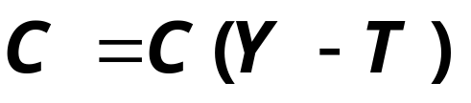
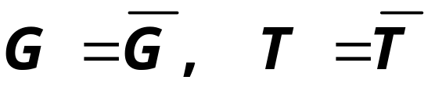
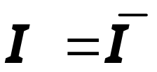

Elements of the Keynesian Cross
consumption function:
govt policy variables:
for now,
investment is exogenous:
planned expenditure:
Equilibrium condition:
Notes:
Stress that much of this model is very familiar to students: same consumption function as in previous chapters, same treatment of fiscal policy variables.
Note: In equilibrium, there’s no unplanned inventory investment. Firms are selling everything they had intended wanted to sell.

Slide 7
Graphing planned expenditure
E
planned
expenditure
income, output, Y
Notes:
Why slope of E line equals the MPC:
With I and G exogenous, the only component of (C+I+G) that changes when income changes is consumption. A one-unit increase in income causes consumption---and therefore E---to increase by the MPC.
Recall from Chapter 3: the marginal propensity to consume, MPC, equals the increase in consumption resulting from a one-unit increase in disposable income. Since T is exogenous here, a one-unit increase in Y causes a one-unit increase in disposable income.

Slide 8
Graphing the equilibrium condition
E
planned
expenditure
income, output, Y

Slide 9
The equilibrium value of income
E
planned
expenditure
E =Y
E =C +I +G
income, output, Y
Notes:
The equilibrium point is the value of income where the curves cross.
Be sure your students understand why the equilibrium income appears on the horizontal and vertical axes.
Answer: In equilibrium, E (which is measured on the vertical) = Y (which is measured on the horizontal).

Slide 10
The equilibrium value of income
E
planned
expenditure
E =Y
E =C +I +G
income, output, Y
E>Y: ___________ inventories: must produce more.
E<Y: ___________ inventories: must produce less.
Notes:
The equilibrium point is the value of income where the curves cross.
Be sure your students understand why the equilibrium income appears on the horizontal and vertical axes.
Answer: In equilibrium, E (which is measured on the vertical) = Y (which is measured on the horizontal).

Slide 11
An increase in government purchases
E
E =Y
E =C +I +G₁
ΔG
Looks like ΔY>ΔG
…so firms increase output, and income rises toward a new equilibrium
Y
E₁ = Y₁
Notes:
Explain why the vertical distance of the shift in the E curve equals ΔG:
At any value of Y, an increase in G by the amount ΔG causes an increase in E by the same amount.
At Y₁, there is now an unplanned depletion of inventories, because people are buying more than firms are producing (E > Y).

Slide 12
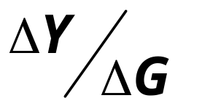
Why the multiplier is greater than 1
Def: Government purchases multiplier:
Initially, the increase in G causes an equal increase in Y: ΔY = ΔG.
But ↑Y ⇒ ↑C
⇒ further ↑Y
⇒ further ↑C
⇒ further ↑Y
So the government purchases multiplier will be _________________.
Notes:
Students are better able to understand this if given a more concrete example. For instance,
Suppose the government spends an additional $100 million on defense.
Then, the revenues of defense firms increase by $100 million, all of which becomes income to somebody: some of it is paid to the workers and engineers and managers, the rest is profit paid as dividends to shareholders. Hence, income rises $100 million (ΔY = $100 million = ΔG ).
The people whose income just rose by $100 million are also consumers,
and they will spend the fraction MPC of this extra income.
Suppose MPC = 0.8, so C rises by $80 million.
To be concrete, suppose they buy $80 million worth of Chevy Trailblazers. Then, General Motors sees its revenues increase by $80 million, all of which becomes income to somebody - either GM’s workers, or its shareholders
(ΔY = $80 million). And what do these folks do with this extra income? They spend the fraction MPC (0.8) of it, causing ΔC = $64 million (8/10 of $80 million). Suppose they spend all $64 million on Hershey’s chocolate bars, the ones with the bits of mint cookie inside. Then, Hershey Foods Corporation experiences a revenue increase of $64 million, which becomes income to somebody or other. (ΔY = $64 million). So far, the total impact on income is $100 million + $80 million + $64 million, which is much bigger than the government’s initial increase in spending. But this process continues, and the final impact on Y is $500 million (because the multiplier is 5).

Slide 13
An increase in government purchases
E
E =Y
ΔC even more
ΔC more
ΔC
ΔY even more
ΔY more
ΔG
ΔY once
Y
Notes:
Explain why the vertical distance of the shift in the E curve equals ΔG:
At any value of Y, an increase in G by the amount ΔG causes an increase in E by the same amount.
At Y₁, there is now an unplanned depletion of inventories, because people are buying more than firms are producing (E > Y).

Slide 14
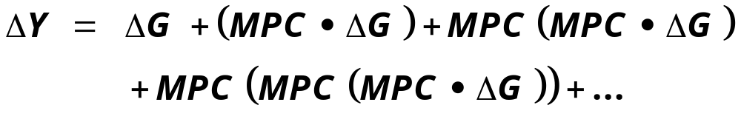
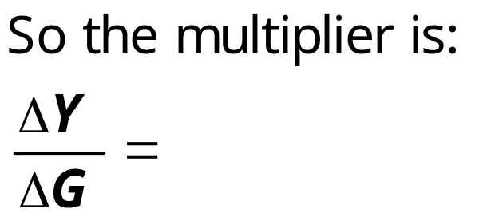
Sum up changes in expenditure

Slide 15




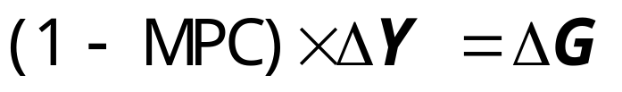
Solving for ΔY
equilibrium condition
in changes
because I exogenous
because ΔC = MPC ΔY
Collect terms with ΔY on the left side of the equals sign:
Finally, solve for ΔY :

Slide 16
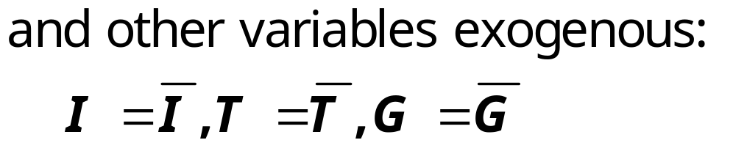

Algebra example
Suppose consumption function: C= a+b(Y-T)
where a and b are some numbers (MPC=b)
Use Goods market equilibrium condition:

Slide 17
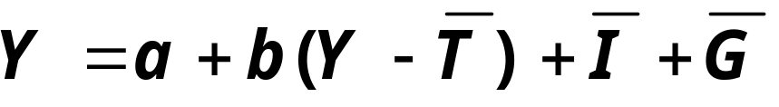
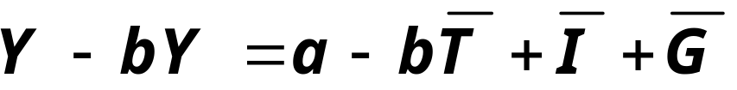
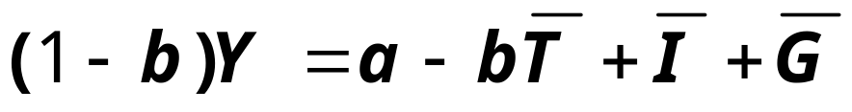
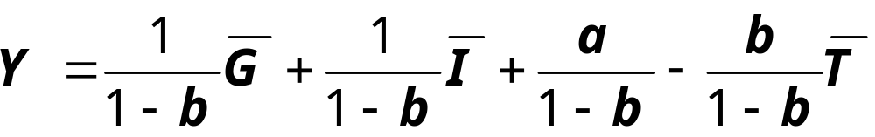
Algebra example
Solve for Y:
So if b=MPC=0.75, multiplier =

Slide 18
An increase in taxes
E
E =Y
Initially, the tax increase reduces consumption, and therefore E:
E =C₁ +I +G
ΔC = ______
…so firms reduce output, and income falls toward a new equilibrium
Y
E₁ = Y₁
Notes:
Experiment: An increase in taxes (note: the book does a decrease in taxes)
Suppose taxes are increased by ΔT. Because I and G are exogenous, they do not change. However, C depends on (Y−T). So, at the initial value of Y, a tax increase of ΔT causes disposable income to fall by ΔT, which causes consumption to fall by MPC × ΔT. Because consumption falls, the change in C is negative: ΔC = − MPC × ΔT
C is part of planned expenditure. The fall in C causes the E line to shift down by the size of the initial drop in C.
At the initial value of output, there is now unplanned inventory investment: Sales have fallen below output, so the unsold output adds to inventory.
In this situation, firms will reduce production, causing total output, income, and expenditure to fall.
The new equilibrium is at Y₂, where planned expenditure once again equals actual expenditure/output, and unplanned inventory investment is again equal to zero.

Slide 19
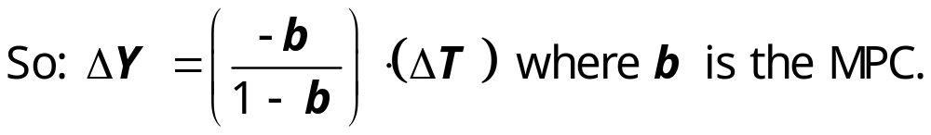
Tax multiplier
Define tax multiplier:
Can read the tax multiplier from the algebraic solution above:
If b=0.75, tax multiplier =

Slide 20


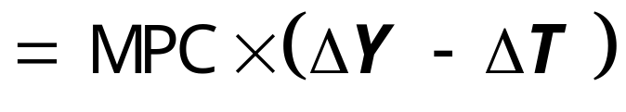
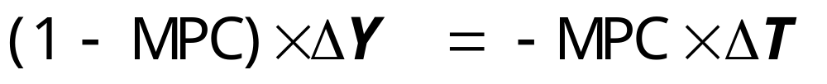
Solving for ΔY
eq’m condition in changes
I and G exogenous
Solving for ΔY :
Final result:

Slide 21
The Tax Multiplier
Question: how is this different from the government spending multiplier considered previously?
The tax multiplier:
…is __________:
An increase in taxes reduces consumer spending, which reduces equilibrium income.
…is __________________________:
(in absolute value) Consumers save the fraction (1-MPC) of a tax cut, so the initial boost in spending from a tax cut is smaller than from an equal increase in G.

Slide 22
A question to consider:
Using the Keynesian Cross, what would be the effect of an increase in investment on the equilibrium level of income/output.
Notes:
This in-class exercise not only gives students practice with the model, it also helps them understand the next topic: the IS curve.

Slide 23
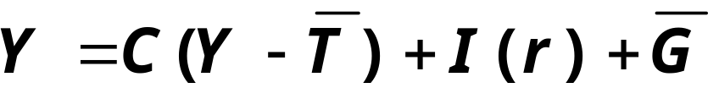
Building the IS curve
def: ____________________________________________________________________________,
i.e. actual expenditure (output)
= planned expenditure
The equation for the IS curve is:

Slide 24
Deriving the IS curve
E
E =Y
E =C +I (r₂ )+G
↓r ⇒ ↑
E =C +I (r₁ )+G
⇒ ↑
⇒ ↑
Y₁
Y₂
Y
r
r₁
r₂
IS
Y₁
Y₂
Y

Slide 25
Understanding the IS curve’s slope
The IS curve is negatively sloped.
Intuition:
A fall in the interest rate motivates firms to increase investment spending, which drives up total planned spending (E ).
To restore equilibrium in the goods market, output (a.k.a. actual expenditure, Y ) must increase.

Slide 26
Fiscal Policy and the IS curve
We can use the IS-LM model to see how fiscal policy (G and T ) can affect aggregate demand and output.
Let’s start by using the Keynesian Cross to see how fiscal policy shifts the IS curve…

Slide 27

Shifting the IS curve: ΔG
E
E =Y
E =C +I (r₁ )+G₂
At any value of r, ↑G ⇒ ↑E ⇒ ↑Y
E =C +I (r₁ )+G₁
…so the IS curve shifts to the right.
The horizontal distance of the
IS shift equals
Y₁
Y₂
Y
r
r₁
IS₁
IS₂
Y₁
Y₂
Y

Slide 28
Algebra example for IS curve
Suppose the expenditure side of the economy is characterized by:
C =95 + 0.75(Y-T)
I = 100 – 100r
G = 20, T=20
Use the goods market equilibrium condition
Y = C + I + G
Y = 215 + 0.75 (Y-20) – 100r
IS: or write as
IS:

Slide 29
Graph the IS curve
r
__
Slope =
IS
Y
IS: r = 2 - 0.0025Y

Slide 30
Slope of IS curve
Suppose that investment expenditure is “more responsive” to the interest rate:
I = 100 – 100r
200r
Use the goods market equilibrium condition
Y = C + I + G
Y = 215 + 0.75 (Y-20) – 200r
0.25Y = 200 – 200r
IS: Y = 800 – 800r or write as
IS: r = 1 - 0.00125Y (slope is lower)
So this makes the IS curve ________: A fall in r raises I ____, which raises Y _____.

Slide 31
Building the LM Curve:
The Theory of Liquidity Preference
due to John Maynard Keynes.
A simple theory in which the interest rate
is determined by money supply and
money demand.

Slide 32



Money Supply
The supply of
real money
balances
is fixed:
r
interest
rate
M/P
real money balances
Notes:
We are assuming a fixed supply of real money balances because
P is fixed by assumption (short-run), and M is an exogenous policy variable.

Slide 33
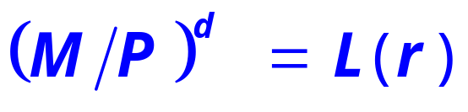

Money Demand
Demand for
real money
balances:
r
interest
rate
L (r )
M/P
real money balances
Notes:
As we learned in chapter 4, the nominal interest rate is the opportunity cost of holding money (instead of bonds).
Here, we are assuming the price level is fixed, so π = 0 and r = i.

Slide 34
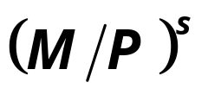
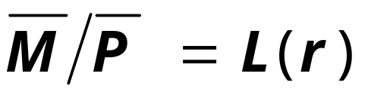
Equilibrium
The interest rate adjusts
to equate the supply and demand for money:
r
interest
rate
L (r )
M/P
real money balances

Slide 35
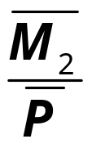
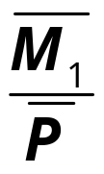
How the Fed raises the interest rate
r
interest
rate
To increase r, Fed reduces M
r₂
r₁
L (r )
M/P
real money balances

Slide 36
CASE STUDY
Volcker’s Monetary Tightening
Late 1970s: π > 10%
Oct 1979: Fed Chairman Paul Volcker announced that monetary policy
would aim to reduce inflation.
Aug 1979-April 1980:
Fed reduces M/P 8.0%
Jan 1983: π = 3.7%
How do you think this policy change
would affect interest rates?
Notes:
This and the next slide summarize the case study on pp.273-274. The data source is given on the next slide.
At this point, students have now learned different theories about the effects of monetary policy on interest rates. This case study shows them that both theories are relevant, using a real-world example to remind students that the classical theory of chapter 4 applies in the long-run while the liquidity preference theory applies in the short run.

Slide 37
Volcker’s Monetary Tightening, cont.
The effects of a monetary tightening
on nominal interest rates
short run
long run
model
Liquidity Preference
(Keynesian)
Quantity Theory, Fisher Effect
(Classical)
prices
sticky
flexible
prediction
Δi > 0
Δi < 0
actual
outcome
8/1979: i = 10.4%
4/1980: i = 15.8%
1/1983: i = 8.2%
Notes:
Since prices are sticky in the short run, the Liquidity Preference Theory predicts that both the nominal and real interest rates will rise in the short run. And in fact, both did. (However, the inflation rate was not zero, and in fact it increased, so the real interest rate didn’t rise as much as the nominal interest rate did during the period shown.)
In the long run, the Quantity Theory of Money says that the monetary tightening should reduce inflation. The Fisher Effect says that the fall in π should cause an equal fall in i. By January of 1983 (which is “the long run” from the viewpoint of 1979), inflation and nominal interest rates had fallen. (However, they did not fall by equal amounts. This doesn’t contradict the Fisher Effect, though, as other economic changes caused movements in the real interest rate.)
About the data:
i = 3-month rate on Commercial Paper (which seemed to be the closest match to the interest rate described in the case study: “on short-term commercial loans”, top of p.274).
% change in M/P from previous slide: I computed M1/CPI (the measure used in the case study), then computed the percentage change in M1/CPI over the 8-month period beginning with the month in which Volcker became the Fed chairman, August 1979.
Source: FRED database, Federal Reserve Bank of St. Louis.

Slide 38
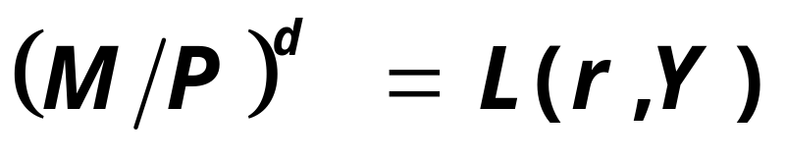
The LM curve
Now let’s put Y back into the money demand function:
The LM curve is a graph of all combinations of r and Y that equate the supply and demand for real money balances.
The equation for the LM curve is:

Slide 39
Deriving the LM curve
(a) The market for
real money balances
(b) The LM curve
r
r
LM
r₁
r₁
L (r , Y₁ )
M/P
Y₁
Y

Slide 40
Understanding the LM curve’s slope
The LM curve is positively sloped.
Intuition:
An increase in income raises money demand.
Since the supply of real balances is fixed, there is now excess demand in the money market at the initial interest rate.
The interest rate must rise to restore equilibrium in the money market.

Slide 41
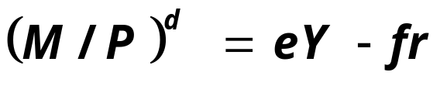
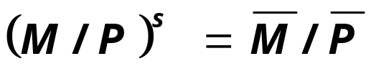
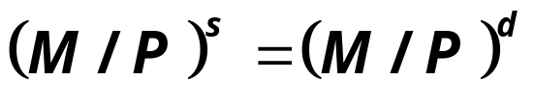
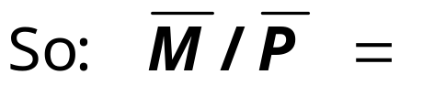

Deriving LM curve with algebra
Suppose a money demand:
  Where e describes the responsiveness of money demand to changes in income.
  And f describes responsiveness to interest rate.
Suppose money supply:
Use money market equilibrium condition:

Slide 42
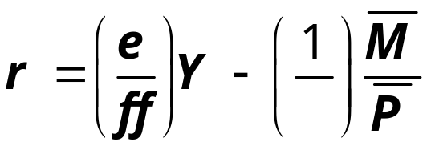
Graph the LM curve
r
LM
Y
A steep LM curve (_________) means that a rise in output implies a ______________ to maintain equilibrium.
Causes of this:
Money demand is _______________ to interest rate (f is small)
Money demand __________________ to output (e large)

Slide 43
How ΔM shifts the LM curve
(a) The market for
real money balances
(b) The LM curve
r
r
LM₁
r₂
r₂
r₁
r₁
L (r , Y₁ )
M/P
Y₁
Y
Notes:
If you’re as anal as I am, you might consider helping your students understand the analytical difference between looking at a shift as a horizontal shift and looking at it as a vertical shift.
We can think of the LM curve shift as a vertical shift:
When the Fed reduces M, the vertical distance of the shift tells us what happens to the equilibrium interest rate associated with a given value of income.
Or, we can think of the LM curve shifting horizontally:
When the Fed reduces M, the horizontal distance of the shift tells us what would have to happen to income to restore money market equilibrium at the initial interest rate. (The graphical analysis would be a little different than what’s depicted on this slide.)

Slide 44
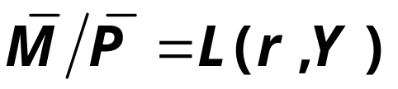
The short-run equilibrium
The short-run equilibrium is the combination of r and Y that simultaneously satisfies the equilibrium conditions in the goods & money markets:
r
Y
Equilibrium
interest
rate
Equilibrium
level of
income

Slide 45
The Big Picture
Keynesian
Cross
IS
curve
IS-LM
model
Explanation of short-run fluctuations
Theory of Liquidity Preference
LM curve
Agg. demand
curve
Model of Agg. Demand and Agg. Supply
Agg. supply
curve

Slide 46
Chapter summary
Keynesian Cross
  basic model of income determination
  takes fiscal policy & investment as exogenous
  fiscal policy has a multiplied impact on income.
IS curve
  comes from Keynesian Cross when planned investment depends negatively on interest rate
  shows all combinations of r and Y that equate planned expenditure with actual expenditure on goods & services

Slide 47
Chapter summary
Theory of Liquidity Preference
  basic model of interest rate determination
  takes money supply & price level as exogenous
  an increase in the money supply lowers the interest rate
LM curve
  comes from Liquidity Preference Theory when money demand depends positively on income
  shows all combinations of r andY that equate demand for real money balances with supply

Slide 48
Chapter summary
IS-LM model
  Intersection of IS and LM curves shows the unique point (Y, r ) that satisfies equilibrium in both the goods and money markets.

