Slide 1
Topic 10:
Aggregate Demand II
(chapter 11) updated 11/15/06
Notes:
This is a very substantial chapter, and among the most challenging in the text. I encourage you to go over this chapter a little more slowly than average, or at least recommend to your students that they study it extra carefully.
I have included a number of in-class exercises to give students immediate reinforcement of concepts as they are covered, and also to break up the lecture. If you need to get through the material more quickly, you may wish to omit some or all of these exercises (perhaps assigning them as homeworks, instead).
A graph unfolds on slides 27-31. If you print this file (or create a PDF version for them to download from the web), you might consider omitting slides 28 and 30 to save paper, as they contain intermediate animations.

Slide 2
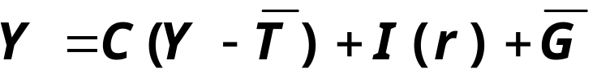
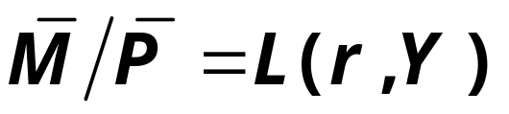
Equilibrium in the IS-LM Model
The IS curve represents equilibrium in the goods market.
r
LM
The LM curve represents money market equilibrium.
r₁
IS
Y
Y₁
The intersection determines
the unique combination of Y and r
that satisfies equilibrium in both markets.

Slide 3
Policy analysis with the IS-LM Model
r
LM
Policymakers can affect macroeconomic variables with
  fiscal policy: G and/or T
  monetary policy: M
We can use the IS-LM model to analyze the effects of these policies.
r₁
IS
Y
Y₁

Slide 4

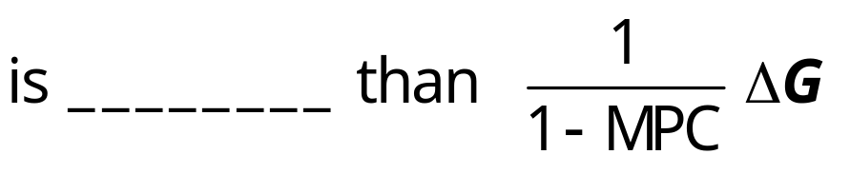
An increase in government purchases
1. IS curve shifts right
r
causing output & income to rise.
r₁
2. This raises money demand, causing the interest rate to rise…
IS₁
Y
3. …which reduces investment, so the final increase in Y
Y₁
Notes:
Chapter 10 showed that an increase in G causes the IS curve to shift to the right by (ΔG)/(1-MPC).

Slide 5

A tax cut
Because consumers save (1−MPC) of the tax cut, the initial boost in spending is smaller for ΔT than for an equal ΔG…
and the IS curve
shifts by
r
LM
r₂
2.
r₁
1.
IS₂
1.
IS₁
Y
Y₁
Y₂
2.
…so the effects on r and Y are___________________
_________________.
2.
Notes:
Chapter 10 used the Keynesian Cross to show that a decrease in T causes the IS curve to shift to the right by (-MPC×ΔT)/(1-MPC).
If your students ask why the IS curve shifts to the right when there’s a negative sign in the expression for the shift, remind them that ΔT < 0 for a tax cut, so the expression actually is positive.
The term showing the distance of the shift in the IS curve is almost the same as in the case of a government spending increase, where the numerator of the fraction equals (1) for government spending rather than (-MPC) for the tax cut. Here’s the intuition: Every dollar of a government spending increase adds to aggregate spending. However, for tax cuts, the fraction (1-MPC) of the tax cut leaks into saving, so aggregate spending only rises by MPC times the tax cut.

Slide 6
Monetary Policy: an increase in M
r
1. ΔM > 0 shifts
the LM curve down
(or to the right)
LM₁
r₁
2. …causing the interest rate to fall
3. …which increases investment, causing output & income to rise.
Y
Y₁
Notes:
Chapter 10 showed that an increase in M shifts the LM curve to the right.
Here is a richer explanation than what appears on this slide:
The increase in M causes the interest rate to fall. [People like to keep optimal proportions of money and bonds in their portfolios; if money is increased, then people try to re-attain their optimal proportions by “exchanging” some of the money for bonds: they use some of the extra money to buy bonds. This increase in the demand for bonds drives up the price of bonds -- and causes interest rates to fall (since interest rates are inversely related to bond prices).
The fall in the interest rate induces an increase in investment demand, which causes output and income to increase.
The increase in income causes money demand to increase, which increases the interest rate (though doesn’t increase it all the way back to its initial value; instead, this effect simply reduces the total decrease in the interest rate).

Slide 7
Shocks in the IS-LM Model
IS shocks: exogenous changes in the _________________________.
Examples:
  stock market boom or crash
  ⇒ change in households’ wealth
  ⇒ ΔC
  change in business or consumer
  confidence or expectations
  ⇒ ΔI and/or ΔC

Slide 8
Shocks in the IS-LM Model
LM shocks: exogenous changes in the _______________________.
Examples:
  a wave of credit card fraud increases demand for money
  more ATMs or the Internet reduce money demand

Slide 9
CASE STUDY
The U.S. economic slowdown of 2001
~What happened~
1. Real GDP growth rate
  1994-2000: 3.9% (average annual)
  2001: 1.2%
2. Unemployment rate
  Dec 2000: 4.0%
  Dec 2001: 5.8%

Slide 10
CASE STUDY
The U.S. economic slowdown of 2001
~Shocks that contributed to the slowdown~
1. ______________
  From Aug 2000 to Aug 2001: -25%
  Week after 9/11: -12%
2. The terrorist attacks on 9/11
  increased uncertainty
  ____________________
Both shocks reduced spending and
_____________________.

Slide 11
CASE STUDY
The U.S. economic slowdown of 2001
~The policy response~
1. Fiscal policy
  large long-term ___________,
  immediate $300 rebate checks
  _______________:
  aid to New York City & the airline industry,
  war on terrorism
2. _______________
  Fed lowered its Fed Funds rate target
  11 times during 2001, from 6.5% to 1.75%
  Money growth increased, interest rates fell

Slide 12
What is the Fed’s policy instrument?
What the newspaper says:
“the Fed lowered interest rates by one-half point today”
What actually happened:
The Fed conducted expansionary monetary policy to shift the LM curve to the right until the interest rate fell 0.5 points.
The Fed targets the Federal Funds rate:
it announces a target value,
and uses monetary policy to shift the LM curve
as needed to attain its target rate.
Notes:
In case your students aren’t familiar with the Fed Funds rate, you might briefly explain that it’s the rate banks charge each other on overnight loans. Since most short-term interest rates move closely together, the changes in the Fed Funds rate caused by monetary policy end up causing similar changes in most other short-term rates. Long term rates may well also move in the same direction, but they are also affected by other factors beyond the scope of this chapter. Chapter 18 discusses monetary policy in detail.

Slide 13
What is the Fed’s policy instrument?
Why does the Fed target interest rates
instead of the money supply?
  1) They are easier to measure than the money supply
  The Fed might believe that LM shocks are more prevalent than IS shocks. If so, then targeting the interest rate stabilizes income better than targeting the money supply.

Slide 14
IS-LM and Aggregate Demand
So far, we’ve been using the IS-LM model to analyze the short run, when the price level is assumed fixed.
However, a change in P would shift the LM curve and therefore affect Y.
The ______________________
(introduced in chap. 9 ) captures this
relationship between P and Y

Slide 15
Deriving the AD curve
r
Intuition for slope
of AD curve:
↑P ⇒ ↓(M/P )
⇒ LM shifts left
⇒ ↑
⇒ ↓
⇒ ↓
LM(P₁)
r₁
IS
Y₁
Y
P
P₁
AD
Y₁
Y
Notes:
It might be useful to explain to students the reason why we draw P₁ before drawing the LM curve:
The position of the LM curve depends on the value of M/P. M is an exogenous policy variable. So, if P is low (like P₁ in the lower panel of the diagram), then M/P is relatively high, so the LM curve is over toward the right in the upper diagram. If P is high, like P₂, then M/P is relatively low, so the LM curve is more toward the left.
Because the value of P affects the position of the LM curve, we label the LM curves in the upper panel as LM(P₁) and LM(P₂).

Slide 16
Monetary policy and the AD curve
r
LM(M₁/P₁)
The Fed can increase aggregate demand:
↑M ⇒ LM shifts right
r₁
⇒ ↓
IS
Y₁
Y
⇒ ↑
⇒ ↑
P
P₁
AD₁
Y₁
Y
Notes:
It’s worth taking a moment to explain why we are holding P fixed at P₁:
To find out whether the AD curve shifts to the left or right, we need to find out what happens to the value of Y associated with any given value of P. This is not to say that the equilibrium value of P will remain fixed after the policy change (though, in fact, we are assuming P is fixed in the short run). We just want to see what happens to the AD curve.
Once we know how the AD curve shifts, we can then add the AS curves (short- or long-run) to find out what, if anything, happens to P (in the short- or long-run).

Slide 17
Fiscal policy and the AD curve
r
LM
Expansionary fiscal policy (↑G and/or ↓T ) increases agg. demand:
↓T ⇒ ↑
⇒
⇒ ↑Y at each value of P
r₁
IS₁
Y₁
Y
P
P₁
AD₁
Y₁
Y

Slide 18
Policy Effectiveness
Fiscal policy is effective (Y will rise much) when:
____________
As the rise in G raises Y,
the increase in money demand _____________
so investment is not crowed out as much.
IS₁
IS₂
LM
r
2
1
2’
LM’
Y₁
Y₂
Y₂’

Slide 19
Policy Effectiveness
Monetary policy is effective (Y will rise much) when:
__________
r
As a rise in M lowers the interest rate (r),
_________________ in response to the fall in r
so output rises more.
IS
LM₁
LM₂
1
2’
2
IS’
Y₁
Y₂
Y₂’

Slide 20
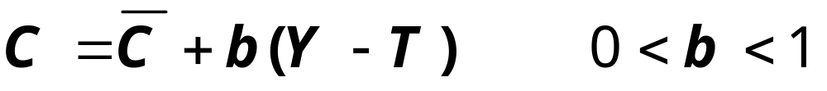
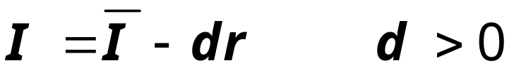
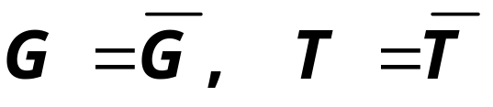
Optional material:
Deriving AD curve with algebra
Suppose the expenditure side of the economy is characterized by:

Slide 21
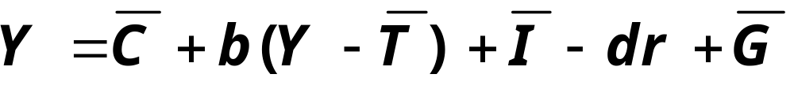
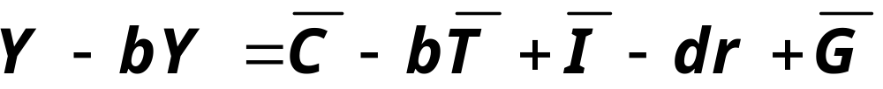
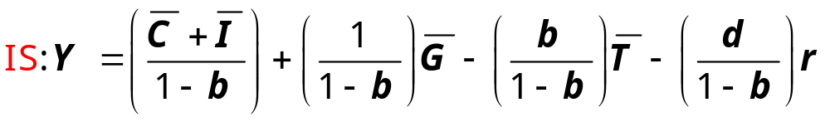
Optional Material:
Deriving AD curve with algebra
Use the goods market equilibrium condition
Y = C + I + G
Solve for Y:
A line relating Y to r with slope –d/(1-b)
Can see multipliers here: rise in Y taking r as given. But r is an endogenous variable and it will change…

Slide 22
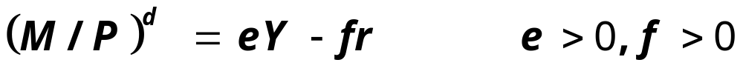
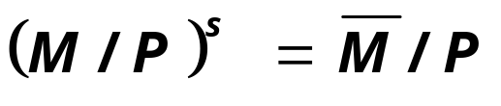
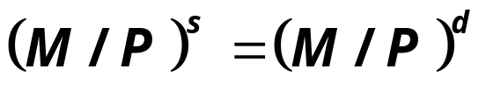
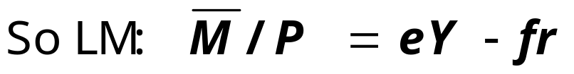
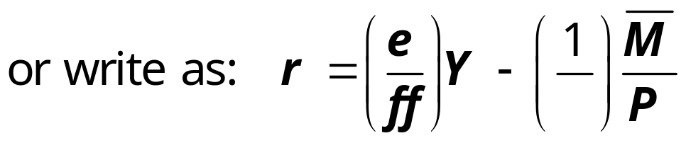
Optional Material:
Deriving AD curve with algebra
Use the money market to find a value for r:
As done for the LM curve previously,
suppose the money market is characterized by:
Equilibrium in money market requires:
Line with slope = e/f

Slide 23
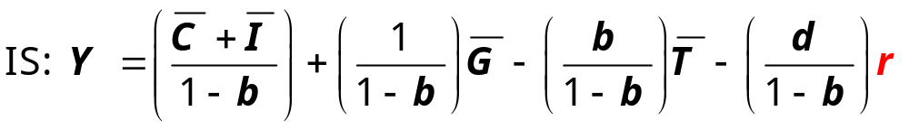
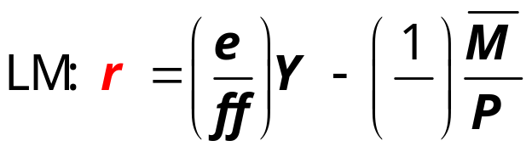
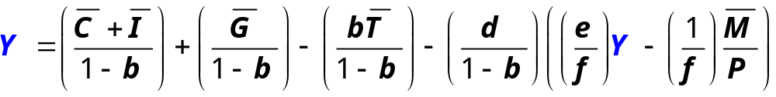
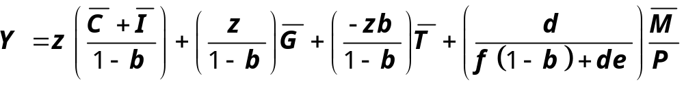
Optional Material:
Deriving AD curve with algebra
Now combine the two, substituting in for r:
Solve for Y. For convenience, define a term:

Slide 24
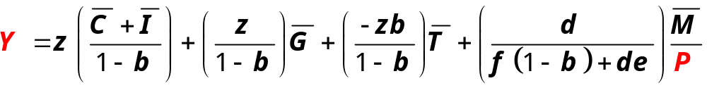
Optional Material:
Deriving AD curve with algebra
P
This implies a negative relationship between output (Y) and price level (P): an Aggregate Demand curve.
AD
Y
This math can help reveal under what conditions monetary and fiscal policies will be most effective…

Slide 25
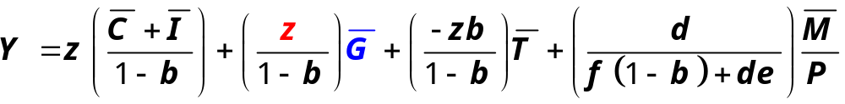
Optional Material:
Policy Effectiveness
Fiscal policy is effective (Y will rise much) when:
LM flatter (f large or e small, so z near 1)
As the rise in G raises Y,
the increase in money demand does not raise r much: -small e:M^{d} not responsive to Y -large f: M^{d} is responsive to r
so investment is not crowded out as much.
IS₁
IS₂
LM
r
2
1
2’
LM’
Y₁
Y₂
Y₂’

Slide 26
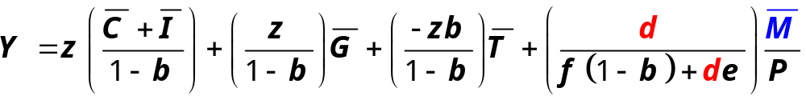
Optional Material:
Policy Effectiveness
Monetary policy is effective (Y will rise much) when:
IS flatter (d large: Investment is responsive to r)
r
As a rise in M lowers the interest rate (r),
investment rises more in response to the fall in r,
so output rises more.
IS
LM₁
LM₂
1
2’
2
IS’
Y₁
Y₂
Y₂’

Slide 27
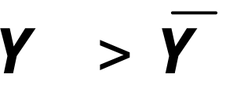
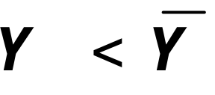
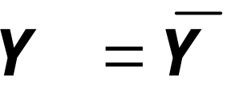
IS-LM and AD-AS in the short run & long run
Recall from Chapter 9: The force that moves the economy from the short run to the long run
is the gradual adjustment of prices.
In the short-run equilibrium, if
then over time, the price level will
rise
fall
remain constant
Notes:
The next few slides put our IS-LM-AD in the context of the bigger picture - the AD-AS model in the short-run and long-run, which was introduced in Chapter 9.

Slide 28
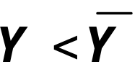

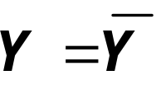
The SR and LR effects of an IS shock
A negative IS shock shifts IS and AD left, causing Y to fall.
r
LRAS
LM(P₁)
In the new short-run equilibrium,
IS₁
Over time P falls, which causes M/P to increase, causing LM
to move down.
Y
P
LRAS
P₁
SRAS₁
Economy eventually reaches a long-run equilibrium with
AD₁
Y
Notes:
Abbreviation:
SR = short run, LR = long run

Slide 29
EXERCISE:
Analyze SR & LR effects of ΔM
Drawing the IS-LM and AD-AS diagrams as shown here,
show the short run effect of a Fed increases in M. Label points and show curve shifts with arrows.
Show what happens in the transition from the short run to the long run. Label points.
How do the new long-run equilibrium values compare to their initial values?
r
LRAS
LM(M₁/P₁)
IS
Y
P
LRAS
P₁
SRAS₁
AD₁
Y
Notes:
This exercise has two objectives:
1. To give students immediate reinforcement of the preceding concepts.
2. To show them that money is neutral in the long run, just like in chapter 4.
You might have your students try other exercises using this framework:
* the short-run and long-run effects of expansionary fiscal policy. Have them compare the long-run results in this framework with the results they obtained when doing the same experiment in Chapter 3 (the loanable funds model).
* Immediately after a negative shock pushes output below its natural rate, show how monetary or fiscal policy can be used to restore full-employment immediately (i.e., without waiting for prices to adjust).

Slide 30
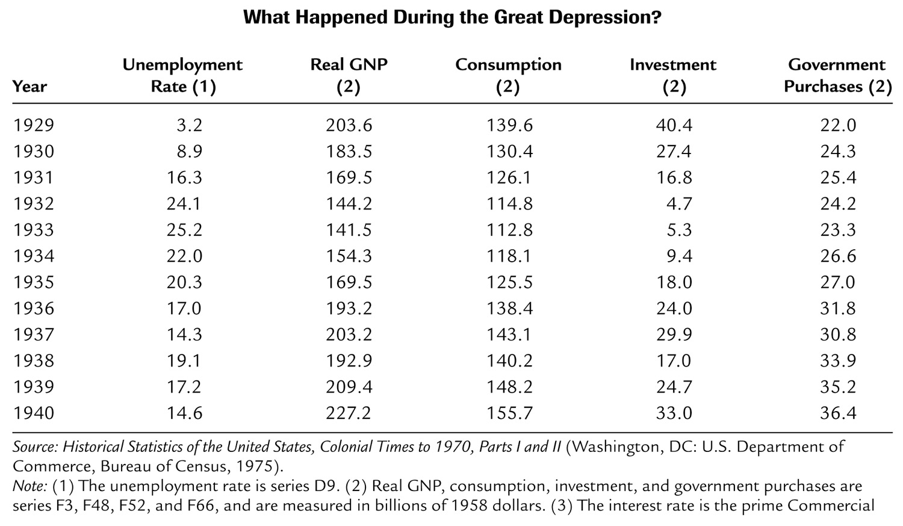

Slide 31
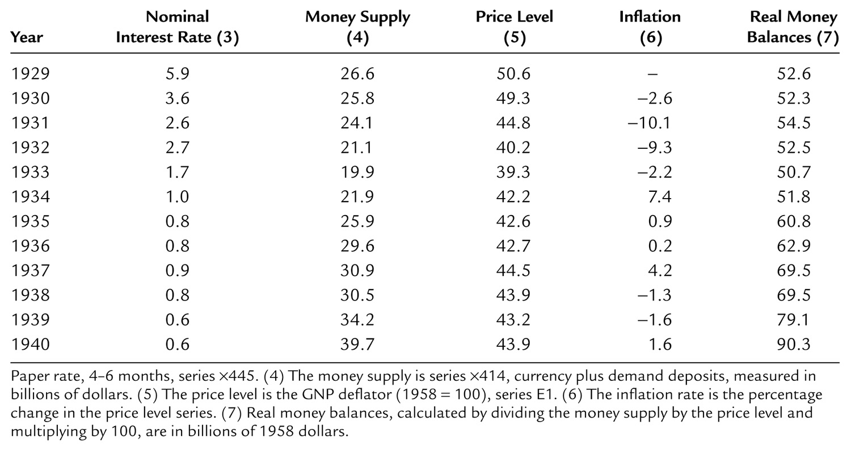

Slide 32
Great Depression: Observations
Real side of economy:
  Output:
  Consumption:
  Investment:
  Gov. purchases:
Nominal side:
  Nominal interest rate:
  Money supply (nominal):
  Price level:

Slide 33
The Spending Hypothesis:
Shocks to the IS Curve
asserts that the Depression was largely due to an exogenous fall in the demand for goods & services -- a leftward shift of the IS curve
evidence:

Slide 34
The Spending Hypothesis:
Reasons for the IS shift
  Oct-Dec 1929: S&P 500 fell 17%
  Oct 1929-Dec 1933: S&P 500 fell 71%
  “correction” after overbuilding in the 1920s
  widespread bank failures made it harder to obtain financing for investment
  in the face of falling tax revenues and increasing deficits, politicians raised tax rates and cut spending
Notes:
In item 2, I’m using the term “correction” in the stock market sense.

Slide 35
The Money Hypothesis:
A Shock to the LM Curve
asserts that the Depression was largely due to huge fall in the money supply
evidence:
Argument:

Slide 36
A revision to the Money Hypothesis
There was a big deflation: P fell 25% 1929-33.
A sudden fall in expected inflation means the ex-ante real interest rate rises for any given nominal rate (i)
ex ante real interest rate = i – π^{e}
This could have discouraged the investment expenditure and helped cause the depression.
Since the deflation likely was caused by fall in M, monetary policy may have played a role here.

Slide 37
Why another Depression is unlikely
Policymakers (or their advisors) now know
much more about macroeconomics:
  The Fed knows better than to _________, _________________especially during a contraction.
  Fiscal policymakers know better than to ________________________________
  ________________.
Federal deposit insurance makes widespread bank failures very unlikely.
_______________ make fiscal policy expansionary during an economic downturn.
Notes:
Examples of automatic stabilizers:
the income tax: people pay less taxes automatically if their income falls
unemployment insurance: prevents income - and hence spending - from falling as much during a downturn
This is discussed in Chapter 14.

Slide 38
Chapter summary
1. IS-LM model
  a theory of aggregate demand
  exogenous: M, G, T,
  P exogenous in short run, Y in long run
  endogenous: r,
  Y endogenous in short run, P in long run
  IS curve: goods market equilibrium
  LM curve: money market equilibrium

Slide 39
Chapter summary
2. AD curve
  shows relation between P and the IS-LM model’s equilibrium Y.
  negative slope because
  ↑P ⇒ ↓(M/P ) ⇒ ↑r ⇒ ↓I ⇒ ↓Y
  expansionary fiscal policy shifts IS curve right, raises income, and shifts AD curve right
  expansionary monetary policy shifts LM curve right, raises income, and shifts AD curve right
  IS or LM shocks shift the AD curve

