Slide 1
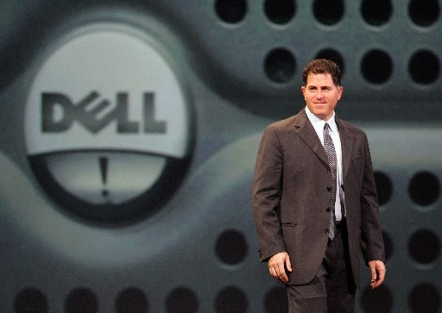
i2E

Slide 2
Is Michael Dell an Entrepreneur?
Why?
High school equivalence degree in third grade
  Urge to go ahead
  Compress things
Setting up stamp auction
  Creating value for both
Took the Apple II apart
  Getting at the bottom of things
Set up a bulletin board
  Reaching out to targetted customers
Upgrading and reselling at profit
  Set up and started running the business in high school

Slide 3
Is Michael Dell an Entrepreneur?
Why?
Came up with an insight in who were the prospective customers
  People who had just moved in
  People who had just got married
Found an efficient method in locating the prospects
  Marriage license submission
Action :
  Send direct mails to targetted people
Outcome :
  Made thousands and thousands of people to buy newspaper
Income :
  Made $ 18,000 in commission
Reward :
  Bought car and stereos
Summer Job
at
Houston Post

Slide 4
The Heart of the Entrepreneurship
PCs were sold through conventional distribution networks
By the time PCs reached the customers:
  technology had moved on
For a PC costing US $ 2000:
  the components were only $ 600
The microprocessor manufacturers were bringing out faster chips but:
  it took long time for them to get into PCs
Pinpointed the enormous inefficiency in the entire value chain resulting in
  short-charging of customers
Notes:
180 degree difference approach

Slide 5
Beginning of the Entrepreneurship Journey
Dropped out of college
Set-up a 1,000 sq ft. office in Austin
Identified the lacuna:
  PCs without hard drives
Set up a business of:
  selling upgrade kits
The “Venture”
  A few order takers
  A few more people to fulfl them
  Manufacturing staff: 3 men with screwdrivers
  Capitalization cost: $1,000

Slide 6
Growth on Fast Track
Within a month, new office of 2,500 sq. ft
Within 3 months, 7,000 sq ft office
Achieved growth without any significant capital ($ 1,000)
  Customers were paying by Credit card
  Credit from suppliers (because they didn’t have many customers)
Botched up many things
  Made mistakes but didn’t repeat them
  Grew and grew and grew because of enormous inherent value in the business

Slide 7
The Innovation Element
Can be at any point in the entire value chain
  New products
  New processes
  New methods of reaching customers
The value is in the mind of the customer
Offered what the customer wanted:
  in the most cost-effective way
Developed enormous leverage with the suppliers
Offered unmatched value to the customers

Slide 8
The Unstoppable Growth Engine
Year Sales
($ million)
1985
6
1990
400
1995
3,500
2000
25,000
2005
50,000
Forbes List of Richest Americans under 40 Years:
# 1 for 6 years
Personal Wealth - $ 18 billion
Notes:
Forbes list

Slide 9
Questions and Questions
Do family background and education matter?
Are there certain traits and attributes of an entrepreneur?
Do entrepreneurs look at things differently? Why? How?
What it takes to move from idea to entreprise?
Do entrepreneurs change the “Rules of the Game”?
What is the most important resource? Money?
----- ????
Is entrepreneurship rewarding?

Slide 10
Innovation
Addressing a critical problem
Exploiting a perceived opportunity
Developing a new “ends-means” framework
Validation
Venturing in uncharted areas
  Risk
  Time

Slide 11
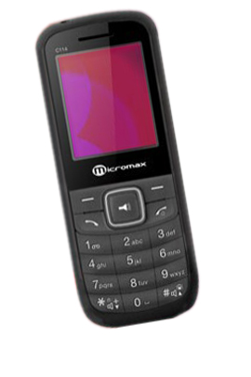
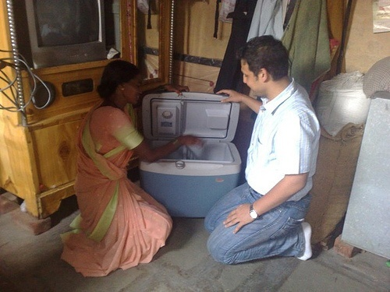

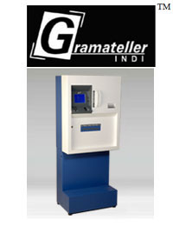
Innovations Galore
Godrej Chotu Cool
Refrigerator without compressor for Rs 3,250
Micromax Mobile Talk time 4 hrs
Big or Small?
Big for Small?
Small for Big?
McAloo Tikki, the Veggie Burger for Rs 20
Highest grossing item on the menu
Sales up by 30 %
Rural ATM

Slide 12
Entrepreneurship
Concept
Practice
Contribution
Attributes and Mindset
Founding and growing a new venture

Slide 13
The Process
Opportunity
Creativity
Value Proposition
Value Creation and Delivery
Making the World a Better Place

Slide 14
New Industries Launched by the E-Generation

Slide 15
New Industries Launched by the E-Generation
Personal Computers | Voice mail information technology services
Biotechnology | Cellular phone services
Cable TV | Internet publishing and shopping
PC Software | Desktop computing
Wireless Communications/ handheld devices | Virtual imaging
Electronic paging | Digital media & entertainment

Slide 16
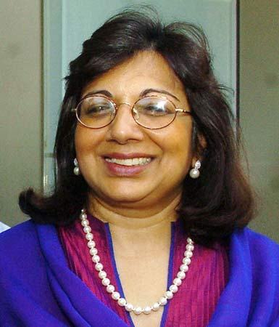

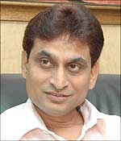
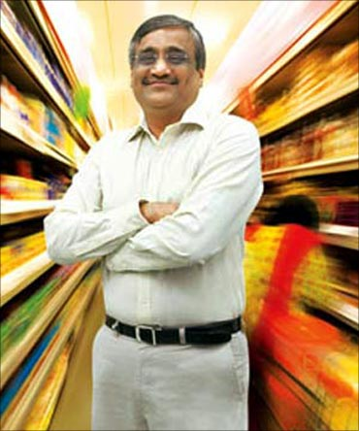
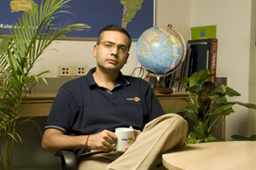
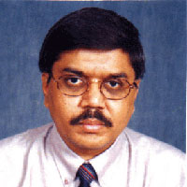
Following a Different Path
Kiran Mazumdar
Subhash Goel
C K Ranganathan
Deep Kalra
Kishor Biyani
Tulsi Thanti

Slide 17
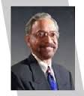

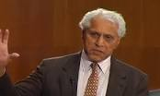
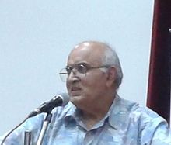

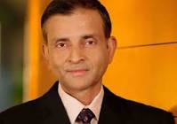
Crossing the Borders
Gururaj Deshpande
Romesh Wadhwani
Suhas Patil
Vivek Ranadive
Kanwal Rekhi
Bharat Desai

Slide 18
Creating a New Value Equation
Reduce
What factors should be reduced
well below the industry standard ?
Eliminate
Create
What factors should be eliminated that the industry has taken for granted ?
What factors should be created that the industry has never offered ?
New Value
Equation
What factors should be raised well
beyond the industry standards ?
Raise

Slide 19
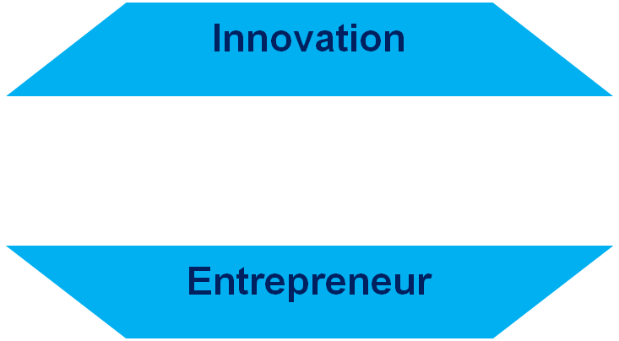
From Mind to Market
Product
Development
Deliver Value
Cost-Benefit
Value Equation
Customer
Need
Opportunity
New Venture
Mindset
Networking
Raise
Resources
People
Assets
Finance

Slide 20
Course Structure
Class sessions
Exercises
Readings
Assignments
Sharing of Experiences with Entrepreneurs-Live Sessions
Business Plan

Slide 21
Learning Expectations
Understand the logic and mechanics of a business entreprise
Mindset and preparation for an Entrepreneur
Develop an understanding of the entrepreneurial process from conceptual stage to becoming an established business
Know about stages of technology evolution, product and business life cycles
Develop an understanding of business functions essential for success of technology entreprises
Feasibility Study/Business Plan

Slide 22
Course Material
Text Books
Technology Ventures: From Idea to Entreprise
Byers/ Dorf
The Start-up Owner’s Manual
Steve Blank
Entrepreneurship
Barringer/ Ireland
Supplementary Books
The Art of the Start
Kawasaki
Stay Hungry, Stay Foolosh
Rashmi Bansal
The New Business Road Test
Mullins
Readings : Required
Business Journals/Magazines

Slide 23
Assignment 1:
How We Got Started –
Michael Dell

Slide 24
Give three points which set Michael Dell apart from normal kids?
What is the most important action that Michael Dell took in his job at The Houston Post?
Why were PC sellers selling computers with older specs at a high price of $2,000?
What was the most innovative element in Dell’s computer venture?
Why did Dell Computers grow very fast?
Mention 3 innovations which impressed you most over the period of last one year. These should be beyond those covered in the class.

Slide 25



Slide 26
Desai Sethi Centre for Entrepreneurship
Established in June 2014 as an Inter-Disciplinary Program Centre
Autumn Semester
  ENT 201/603: Introduction to Entrepreneurship
  ENT 207/605: Business Fundamentals for Technopreneurs
  ENT 209/607: Managing Technological Innovation
  ENT 204/606: Developing a Proof of Concept-Basic
Spring Semester
  ENT 208/602: Technology Venture Creation
  ENT 210/604: Marketing for Entrepreneurs
  ENT 205/601: Intellectual Property Management for Entrepreneurs
  ENT 206/608: Developing Proof of Concept-Advanced
500+ students have joined these courses
Extensive networking with alumni entrepreneurs and Venture Capitalists for courses and mentoring
New Program: B. Tech. (Minor) in Entrepreneurship

Slide 27
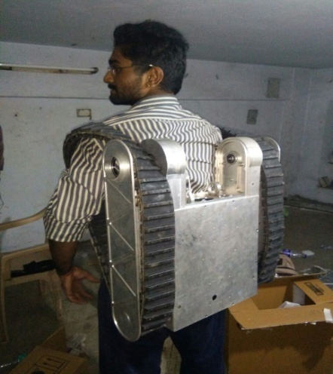
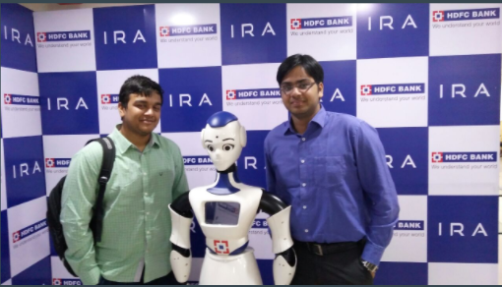

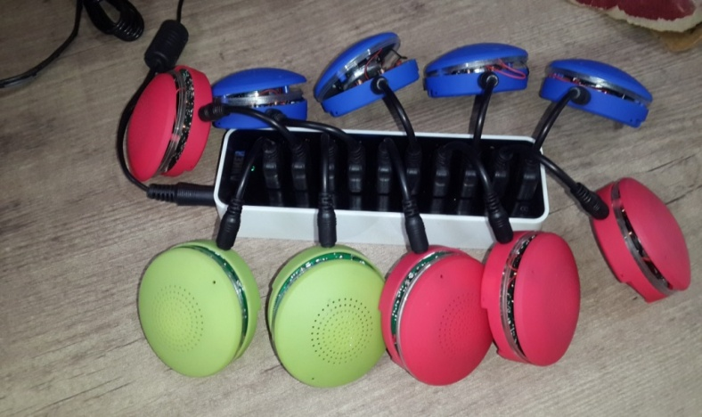
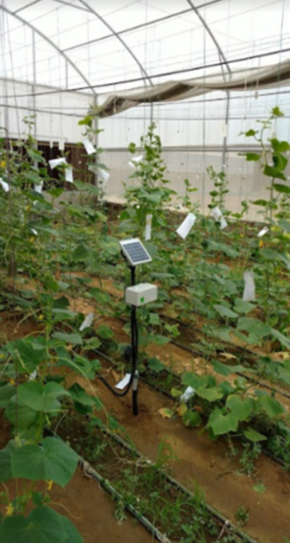
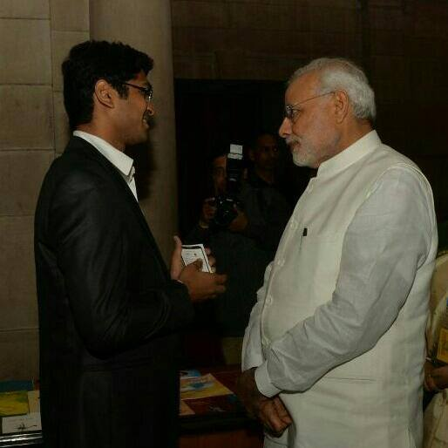
JanYu Technologies
Spearheading the robotic revolution towards a mine-free world
EasyVoice
Enabling Digital Technology solutions
Tactical Remotely Operated Vehicle(ROV)
Felicitated by State Bank of India for timely delivery of a project
SOUNDREX – Immersive Music experience
Technologies for better healthcare delivery
Proximal SoilSenS Technologies Pvt. Ltd.
Optimizing Water Usage Through Soil Moisture Detection
Top 20 in the K Star Global Challenge

Slide 28
Opportunity to Work on Live IoT Project in Campus
$ 267 Billion – Size of global IoT Tech., App. and Solutions market by 2020, Forbes.
$10 Billion – Size of Smart City Opportunity in India in the next 5 years, McKinsey.
Current Projects
New Project Ideas Also Welcome
What you are expected to do?
Participate in a detailed Customer Discovery/Customer Validation process inside the campus in which you are expected to meet the different stakeholders in a given problem area and understand their pain points
Collate disparate baseline data existing at different locations and in different formats to come up with insight
Design a proof-of-concept PoC with clear success criteria
Help execute the PoC in a quick and structured manner
Finally assist the startups in delivering an impressive presentation in the third week of September.
Approved Projects of Ex-Students of the Course
Smart Electricity Mngt. (Ushvatech)
Smart Irrigation Mngt. (SoilSense)
Smart Water Mngt. (Faclon)

Slide 29
Should I Join the Course?
Do I want to create things which will be of value?
Am I serious about learning entrepreneurship?
Entrepreneur:
quits a 9 to 5 job so that s/he can work for 16 hours a day
Am I willing to put in efforts of 12 credits for a 6-credit course?

Slide 30
Thank You

Slide 31
Do family background and education matter?
A
B
C

Slide 32
Do entrepreneurs look at things differently? Why? How?
A
B
C

Slide 33
Are there certain traits and attributes of an entrepreneur?
A
B
C

Slide 34
What is the most important resource? Money? ????
A
B
C

