Slide 1
Entrepreneurship

Slide 2
Global Entrepreneurs
Richard Branson
Bill Gates
Fredrick Smith
Steve Case
Gordon Moore/ Robert Noyce
Edwin Land
Mitch Kapor
Amar Bose
Mark Zuckerberg
Robert Swanson/ Herbert Boyer
Sergey Brin/Larry Page
Anita Rodick
Dietmar Hopp/ Hasso Plattner

Slide 3
Mega-Entrepreneurs Who Started In Their 20s
Entrepreneurial Company
Microsoft
Netscape
Dell Computers
Gateway 2000
McCaw Cellular
Apple Computers
Digital Equipment Corporation
Federal Express
Genentech
Polaroid
Nike
Lotus Development Corporation
Groupon
Founder(s)
Bill Gates and Paul Allen
Marc Andressen
Michael Dell
Ted Waitt
Craig McCaw
Steve Jobs and Steve Wozniak
Ken and Stan Olsen
Fred Smith
Robert Swanson
Edwin Land
Phil Knight
Mitch Kapor
Andrew Mason

Slide 4
Entrepreneurs—Challenging the Unknown
Recognize opportunities where others see chaos or confusion
Should think beyond the available resources to become a successful innovator
Are aggressive catalysts for change within the marketplace
Challenge the unknown and continuously create the future

Slide 5
Impact of Entrepreneurial Firms
Innovation
  Process of creating something new, which is central to the entrepreneurship
  Entrepreneurial firms are responsible for 60% of all innovations
Job Creation
  In the past two decades, economic activity has moved in the direction of smaller entrepreneurial firms
    unique ability to innovate and focus on specialized tasks
Impact on Society
  Dramatic impact on society through new products and services that
    make our lives easier,
    Enhance productivity at work,
    improve our health; and
    entertain us in new ways.
Impact on Larger Firms
  New business models around
    Products and services that help large firms become
    More efficient and effective

Slide 6
Entrepreneurship Defined
The essence of entrepreneurial behavior is
  identifying opportunities and putting useful ideas into practice
The set of tasks called for by this behavior can be accomplished by either an individual or a group and typically
  requires creativity, drive and a willingness to take risks
Entrepreneurship is the process by which individuals pursue opportunities
  without regard to the resources they currently control

Slide 7
Entrepreneurship : Process & Payoff
Entrepreneurship is a process that causes
change
through
innovation
brought about by individuals
who generate or respond to economic
opportunities
that create
value
for both themselves and
society

Slide 8
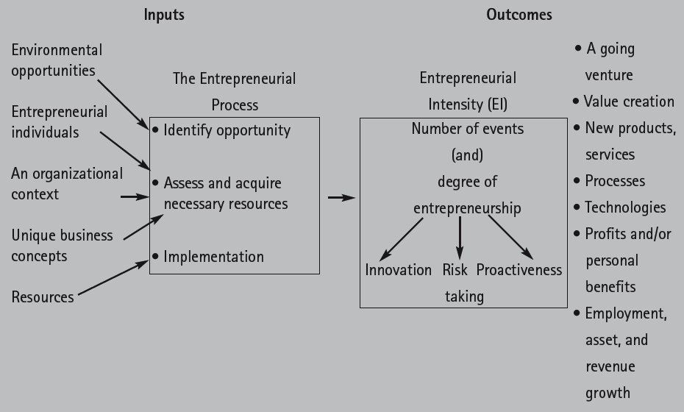
Integrative Model of
Entrepreneurial
Inputs and Outcomes

Slide 9
Inputs
The Entrepreneurial Process
Environmental Opportunities
Entrepreneurial Individuals
An Organisational Context
Unique Business Concept
Resources
Identify Opportunity
Assess and Acquire Necessary Resorces
Implementation
Entrepreneurial Opportunities
  Conditions in which new products or services can satisfy a need in the market
Entrepreneurs must be able to:
  Identify opportunities not perceived by others
  Take actions to exploit the opportunities
  Establish a competitive advantage

Slide 10
Outcomes
The Entrepreneurial Intensity
A Going Venture
Value Creation
New Products, Services
Processes
Technologies
Profits and/or Personal Benefits
Employment, Assets and Revenue Growth
Number of Events and Degree of Entrepreneurship
Innovation
Proactive-
ness
Risk Taking
Nexus of Innovative Individuals and Valuable Opportunities

Slide 11
The Myths of Entrepreneurship
Myth 1: Entrepreneurs Are Doers, Not Thinkers
Myth 2: Entrepreneurs Are Born, Not Made
Myth 3: Entrepreneurs Are Always Inventors
Myth 4: Entrepreneurs Are Academic and Social Misfits
Myth 5: Entrepreneurs Must Fit the “Profile”
Myth 6: All that an Entrepreneur Needs Is Money
Myth 7: All that an Entrepreneur Needs Is Luck
Myth 8: Ignorance Is Bliss For Entrepreneurs
Myth 9: Entrepreneurs Seek Success But Experience High Failure Rates
Myth 10:Entrepreneurs Are Extreme Risk Takers (Gamblers)

Slide 12
Current Price System and New Technology
Prices contain all of the information from all participants in the economy needed to allocate resources
People can therefore make decisions about allocation of resources through established decision rules
Prices do not always allocate resources effectively
An inventor developing a new product must make decisions about the use of resources
Information about new product does not exist till it enters the market place
Prices and revenues for new products cannot determine the resource allocation decision
Current prices do not provide information about a way of producing or organizing that requires a technology that does not yet exist
By definition, such information is not available to market participants
Entrepreneurship creates technology and is enabled by it
Housing minister targets 1 million new homes by 2020

Slide 13

Role of Asymmetry
Entrepreneurship requires differences between people
Specifically, entrepreneurship requires
  the preferential access to information
  ability to recognize opportunities
    both of which vary across people
In the absence of variation across people
  everyone would recognize and act upon all opportunities making it impossible for any one person
    to gain access to resources at a price at which recombination would yield profit

Slide 14
Elements of Entrepreneurship
Context
Start-up
Growth
Exit
Value Creation

Slide 15

Context
Positive attitude towards business
  Positive view of business
  Positive view of initiative over conformity
  Role models
Constructive social dynamic
  Focus on sharing a growing pie and not on seizing and dividing the pie
Positive attitude toward success and failure
  Permit and promote success
  Don’t punish well-intended failure
Good demographics

Slide 16
Cultural Conditions
Emphasis in education on
  Problem-solving, creativity and group learning
Individualist, proactive culture characterized by
  A high emphasis on personal achievement
Widespread willingness to
  Take on calculated risks so that
  People do not shy away from uncertainty
Common celebration of
  Personal success stories in popular culture
Equal opportunity framework leading to
  Pluralistic environment with thriving minorities and women

Slide 17
Start-up
Access to customer and market
  Ability to develop primary demand
Effective and timely access to innovations
  Inventiveness/ creativity
  Strong investment in innovations
  Effective knowledge dissemination
Investment in business infrastructure
Access to risk financing
  Availability
  Mechanisms

Slide 18
Growth
Value retention and reinvestment
Efficient and timely access to people
Environment conducive to effective employee motivation
Effective and available supporting business services
Regulations permitting flexible investment by various financial [public and private] players

Slide 19
Exit
Reasonable capital gains rates
  Share in the value
Effective exit markets
  Trade sales
  IPO
Efficient bankruptcy treatment

Slide 20
Beyond Business As Usual
Entrepreneurial judgment is the key
No decision rule that can be applied
  using freely available information
No way to model complex decisions
  involving uncertainty and discovery
Major impact on account of
  risk and innovation

Slide 21
Sailing in Uncharted Waters
Exploitation of opportunity is, by definition, uncertain
Information necessary to determine whether a particular effort to exploit an opportunity will be profitable
  cannot be known with certainty at the time that the opportunity is identified because
    that information does not come into existence
    until the entrepreneur pursues the opportunity
The pursuit of opportunity, itself, determines
  whether the demand exists,
  whether the entrepreneur can compete with others, and
  whether a new value chain can be created?

Slide 22
Basis for New Ventures
Customers
Suppliers
Demographics
Technological advances

Slide 23

IBM senses change with “5-in-5” list for 2012
Video
Touch
Sight
Hear
Taste
Smell
IBM believes cognitive computing whereby computers learn rather than passively rely on programming will be at the core of these innovations, enabling systems that will enhance and augment each of our five senses.
http://www.gizmag.com/ibm-5-in-5-list-2012/25489/

Slide 24
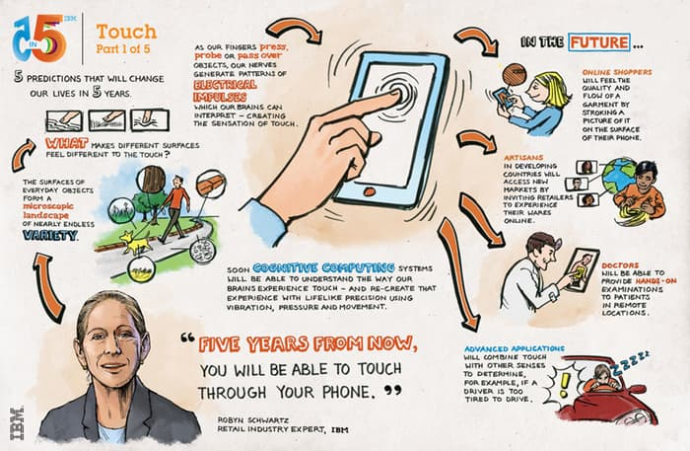
Touch
What makes different surfaces feel different to the Touch?
Online shoppers will feel the product before purchasing
Artisans in developing world will be able to access new markets
Doctors enabled to provide hands-on examinations
Determining if a driver is too tired

Slide 25
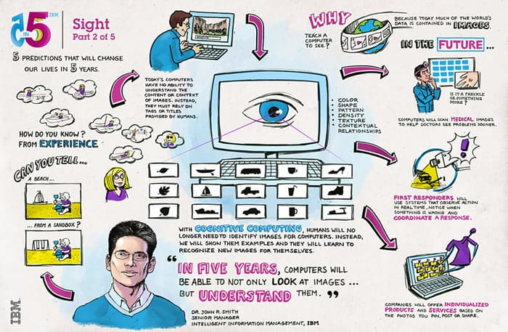
Sight
How do you know a Beach from a Sandbox?
Computers scanning medical images helping doctors diagnose faster
Fast responders using systems that observe action in real time and notice when something is wrong
Companies offering individualized products and services based on photos posted by you.

Slide 26
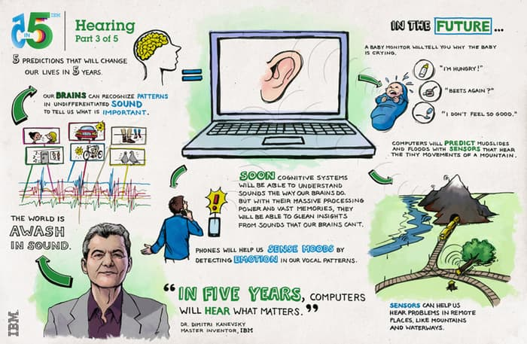
Hearing
In five years computers will hear what matters.
Baby monitor telling you why the baby is crying
Computers predicting mud slides and floods with sensors
Being able to hear problems in remote areas like mountains

Slide 27
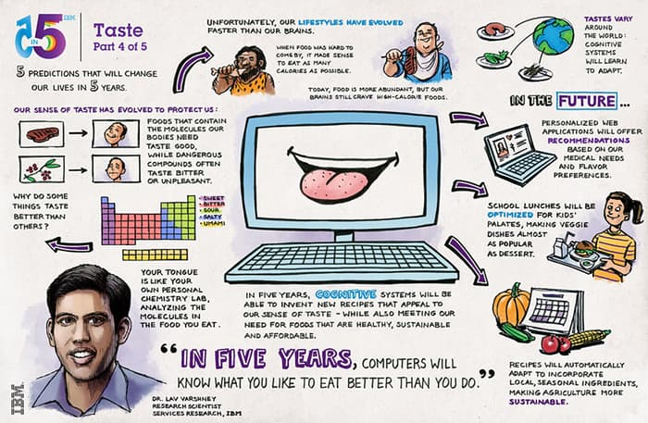
Taste
Why do some things taste better than others?
Cognitive systems will learn to adapt tastes
Personalized web applications offering recommendations based on medical needs and flavour preferences
School lunches optimized for kids palates
Recipes automatically adapting to incorporate l making agriculture more sustainable

Slide 28
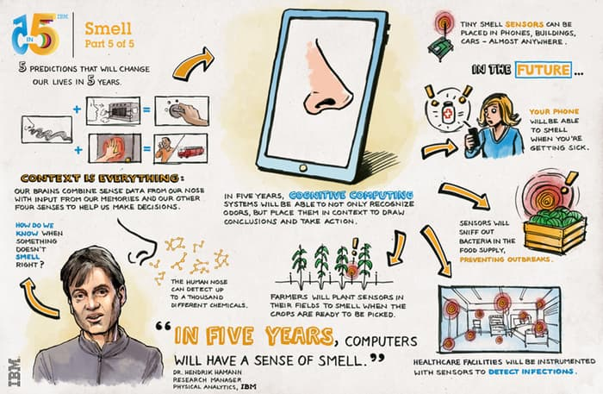
Smell
In five years computers will have a sense of smell.
Your phone will be able to smell when you’re getting sick
Sensors will sniff out bacteria in food supply
Healthcare facilities will be instrumented with sensors to detect infections

Slide 29
Assignment #1
Sensing the New Venture
ENT 201/603
Introduction to Entrepreneurship

Slide 30
ENT 201/603 Assignment #1:
Sensing the New Venture
S No. | Name | Roll No. | Department | Year
1
2
3
4
Team #:
Sense:
Application:

Slide 31
Assignment #1
Sensing the New Venture
Select the sense element
List the potential applications given in the report [Are some in market already?]
Come up with your own application
Who would be the ideal customers for the application?
How will they benefit vis-à-vis current situation?

Slide 32
Deliverables
Thirtyfive teams each of 4 members
Five senses-
  Seven teams for each sense
Output: 5 slides
Slide #1:Team Members, Sense, New Application
Slide #2: List of Applications in the Report [Already in Market]
Slide #3: Your Application & Ideal Customer Profile
Slide #4: Current Situation with problems/needs
Slide #5: Your Solution with Specific Benefits

Slide 33
Thank You

