Slide 1
Substance Dualism
Rene Descartes

Slide 2
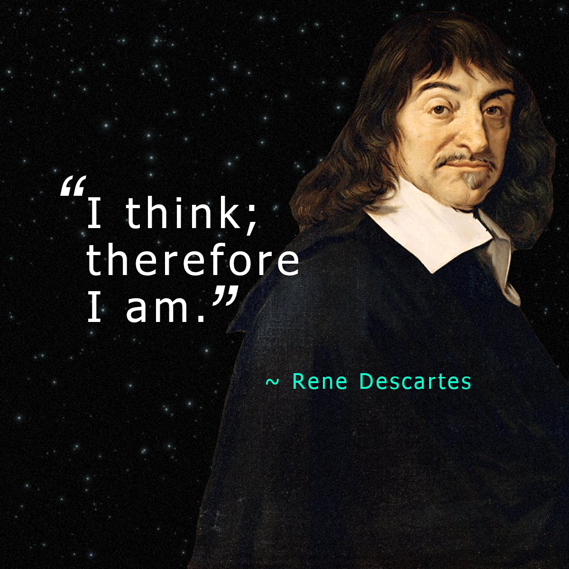

Slide 3
Descartes Epistemology and Ontology
Epistemological Concern for building a philosophical theory. Hence, he was in search of a small Archimedean point which provides foundation to all kinds of knowledge.
Certainty, Indubitable, and Unshakable
Descartes is a foundationalist

Slide 4
Descartes' Skepticism
Method of Doubt
Everything is unreal
Sense experiences, Testimony, sometimes mathematical reasoning.
Cases of illusion, Hallucination, etc.

Slide 5
Dualism
Existence of the world
Existence of the mind
Reality divides into two basic kinds of substances. - the matter and the mind

Slide 6
Matter
“Extended in space: any instance of it has length, breadth, height, and occupies a determinate position in space.” (Churchland 1988: 8)
Descartes seems to be most imaginative physicists of his time – enthusiastically advocate “Mechanical Philosophy” (Ibid)

Slide 7
Mind
Substance that has no spatial extension or spatial position whatever, a substance whose essential feature is the activity of thinking.

Slide 8
Who am I?
Am I a rational animal?
“The real you is not your material body, but rather a nonspatial substance, an individual unit of mind-stuff quite distinct from your material body.”
“I think, I am something” – I am, I exist.

Slide 9
The Conceivability Argument
Does Descartes thought that these laws have an apriori basis
- referring to the real distinction between mind and body
Is there a possibility of existing without body
I cannot after all identical with body.

Slide 10
Experience
The experience cannot be veridical in all probability, they are hallucinatory experiences brought on by stress or anxiety.
Imagine existing in a disembodied state
Possibility and assertion of grounds of independent existence
(Real distinction between self and the body)

Slide 11
The Divisibility Argument
Self as subject of experience
As a simple substance
Substance: persisting object or things that can undergo changes in its properties overtime while remaining one and the same thing.

Slide 12
COGITO: Thinking substance
I think, therefore, I am
I as first person pronoun is a linguistic device whose function is to refer to the subject who is using it
Persists through time without loss of identity.
Loss of parts of body

Slide 13
Concluding Notes 31/07/17
Descartes believed human mind is better known than body. Mind is directly known through introspection where as the knowledge of body is indirectly inferred.
To say that I exist, of course not to deny the embodied existence – that existence has both mental and physical substance. However, the knowledge of existence is confirmed with the help of the mind. I am primarily a ‘thinking thing”. As thinking is essentially a conscious act, it is shown in the performance of various voluntary action . For instance, ‘I raise my arm’ – is an conscious action in comparison to the fact that ‘my arm goes up.’ The former is an action where the later is an event. Action are basically brought out by the conscious power of the mind in coordination with the body. Of course, Descartes does not deny the existence of the body and bodily activities refer to events. For example, blood circulation, digestion, etc. are taking place while the agent is consciously doing something. Conscious actions do not affect the bodily processes. Rather, the agent’s action is an indicator of how the mind is harmoniously intervening in the course of events that are taking place in the body. Events are causally related. As one events succeeds the other; we call that which succeeds is the effect and here the effect is preceding the cause. In science, the law of causality is considered as a postulate. While explaining the causal relations between events, the causal law operates. The operation of causality does not affect the Mind. Rather the power of the mind while bringing about something apriori shows the causal power of the mind. The existence of the mind is thus conceived. That is, the knowledge of self is conceived beyond the knowledge of the bodily existence. There is a sense of transcendence present is Descartes theorization of the mind, though he does not clearly brings this thesis, rather it is brought by his critiques like Immanuel Kant and more specifically by Edmund Husserl.
The cogito, refers to I think.
Cogito ergo sum – I think, therefore, I am.

