Slide 1
Dreaming Souls
By Owen Flanagan

Slide 2
Hamlet’s dilemma:
Hamlet is contemplating suicide but is troubled by the idea that even after death, the ultimate sleep, he might have hellish dreams for all eternity.
Conscience makes cowards of us all.
Consciousness vs Intelligence. (ex Deep Blue)
Function of Dream Consciousness.

Slide 3
Author’s dreams:
1955: A pack of wolves was chasing me. I was terrified and couldn’t run away fast enough. Author wakes up breathless.
1997: I was involved in a secret CIA mission. My unit was badly positioned relative to enemy, and we were pathetically armed. I was very frightened. I tried to explain my comrades that we are badly equipped. Then I gave an antiwar speech insisting that we do not obey government’s order to battle. I had some supporters and subjected to some ridicule.

Slide 4
Phenomenology of dreams
Subjective opinion of dream. (how dreams seem to a person having them, memory of the dream, visual vividness of dreams )
The first dream is very simple yet very frightening.
The second dream is more involved and complex having scenarios typically familiar to an adult.
As the author ages, the dream experience has changed. (relation between the experiences gathered by a person over his life and dreams)
Do dreams tell anything about a person?
Subjective-objective contrast: To develop a formal theory about dreams, it is necessary to combine all sciences dealing with study of dreams and not just subjective experience. (ex. lower back pain)

Slide 5
Neuroscience perspective
Sleeping comes in two forms:
Non-rapid eye movement (NREM): Your eyes are relatively stationary beneath your lids.
Rapid eye movement (REM): Eyes are darting around beneath the lids.
Dreams occur in both types of sleep. However, NREM dreams are more thought like and less imagistic than REM dreams. REM dreams are more bizarre and vivid. (ex. planting a tomato plant vs watching a Tarantino movie while high on marijuana.)

Slide 6
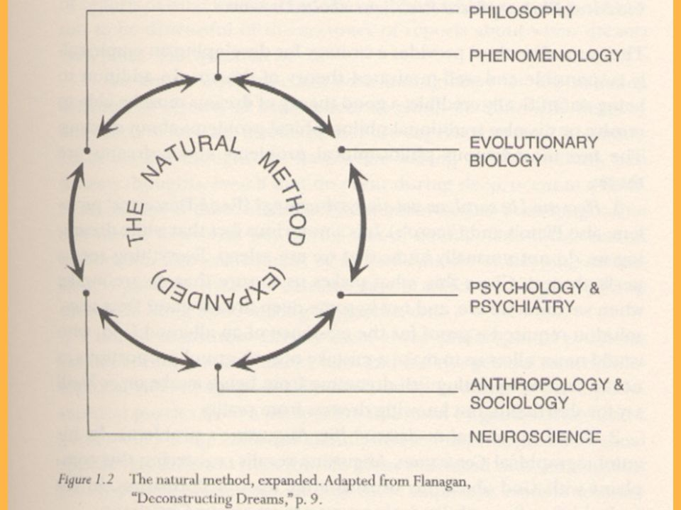
The Natural Method

Slide 7
Classical Philosophical Problems about Dreaming
How can I be sure I am not always dreaming? (Descartes problem)
No, we are not. Movies like The Matrix and Inception have also dealt with a similar question. There are telling neurobiological and phenomenological differences between being awake and asleep.
(ex. In a dream you cannot pinpoint the exact way how you reached the particular location where the dream happening take place.)

Slide 8
Can I be immoral in my dreams? (St Augustine’s problem)
Dreams are happening and not actions, whereas what one does or chooses to think about is voluntary. Hence dreams can contain sinful action without the person committing a sin.
However dreams are sometimes identity expressive and repeated sinful dreams might indicate something about the person’s personality.

Slide 9
Are dreams experiences that occur during sleep?
Or dreams are just reports of experience we think we had while sleeping but which in fact are composed of thoughts we had while awake?
Dreams are experiences that take place during sleep and are perfectly natural phenomena. However dreams don’t respond to a set of natural laws in the sense that govern water or protons or any matter.
NREM and REM mentation differ neurobiologically and phenomenologically from one another and from awake experiences.

Slide 10
Is dreaming functional?
What function does dreaming serve?
Can be thought of as a by-product or freebie that comes from interrelation of cognitive processes and sleeping.
(ex. Spandrels, the colour of bones, the rhythmic sound of a pumping heart etc.)
Though not intended by mother nature, such by-products can be made useful in some sense.

