Slide 1
On the Consciousness and Language of Art
Albert Hofstadter
1969

Slide 2
Some sayings …
Albert Hofstadter
Language is the house of Being, i.e., where humans dwell.
"letting us find in it a real dwelling place instead of the cold, sterile hostelry in which we presently find ourselves."

Slide 3
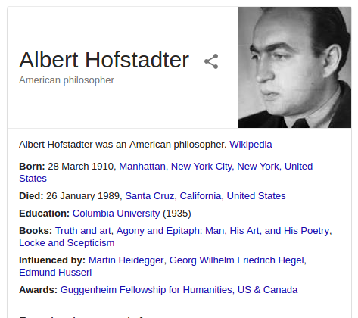
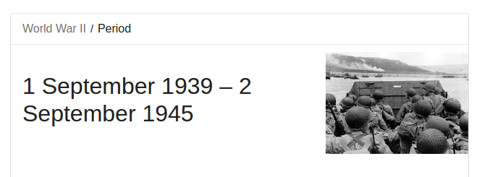
About

Slide 4
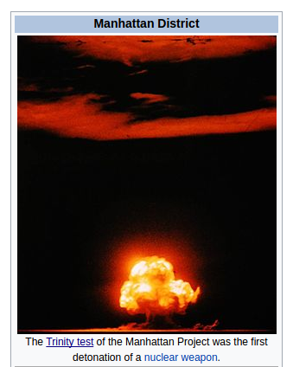
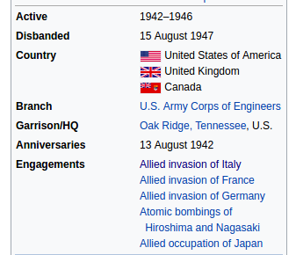
Duration

Slide 5
On the Consciousness and Language of Art
Consciousness: (noun)
the state of being aware of and responsive to one's surroundings.
eg.// "she failed to regain consciousness and died two days later"
Language: (noun)
the method of human communication, either spoken or written, consisting of the use of words in a structured and conventional way.
Art: (noun)
the expression or application of human creative skill and imagination, typically in a visual form such as painting or sculpture, producing works to be appreciated primarily for their beauty or emotional power.

Slide 6
The first paragraph ...
Art is a language by which the human mind gives utterance to its own integrity.
It holds the two main sides of mind, objective and subjective, in their appropriate unity
And it articulates that unity in an image for intuition.

Slide 7
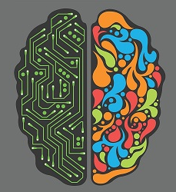
Two sides of
mind
Therotical
Devoted to form knowledge of reality
Its aim is truth
Agreement of the subject’s intention with the reality
Its function is
The development of science
The illumination of reality
Practical
Devoted to the exercise of freedom
Its aim is the good/rightness of things
Agreement of the reality with the subject’s intention
Its function is
The development of man’s governance over things, including himself

Slide 8

Factors ...
Theoretical and practical mind are necessary factors in the integral unity of the psyche(the human soul, mind, or spirit),
just as the objective and the subjective are necessary factors in the unity of consciousness.
In one(the theoretical side), intention agrees with reality;
in the other(the practical side), reality agrees with intention.
In both, the union is one of agreement.
The ideal of mind in its integrity is the mutual agreement of intention and reality.
Neither the cognitive intention of theoretical mind and not merely the elective intention of practical mind, but the full intention of mind in its integrity, namely, the affective intention of the love that binds spirit to its affinity.

Slide 9
The third factor
The third and unifying principle of mind is the spiritual one, whose aim is to reach the mutual agreement of intention and reality.
It includes knowing, on the one hand and freedom, on the other hand with its essential aim being, to exist in the mutual ownness of love.
Ownness for which the classic formula is found in the words of the
Song of Songs: "My beloved is mine, and I am his"
This mutual ownness of love is the ultimate and true form of ownness. It transcends and includes the cognitive as well as the practical appropriation of reality.
The consciousness that belongs to this mutual ownness Albert calls kin-consciousness

Slide 10
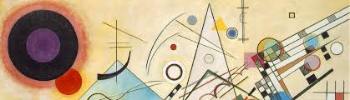
Getting into Art !!!
The language of art is the language of this mutual ownness, its negation, and its modifications.
In art man's spirit utters its meanings as unities of the subjective and objective revealing the essential bond between the two.
The two sides in art would form with realism and naturalism on one hand and abstract freedom on the other.

Slide 11
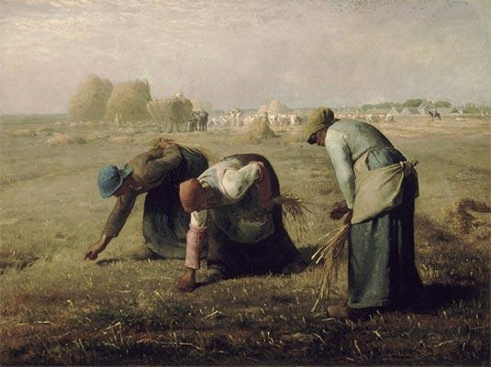
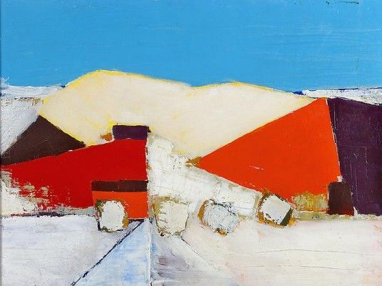
The two sides/dimensions of Art
Realism (Objective presentation)
Abstract (Subjective expression)

Slide 12
An illustration of the language of art as a unity of mutual belonging
Red lips are not so red
As the stained stones kissed by the English dead.
-Wilfred Owen (in "Greater Love")
In regards to the soldier’s sacrifice, the speaker expresses the irony by a really objective image:
The contrasting vision of the living, pulsating, warm red lips of the beloved and the stone stained with the blood of the slain lover.
The actual kiss of death itself.

Slide 13
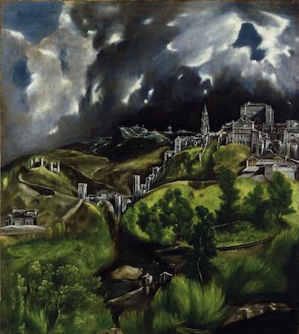
Language of Art
El Greco's "View of Toledo" (Metropolitan Museum of Art, New York City)
This art transforms hills, buildings, river, clouds, and sky into an image full of mystery and foreboding, as though some awful miracle is about to happen;

Slide 14

Finally
Art is a way of being possessed by ownness itself, or, as we may say, by love itself.
The artist is the creature of love and art is love's way of uttering itself, by finding the language that belongs to it.
It is this ultimate unity of inner content and outer shape, of total meaning and external vehicle, that makes an artist.
The meaningful totality that consists in the unity of the subjective and objective needs to be given utterance in order to articulate itself.

Slide 15
Thank you
By Neeladrishekhar Kanjilal (140050007)

