Slide 1
A survey on Other Minds
Derived from Miratun Nahar's essay and articles on plato.stanford.edu
Prepared by Kushal Babel

Slide 2
Contents
The Epistemological Problem
The Conceptual Problem
General Problem of Other Minds
Specific Problem of Other Minds
Origin
Traditional and Modern Solutions
Is there really a problem?

Slide 3

The Epistemological Problem
Philosophical Zombies : A philosophical zombie (as opposed to the ordinary kind of zombie) is a thing that is in all respects exactly like a person– it eats, and sleeps, and drinks, and has conversations, and goes on dates. But it has no “inner life”
How do you know that other people aren’t philosophical zombies?

Slide 4
The Conceptual Problem
How do we even think of other minds than our own? My personal experiences allow me to think about my own mind, and the appearances of physical objects give me a way to think about them: but I don’t experience other minds, and they don’t cause appearances in me. How can I even think “You have a mind”?

Slide 5
General & Specific Problem
The general problem : "Do other people have minds?"
The specific problem : How can we ever claim that we can know in a certain context the particular mental phenomena of the person other than myself when mental states are never publicly observable

Slide 6
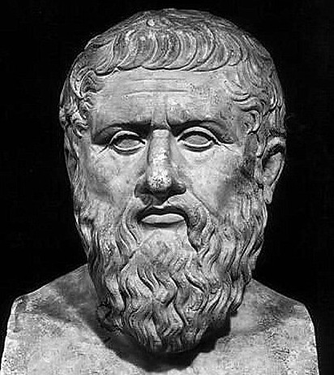
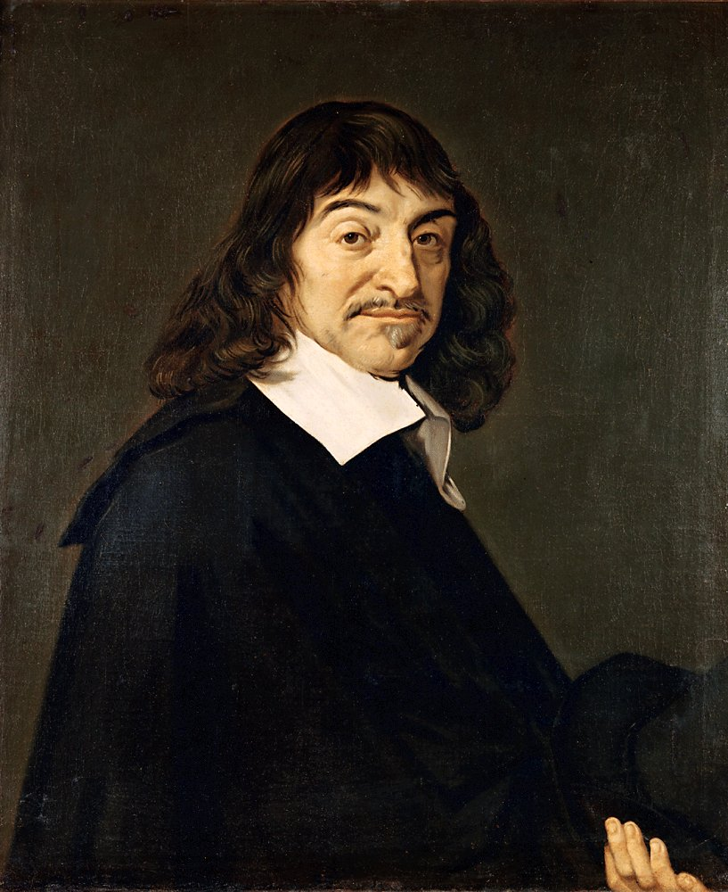


Origin
Plato
Rene Descartes

Slide 7
Setting
Plato
Descartes
Soul is divine, immortal and sinless
Soul travels the heavenly space and sometimes attaches with the body
It is the body that manifests pleasure & pain
Sins arise from associations with body which tries to bring soul to its level
Life begins when soul attaches itself to the body
Thus, only the specific problem of other minds arises (as no evidential relation b/w mind and body established)
Substance Dualism
The general problem of other minds arises

Slide 8
Solution 1
Russell's Analogical Argument : Induction
Criticism : Can't generalize based on one instance

Slide 9
Solution 2
Refute the very problem
Behaviorism : No mental states, only dispositions
Denial of Self : Hume (Famous skeptic) thought there wasn’t a problem of other minds, because he thought that there was no evidence that I have a mind (only thoughts exists and there is no "mind" that causes them)
Mental States are not hidden

Slide 10
Is there really a problem?
No theory of mind escapes the other minds problem and that all such theories have an equally difficult problem.
Any theory of mind is a general theory, so it has to embrace minds wherever they are found. So it has to cover all human beings, oneself and others.
Any theory is to hold of minds in general, to be inclusive of other human beings in particular, so it cannot legitimately be used to justify the claim that those other minds do, in fact, exist.

