Slide 1
Perception
Bertrand Russel

Slide 2
Introspective Analysis
Traditionally, there are three kinds of mental occurrences:
Feeling: Pleasure and unpleasure
Willing: Desire and aversion
Knowing: Cognition

Slide 3
Introspective Analysis
Cognition is of various sorts.
Memory
Conception
Perception

Slide 4
Introspective Analysis
Sensation vs Perception:
Sensation, as opposed to perception, is solely due to the stimulus and the sense organ, not to past experience.
Perception = Sensation + Past experience

Slide 5
Introspective Analysis
Can we discover the influence of past experiences through introspection?

Slide 6
Introspective Analysis
Which one is stronger statement?
I see a triangle
There is a triangle

Slide 7


Slide 8
Causal Analysis
Causation of perceptions is studied by three sciences:
Physics
Physiology
Psychology

Slide 9
Causal Analysis
Privacy of perception
There is an element of privacy about every perception.
Public: Sight, sound, touch, smell
Partly Private, Partly Public: Human body
Private: Recollection, dreams

Slide 10
Causal Analysis
Is life a dream?
In dreams, we are convinced that the occurrences of the dream are public, and yet on waking we become that they are purely private. Publicity, therefore, has not the highest grade of certainty.

Slide 11
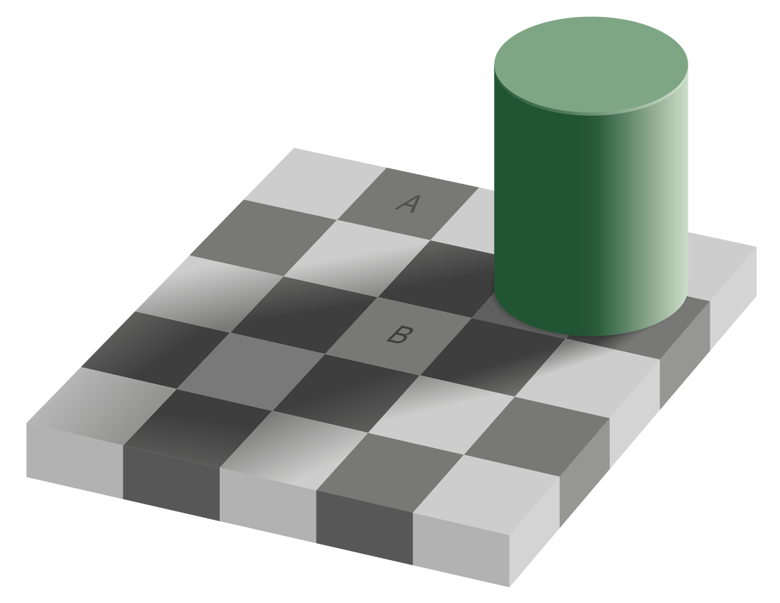

Slide 12
Causal Analysis
Distinction between dream and waking life:
Recurrence of perceptions in groups under certain circumstances
Testimony

Slide 13
