Slide 1
Lecture 3: DAC
RK Shyamasundar

Slide 2
Authorization
We will use the terms authorization and access control interchangeably
Authorization answers the question “who is allowed to do what?”
A first step in the development of an access control system is the identification of the objects to be protected, the subjects that execute activities and request access to objects, and the actions that can be executed on the objects, and that must be controlled

Slide 3
Principal or user are used synonymously to subject
Objects are also referred to as resources
Actions are also called as operations or transactions
Access control policies can be grouped into two main classes
  Discretionary (DAC) (authorization-based) policies control access based on the identity of the requestor and on access rules stating what requestors are (or are not) allowed to do
  Mandatory (MAC) policies control access based on mandated regulations determined by a central authority

Slide 4
Discretionary Access Control
Discretionary policies enforce access control on the basis of the identity of the requestors and explicit access rules that establish who can, or cannot, execute which actions on which resources
They are called discretionary as users can be given the ability of passing on their privileges to other users, where granting and revocation of privileges is regulated by an administrative policy

Slide 5
The Access Matrix model (AMM)
The access matrix model provides a framework for describing discretionary access control
First proposed by Lampson for the protection of resources within the context of operating systems, and later refined by Graham and Denning, the model was subsequently formalized by Harrison, Ruzzo, and Ullmann (HRU model), who developed the access control model proposed by Lampson to the goal of analyzing the complexity of determining an access control policy

Slide 6
The Access Matrix model
The original model is called access matrix since the authorization state, meaning the authorizations holding at a given time in the system, is represented as a matrix
The matrix therefore gives an abstract representation of protection systems

Slide 7
The Access Matrix model
In the access matrix model, the state of the system is defined by a triple (S,O,A), where S is the set of subjects, who can exercise privileges; O is the set of objects, on which privileges can be exercised; and A is the access matrix, where rows correspond to subjects, columns correspond to objects, and entry A[s,o] reports the privileges of s on o
The type of the objects and the actions executable on them depend on the system

Slide 8
File1
File2
Program1
Ann
own, read, write | read, write | execute
read
 | read | execute, read
Bob
Carl
An example of Access matrix model

Slide 9
The Access Matrix model
Changes to the state of a system is carried out through commands that can execute primitive operations on the authorization state, possibly depending on some conditions
The HRU formalization identified six primitive operations that describe changes to the state of a system
  adding and removing a subject
  adding and removing a object
  adding and removing a privilege

Slide 10
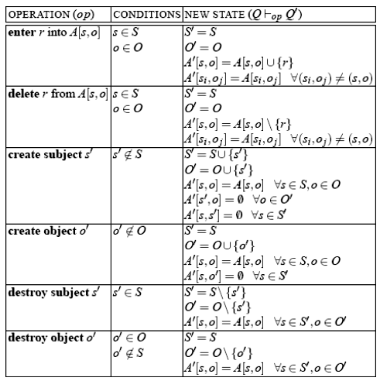
Primitive operations of the HRU model

Slide 11
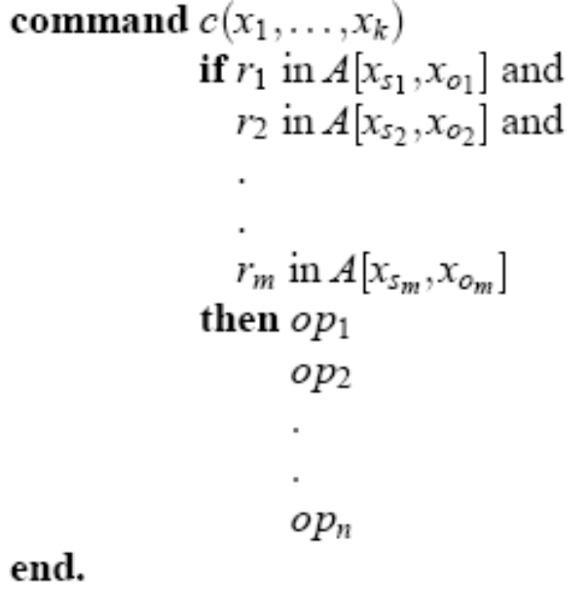
HRU model
Each command has a conditional part and a body and has the form
with n > 0,m ≥ 0. Here r₁, ..., r_{m} are actions, op₁, ..., op_{n} are primitive operations, while s₁, ..., s_{m} and o₁, ..., o_{m} are integers between 1 and k. If m=0, the command has no conditional part

Slide 12

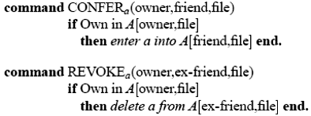
For example, the following command creates a file and gives the creating subject ownership privilege on it
The following commands allow an owner to grant to others, and revoke from others, a privilege to execute an action on her files

Slide 13
Let Q ⊢_{op} Q′ denote the execution of operation op on state Q, resulting in state Q′. The execution of command c(a₁, ..., a_{k}) on a system state Q = (S,O,A) causes the transition from state Q to state Q′ such that ∃ Q₁, …, Q_{n} for which Q ⊢op*₁ Q₁ ⊢op*₂ ... ⊢op*_{n} Q_{n} = Q′, where op*₁ … Op*_{n} are the primitive operations op₁ … op_{n} in the body (operational part) of command c, in which actual parameters a_{i} are substituted for each formal parameters x_{i}, i := 1, … , k. If the conditional part of the command is not verified, then the command has no effect and Q = Q′

Slide 14
Although the HRU model does not include any built-in administrative policies, the possibility of defining commands allows their formulation
Administrative authorizations can be specified by attaching flags to access privileges
For instance, a copy flag, denoted *, attached to a privilege may indicate that the privilege can be transferred to others

Slide 15

Granting of authorizations can then be accomplished by the execution of commands like the one below
The ability of specifying commands of this type clearly provides flexibility as different administrative policies can be taken into account by defining appropriate commands

Slide 16
An alternative administrative flag (called transfer only and denoted +) can be supported, which gives the subject the ability of passing on the privilege to others but for which, so doing, the subject looses the privilege
Such a flexibility introduces an interesting problem referred to as safety, and concerned with the propagation of privileges to subjects in the system
Intuitively, given a system with initial configuration Q, the safety problem is concerned with determining whether or not a given subject s can ever acquire a given access a on an object o, that is, if there exists a sequence of requests that executed on Q can produce a state Q′ where a appears in a cell A[s,o] that did not have it in Q

Slide 17
Note that, not all leakages of privileges are bad and subjects may intentionally transfer their privileges to trustworthy subjects
Trustworthy subjects are therefore ignored in the analysis
It turns out that the safety problem is undecidable in general
It remains instead decidable for cases where subjects and objects are finite, and in systems where the body of commands can have at most one operation (while the conditional part can still be arbitrarily complex)

Slide 18
Sandhu proposed the Typed Access Matrix (TAM) model
TAM extends HRU with strong typing: each subject and object has a type; the type is associated with the subjects/objects when they are created and thereafter does not change
Safety results decidable in polynomial time for cases where the system is monotonic (privileges cannot be deleted), commands are limited to three parameters, and there are no cyclic creates
Safety remains undecidable otherwise

Slide 19
Implementation of the AMM
Although the matrix represents a good conceptualization of authorizations, it is not appropriate for implementation
In a general system, the access matrix will be usually enormous in size and sparse (most of its cells are likely to be empty)
Storing the matrix as a two-dimensional array is therefore a waste of memory space
There are three approaches to implementing the access matrix in a practical way

Slide 20
Authorization Table: Non empty entries of the matrix are reported in a table with three columns, corresponding to subjects, actions, and objects, respectively. Each tuple in the table corresponds to an authorization
Access Control List (ACL): The matrix is stored by column. Each object is associated with a list indicating, for each subject, the actions that the subject can exercise on the object
Capability: The matrix is stored by row. Each user has associated a list, called capability list, indicating, for each object, the accesses that the user is allowed to exercise on the object

Slide 21
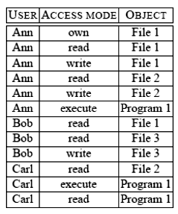
Example Authorization table

Slide 22
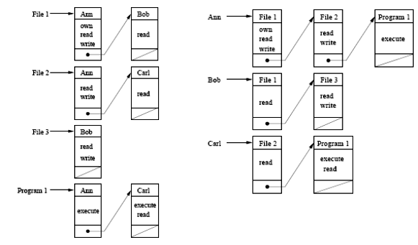
Example capabilities
Example ACL

Slide 23
Capabilities and ACLs present advantages and disadvantages with respect to authorization control and management
  In particular, with ACLs it is immediate to check the authorizations holding on an object, while retrieving all the authorizations of a subject requires the examination of the ACLs for all the objects
  Analogously, with capabilities, it is immediate to determine the privileges of a subject, while retrieving all the accesses executable on an object requires the examination of all the different capabilities
These aspects affect the efficiency of authorization revocation upon deletion of either subjects or objects

Slide 24
In a system supporting capabilities, it is sufficient for a subject to present the appropriate capability to gain access to an object
This represents an advantage in distributed systems since it permits to avoid repeated authentication of a subject: a user can be authenticated at a host, acquire the appropriate capabilities and present them to obtain accesses at the various servers of the system
However, capabilities are vulnerable to forgery (they can be copied and reused by an unauthorized third party)
Another problem in the use of capability is the enforcement of revocation, meaning invalidation of capabilities that have been released

Slide 25
Modern operating systems typically take the ACL-based approach
Some systems implement an abbreviated form of ACL by restricting the assignment of authorizations to a limited number (usually one or two) of named groups of users, while individual authorizations are not allowed
The advantage of this is that ACLs can be efficiently represented as small bit-vectors
For instance, in the popular Unix operating system, each user in the system belongs to exactly one group and each file has an owner (generally the user who created it), and is associated with a group (usually the group of its owner)

Slide 26
Authorizations for each file can be specified for the file’s owner, for the group to which the file belongs, and for “the rest of the world” (meaning all the remaining users)
No explicit reference to users or groups is allowed
Authorizations are represented by associating with each object an access control list of 9 bits: bits 1 through 3 reflect the privileges of the file’s owner, bits 4 through 6 those of the user group to which the file belongs, and bits 7 through 9 those of all the other users
The three bits correspond to the read (r), write (w), and execute (x) privilege, respectively

Slide 27
Vulnerabilities of DAC
In defining the basic concepts of discretionary policies, we have referred to access requests on objects submitted by users, which are then checked against the users’ authorizations
Although it is true that each request is originated because of some user’s actions, a more precise examination of the access control problem shows the utility of separating users from subjects

Slide 28
Users are passive entities for whom authorizations can be specified and who can connect to the system
Once connected to the system, users originate processes (subjects) that execute on their behalf and, accordingly, submit requests to the system
Discretionary policies ignore this distinction and evaluate all requests submitted by a process running on behalf of some user against the authorizations of the user
This aspect makes discretionary policies vulnerable from processes executing malicious programs exploiting the authorizations of the user on behalf of whom they are executing

Slide 29
In particular, the access control system can be bypassed by Trojan Horses embedded in programs
A Trojan Horse is a computer program with an apparently or actually useful function, which contains additional hidden functions that exploit the legitimate authorizations of the invoking process
A Trojan Horse can improperly use any authorizations of the invoking user, for example, it could even delete all files of the user

Slide 30
This vulnerability to Trojan Horses, together with the fact that discretionary policies do not enforce any control on the flow of information once this information is acquired by a process, makes it possible for processes to leak information to users not allowed to read it
All this can happen without the cognizance of the data administrator/owner, and despite the fact that each single access request is controlled against the authorizations

Slide 31
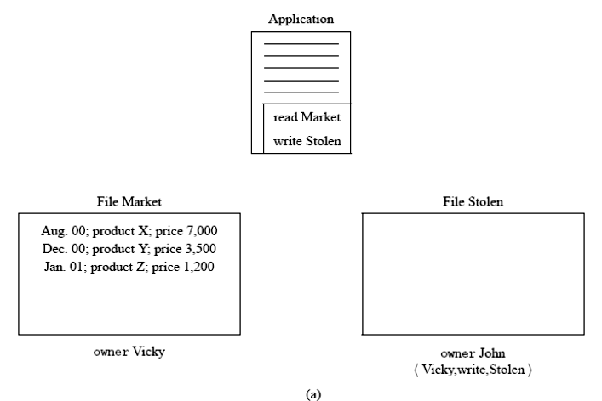

Slide 32
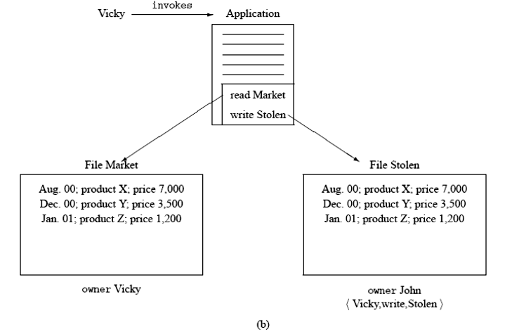

Slide 33
We object that there is little point in defending against Trojan Horses leaking information flow: such an information flow could have happened anyway, by having Vicky explicitly tell this information to John, possibly even off-line, without the use of the computer system
This is where the distinction between users and subjects operating on their behalf comes in
While users are trusted to obey the access restrictions, subjects operating on their behalf are not

Slide 34
Processes run programs which, unless properly certified, cannot be trusted for the operations they execute
For this reason, restrictions should be enforced on the operations that processes themselves can execute
In particular, protection against Trojan Horses leaking information to unauthorized users requires controlling the flows of information within processes execution and possibly restricting them
Mandatory policies provide a way to enforce information flow control through the use of labels

Slide 35


Slide 36
Limits of firewalls
Once a host on an intranet behind a firewall has been compromised, the attacker can communicate with this machine by tunnelling traffic over an open protocol (e.g., HTTPS) and launch further intrusions unhindered from there.
Little protection is provided against insider attacks.
Centrally administered rigid firewall policies severely disrupt the deployment of new services. The ability to “tunnel” new services through existing firewalls with fixed policies has become a major protocol design criterion. Many new protocols (e.g., SOAP) are for this reason designed to resemble HTTP, which typical firewall configurations will allow to pass.
Firewalls can be seen as a compromise solution for environments, where the central administration of the network configuration of each host on an intranet is not feasible. Much of firewall protection can be obtained by simply deactivating the relevant network services on end machines directly.

Slide 37
Enforcement (1)
Monitoring: Because attacks (by definition) involve execution, a second means of defense can be to monitor a set of interfaces and halt execution before any damage is done using operations those interfaces provide. Three elements comprise this defense:
a security policy, which prescribes acceptable sequences of operations from some set of interfaces;
a reference monitor, which is a program that is guaranteed to receive control whenever any operation named in the policy is requested, and
a means by which the reference monitor can block further execution that does not comply with the policy.

Slide 38
Enforcement (2)
Principle of Complete Mediation: The reference monitor intercepts every access to every object
Principle of Least Privilege. A principal should be only accorded the minimum privileges it needs to accomplish its task
  impossible to implement if the same privilege suffices for multiple different objects or operation
Principle of Separation of Privilege. Different accesses should require different privileges.
Principle of Failsafe Defaults. The presence of privileges rather than the absence of prohibitions should be the basis for determining whether an access is allowed to proceed

Slide 39
Recovery
Attacks whose effects are reversible could be allowed to run their course, if a recovery mechanism were available afterwards to undo any damage
Confidentiality Violations: no longer confidential once revealed
Integrity Violations: Changes to internal system state are usually reversible, so recovery can be used to defend against attacks whose sole effect is to change that state.
Availability Violations: For a system not involved in sensing or controlling the physical environment, recovery from availability violations could be feasible: evict the attacker and resume normal processing

Slide 40
Information Flows
Secret
Confidential
Unclassified

