Slide 1
Taint Analysis

Slide 2
Paper
Edward J. Schwartz, Thanassis Avgerinos, and David Brumley
All You Ever Wanted to Know about Dynamic Taint Analysis and Forward Symbolic Execution (but Might Have Been Afraid to Ask).
IEEE Symposium on Security and Privacy 2010

Slide 3
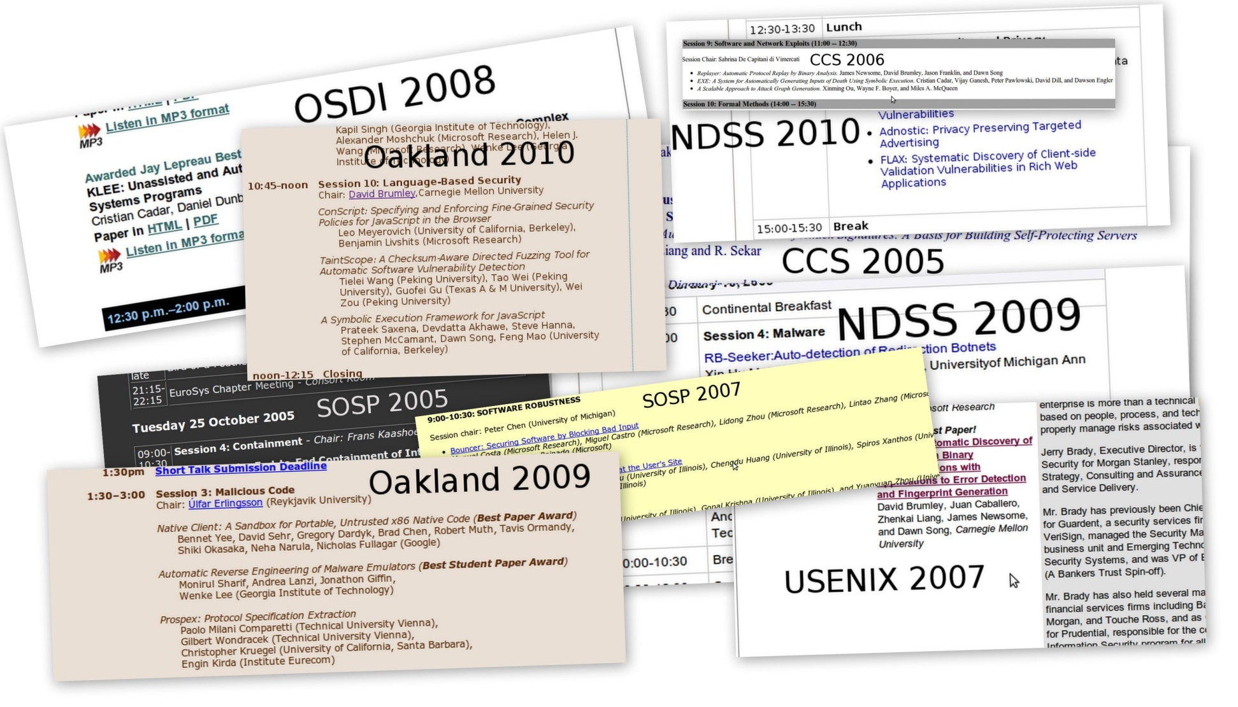
Two Essential Runtime Analyses
Detect Exploits [Costa2005,Crandall2005,
Newsome2005,Suh2004]
Detect packing in malware [Bayer2009,Yin2007]
Dynamic Taint Analysis: What values are derived from user input?
Automated Test Case Generation
[Cadar2008,Godefroid2005,Sen2005]
Input Filter Generation [Costa2007,Brumley2008]
Forward Symbolic Execution: What input will make execution reach this line of code?

Slide 4

Δ
tainted
untainted
Var
Val
x = get_input( )
y = x + 42
…
goto y
x
7
Input is tainted
τ
Taint Introduction
Var
Tainted?
t = IsUntrusted(src)
Input
x
T
get_input(src)↓ t

Slide 5
Δ
tainted
untainted
Var
Val
x = get_input( )
y = x + 42
…
goto y
x
7
y
49
Data derived from user input is tainted
τ
Taint Propagation
Var
Tainted?
t1 = τ[x1] , t2 = τ[x2]
BinOp
x
T
x1 + x2 ↓ t1 v t2
y
T

Slide 6
Δ
tainted
untainted
Var
Val
x = get_input( )
y = x + 42
…
goto y
x
7
y
49
Policy Violation
Detected
τ
Taint Checking
Var
Tainted?
Pgoto(ta) = ¬ ta (Must be true to execute)
x
T
y
T

Slide 7
Real Use:
Exploit Detection
x = get_input( )
y = …
…
goto y
Jumping to overwritten return address
…
strcpy(buffer,argv[1]) ;
…
return ;

Slide 8
Memory Load
Variables
Memory
Δ
μ
Var
Val
Addr
Val
x
7
7
42
τ
τμ
Var
Tainted?
Addr
Tainted?
x
T
7
F

Slide 9
Problem: Memory Addresses
Var
Val
Δ
x = get_input( )
y = load( x )
…
goto y
x
7
Addr
Val
μ
7
42
All values derived from user input are tainted??
Addr
Tainted?
τμ
7
F

Slide 10
Policy 1:
Taint depends only on the memory cell
Var
Val
Δ
x = get_input( )
y = load( x )
…
goto y
Undertainting
Failing to identify tainted values
- e.g., missing exploits
x
7
Jump target could be any untainted memory cell value
Addr
Val
μ
7
42
Taint Propagation
Addr
Tainted?
v = Δ[x] , t = τμ[v]
τμ
Load
load(x) ↓ t
7
F

Slide 11
Policy 2:
If either the address or the memory cell is tainted, then the value is tainted
Memory
printa
printb
x = get_input( )
y = load(jmp_table + x % 2 )
…
goto y
Overtainting
Unaffected values are tainted
- e.g., exploits on safe inputs
Address expression is tainted
jmp_table
Policy Violation?
Taint Propagation
v = Δ[x] , t = τμ[v], ta = τ[x]
Load
load(x) ↓ t v ta

Slide 12
Research Challenge State-of-the-Art is not perfect for all programs
Undertainting: Policy may miss taint
Overtainting: Policy may wrongly detect taint

Slide 13
The Challenge
bad_abs(x is input)
if (x < 0) then
return -x
if (x = 0x12345678) then
return -x
return x
2³² possible inputs
0x12345678
Forward Symbolic Execution: What input will make execution reach this line of code?

Slide 14
A Simple Example
x symbolic
can have any value
Interpreter
bad_abs(x is input)
What input will make execution reach this line of code?
Interpreter
Interpreter
If (x < 0)
x ≥ 0
t
f
Interpreter
return -x
Interpreter
If x == 0x12345678
f
t
x < 0
return x
return -x
x ≥ 0 Λ
x != 0x12345678
x ≥ 0 Λ
x == 0x12345678

Slide 15
One Problem: Exponential Blowup Due to Branches
Interpreter
Branch 1
Branch 2
Branch 3
Exponential Number of Interpreters/formulas in # of branches

Slide 16
Path Selection Heuristics
Symbolic Execution Tree
However, these are heuristics. In the worst case all create an exponential number of formulas in the tree height.
…
Depth-First Search (bounded) ,Random Search [Cadar2008]
Concolic Testing [Sen2005,Godefroid2008]

Slide 17
Symbolic Execution is not Easy
Exponential number of interpreters/formulas
Exponentially-sized formulas
Solving a formula is NP-Complete!
branching
s + s + s + s +
s + s + s + s == 42
substitution

Slide 18
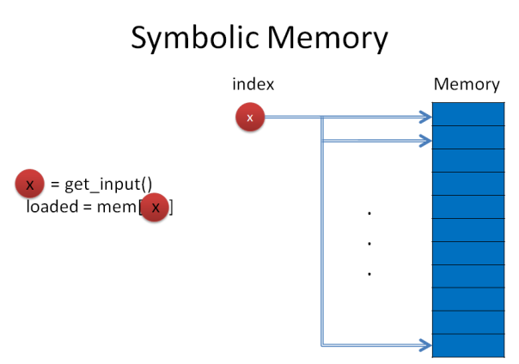
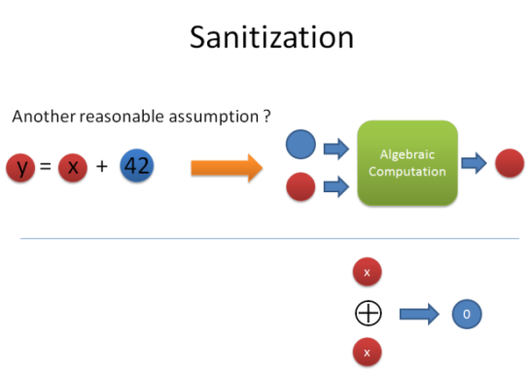
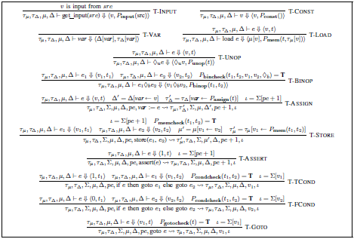
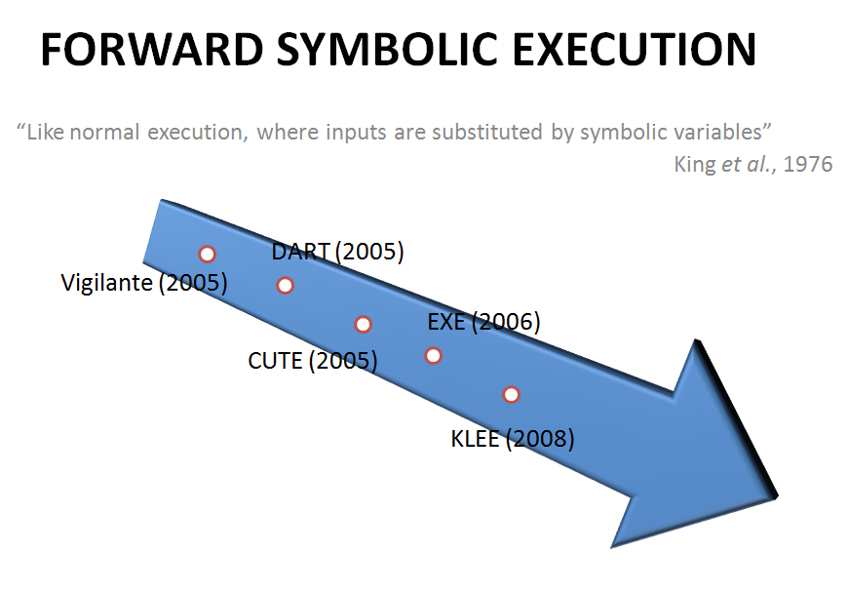
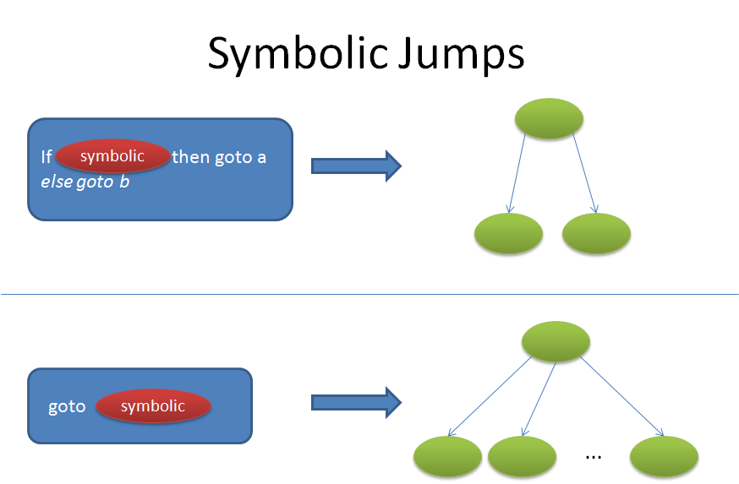
Other Important Issues
Formalization
More complex policies
Π = (s + s + s + s +
s + s + s + s) == 42

Slide 19
Summary
Dynamic taint analysis and forward symbolic execution used extensively in literature
Formal algorithm and what is done for each possible step of execution often not emphasized

