Slide 1
Security Protocols
Security protocols are the intellectual core of security engineering
They are where cryptography and system mechanisms meet
They allow trust to be taken from where it exists to where it’s needed
But they are much older then computers…

Slide 2
A Simple Authentication
An infrared token used in some multi-storey parking garages to enable subscribers to raise the barrier.
First transmits its serial number & then transmits an authentication block that consists of the same serial number, followed by a random number, all encrypted using a key that is unique to the device.
T → G : T, {T, N}KT
The in-car token sends its name, T, followed by the encrypted value of T concatenated with N, where N stands for “number used once,” or nonce.

Slide 3
A Simple Authentication
Key management: A typical garage token’s key KT is simply its serial number encrypted under a global master key, KM, known to the central server:
KT = {T}KM
This is known as key diversification.
Gives a very simple way of implementing access tokens, and is very widely used in smartcard-based systems as well.

Slide 4
A Simple Authentication: Common Mistake
Checking that the nonce is different from last time,
Given two valid codes A and B, the series ABABAB. . . was interpreted as a series of independently valid codes.
In one car lock, the thief could open the door by replaying the last-but-one code.

Slide 5
Car unlocking protocols: Challenge Response
Principals are the engine controller E and the car key transponder T
Static (T → E: KT)
Non-interactive
  T → E: T, {T,N}_{KT}
Interactive
  E → T: N
  T → E: {T,N }_{KT}
N is a ‘nonce’ for ‘number used once’.
As the car key is inserted into the steering lock, the engine management unit sends a challenge, consisting of a random n-bit number to the key using a short-range radio signal.
The car key computes a response by encrypting the challenge.

Slide 6
What goes wrong
In cheap devices, N may be random or a counter – one-way communication and no clock
It can be too short, and wrap around
If it’s random, how many do you remember? (the valet attack)
Counters and timestamps can lose sync leading to DoS attacks
There are also weak ciphers – Eli Biham’s 2008 attack on the Keeloq cipher (2¹⁶ chosen challenges then 500 CPU days’ analysis – some other vendors authenticate challenges)

Slide 7
Problems
This is still not bulletproof.
In one system, the random numbers generated by the engine management unit turned out to be rather predictable, so it was possible for a thief to interrogate the key in the car owner’s pocket, as he passed, with the anticipated next challenge.

Slide 8
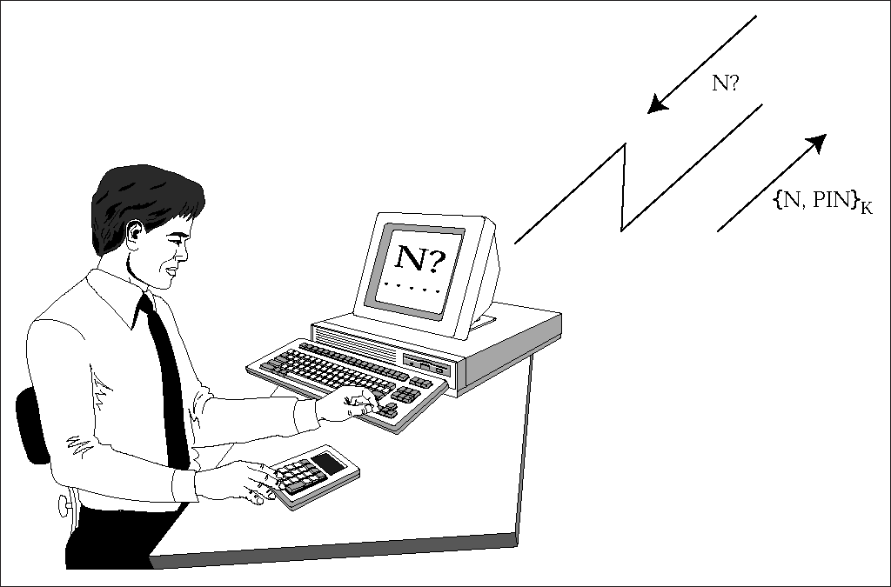
Two-factor authentication (password generator)
S → U: N
U → P: N, PIN
P → U: {N, PIN}_{KP}
S Server
P Pwd Genertaor
U User

Slide 9
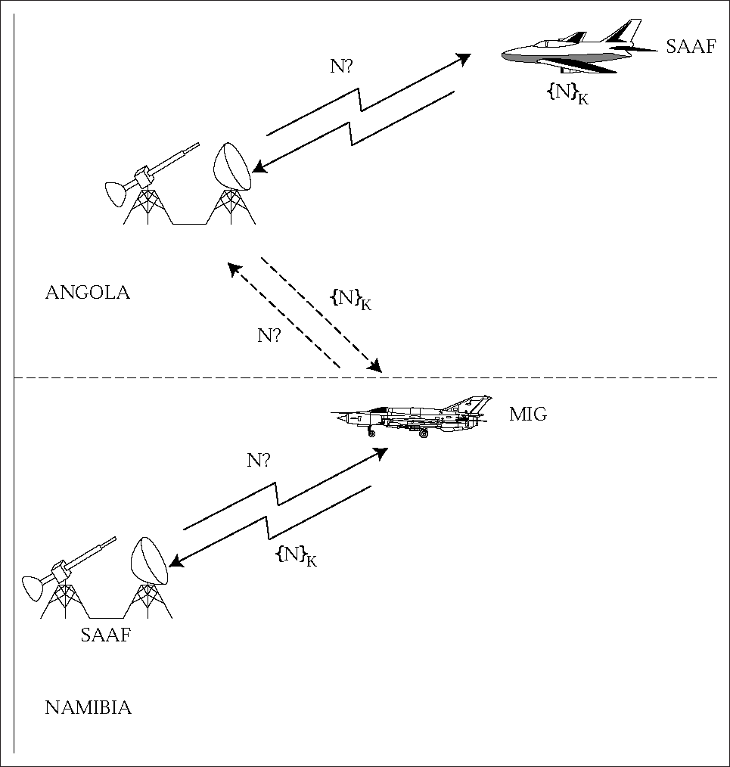
IFF (2)

Slide 10
Several MIGs had loitered in southern Angola, just north of the South African air defense belt, until a flight of SAAF Impala bombers raided a target in Angola.
Then the MIGs turned sharply and flew openly through the SAAF’s air defenses, which sent IFF challenges.
The MIGs relayed them to the Angolan air defense batteries, which transmitted them at a SAAF bomber;
the responses were relayed back in real time to the MIGs, which retransmitted them and were allowed through

Slide 11
IFF (3)
The middleman attack is very general – Conway discussed how to beat a grandmaster at postal chess
The fix for the man-in-the-middle attack is often application specific
E.g. NATO mode 12 IFF: 32 bit encrypted challenge (to prevent enemy using IFF to locate beyond radar range) at rate of 250 per second

Slide 12
Identify Friend or Foe (IFF)
Basic idea: fighter challenges bomber
  F → B: N
  B → F: {N}_{K}
But what if the bomber reflects the challenge back at the fighter’s wingman?
  F → B: N
  B → F: N
  F → B: {N}_{K}
  B → F: {N}_{K}

Slide 13
Overcoming Reflection Attack
In many cases, it is sufficient to include the names of the two parties in the authentication exchange.
Require a friendly bomber to reply to the challenge:
F → B : N with a response such as:
B → F : {B, N}K
Thus, a reflected response {F, N} (or even {F’, N} from the fighter pilot’s wingman) could be detected.

Slide 14
Reflection Attacks
Mutual authentication: Mutual Id of two Suppose, that a simple challenge-response IFF system designed to prevent anti-aircraft gunners attacking friendly aircraft also had to be deployed in a fighter-bomber.
Now suppose that the air force simply installed one of its air gunners’ challenge units in each aircraft and connected it to the fire-control radar.
But now an enemy bomber might reflect a challenge back at our fighter, get a correct response, and then reflect that back as its own response:

Slide 15

Source: Ross Anderson

