Slide 1
Feature - Express Checkout
Prepared by Khushbu Gupta

Slide 2
Suggested Feature for
“Express Checkout” is fast checkout process which completes the checkout process in just 2-clicks.
The reason why I suggest are –
To increase the conversion rate of checkout.
Minimize the time spend by users in checkout.

Slide 3
What is Express Checkout
Express checkout allows seamless shopping experience for e-commerce websites that uses shopping cart.
It reduces the checkout steps in the shopping funnel by allowing customer to use the shipping address and payment details as per previous successful orders or primary/default settings.
(Click. Click. Sold.) Express checkout is 2-click process and for faster transactions.

Slide 4
Implementations
Add “Buy Now” option need to be applied on PDP page which lands users directly to final step of checkout page.
This checkout process will only be available for existing user who had already made a purchase on the site at least once.
On making checkout primary billing address, shipping details, email, debit/credit card details will automatically be added as per users previous successful orders.

Slide 5
Impacts
Product Display Pages
Checkout - Review pages
Existing user

Slide 6
great reasons to add express checkout
Minimize checkout time for existing users
Optimize conversion rate of ‘checkout’
Better user experience
Retain existing user

Slide 7
Current Checkout Workflow

Slide 8
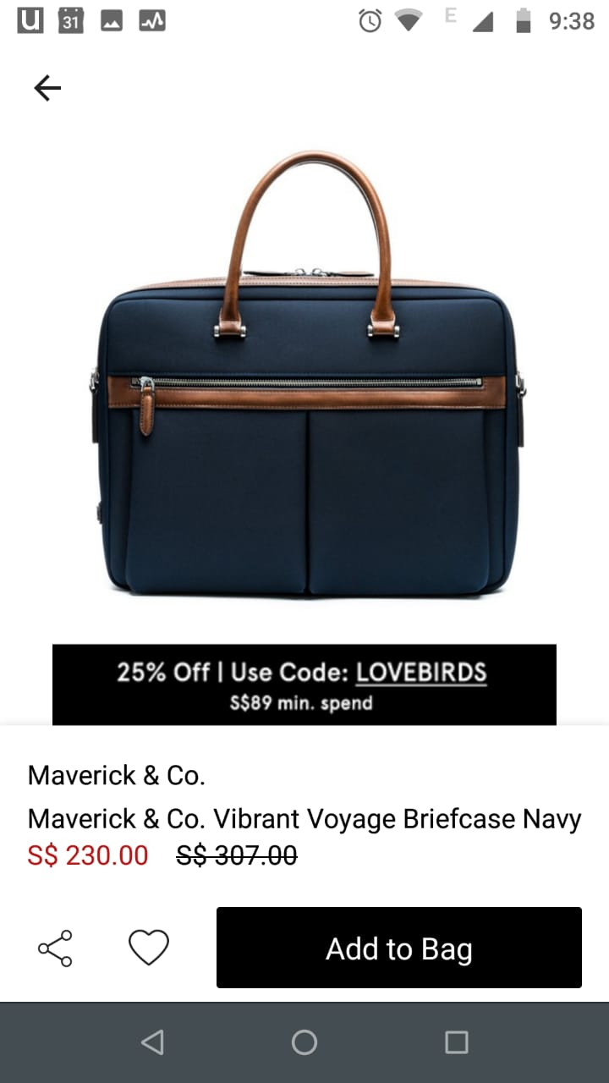
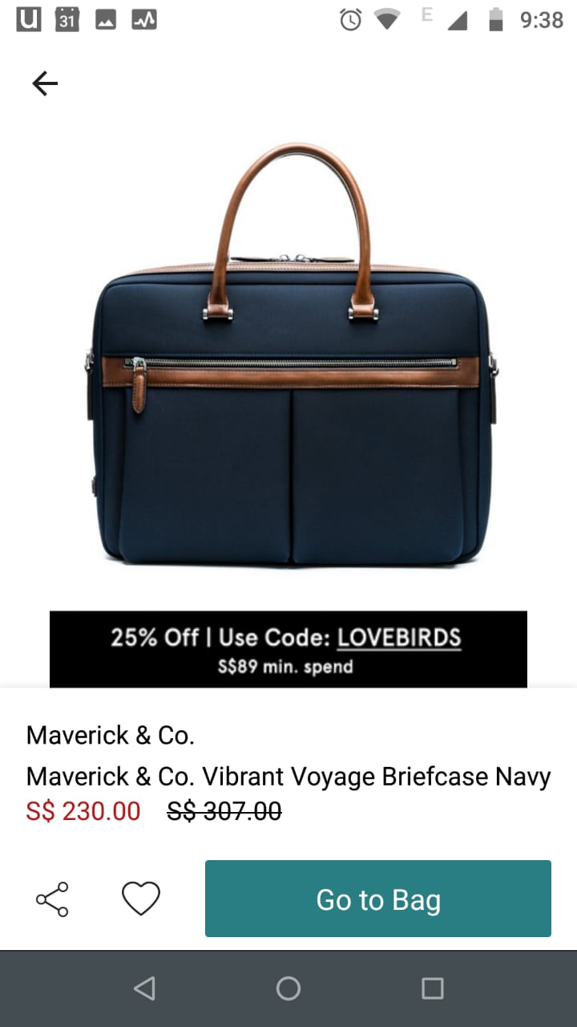
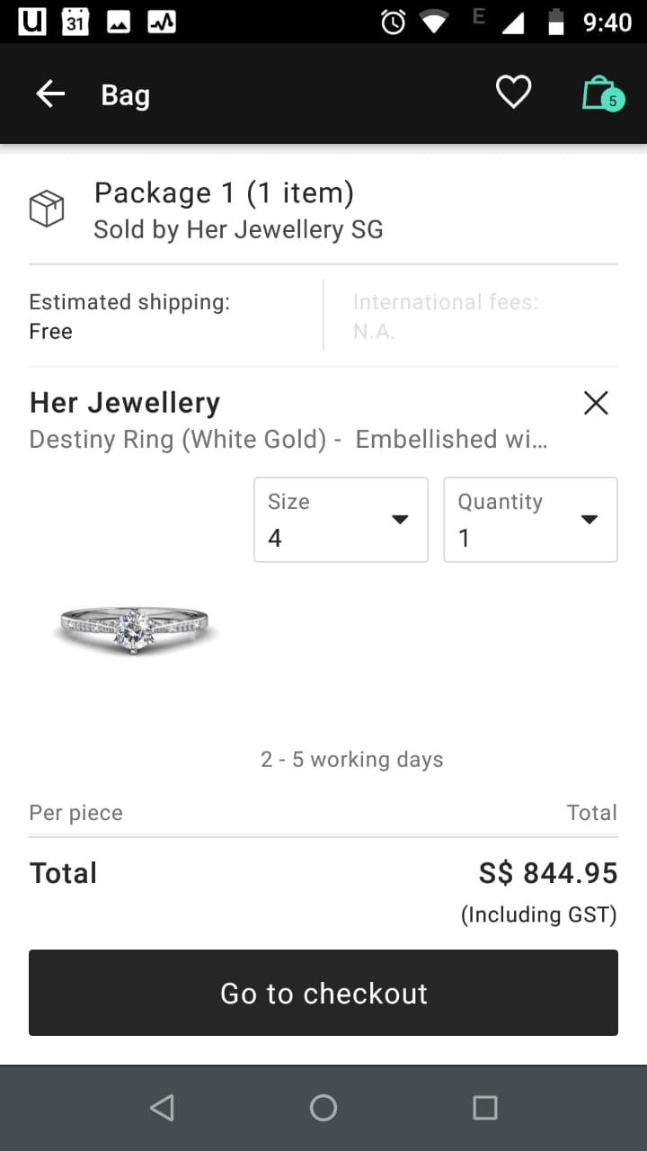
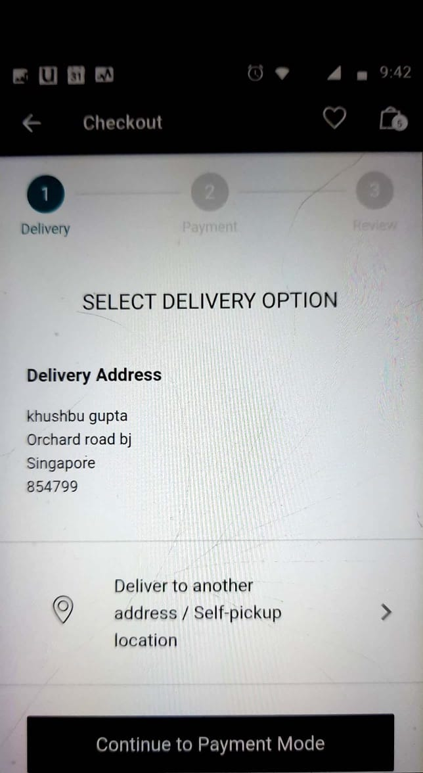
Fourth click: ‘ Enter address and continue to Payment Mode’
First click: ‘Add to Bag’
Second click: ‘ Go to Bag ’
Third click: ‘ Go to checkout ’

Slide 9
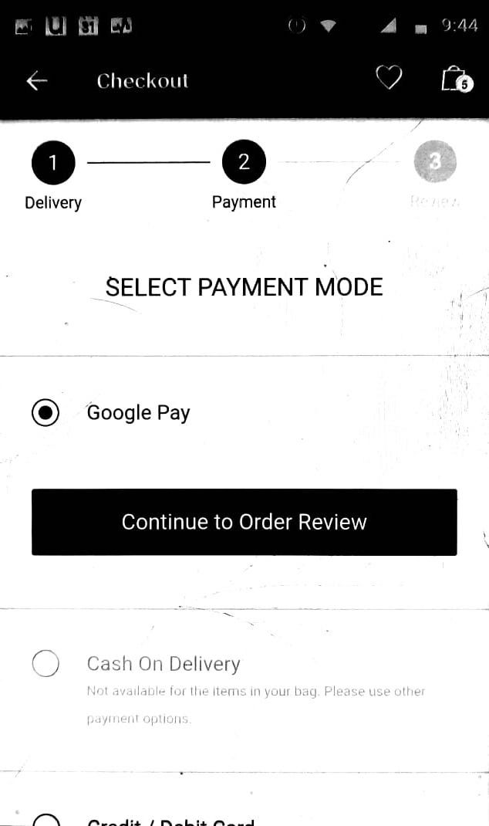
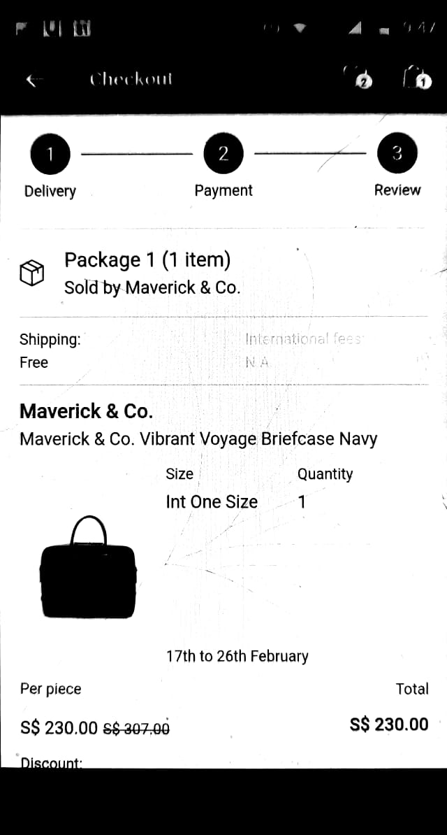
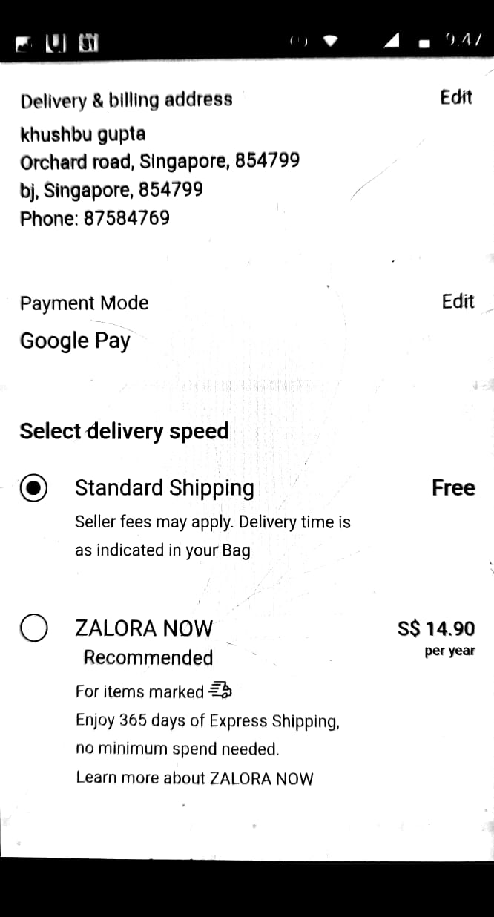
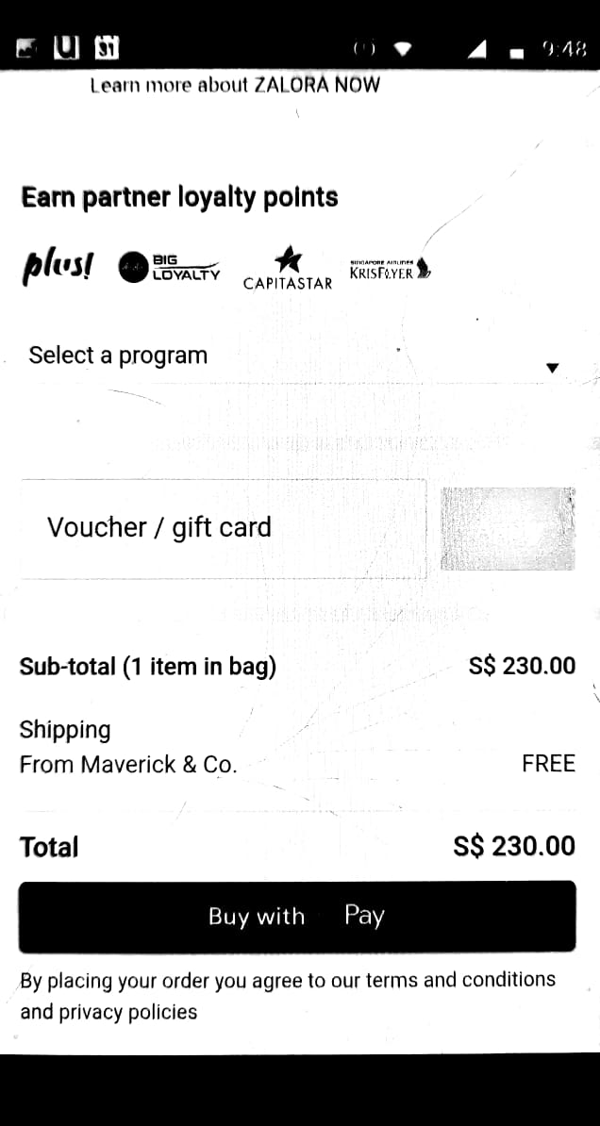
Fifth click: ‘ Select payment and continue’
Sixth click: ‘Review address’
Sixth click: ‘Review payment’
Seventh click: Buy with G-Pay

Slide 10
Express Checkout Wire-frames and Workflow

Slide 11
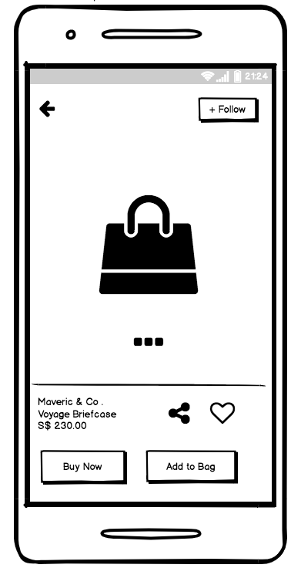
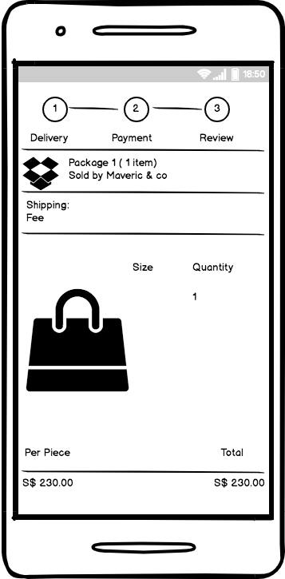
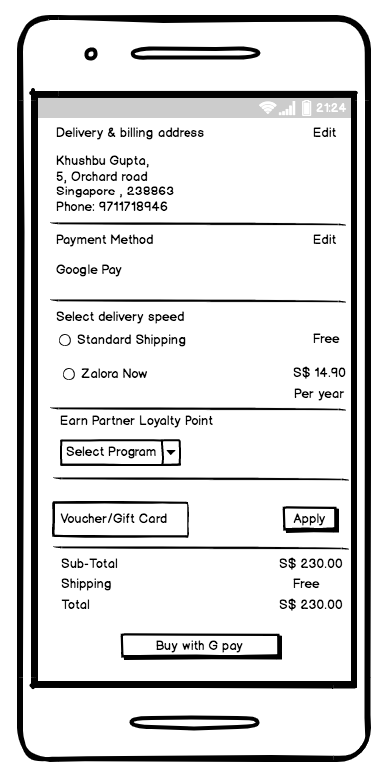
Express checkout will skip 1,2-Delivery, Payment step and directly jump to 3- Review.
Scroll down on review screen to confirm address and payment details as per the previous transaction and continue to pay.
First click: ‘Buy Now’ button

Slide 12
KPI to Measure Success
Perform A/B test
Payment conversion rate
Payment success rate
Cart abandonment rate
User retention rate

Slide 13
Thank You !

