Slide 1
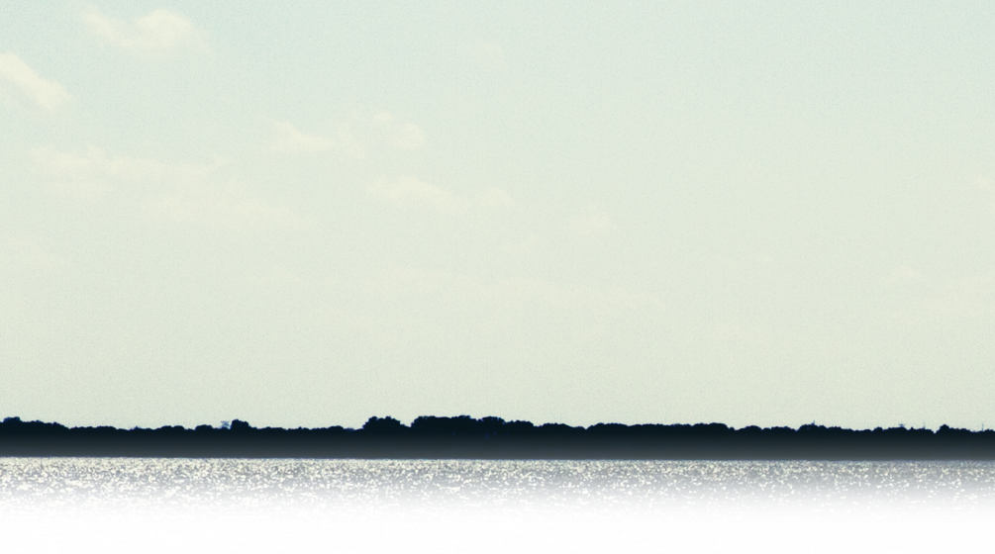

August 13th – 15th 2012
Kalahari Resort, Wisconsin Dells, WI

Slide 2
thatConference is your “Summer Camp for Geeks”. Held at the Kalahari Resort in the beautiful Wisconsin Dells, it’s your last chance to get away before summer slips away. Spend three days with a thousand of your fellow campers, geeking out on everything code, web, mobile and cloud.
Your camp counselors are the best survivalists in the industry, and will make sure you leave with the skills you need. With over 125 sessions to choose from, your head may overheat, so cool off in one of the many nearby pools. Unlike your usual technology conference, you will be camping at the best waterpark in the region. Not happy with all the content we crammed under the tent? Feel free to join our open spaces and tailor your conference experience.

Slide 3
meta
Founders – Clark Sell, Scott and Jean Seely
Web - http://thatConference.com
Twitter - @thatConference
Email – contact@thatconference.com
Kalahari Resort in the Wisconsin Dells, WI
Midwest GiveCamp is the weekend leading into thatConf
Newsletter at http://thatConference.com
Group at: http://groups.google.com/group/thatconference
Looking for Sponsors and Speakers.

