Slide 1
Wine Quality What is good wine composition?
Team Members:
Clay Selleck
MacDonald Chiwara
Don Mudd

Slide 2
Objectives
To determine all the components which make a good wine
To predict the wine quality using machine learning

Slide 3
Understanding the Dataset
Packages used include:
Numpy, Pandas, Seaborn, Plotly, Pickle, Networkx
Scikit-learn for machine learning model
Dataset https://www.kaggle.com/uciml/red-wine-quality-cortez-et-al-2009
Data loaded using pandas
1599 rows, 12 Columns
Attributes and definitions available on the website

Slide 4
Attribute Statistics
 | fixed acidity | volatile acidity | citric acid | residual sugar | chlorides | free sulfur dioxide | total sulfur dioxide | density | pH | sulphates | alcohol
mean | 8.31 | 0.53 | 0.27 | 2.53 | 0.09 | 15.85 | 46.47 | 0.996743 | 3.31 | 0.66 | 10.42
stdev | 1.73 | 0.18 | 0.19 | 1.37 | 0.05 | 10.37 | 32.87 | 0.001879 | 0.15 | 0.17 | 1.06
Max | 15.60 | 1.33 | 0.79 | 15.40 | 0.61 | 68.00 | 286.00 | 1.003690 | 4.01 | 1.98 | 14.00
Min | 4.60 | 0.12 | 0.00 | 0.90 | 0.01 | 1.00 | 6.00 | 0.990070 | 2.74 | 0.33 | 8.40
R² | 0.0048 | 0.5252 | 0.1303 | 0.0022 | 0.0855 | 0.0041 | 0.0469 | 0.0951 | 0.0221 | 0.0031 | 0.3596

Slide 5
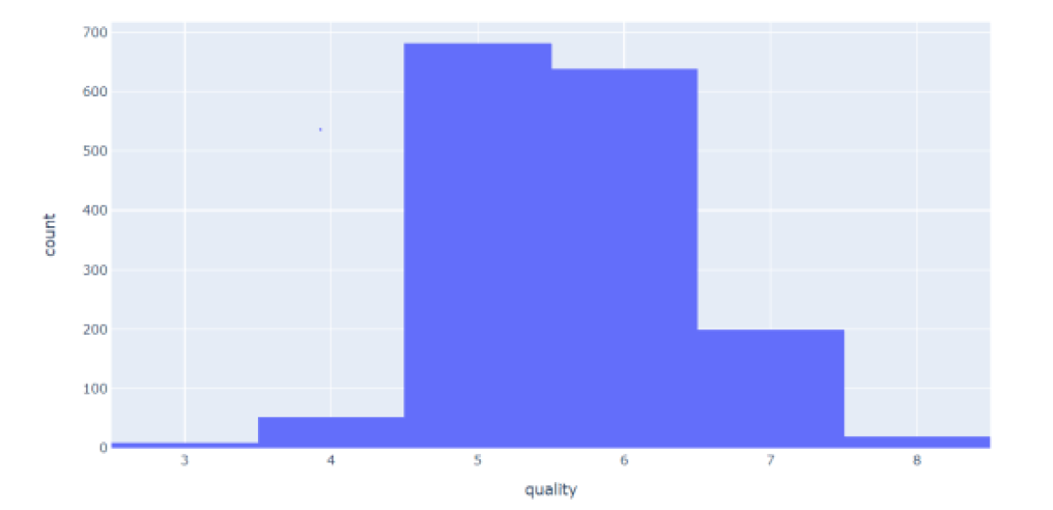
Data Preparation
Cleaning and renaming columns
Handling missing or null values
Majority of wines are in the 5 – 6 quality range

Slide 6
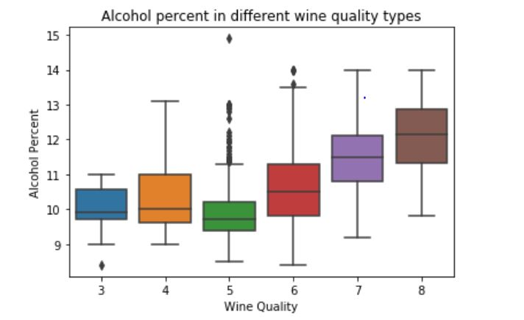
Correlation
Wine quality is positively correlated with alcohol, sulphates, citric acid, & fixed acidity but has a negative correlation with volatile acidity.
Feature | Cor - Qlty
alcohol | 0.476
sulphates | 0.251
citric_acid | 0.226
fixed_acidity | 0.124
residual_sugar | 0.014
free_sulfur_dioxide | -0.051
pH | -0.058
chlorides | -0.129
density | -0.175
total_sulfur_dioxide | -0.185
volatile_acidity | -0.391

Slide 7
Data classification
The target variable - quality was regrouped and categorized from 1 - 10:
Converted the attribute to a binary output
We categorized these variables into 2 categories of wine
Bad quality (3 – 5), 744 records
Good quality (6 – 8), 855 records
Standard Scaler was used to get optimize the results
Graphs and analysis of model are available on website

Slide 8
Data Partitioning
After cleaning the dataset, we divided the rows into two groups as follows:
Training Set: This contained75% of the data
Test Set: contained 25% of the data
We used two modeling techniques to try to predict the outcome of our data,
Logistic Regression
Naïve Bayes
Model Evaluation
In comparing the results we decided to go with Logistic Regression.
Prediction accuracy - good quality 77%, poor quality 74%
Overall model accuracy – 76%
Model saved using Joblib
Modeling

Slide 9

Analysis of Wine Quality vs Attributes

Slide 10
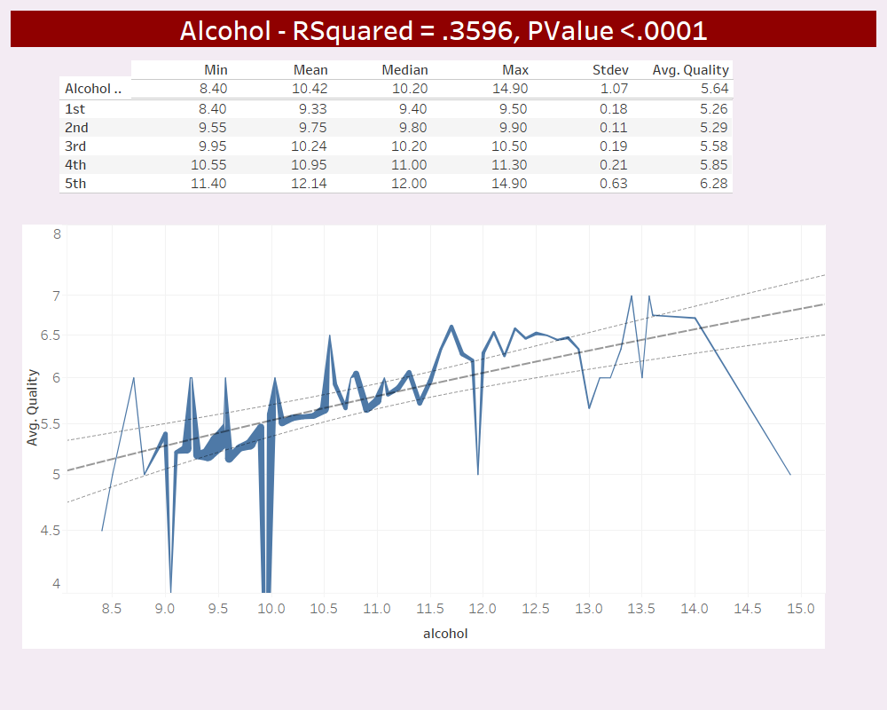
Alcohol levels range from 8.4% to 14.9% with an average of 10.4% and the 2nd highest RSquared factor.
% Alcohol would appear to have a significant impact on the quality of the wine with the 2nd highest R Squared value of our attributes/ features with the higher the alcohol the better the quality. Most of the wines in our data were between 9 and 12% but alcohol content between 12 and 12.5% appears to be the ideal range based on the data while the wines with an alcohol % around 9.5% faired the worst.

Slide 11
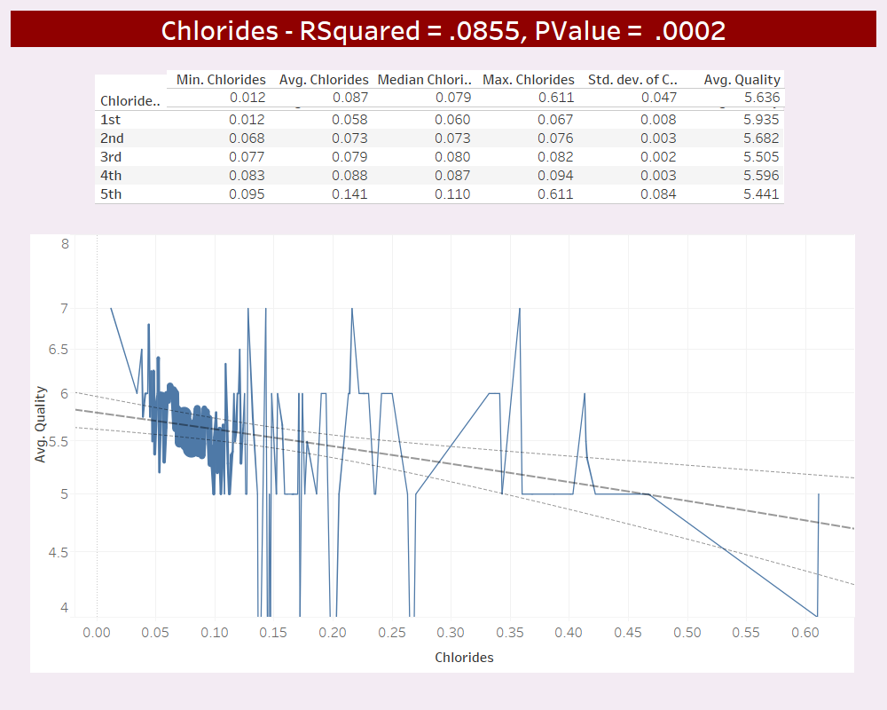
Chloride levels range from .012 to .611 g/L with a mean of .087 g/L. RSquared factor ranks 5th out of the 11 attributes.
The level of chlorides is moderately important in determining wine quality with higher levels having a negative affect. Wines from Australia and Argentina tend to have higher levels of chlorides than those produced in the US and France.

Slide 12
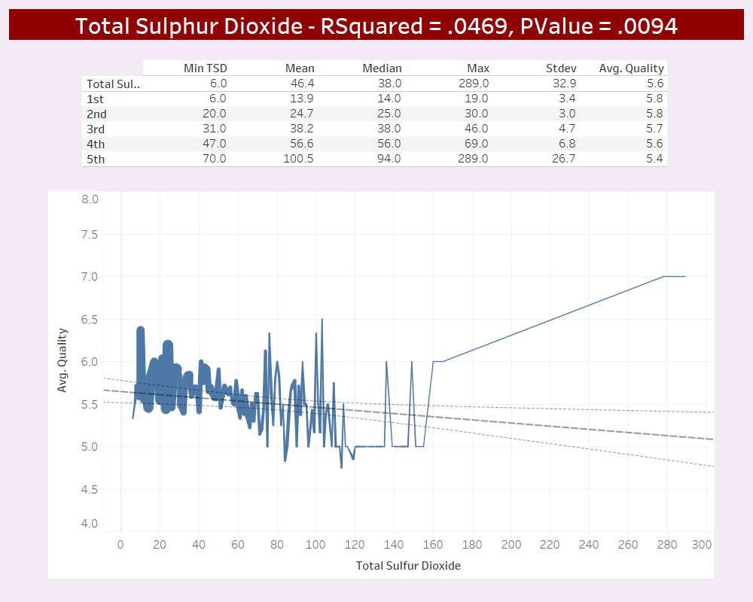
Total Sulphur dioxide levels range from 6 to 289 g/L with a mean 46 g/L. RSquared factor ranks 6th out of the 11 attributes.
Total SO2 like free SO2 has limited impact on our ability to predict wine quality but wines with total SO2 levels of between .15 and .30 g/L tend to produce the wines with higher quality.

Slide 13
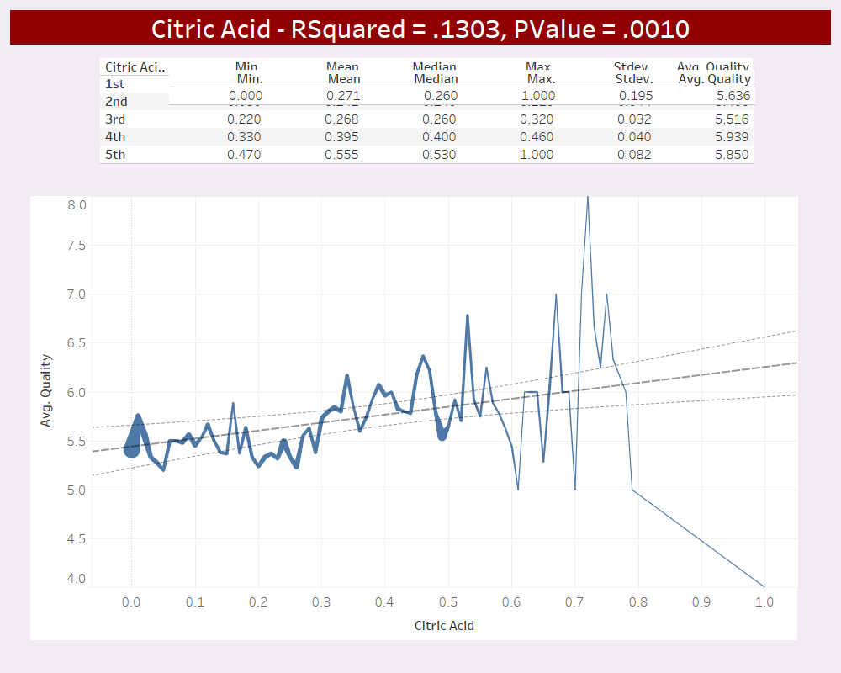
Citric acid levels range from 0 to 1 with a mean .27. RSquared factor ranks 3rd overall.
Citric acid is often added to wines to increase acidity, complement a specific flavor. It can be added to finished wines to increase acidity and give a “fresh” flavor. The data shows that citric acid levels have moderate impact on wine quality with moderately high levels having a positive impact while extremely low levels (< .05 g/l) producing low quality wines.

Slide 14
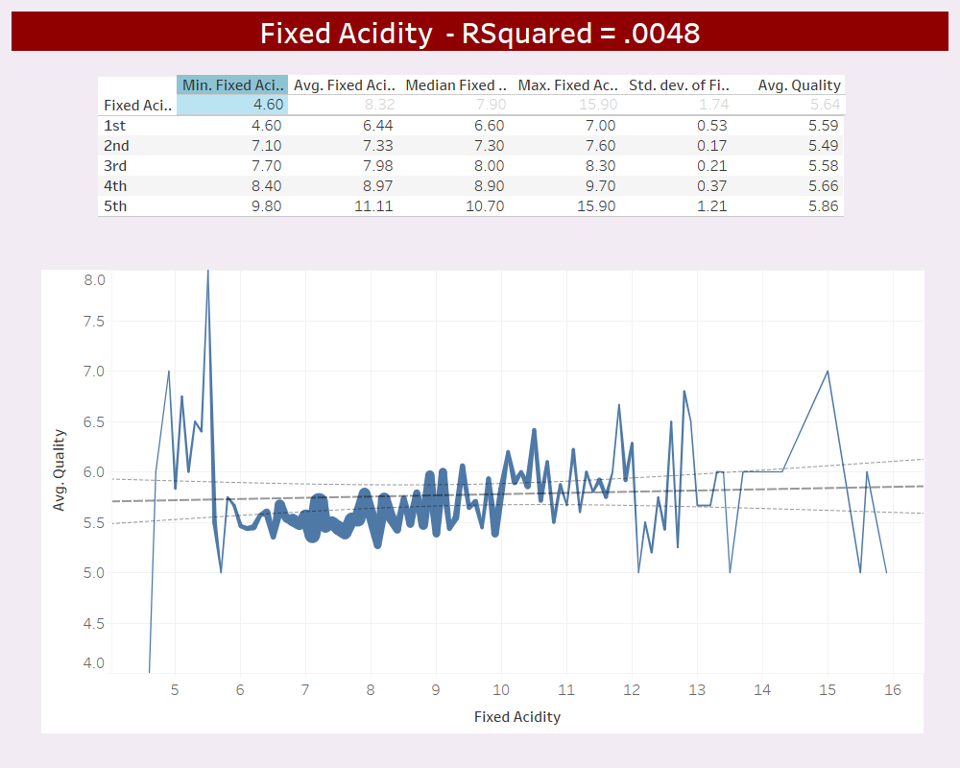
Fixed Acidity levels range from 4.6 to 15.9 g/L with a mean 8.3. RSquared factor ranks 8th out of the 11 attributes.
The key difference between volatile and fixed acids is that the volatile acids easily vaporize whereas the fixed acids do not. The level of fixed acidity appears to have minimal impact in determining wine quality, but extremely low levels tend to have a negative impact on wine quality with wines testing highest having the best.

Slide 15
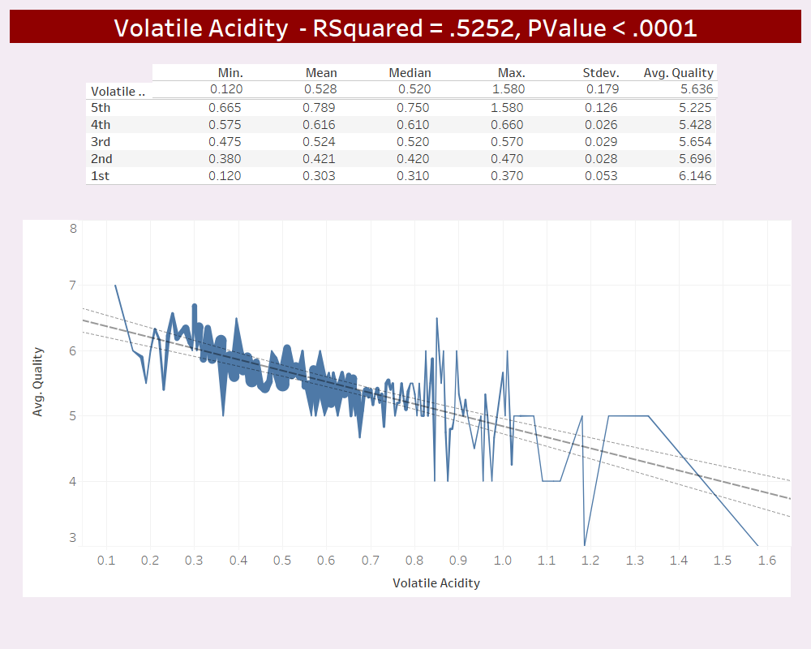
Volatile acidity levels range from .12 to 1.48 g/L with a mean .53 g/L. RSquared factor ranked highest of all attributes
Volatile acidity, unlike fixed acidity does appear to have a significant impact on wine quality as it has the highest R Squared value of 11 attributes / features. Our results show that the lower the level of volatile acid, the better the wine quality.

Slide 16
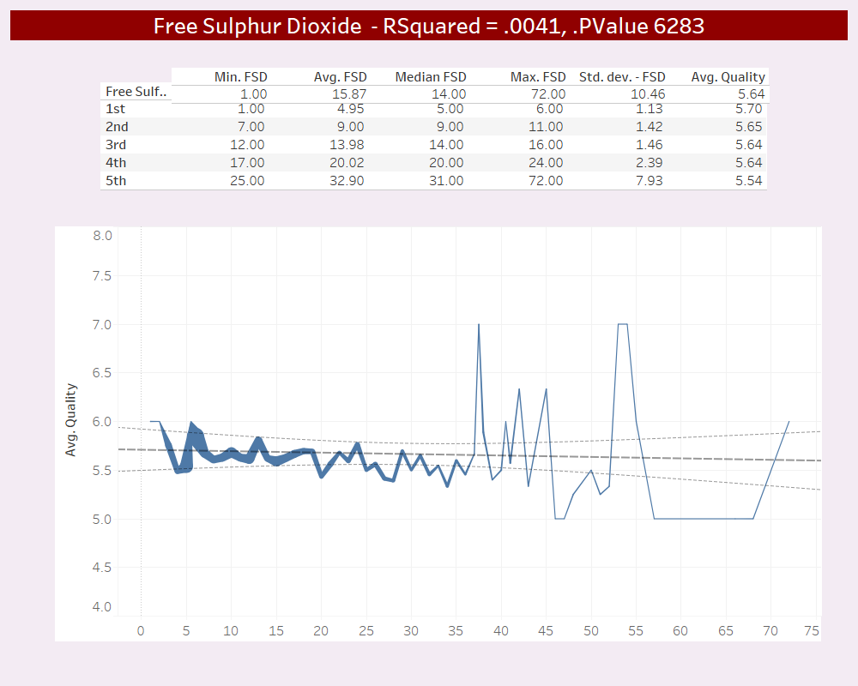
Free Sulphur dioxide levels range from 1 to 72 g/L with a mean 16 g/L. RSquared factor ranks 9th out of the 11 attributes
Sulfur dioxide, SO2, is a colorless gas or liquid with a strong, choking odor. Sulphur dioxide is present in wines as "free”SO2 and also bound to acetaldehyde. The sum gives total SO2. It is added to wine as an antioxidant in order to produce fresher tasting and wine with better appearance. It also allows longer storage of the wine Free SO2 tends to have very limited impact when it comes to determining wine quality but wines with the lowest Free SO2 have the highest quality rating while the highest level has the quality

Slide 17
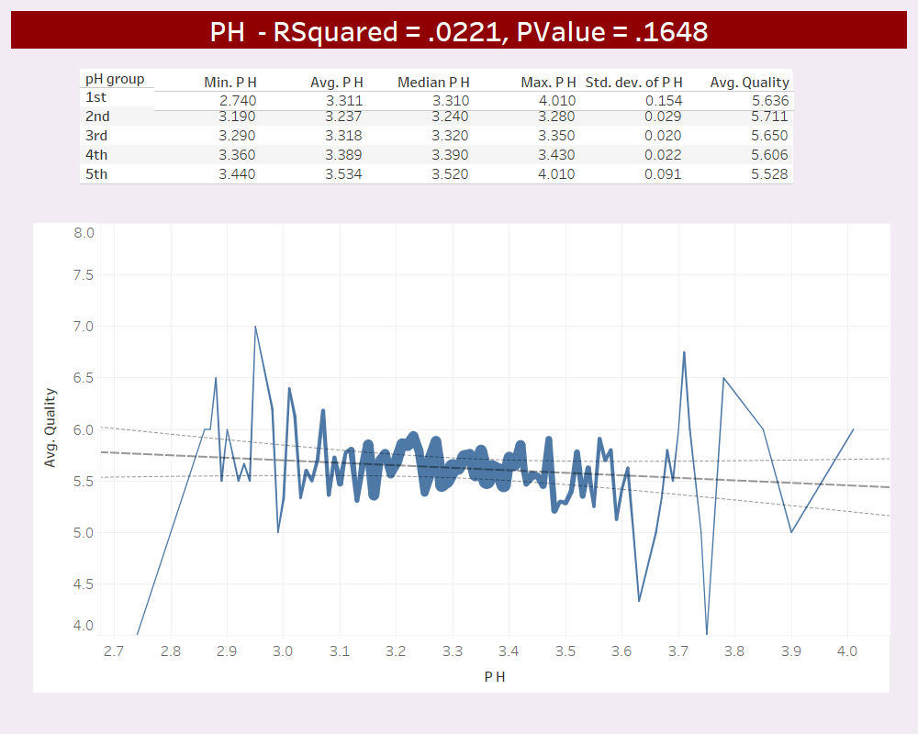
PH levels range from 2.7 to 4 with a mean of 3.3. RSquared factor ranks 7th overall.
The PH level of a wine is generally considered to be critical to wine quality but our data suggests that it has limited impact on our ability to determine overall wine quality. Our data suggests that a PH level of between 3.2 and 3.3 have better overall quality

Slide 18
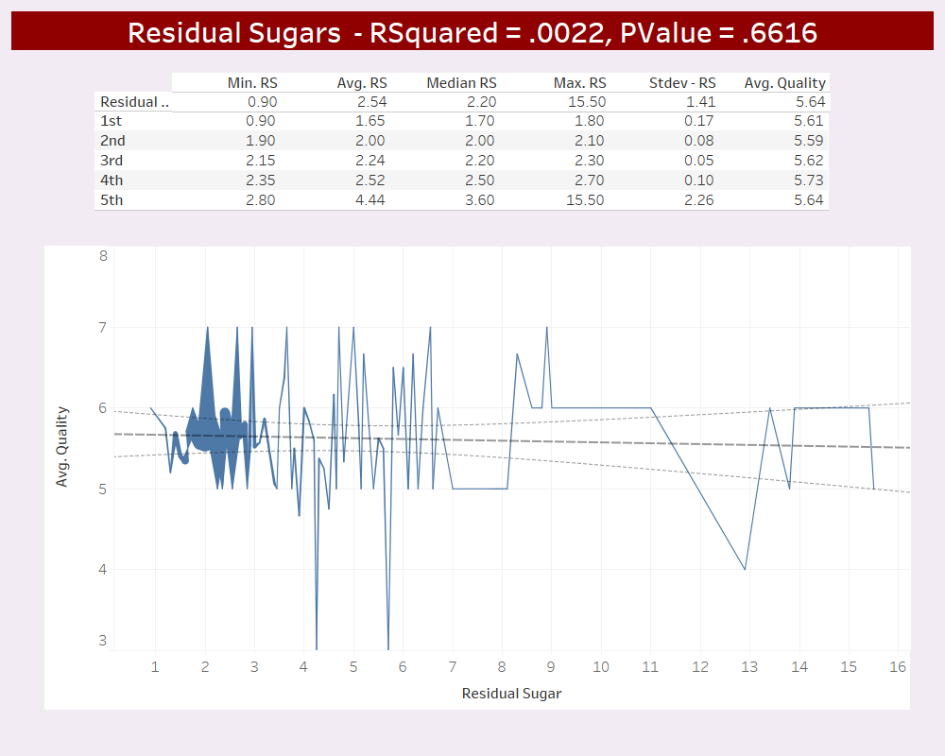
Residual sugar levels range from 9 to 15.5 g/L with a mean 2.5. RSquared factor ranks last of the 11 attributes.
Residual Sugar (or RS) is from natural grape sugars that are leftover in the wine after the fermentation process finishes. Wines with a RS level below .01 are considered very dry, .03 - .05 as semi-sweet, .05 as sweet. The wines in our data had RS of less than .03 and would be in the dry category. From our data, Residual Sugars have limited impact our ability to determine wine quality

Slide 19
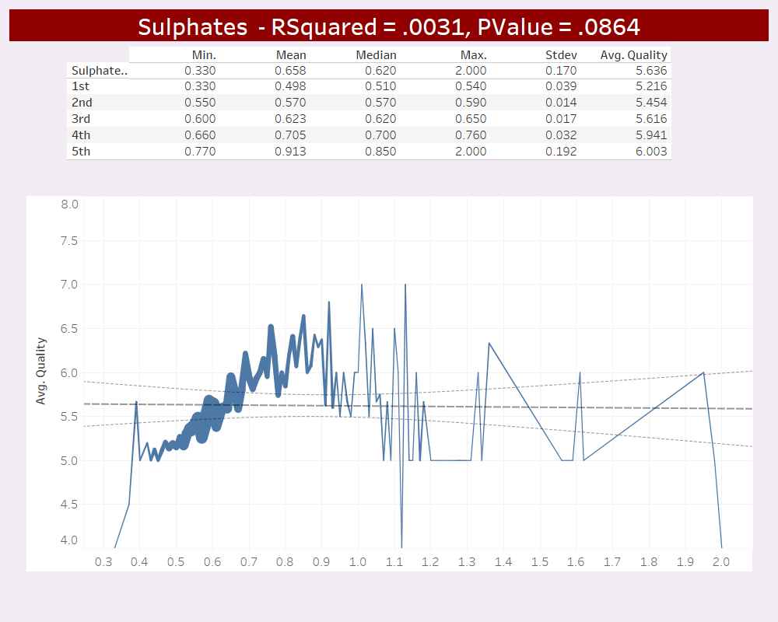
Sulphate levels range from .3 to 2.0 g/L with a mean of .66 g/L. RSquared factor ranks 10th out of the 11 attributes.
Hydrogen sulfide, H₂S, is an undesirable compound produced during wine fermentation. Formation of hydrogen sulfide typically occurs during the primary fermentation when yeast activity is high with copper sulphate commonly added to remove or lower the H₂S levels. Sulphate SO42 and sulfite SO43 are both Oxy-anions of Sulfur, a non-metallic element. With the an extremely low R Squared factor, sulphate has limited impact on our ability to determine win quality but levels of .65 and .90 tend to produce wines with higher wine quality than those with Sulphate levels of .55.

Slide 20
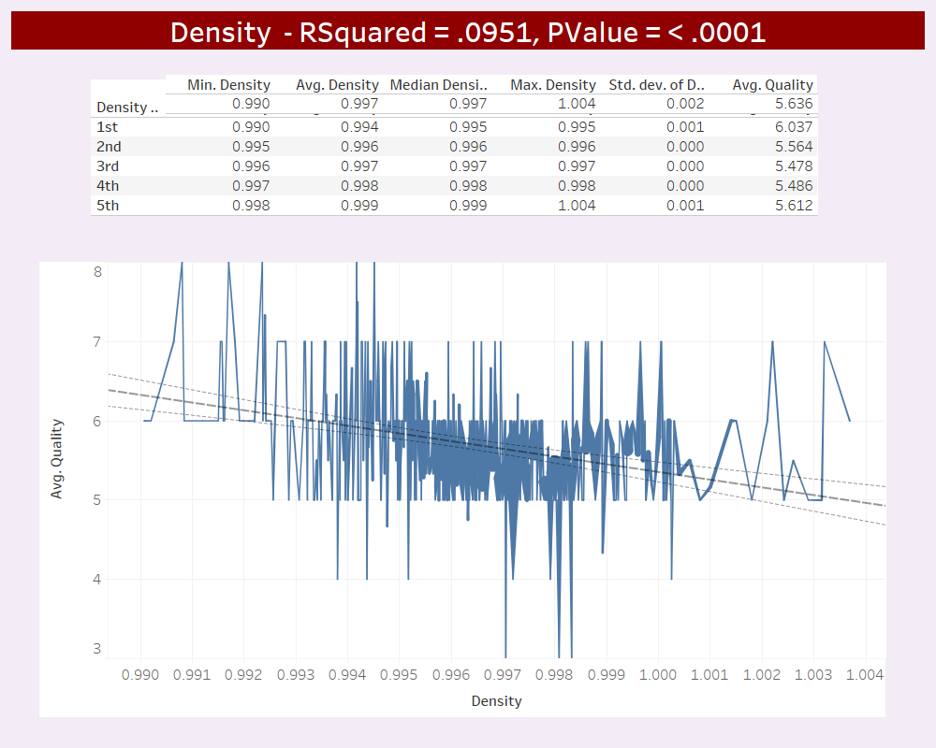
Density values range from .99 to 1.004 with a mean .997. RSquared factor ranks 4th out of the 11 attributes.
Density has a moderate impact to wine quality with lighter wines being favored over heavy wines.

Slide 21
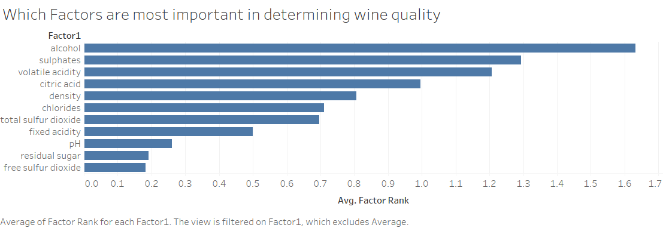
The top 3 attributes when it comes to predicting wine quality are alcohol, sulphates & volatile acidity

Slide 22
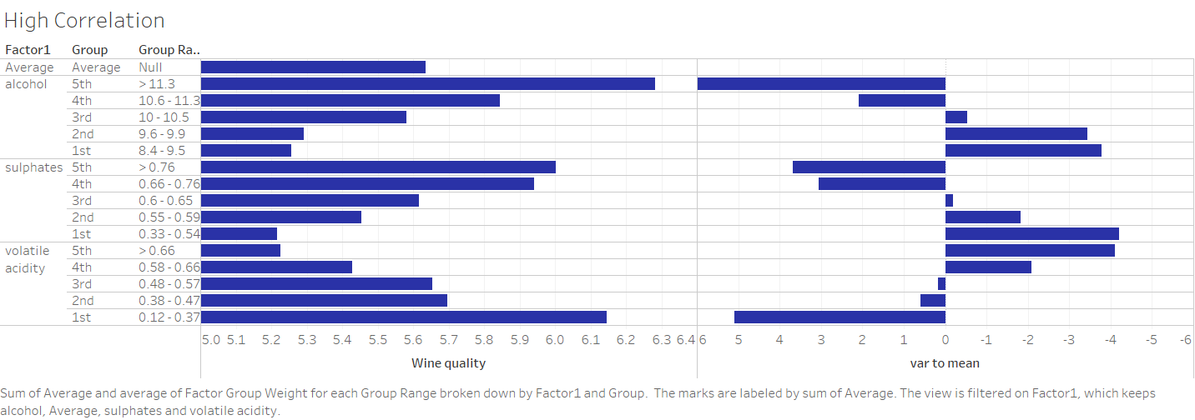

Slide 23
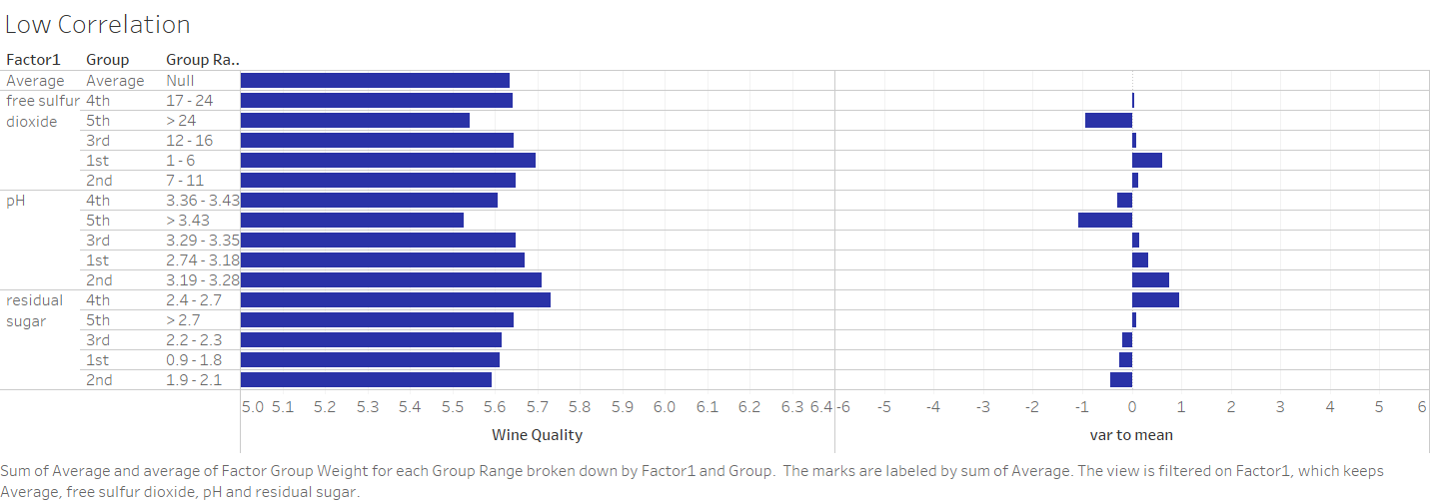

Slide 24
Conclusion
By controlling the variables, quality of wine can be predicted.
Control of alcohol and residual sugar content can help in production of good quality wine

Slide 25


