Slide 1
Wine Quality What is good wine composition?
Team Members:
Clay Selleck
MacDonald Chiwara
Don Mudd

Slide 2
Objectives
To determine all the components which make a good wine
To predict the wine quality using machine learning

Slide 3
Understanding the Dataset
Packages used include:
Numpy, Pandas, Seaborn, Plotly, Pickle, Networkx
Scikit-learn for machine learning model
Dataset https://www.kaggle.com/uciml/red-wine-quality-cortez-et-al-2009
Data loaded using pandas
1599 rows, 12 Columns
Attributes and definitions available on the website

Slide 4
Attribute Statistics
 | fixed acidity | volatile acidity | citric acid | residual sugar | chlorides | free sulfur dioxide | total sulfur dioxide | density | pH | sulphates | alcohol
mean | 8.31 | 0.53 | 0.27 | 2.53 | 0.09 | 15.85 | 46.47 | 0.996743 | 3.31 | 0.66 | 10.42
stdev | 1.73 | 0.18 | 0.19 | 1.37 | 0.05 | 10.37 | 32.87 | 0.001879 | 0.15 | 0.17 | 1.06
Max | 15.60 | 1.33 | 0.79 | 15.40 | 0.61 | 68.00 | 286.00 | 1.003690 | 4.01 | 1.98 | 14.00
Min | 4.60 | 0.12 | 0.00 | 0.90 | 0.01 | 1.00 | 6.00 | 0.990070 | 2.74 | 0.33 | 8.40
R² | 0.0048 | 0.5252 | 0.1303 | 0.0022 | 0.0855 | 0.0041 | 0.0469 | 0.0951 | 0.0221 | 0.0031 | 0.3596

Slide 5
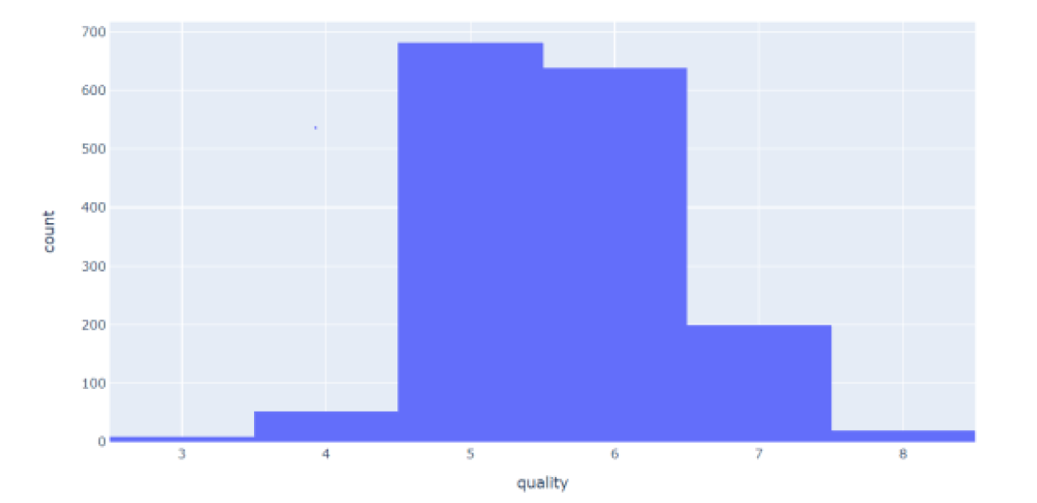
Data Preparation
Cleaning and renaming columns
Handling missing or null values
Majority of wines are in the 5 – 6 quality range

Slide 6
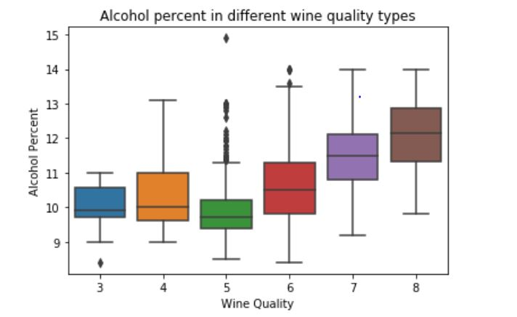
Correlation
Wine quality is positively correlated with alcohol, sulphates, citric acid, & fixed acidity but has a negative correlation with volatile acidity.
Feature | Cor - Qlty
alcohol | 0.476
sulphates | 0.251
citric_acid | 0.226
fixed_acidity | 0.124
residual_sugar | 0.014
free_sulfur_dioxide | -0.051
pH | -0.058
chlorides | -0.129
density | -0.175
total_sulfur_dioxide | -0.185
volatile_acidity | -0.391

Slide 7
Data classification
The target variable - quality was regrouped and categorized from 1 - 10:
Converted the attribute to a binary output
We categorized these variables into 2 categories of wine
Bad quality (3 – 5), 744 records
Good quality (6 – 8), 855 records
Standard Scaler was used to get optimize the results
Graphs and analysis of model are available on website

Slide 8
Data Partitioning
After cleaning the dataset, we divided the rows into two groups as follows:
Training Set: This contained75% of the data
Test Set: contained 25% of the data
We used two modeling techniques to try to predict the outcome of our data,
Logistic Regression
Naïve Bayes
Model Evaluation
In comparing the results we decided to go with Logistic Regression.
Prediction accuracy - good quality 77%, poor quality 74%
Overall model accuracy – 76%
Model saved using Joblib
Modeling

Slide 9

Analysis of Wine Quality vs Attributes

Slide 10
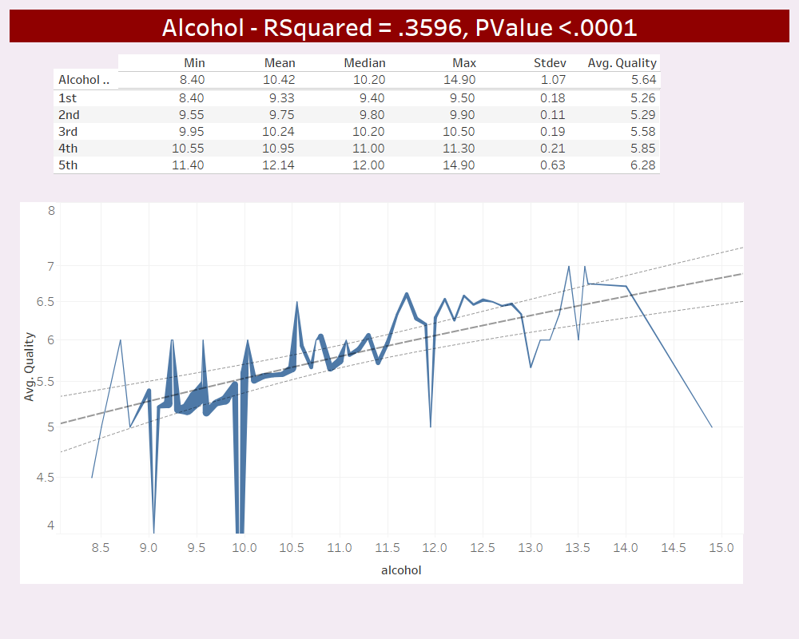
Alcohol levels range from 8.4% to 14.9% with an average of 10.4% and the 2nd highest RSquared factor.

Slide 11
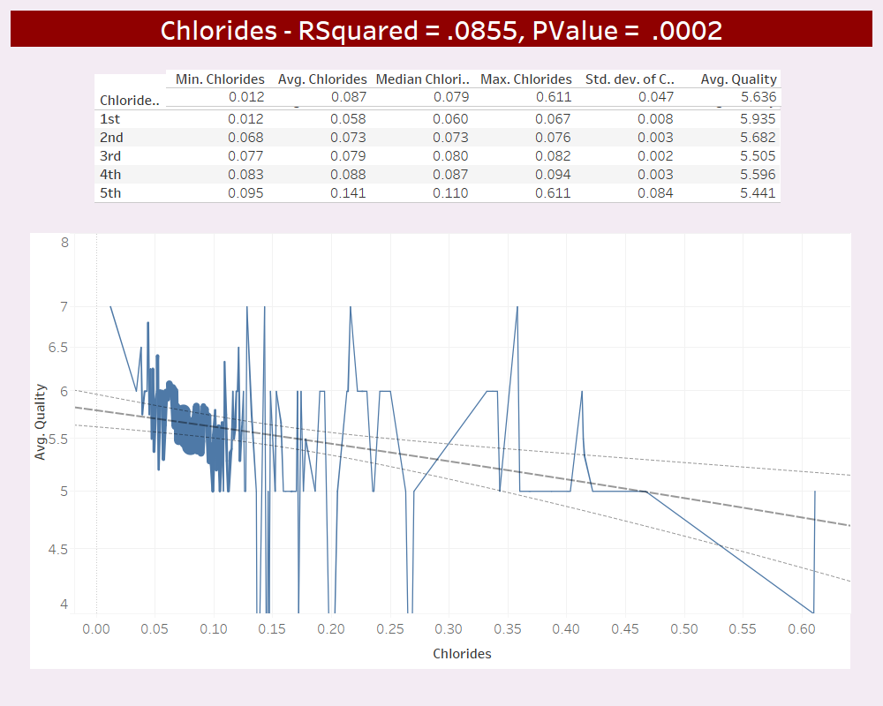
Chloride levels range from .012 to .611 g/L with a mean of .087 g/L. RSquared factor ranks 5th out of the 11 attributes.

Slide 12
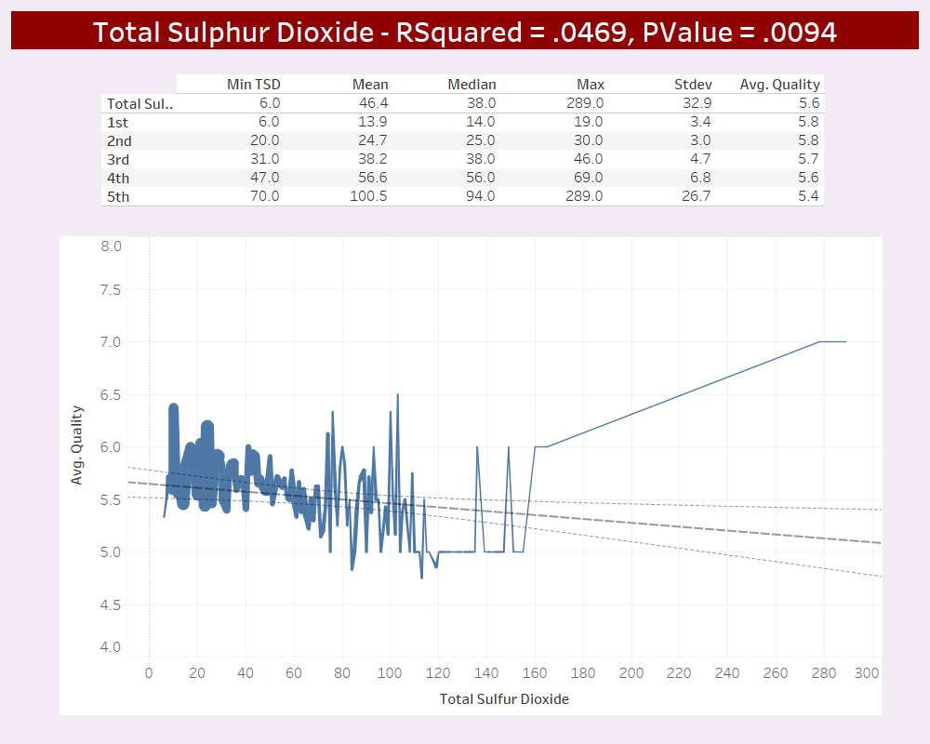
Total Sulphur dioxide levels range from 6 to 289 g/L with a mean 46 g/L. RSquared factor ranks 6th out of the 11 attributes.

Slide 13
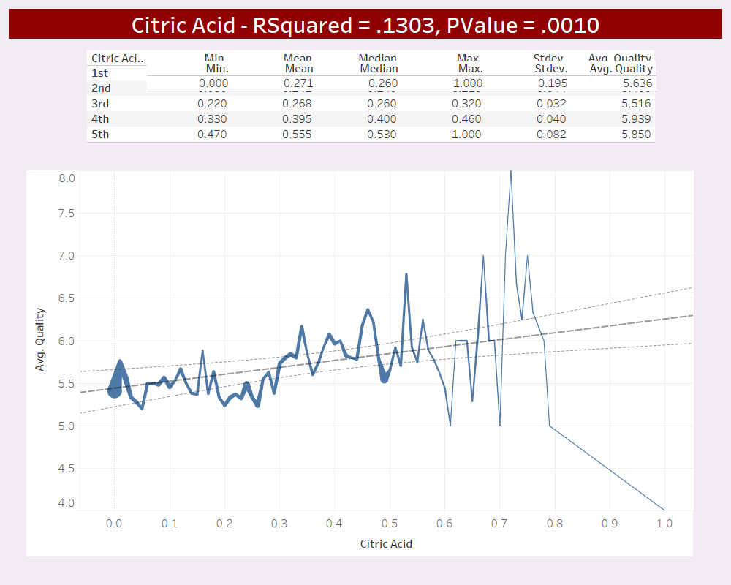
Citric acid levels range from 0 to 1 with a mean .27. RSquared factor ranks 3rd overall.

Slide 14
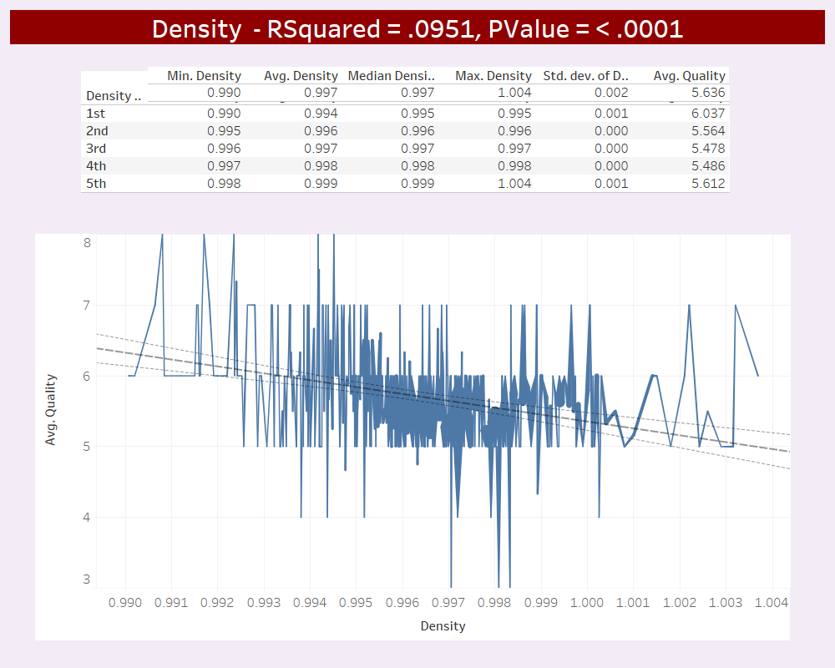
Total Sulphur dioxide values range from .99 to 1.004 with a mean .997. RSquared factor ranks 4th out of the 11 attributes.

Slide 15
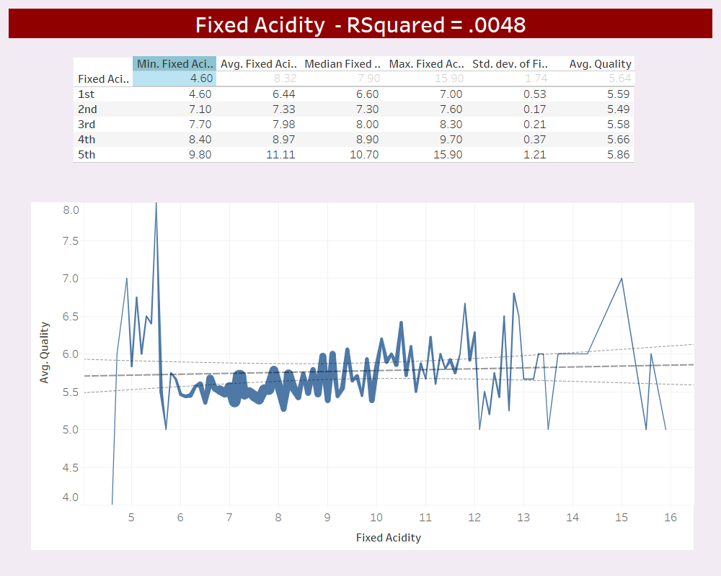
Fixed Acidity levels range from 4.6 to 15.9 g/L with a mean 8.3. RSquared factor ranks 8th out of the 11 attributes.

Slide 16
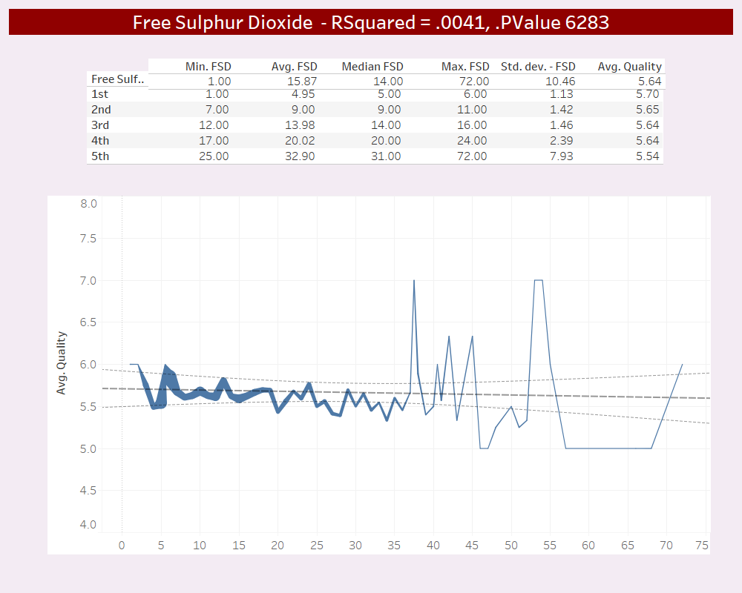
Free Sulphur dioxide levels range from 1 to 72 g/L with a mean 16 g/L. RSquared factor ranks 9th out of the 11 attributs.

Slide 17
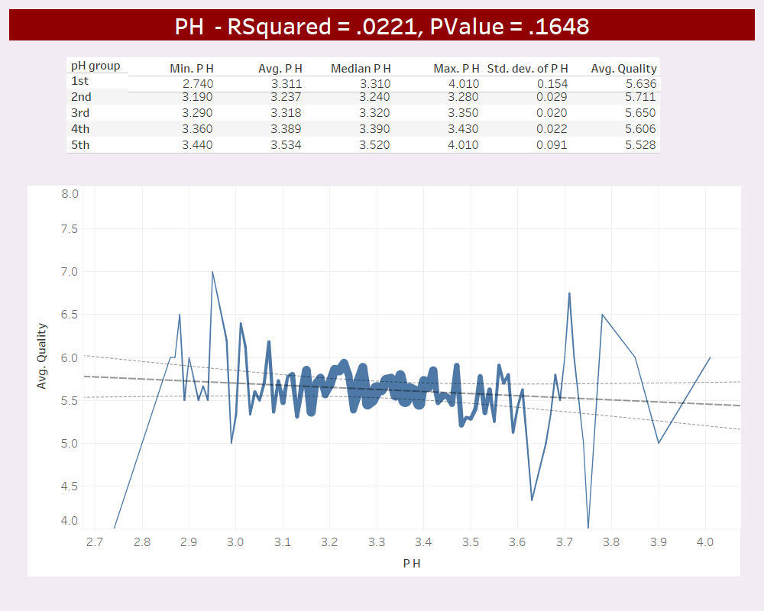
pH levels range from 2.7 to 4 with a mean of 3.3. RSquared factor ranks 7th overall.

Slide 18
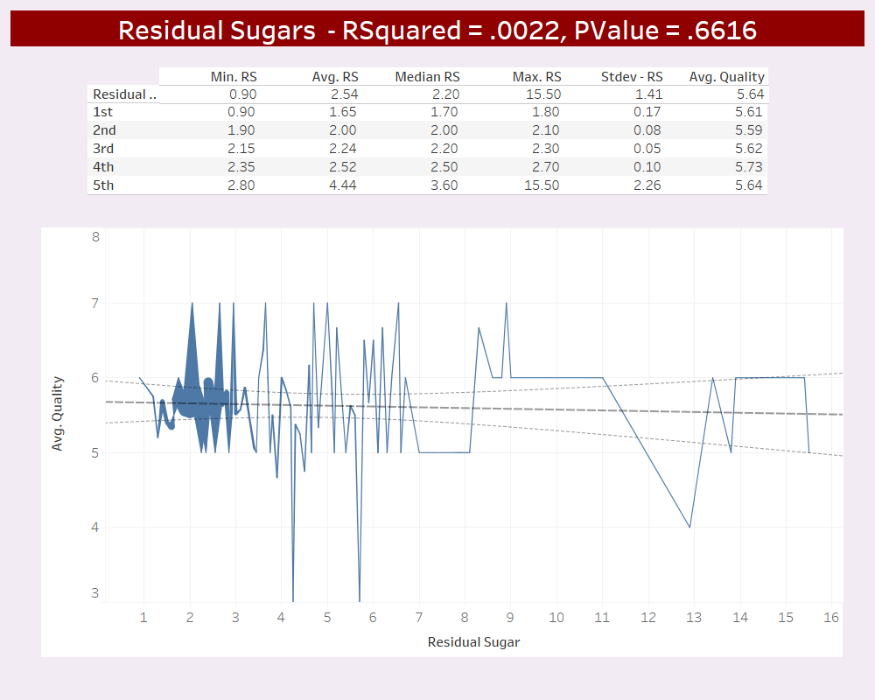
Residual sugar levels range from 9 to 15.5 g/L with a mean 2.5. RSquared factor ranks last of the 11 attributes.

Slide 19
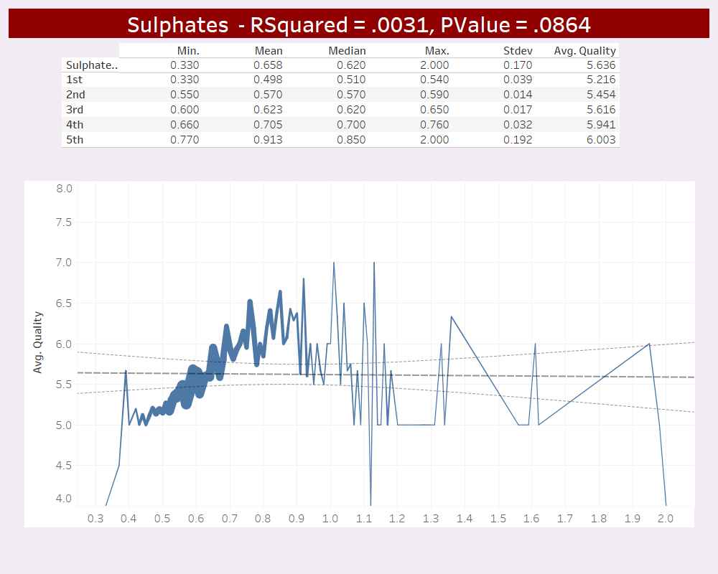
Sulphate levels range from .3 to 2.0 g/L with a mean of .66 g/L. RSquared factor ranks 10th out of the 11 attributes.

Slide 20
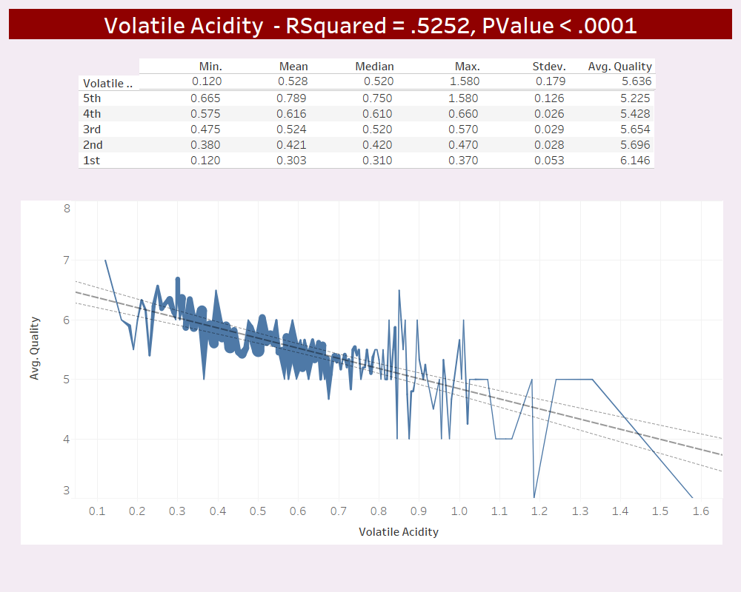
Volatile acidity levels range from .12 to 1.48 g/L with a mean .53 g/L. RSquared factor ranked highest of all attributes

Slide 21
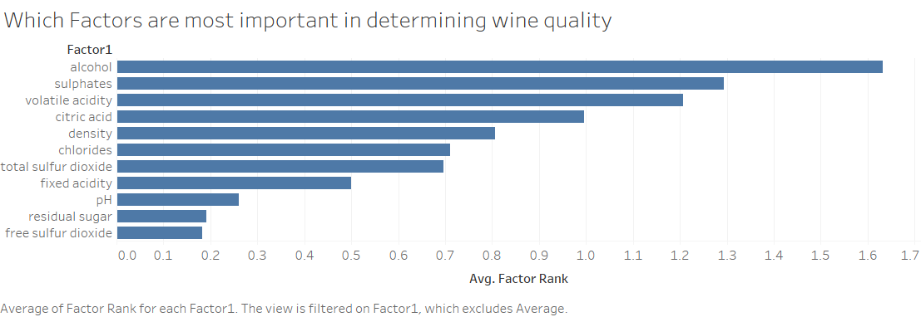
The top 3 attributes when it comes to predicting wine quality are alcohol, sulphates & volatile acidity

Slide 22
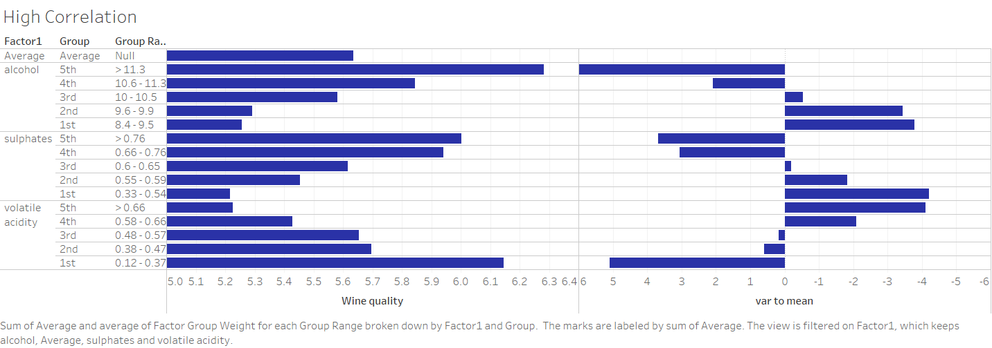

Slide 23
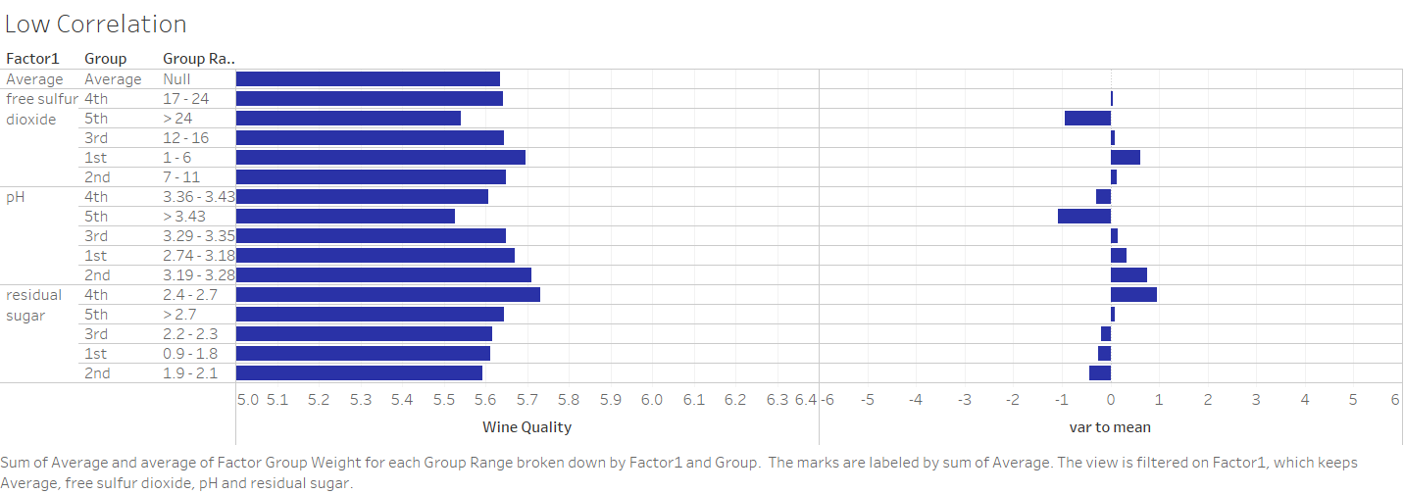

Slide 24
Conclusion
By controlling the variables, quality of wine can be predicted.
Control of alcohol and residual sugar content can help in production of good quality wine

Slide 25


