Slide 1
CSE611 Web Programming
Team Name: Delta-T
Team Member
Mahmudul Hasan Khan, ID : 143-25-417
Nasir Ahmad, ID: 143-25-423
Md. Kamrul Hasan, ID:132-25-307
Asive Chowdhury, ID: 143-25-426
Suaiba Haque Turabi, ID: 143-25-430
Education Institute Management System

Slide 2
Agenda
  Objective of the Project
  Salient Features of the System
  Target Customer- Market and Size
  Expected Customer Responses to the Portal
  Design and UI
  Implementation Plan
  References

Slide 3
Objective of the Project
  To Build and online management system which will manage the whole administrative process of an educational Institute

Slide 4
Salient Features of the System
Login Information
  Student Login
  Teacher Login
  Administrator Login

Slide 5
Salient Features of the System
Notice Board
    Exam announcement
    Meeting for Parents
    Vacation announcement
    Other information

Slide 6
Salient Features of the System
Student Information
    Accessing the system using user name and password
    Course information in-details
    Result information in-details
    Other information

Slide 7
Salient Features of the System
Teacher Information
  Access system using username and password
  Assigned courses
  Result information in-details
  Other information

Slide 8
Salient Features of the System
Dashboard feature
    Admission and Registration Management
    Student and Teacher Management
    Course and Result Management
    Notice and Other’s Management

Slide 9
Salient Features of the System
Security/Privacy feature:
    User Authentication
    User Authorization
    Privacy Control

Slide 10
Target Customer
Any educational institute in home and abroad such as schools (Kindergarden, Primary, Secondary), Colleges, Universities etc.
The size of the customer will be the total number of students of any types of educational institute in a country

Slide 11
Customer Response to the Portal
Organization of the site is simple
Easy to navigate the site
Strong and Individual Login process
Availability of necessary information
Less graphics load the site faster with minimum bandwidth
So, it is expected the responses from the customer will be good.

Slide 12
Forward and backword of Stakeholders
Students
  Forward
    They need tuition
    They need coaching
  Backword
    They have to pay tuition fees
    They need school dress

Slide 13
Forward and Backword of Stakeholders
Teachers
  Forward
    They have to teach in the class
    They have to take exam and give marks
  Backward
    They would need salary

Slide 14
Template - good/ bad/ ugly?
Impression of the visitors
  Fast loading
  Easy navigation
  Never lost
  Guided by self
Technical aspects
  Browser compatibility
  Responsiveness
  Follow design standard and guidelines

Slide 15
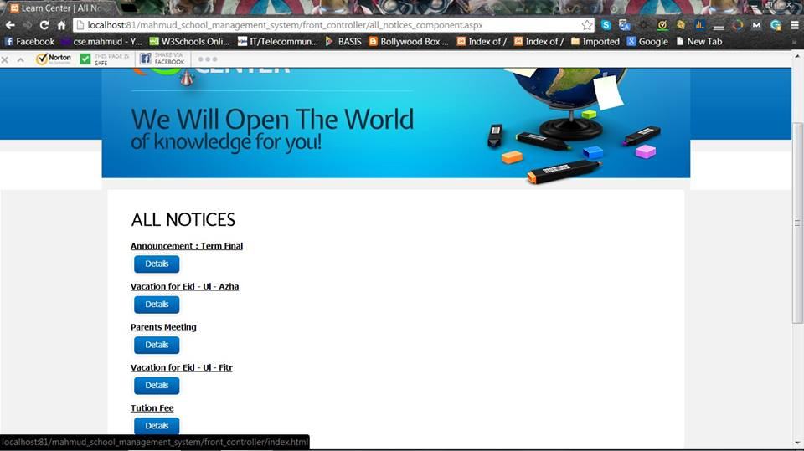
Design and UI- View All Notices

Slide 16
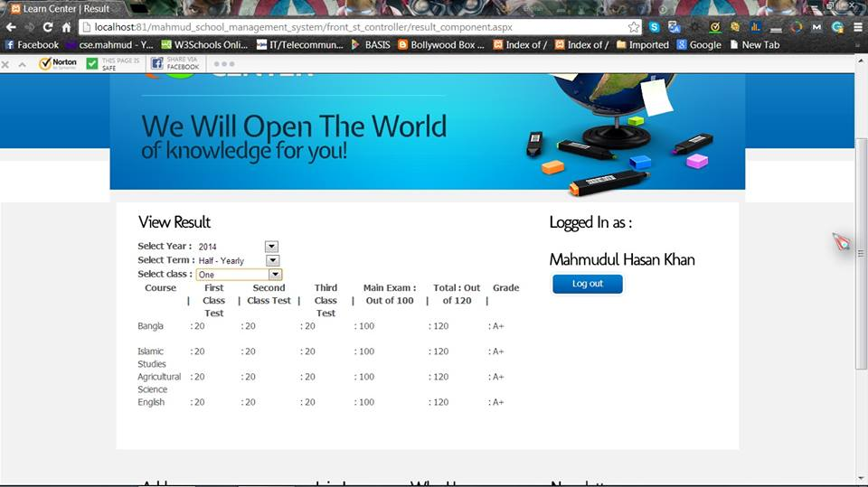
Design and UI- View Results

Slide 17
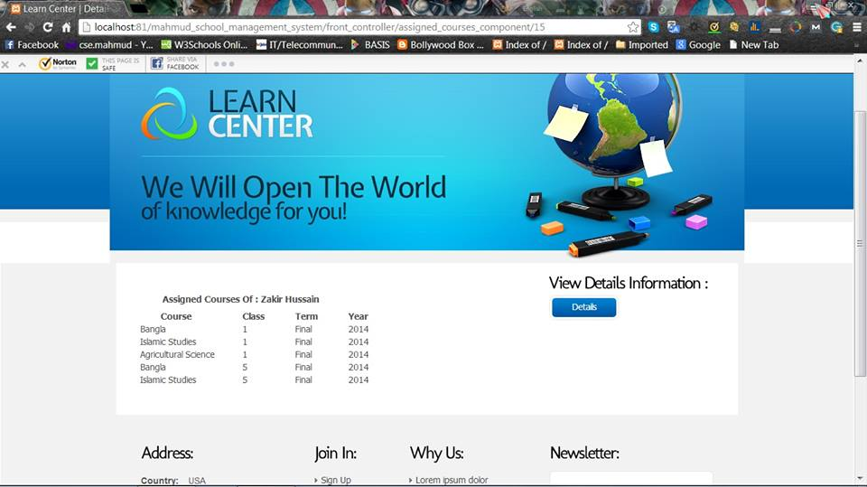
Design and UI-View Assigned Courses

Slide 18
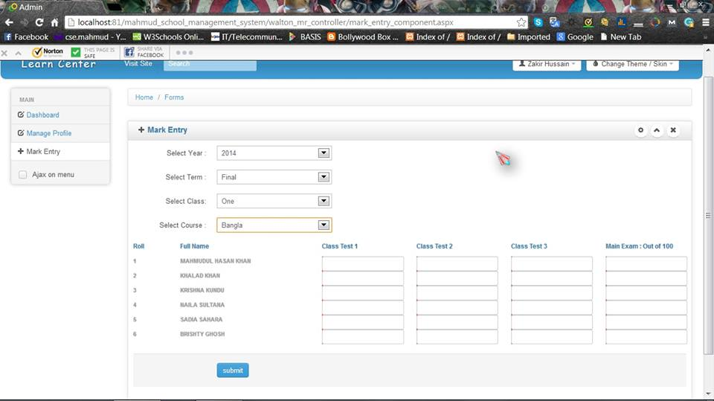
Design and UI- Input Marks

Slide 19
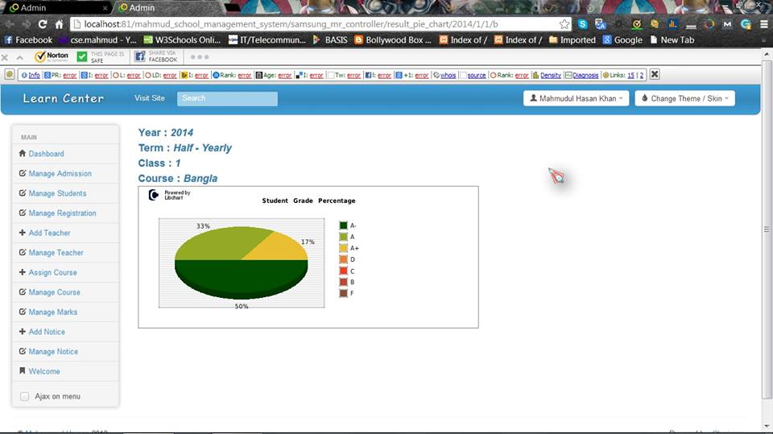
Design and UI- Pie Chart View

Slide 20
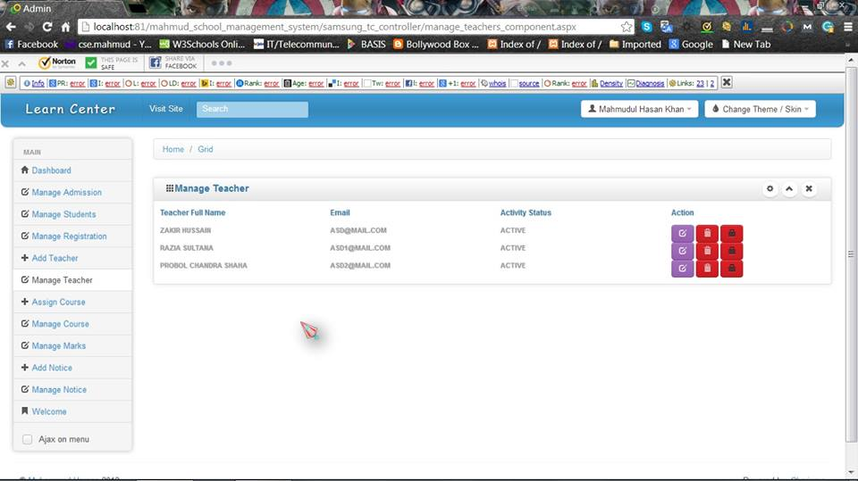
Design and UI- Manage Teacher

Slide 21
Design and UI- Color Combination
In order to keep simplicity , we have used white background
Besides white color, we have used blue color which is favorite to all

Slide 22
Implementation Plan
Make analysis and Develop an Object Oriented Diagram for the project
Take an attempt to make a prototype of the project
Make a Database with tables in MySQL
Make user interfaces with HTML, CSS and Bootstrap
Implement the project with PHP in CodeIgniter Framework
Testing the project
Show the prototype to the customers and update the prototype according to their requirements

Slide 23
References
http://www.w3schools.com/
http://en.wikipedia.org/wiki/Main_Page
https://ellislab.com/codeigniter

Slide 24
Thanks

