Slide 1
Open-source developer collaboration networks
Jozsef Csepanyi

Slide 2
Agenda
Introduction
Background
Research topic
Collaboration networks
Network measures
DCN patterns
Large-scale DCN analysis
Conclusion

Slide 3
1. Introduction
Importance of FLOSS projects
FLOSS = Free / Libre Open-Source Software, or
OSS = Open-Source Software
Companies are embracing OSS
E.g. Microsoft adding Linux shell and Android to Windows
Reasons are:
Interoperability
Transparency
Modularity
Cost

Slide 4
2. Background (1/2)
Commercial software
Open-source software
Strict hierarchy
Precise responsibilities
Closed source code
Clear business goal
Well-defined quality criteria
Self-organizing and dynamic structure
Open source code
Volunteering
More interaction and innovation
Evolutionary projects

Slide 5
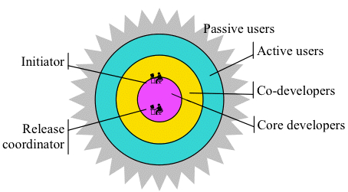
2. Background (2/2)
Each layer in the onion model is about one magnitude larger than the closest inner layer [3]
Core does not change throughout a project’s lifecycle [1]
More decentralized over time [1]
Lack of research into temporal models
Onion model [2]

Slide 6
3. Research topic
How do major events in the project lifecycle change the collaboration network of the project?
Effect of expected events (releases)
Effect of unexpected events (layoffs)

Slide 7
4. Collaboration networks (1/3)
Developer Collaboration Network (DCN)
A network of developers within an OSS project based on collaborative effort.
Types [4]:
Bug Tracking System-based (BTS-DCN)
Social Interaction-based (SI-DCN)
Version Control System-based (VCS-DCN)
The VCS (git and GitHub) tracks who edited which files and when
Collaboration effort: same file edited by two developers within a given timeframe

Slide 8
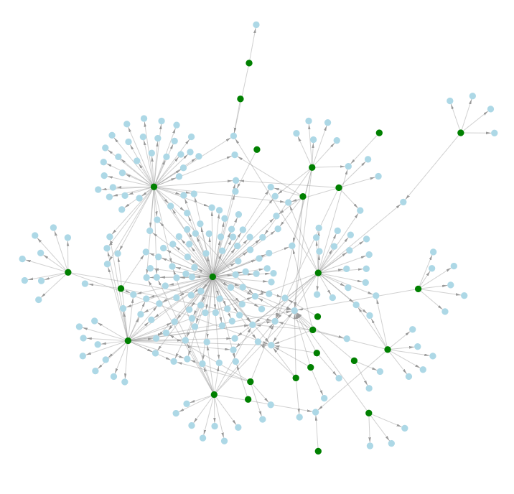
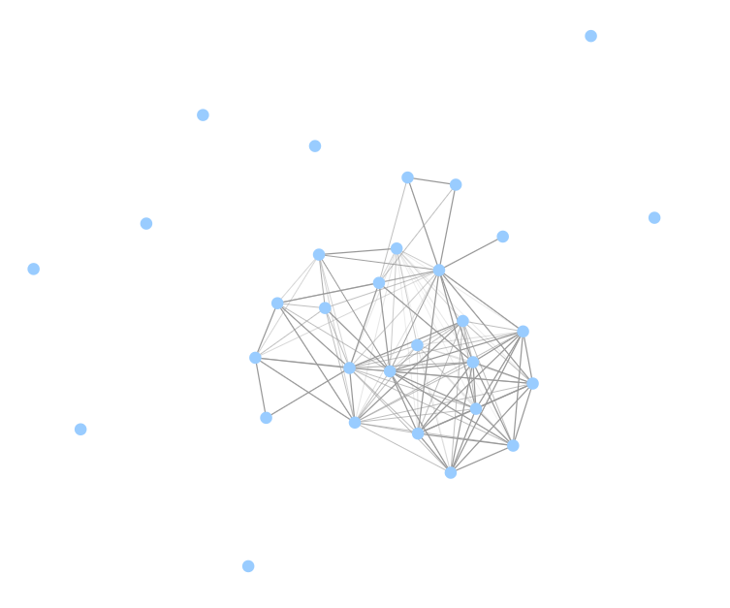
4. Collaboration networks (2/3)
Bipartite network
Author  File
Weighted undirected graph
Author  Author

Slide 9
4. Collaboration networks (3/3)
Collaboration network change over time

Slide 10
5. Network measures (1/5)
The network is described with network measures
Mean path length
Centralization
Clustering coefficient
Core/periphery ratio
Hierarchy
Non-network related measures
Issues opened
Issues closed

Slide 11
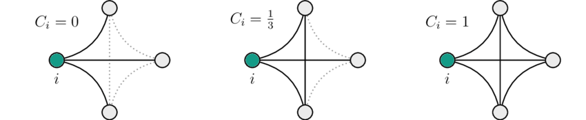
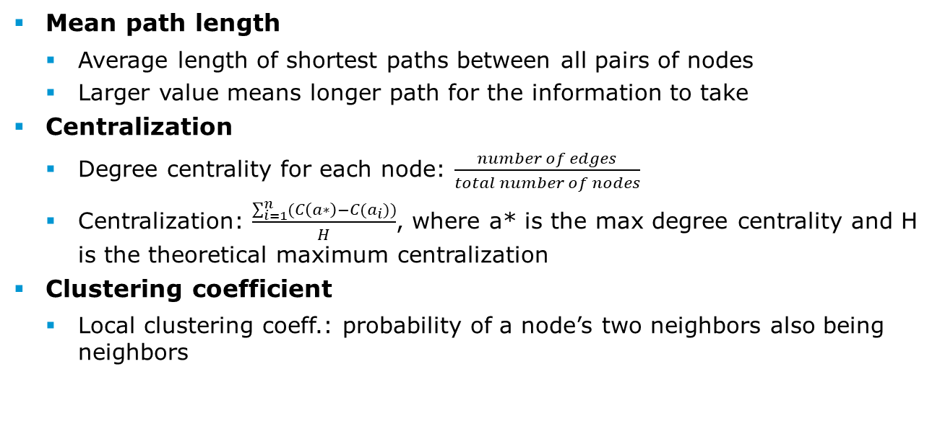
5. Network measures (2/5)
Mean path length
Average length of shortest paths between all pairs of nodes
Larger value means longer path for the information to take
Centralization
Degree centrality for each node: $\frac{number of edges}{total number of nodes}$
Centralization: $\frac{\sum_{i=1}^{n}{(C\left(a∗\right)−C(a_{i}))}}{H}$, where a* is the max degree centrality and H is the theoretical maximum centralization
Clustering coefficient
Local clustering coeff.: probability of a node’s two neighbors also being neighbors

Slide 12
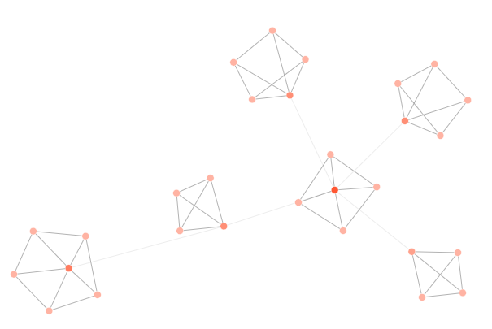
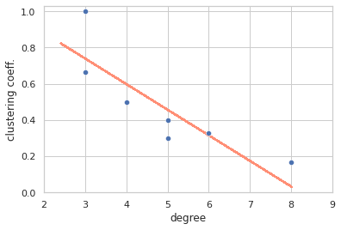
5. Network measures (3/5)
Hierarchy
Scale-free hierarchical network: hubs weakly connect to many distance nodes (other hubs), non-hubs cluster around hubs
Hub = team leader, non-hub = developer

Slide 13
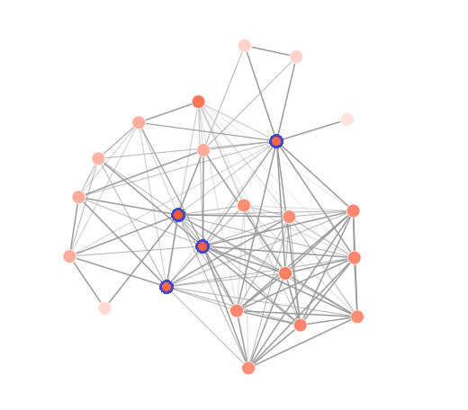
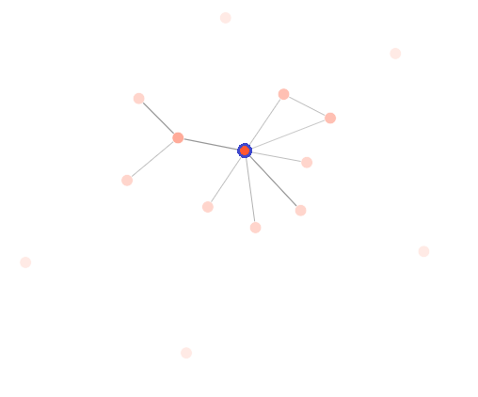
5. Network measures (4/5)
Core/periphery ratio
Core: top 20th percentile of developers regarding
Degree centrality
K-core
Research has found that the core does not change over the project lifecycle → Decrease of ratio means more periphery joined

Slide 14
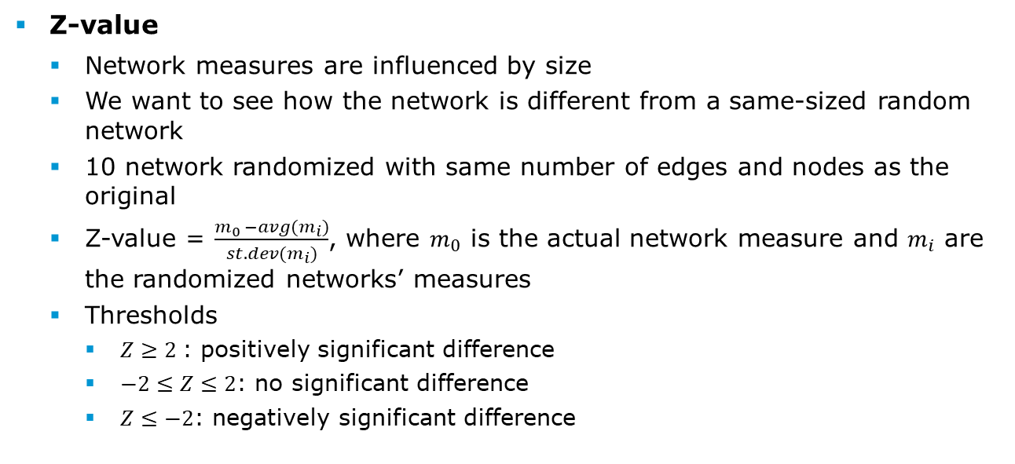
5. Network measures (5/5)
Z-value
Network measures are influenced by size
We want to see how the network is different from a same-sized random network
10 network randomized with same number of edges and nodes as the original
Z-value = $\frac{m_{0 }−avg(m_{i})}{st.dev(m_{i})}$, where $m_{0}$ is the actual network measure and $m_{i}$ are the randomized networks’ measures
Thresholds
$Z≥2$: positively significant difference
$−2≤Z≤2$: no significant difference
$Z≤−2$: negatively significant difference

Slide 15
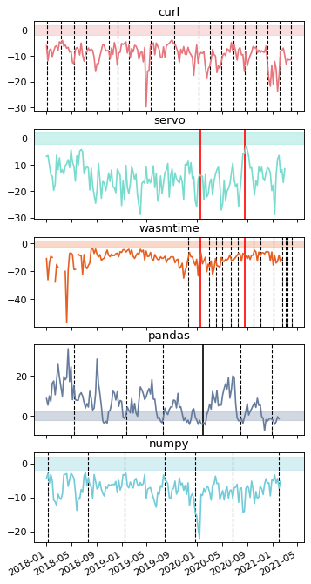
6. DCN patterns (1/4)
Overall: the uniqueness of each project greatly influences the network measures
Network graph
Colored area: not significant Z-value
Black lines: releases (minor and major)
Red lines: layoff events
Projects:
Pandas: positive difference
The rest: negative difference
All: at a release or layoff event the network becomes more similar to a random network
Smaller projects tend to only have activity right before a release
Larger projects have constant activity
Network density

Slide 16
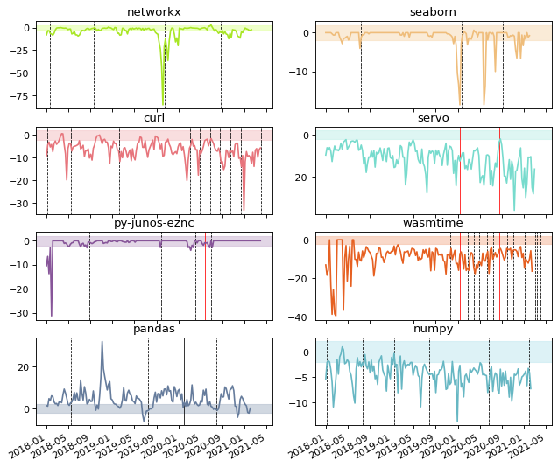
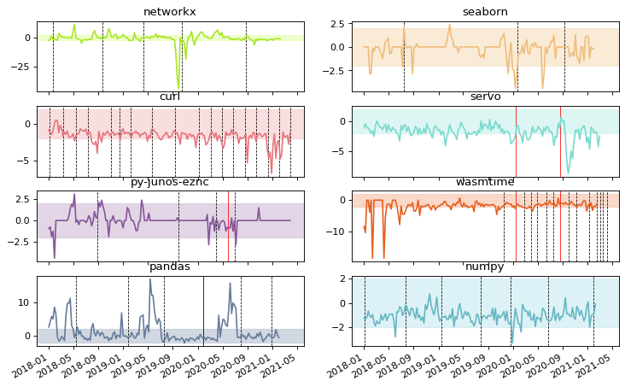
6. DCN patterns (2/4)
Clustering coefficient
Core/periphery ratio

Slide 17






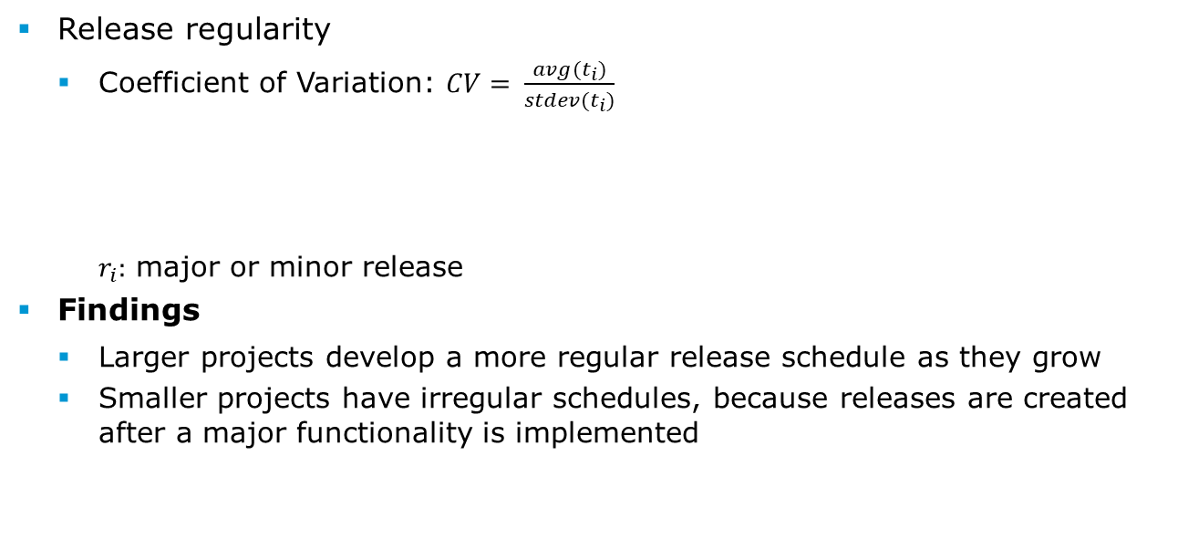



6. DCN patterns (3/4)
Release regularity
Coefficient of Variation: $CV= \frac{avg(t_{i})}{stdev(t_{i})}$ $r_{i}:$ major or minor release
Findings
Larger projects develop a more regular release schedule as they grow
Smaller projects have irregular schedules, because releases are created after a major functionality is implemented
$$r_{1}$$
$$r_{2}$$
$$r_{3}$$
$$r_{4}$$
$$r_{5}$$
$$t_{1}$$
$$t_{2}$$
$$t_{3}$$
$$t_{4}$$

Slide 18
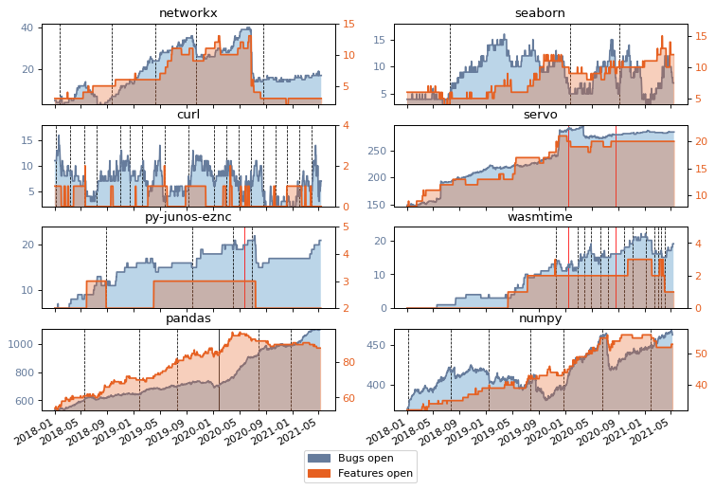
6. DCN patterns (4/4)
Number of open issues constantly grow in (almost) all projects
Issues do not correlate with releases
There are ‘issue clean-up’ periods, where all the open issues are revisited
Bug and feature classification
Heterogeneity of issue tracking makes it inaccurate
Simple keyword categorization effective only for 10-15% of issues

Slide 19
7. Large-scale DCN analysis (1/9)
Randomized sampling of large GitHub repositories
Selection criteria:
Commits: minimum 5000
Contributors: minimum 5
Minimum amounts for issues, pull requests, release, stars, forks
Forks are excluded
Need to have at least one open issue and one open pull request (the project is not abandoned)
Result: 2211 repo → randomly selected 110
Successfully mined: 78 repository

Slide 20
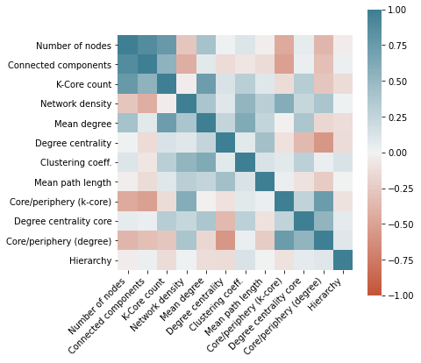
7. Large-scale DCN analysis (2/9)
Correlation matrix
Network measures for the last 28 days before a release

Slide 21
7. Large-scale DCN analysis (3/9)
Hypotheses | Result
H1a: A minor release has more lines changed than a patch release | Supported
H1b: A major release has more lines changed than a minor release | Not Supported
H2: There is less independence between developers at releases | Reverse supported
H3: Developers are clustered together significantly more during a release | Not supported
H4: The developer network becomes less hierarchical during a release | Supported
H5: More periphery developers are involved at a release | Supported
H6a: More issues opened before and after a release means more lines changed in the new version | Reverse supported
H6b: More issues closed before and after a release means more lines changed in the new version | Reverse supported

Slide 22
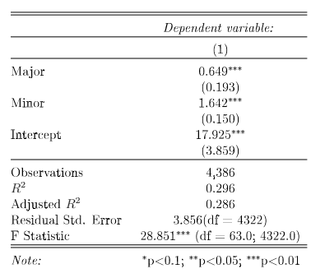

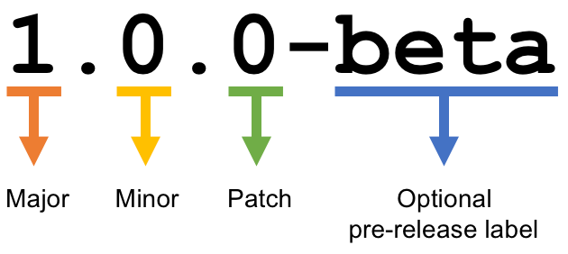

7. Large-scale DCN analysis (4/9)
H1a: Minor release > patch release (by number of lines changed)
H1b: Major release > minor release (by number of lines changed)
Baseline: patch (0)
H1a
H1b
Reasons:
Misclassification: multiple major release support
Arbitrary naming: major release just bundles the minor releases

Slide 23

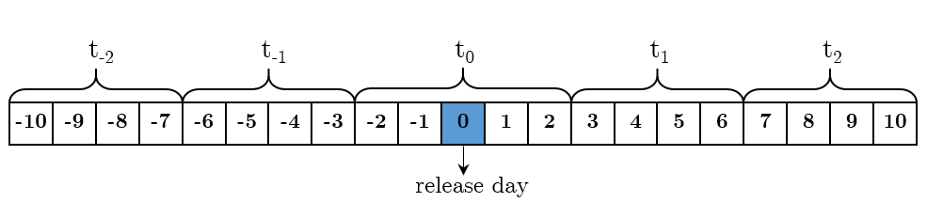
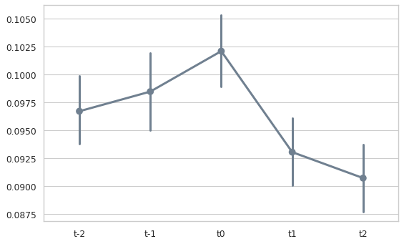
7. Large-scale DCN analysis (5/9)
H2: Less independence between developers at a release
Measure: mean path length → expected to fall at release
Time windows:
Mean path length rises at release
Proof for the contrary of our hypothesis
Reason: a release requires special tasks, that requires collaboration outside of normal circles

Slide 24
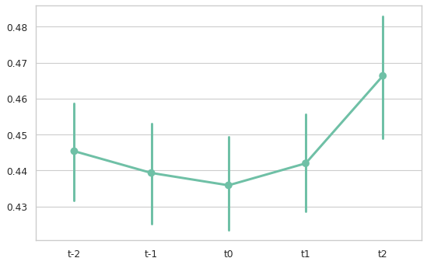
7. Large-scale DCN analysis (6/9)
H3: Developers cluster more at a release
Measure: clustering coefficient → expected to rise at release
Opposite is seen
BUT: after normalization only 15% of releases remain
→ not significant amount

Slide 25
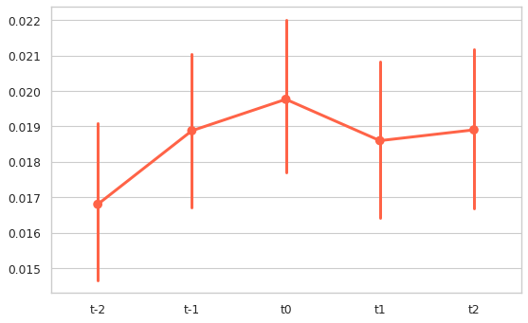
7. Large-scale DCN analysis (7/9)
H4: Developer network is less hierarchical at a release
Measure: hierarchy→ expected to rise at release
Higher value means less hierarchy
Before the release it is significantly low
But after release it stays high

Slide 26
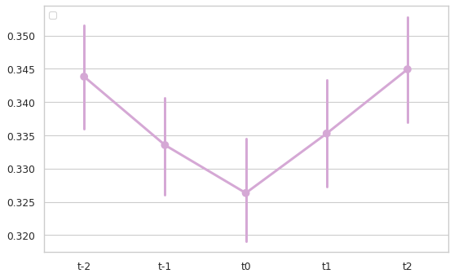
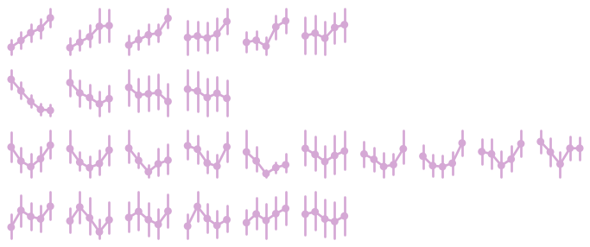
7. Large-scale DCN analysis (8/9)
H5: Periphery is more active at a release
Measure: core/periphery ratio → expected to fall
4 patterns recognized

Slide 27
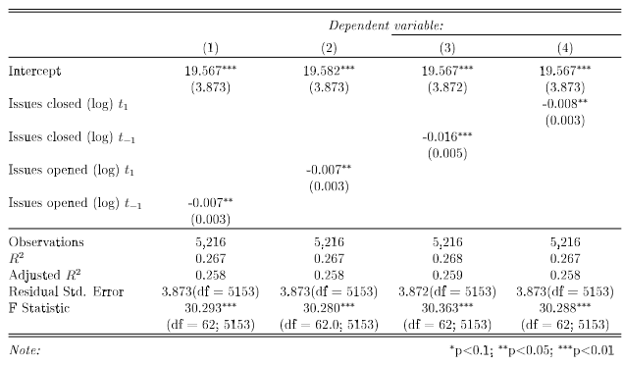
7. Large-scale DCN analysis (9/9)
H6a: More issues opened means more lines changed
H6b: More issues closed means more lines changed
All coefficients have p<0.05
Negative coefficient → reverse correlation
Correlation with the log of lines changed (not linear)
Explanation:
Most issues are resolved with patch releases, since they have less lines changed (H1a-b)

Slide 28
8. Conclusion (1/2)
Heterogeneity of projects makes is hard to draw general conclusions
Network size
Release cycles
Issue tracking
Software type and language
Different patterns in measures
However, generally projects get more chaotic around releases
Longer paths between developers
Less hierarchy
More developers
Different tasks than normally

Slide 29
8. Conclusion (2/2)
Future research topics
Bug and feature categorization (natural language processing)
More precise semantic versioning classification algorithm
How the success of an OSS can be measured (maturity levels)
All resources can be found online
Github (source code): https://github.com/csepanyij/master-thesis
Zenodo (mining databases): https://doi.org/10.5281/zenodo.5002638

Slide 30
Thank you for your attention!

Slide 31
References
[1] Kelvin McClean, Des Greer, and Anna Jurek-Loughrey. Social network analysis of open source software: A review and categorisation. Informationand Software Technology, 130:106442, February 2021.
[2] Kevin Crowston and James Howison. The social structure of free and open source software development. https://rstmonday.org/ojs/index.php/fm/article/download/1478/1393, February 2005
[3] Audris Mockus, Roy T. Fielding, and James D. Herbsleb. Two case studies of open source software development: Apache and Mozilla. ACM Transactions on Software Engineering and Methodology, 11(3):309-346, July 2002.
[4] Mohammed Aljemabi and Zhongjie Wang. Empirical Study on the Evolution of Developer Social Networks. IEEE Access, PP: 1-1, September 2018.

Slide 32
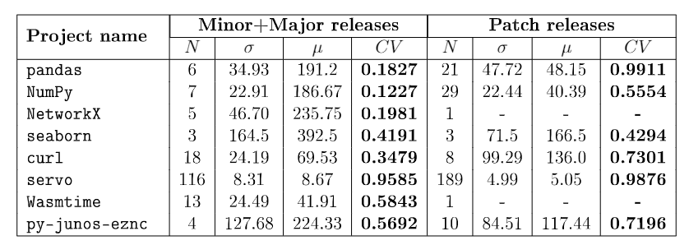
Appendices
Release regularities of projects

Slide 33
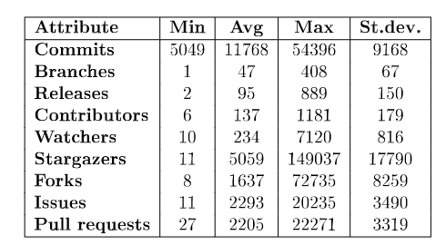
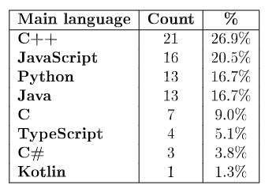
Appendices
Basic statistics of the 78 mined repository

