Slide 1

A Multi-Model Approach for Classifying Sleep Disorders Utilizing Machine Learning and Deep Learning Techniques
395
Presented by,
Md. Ruhul Amin Shazid
Department of CSE
Bangladesh University of Business and Technology (BUBT)

Slide 2
Outline
Introduction
Motivation
Research Objectives
Methodology
Result and Analysis
Limitations
Conclusion

Slide 3
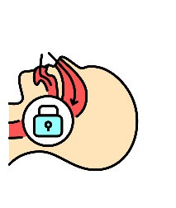
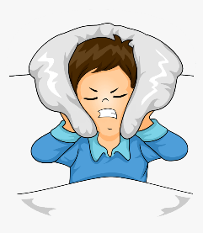
Introduction
Sleep disorders are disruptions in normal sleep patterns, affecting the quality of rest.
Early diagnosis of these sleep disorders is important for managing
these conditions and promoting well-being.
1.Insomnia
is a sleep disorder where a person's breathing is repeatedly interrupted during sleep
is when an individual finds it difficult to fall asleep or stay asleep
2.Sleep Apnea

Slide 4
Motivation
Early Detection of Sleep Disorders
Limitations of Current Approaches:
The Potential of Advanced Models
Precision in Sleep Disorder Classification
Performance Evaluation and Model Superiority
Comparative Analysis for Informed Decision-Making

Slide 5
Research Objectives
Our research objectives involve adopting a multi-model approach to effectively classify
sleep disorders. The primary aim is to implement various models including,
Machine
Learning
Deep
Leaning
To conduct a thorough analysis to determine the best model for
accurately classifying sleep disorders.

Slide 6
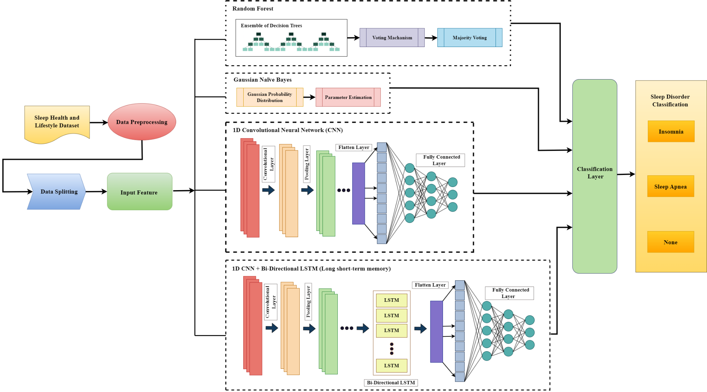
Methodology
Figure 01: Utilizing Both Machine Learning and Deep Learning Techniques to Classify Sleep Problems

Slide 7
Result and Analysis
Reference | Models | Accuracy
Machine Learning Models | Random Forest | 88%
 | Gaussian Naïve Bayes | 72%
Deep Leaning Models | 1D CNN | 90.67%
 | 1D CNN + Bidirectional LSTM | 92%
Deep learning outperforms machine learning.
The hybrid model shows more accuracy than individual models.

Slide 8
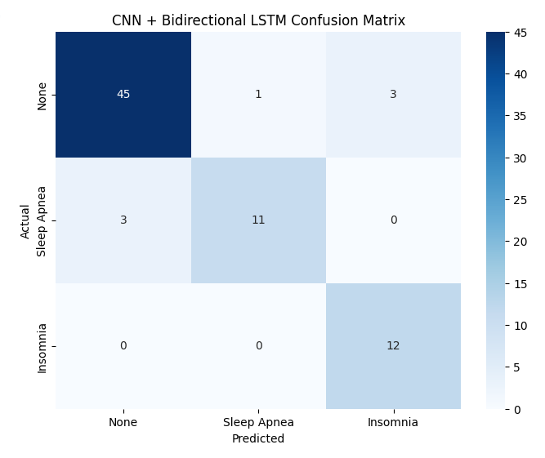
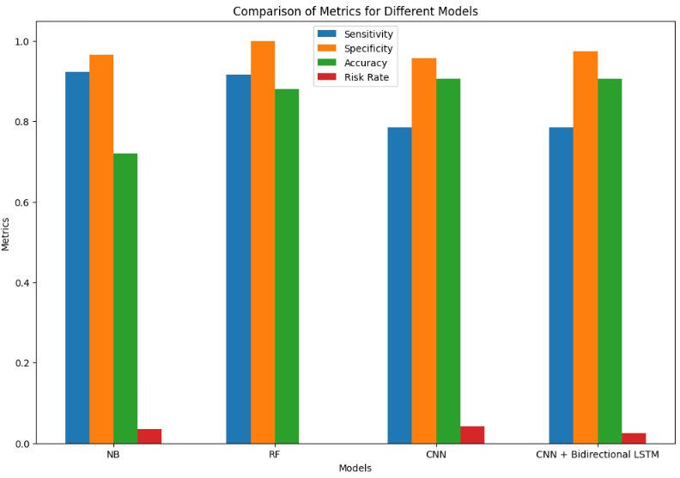
Confusion Matrix of the Hybrid Mode
Performance Metrics of Each Mode

Slide 9
Limitations
Synthetic Data Constraints
Model Interpretability Challenge
Real-time Monitoring Challenges

Slide 10
Conclusion
Diverse models classify sleep disorders into three categories.
Our method combines the best features of 1D CNN and Bi-LSTM.
Comparison includes both machine learning and deep learning models.
The hybrid model achieves 92% accuracy.
Future work: Explore ECG for sleep disorder diagnosis.

Slide 11
Thank you

