Slide 1


Deep Learning Based Real Time Bengali Multi-Vehicle Number Plate Detection
2024 (ICCA)- International Conference on Computing Advancements
Paper ID: 301
Presented By Shaneen Ara
Organized by AIUB

Slide 2







Abstract
Methodology
Introduction
ItOD-AD
Result Analysis
Related Works
Conclusion
References

Slide 3



Abstract
The study develops an advanced system using YOLOv8 to accurately and quickly detect Bengali vehicle license plates in real-time, outperforming traditional CNN models.
Leveraging tools like Google Colaboratory Pro, the YOLOv8 model ensures efficient, fast, and accurate real-time detection.
The system aims to reduce traffic congestion and revenue leakage, contributing to smarter, more sustainable transportation through deep learning techniques.

Slide 4
INTRODUCTION
Real-Time Bengali License Plate Detection:The study uses advanced deep learning techniques to develop a system that accurately detects vehicle license plates in real-time, specifically for Bengali language and diverse environments.
YOLOv8 for Speed and Accuracy: YOLOv8, an advanced deep learning model, is employed for its faster, more accurate, and easier-to-use features compared to traditional CNN models.
Use of Modern Tools: Tools like Google Colaboratory Pro and Google Compute Engine are used to ensure real-time functionality and high accuracy in license plate detection.
Addressing Real-World Challenges: The research aims to solve issues like traffic congestion and revenue leakage through precise license plate detection, contributing to smoother and more efficient transportation infrastructure.

Slide 5
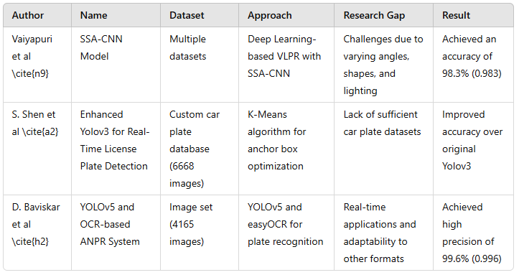
Related Works

Slide 6
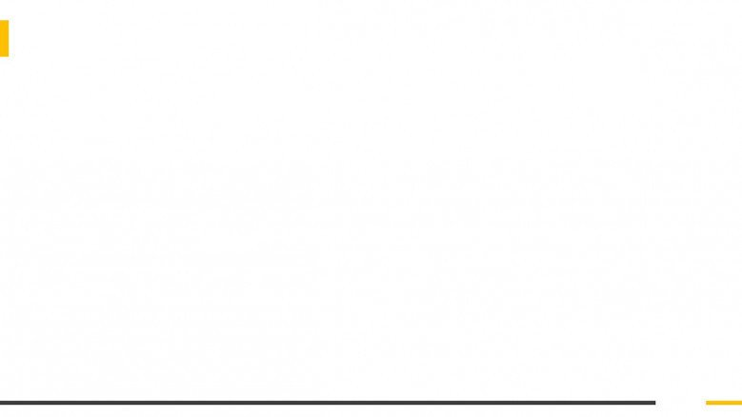

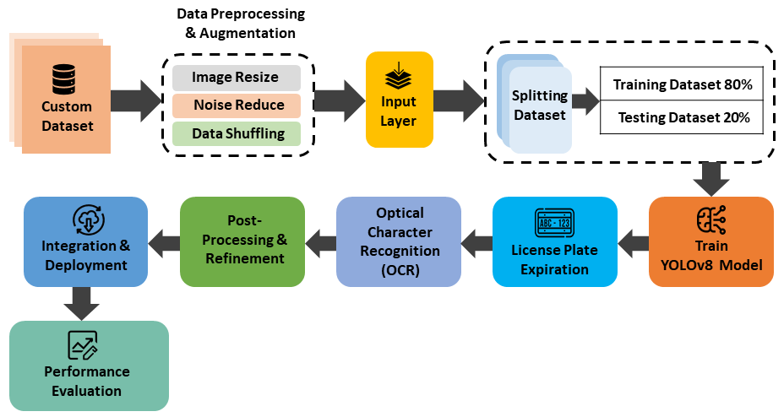
Methodology
Methodology Architecture

Slide 7
Methodology
Proposed Model Architecture: The system is based on the YOLOv8 architecture, which processes vehicle images, localizes license plates, and recognizes characters using Optical Character Recognition (OCR)​.
Data Gathering: A diverse set of vehicle images is collected, annotated with bounding boxes around license plates, and split into training, validation, and test datasets​.
Data Analysis and Preprocessing: Images are preprocessed by resizing, noise reduction, and shuffling. The dataset is formatted for YOLOv8 to enable accurate model training without needing fixed image dimensions.​
Training and Validation: YOLOv8 is trained using annotated images, with iterative learning processes for improving detection accuracy. The model is regularly validated to fine-tune parameters.
Testing and Evaluation: The trained model is tested on unseen images to evaluate performance. Key metrics like precision, recall, F1-score, and accuracy are used to assess the model​

Slide 8
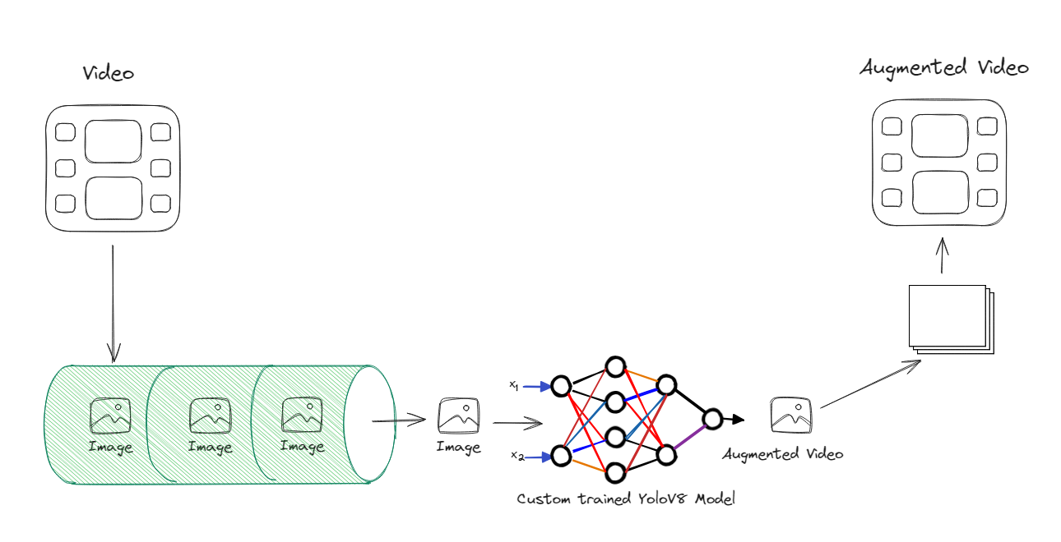
Result Analysis
Fig. 2. Random Training Video Data

Slide 9


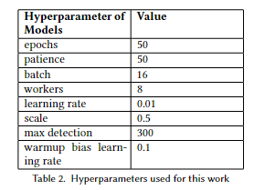
Evaluation

Slide 10
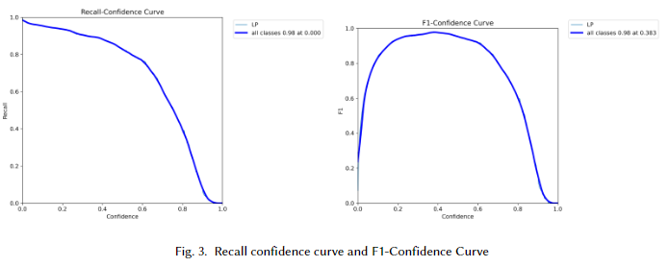
Evaluation

Slide 11
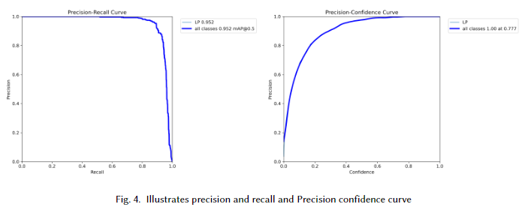
Evaluation

Slide 12
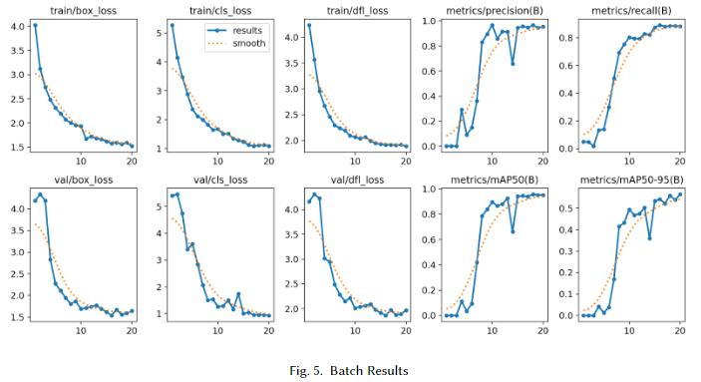
Evaluation

Slide 13
Conclusion
High Accuracy: The YOLOv8-based system achieved 97.8% accuracy in real-time Bengali vehicle number plate detection.
Practical Impact: The model improves traffic management and surveillance, performing well across diverse real-world conditions.
Future Enhancements: Further research will focus on improving adaptability to various number plate formats and challenging scenarios.

Slide 14
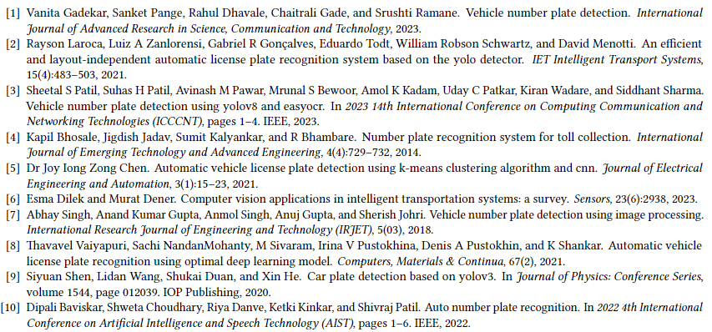
Reference

Slide 15

Any Question?

