Slide 1
Firewall

Slide 2
Outline
Firewall concept
Netfilter
Implement a simple firewall using Netfilter
Iptables firewall in Linux
Stateful Firewall and connection tracking
Bypassing Firewall

Slide 3

Overview of Firewall

Slide 4
Concept
Direction
Ingress
Egress
Types
Packet Filter
Stateful Firewall
Application/Proxy Firewall

Slide 5
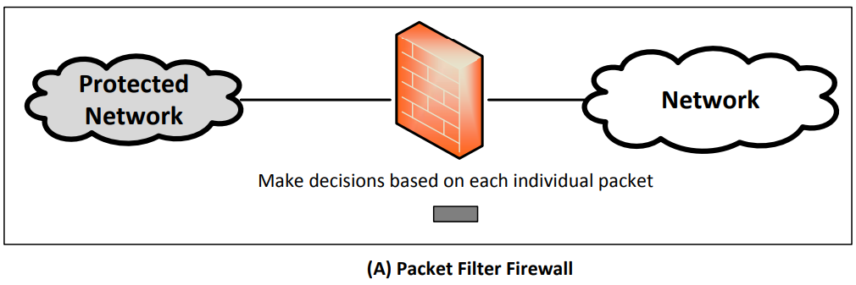
Packet Filter

Slide 6
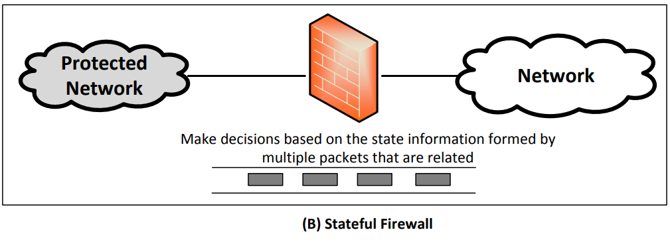
Stateful Firewall
Notes:
Eitar example hote pare emon je jei tcp already established shei tcp er packet gula allow korbo; baki gula allow korbo na
Stateless ta ashole just sob packet gula check kore

Slide 7
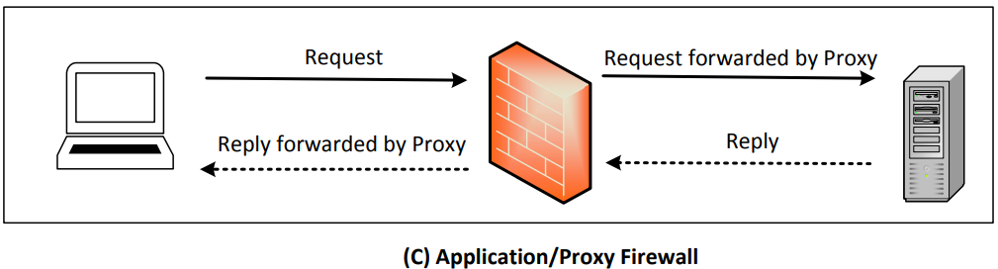
Application/Proxy Firewall

Slide 8
Implement a simple firewall

Slide 9
How Firewall Works

Slide 10
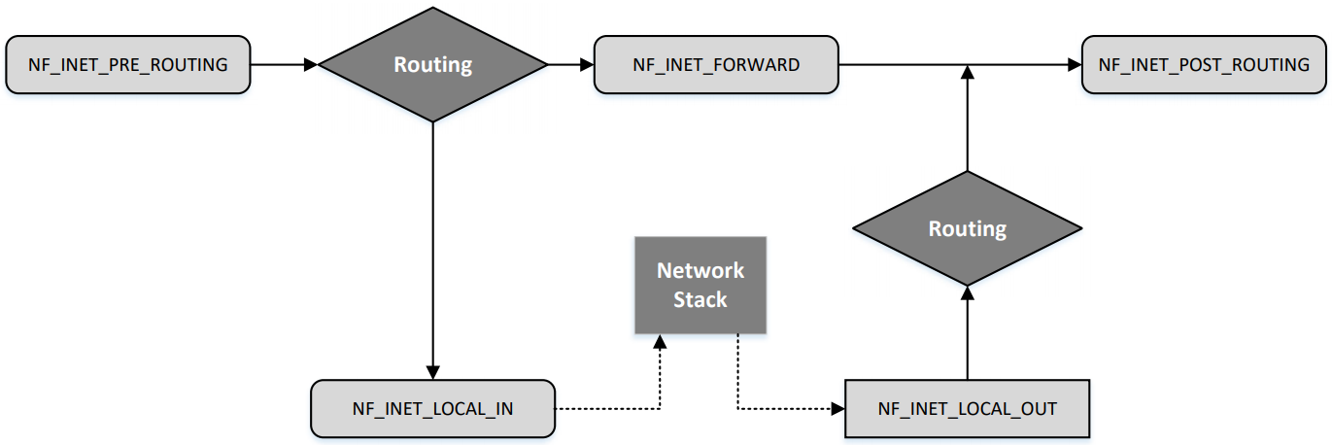
Netfilter Hooks

Slide 11
Applications of Netfilter
Packet Filtering: Stateless Firewall
Connection Tracking: Stateful Firewall
Packet Address Translation: NAT
Further Packet Modification

Slide 12
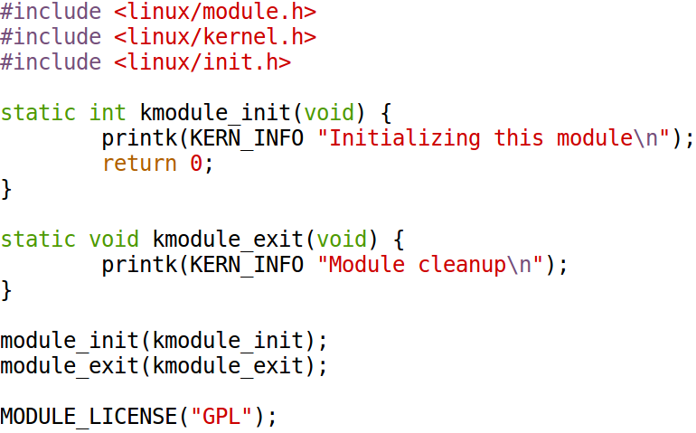
Kernel Module: Code

Slide 13
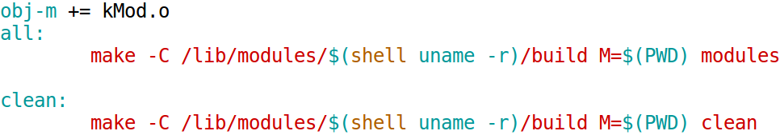
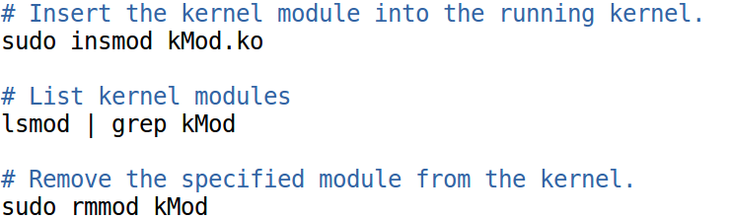
Compilation & Installation
Compilation
Commands

Slide 14
Kernel Module: Commands
Commands
Checking the kernel printout
$ dmesg

Slide 15
Using Netfilter

Slide 16
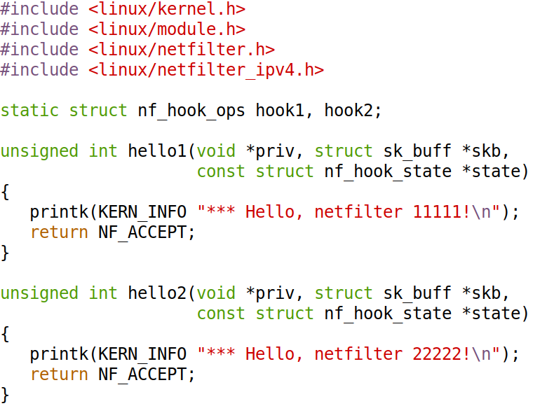
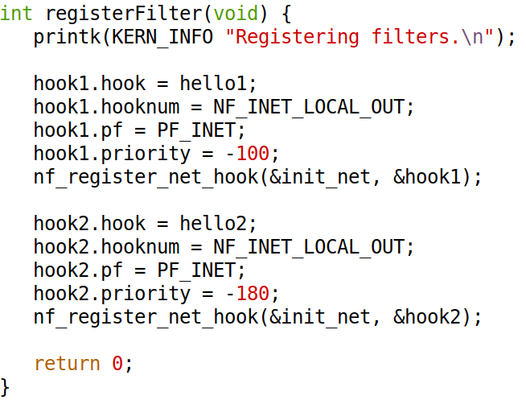
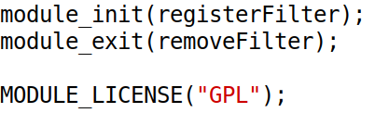
Registering Hook Functions
Notes:
Jar priority number kom tar priority higher

Slide 17
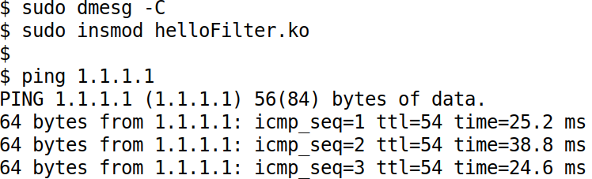
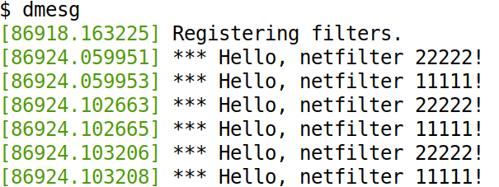
Execution Results

Slide 18
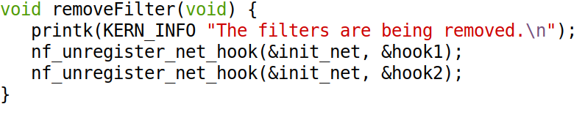
Remove Hook Functions

Slide 19
Verdict on Packets (Return Values)
NF_ACCEPT: Let the packet flow through the stack
NF_DROP: Discard the packet
NF_QUEUE: Pass the packet to the user space
NF_STOLEN: Tell netfilter to forget about this packet
NF_REPEAT: Request the netfilter to call this module again.

Slide 20
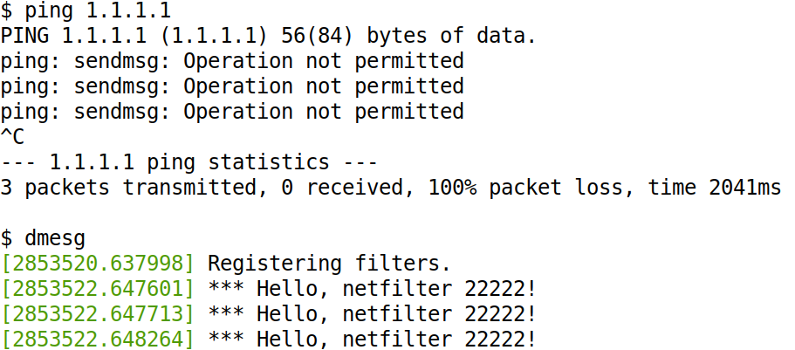
Experimenting with the Return Value
Hook hello2: change NF_ACCEPT to NF_DROP

Slide 21
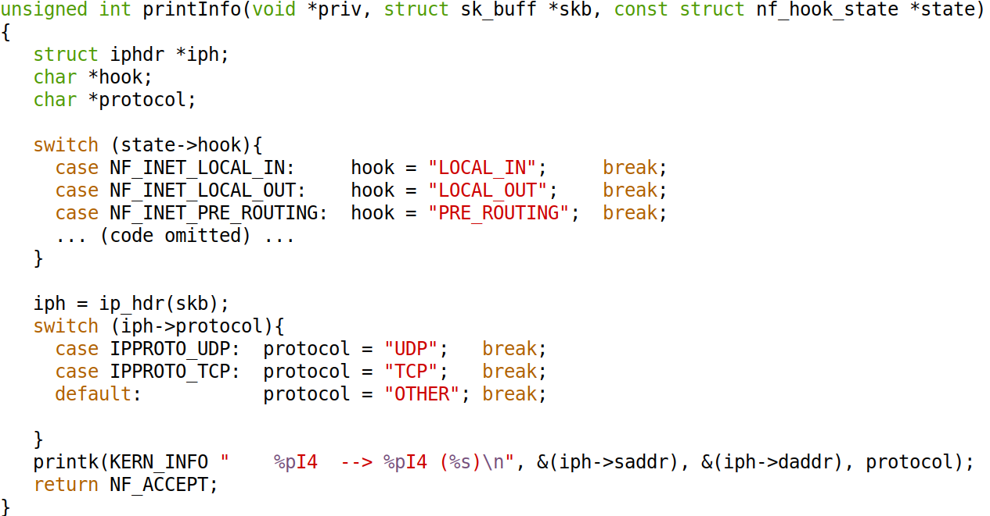
Hook Example 1: Print Out Information

Slide 22
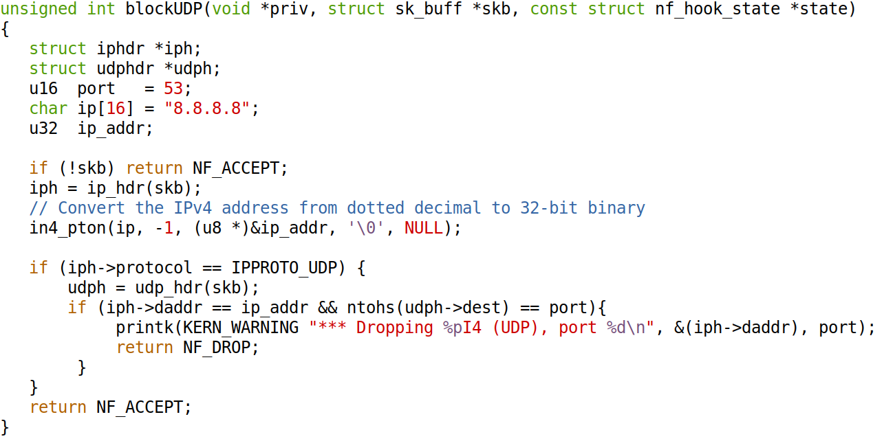
Hook Example 2: Block Packets

Slide 23
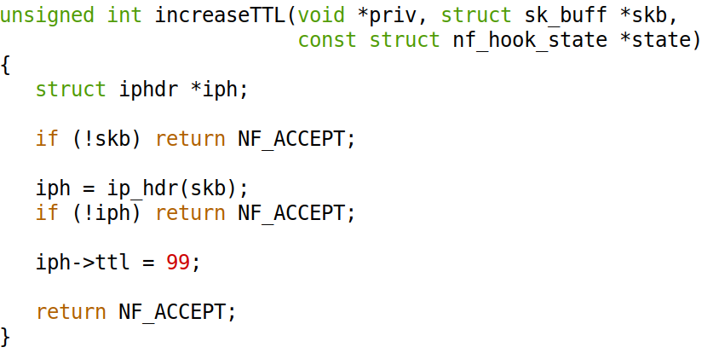
Hook Example 3: Modify Packets

Slide 24
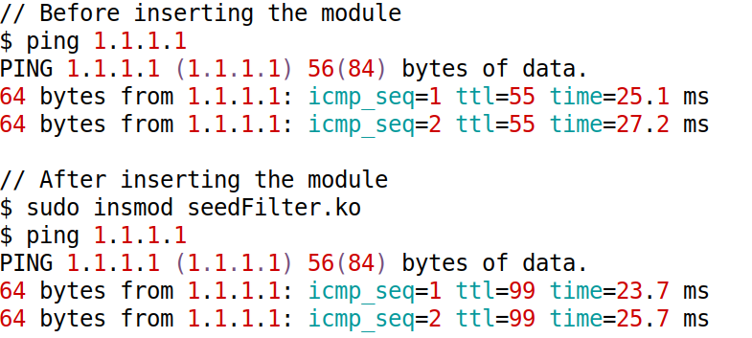
Testing: Increase TTL

Slide 25
iptables

Slide 26
Iptables
Linux’s built-in firewall
iptables is only the user-space program
The actual firewall in the kernel is Xtables
iptables is often used to refer to both

Slide 27
Iptables and Netfilter

Slide 28
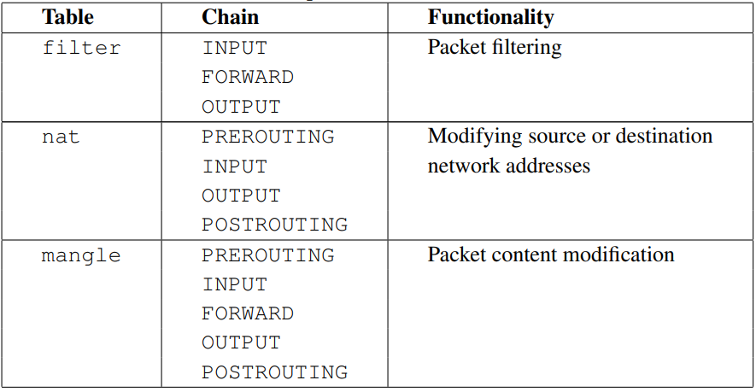
Tables and Chains

Slide 29
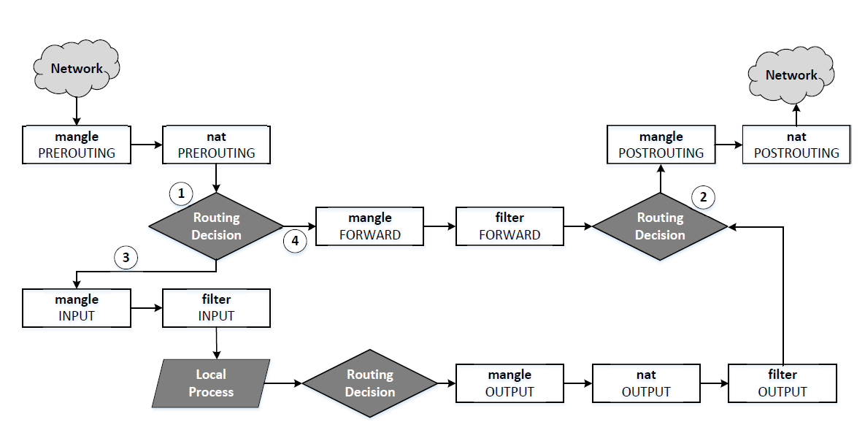
Packet Traversal Path

Slide 30
Using iptables: General Format
iptables [-t filter] -A INPUT <rule> -j <target>

Slide 31
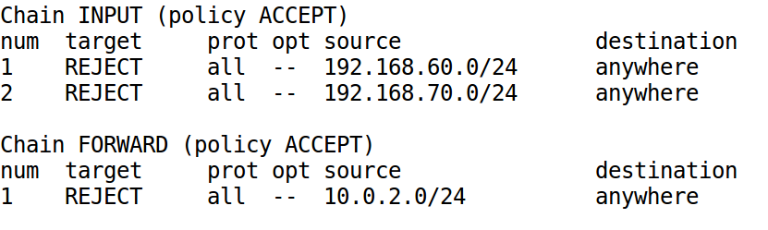
Examples
List/Delete All Rules
$ sudo iptables -t nat -L
$ sudo iptables -t nat -F
List/Delete Rules with Numbers
$ sudo iptables -L --line-numbers
$ sudo iptables -D INPUT 2

Slide 32
Specifying Rule (1)
Layers 2 and 3
-i interface (incoming)
-o interface (outgoing)
-s source IP (/mask)
-d destination IP (/mask)

Slide 33
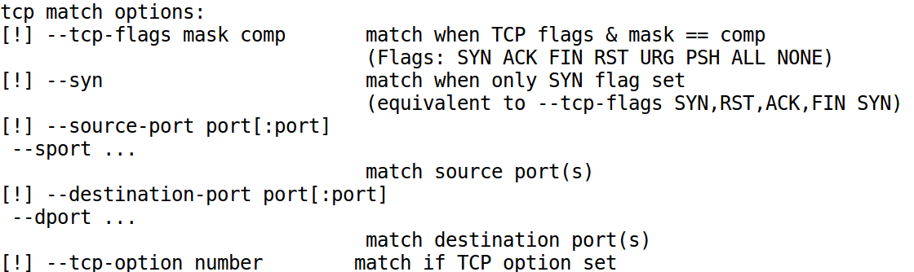
Specifying Rule (2): TCP/UDP/ICMP
-p protocol [protocol specific rule]
ex: -p tcp --dport 22
ex: -p icmp --icmp-type echo-request
Get help: iptables -p tcp -h

Slide 34
Target
ACCEPT
DROP
RETURN
LOG
Target Extension (e.g., SNAT, TOS, TTL)
Get help: iptables -j SNAT -h

Slide 35
Examples
Block IP
$ sudo iptables -A INPUT -s 192.168.30.6 -d 192.168.1.0/24 -j DROP
Open TCP ports 22 and 80
$ sudo iptables -A INPUT -p tcp --dport 22 -j ACCEPT
$ sudo iptables -A INPUT -p tcp --dport 80 -j ACCEPT
Allow all outgoing TCP traffic
$ sudo iptables -A OUTPUT -p tcp -j ACCEPT

Slide 36
Implement NAT Using iptables

Slide 37
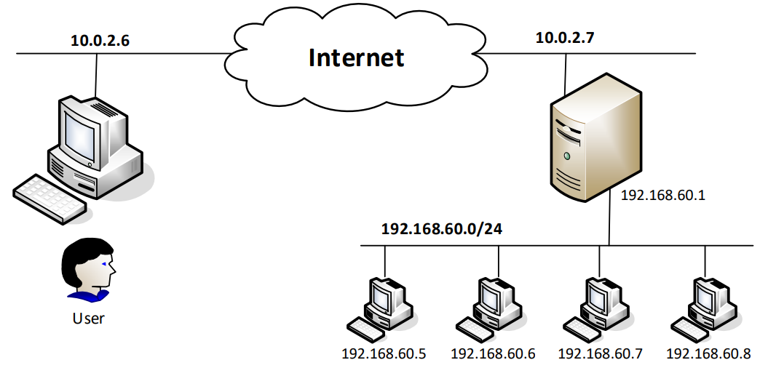
Network Address Translation (NAT)

Slide 38
Using iptables for Source NAT
Modify Source IP: Source NAT (SNAT)
$ sudo iptables -t nat -A POSTROUTING -o enp0s3 \
-j SNAT --to-source 10.0.2.7
IP Masquerading and NAT
$ sudo iptables -t nat -A POSTROUTING -o enp0s3 \
-j MASQUERADE

Slide 39
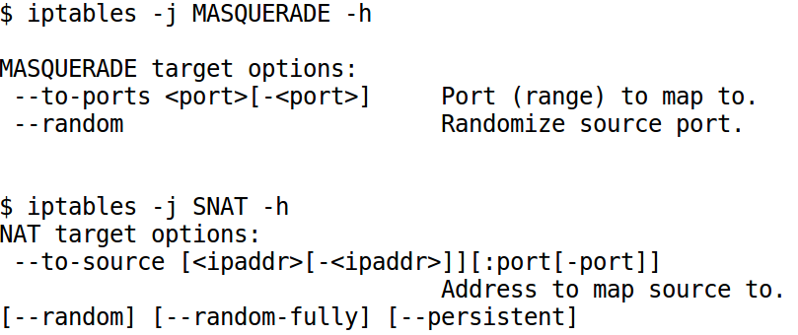
Getting Help

Slide 40
Destination NAT: Port Forwarding
$ sudo iptables -t nat -A PREROUTING -p tcp --dport 8000 \
-j DNAT --to-destination 192.168.60.5:23

Slide 41
DNAT: Load Balancing

Slide 42
DNAT: Load Balancing
$ sudo iptables -t nat -A PREROUTING -p tcp --dport 8000 \
-m statistic --mode random --probability P1 \
-j DNAT --to-destination 192.168.60.5:8000
$ sudo iptables -t nat -A PREROUTING -p tcp --dport 8000 \
-m statistic --mode random --probability P2 \
-j DNAT --to-destination 192.168.60.6:8000
$ sudo iptables -t nat -A PREROUTING -p tcp --dport 8000 \
-m statistic --mode random --probability P3 \
-j DNAT --to-destination 192.168.60.7:8000
Notes:
Derive P1, P2, and P3

Slide 43
Load Balancing: Use Another Module
$ sudo iptables -t nat -A PREROUTING -p tcp --dport 8000 \
-m statistic --mode nth --every 3 --packet 0 \
-j DNAT --to-destination 192.168.60.5:8000
$ sudo iptables -t nat -A PREROUTING -p tcp --dport 8000 \
-m statistic --mode nth --every 2 --packet 0 \
-j DNAT --to-destination 192.168.60.6:8000
$ sudo iptables -t nat -A PREROUTING -p tcp --dport 8000 \
-j DNAT --to-destination 192.168.60.7:8000

Slide 44
Use iptables Match/Target Extensions

Slide 45
Match and Target Extensions
iptables [-t filter] -A INPUT <rule> -j <target>

Slide 46
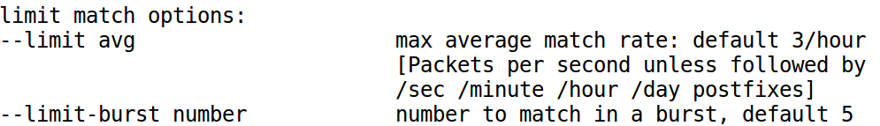
Match Extension Example: the Limit Module
$ sudo iptables -A INPUT -p icmp \
-m limit --limit 10/min --limit-burst 5 \
-j ACCEPT
$ sudo iptables -A INPUT -p icmp -j DROP
$ sudo iptables -m limit -h

Slide 47
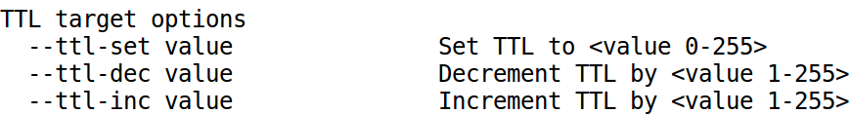
Target Extension Examples
The SNAT and DNAT Target Extension (nat table)
Increase the TTL field of all packets by 5 (mangle table)
$ sudo iptables -t mangle -A OUTPUT -j TTL --ttl-inc 5
Get help: iptables -j TTL -h

Slide 48
Stateful Firewall & Connection Tracking

Slide 49
Need for Connection Tracking

Slide 50
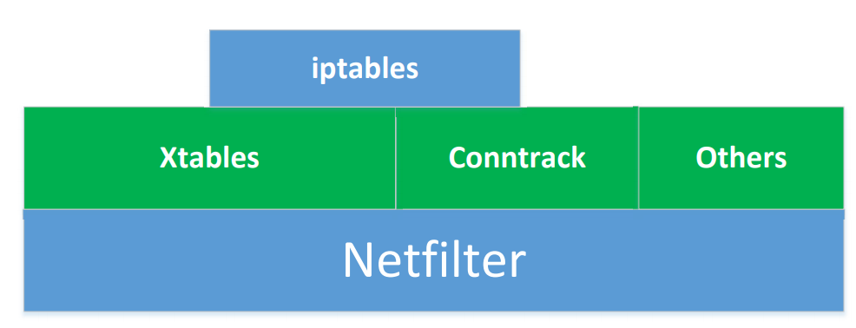
Mechanism for Connection Tracking

Slide 51
Connection States
NEW
ESTABLISHED
RELATED
INVALID

Slide 52
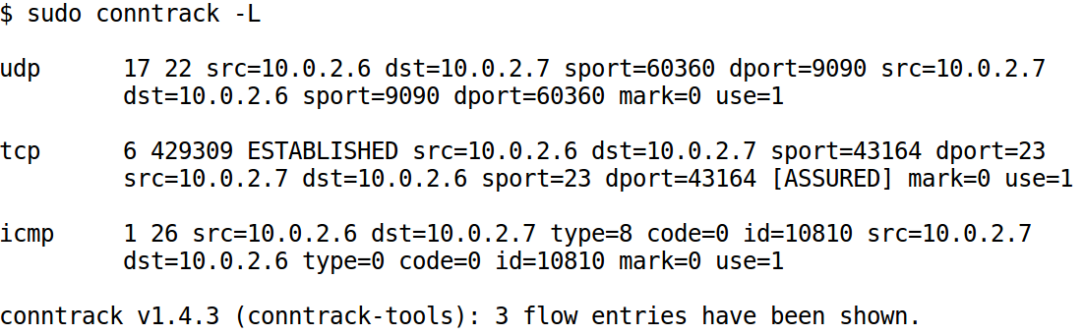
Check Connection Tracking

Slide 53
Using Connection Tracking
$ sudo iptables -A INPUT –p tcp \
-m conntrack --ctstate NEW,RELATED,ESTABLISHED \
-j ACCEPT

Slide 54
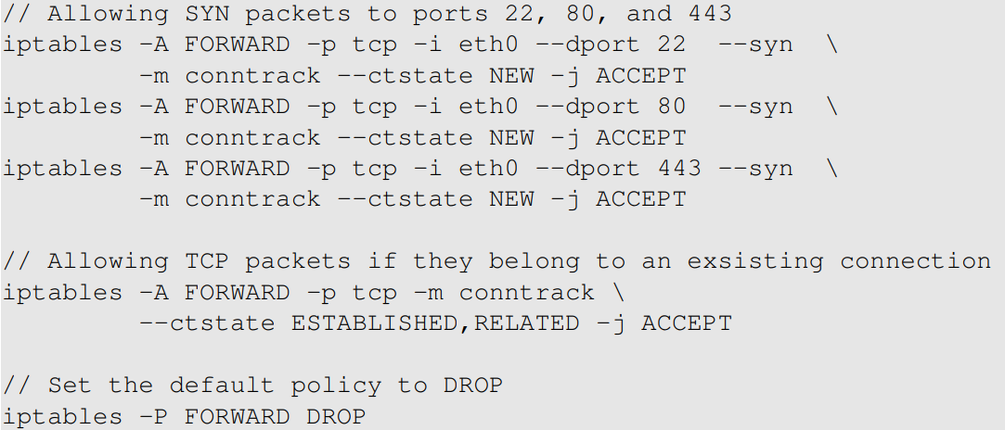
An Example

Slide 55
Application Firewall/Proxy

Slide 56
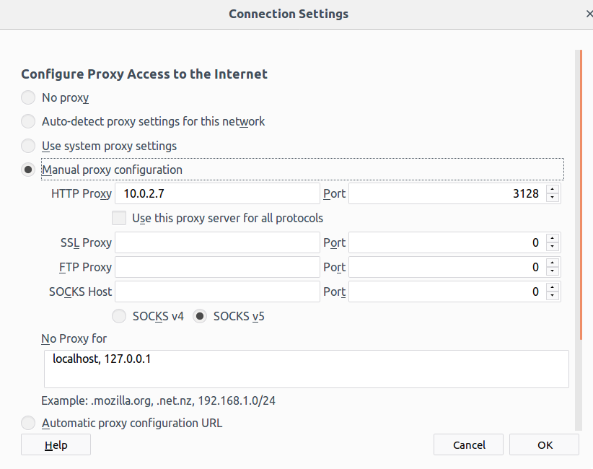
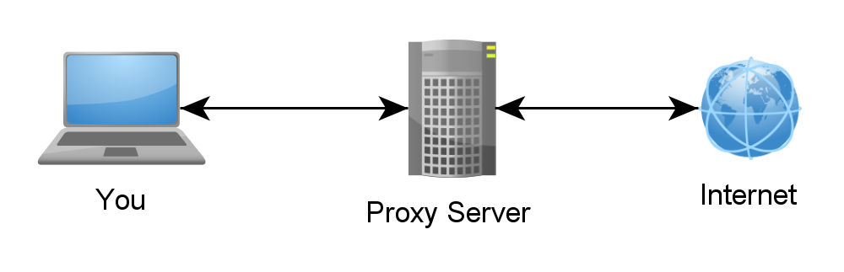
Web Proxy

Slide 57
bypassing firewall

Slide 58
How to Bypassing Firewall
Use vulnerabilities
Use tunneling

Slide 59
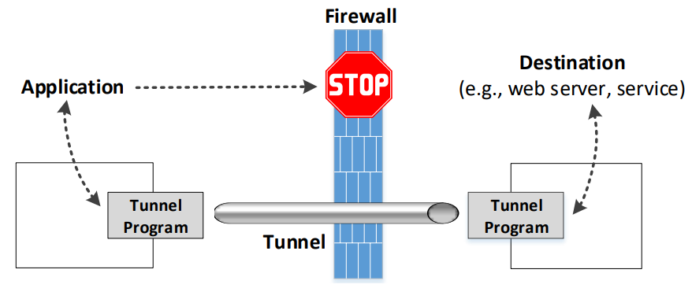
The General Ideas of Tunneling

Slide 60
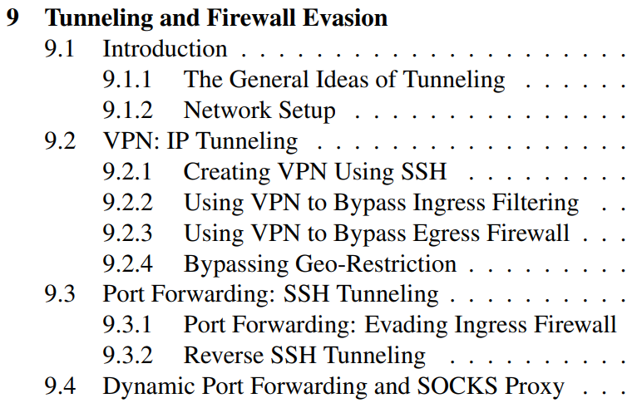
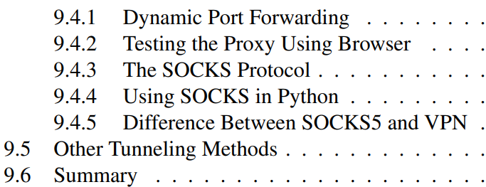
New Chapter (3rd edition)

Slide 61
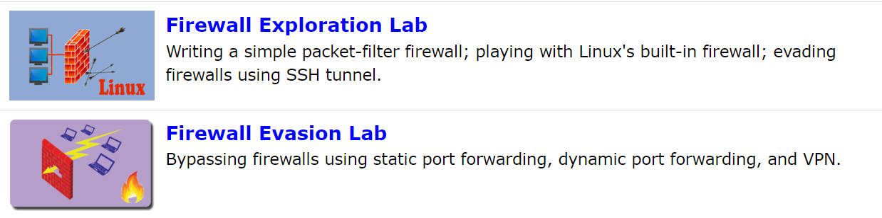
Labs

