Slide 1
Tunneling and Firewall Evasion

Slide 2
Outline
VPN Tunnels
Port Forwarding
SOCKS Proxy

Slide 3
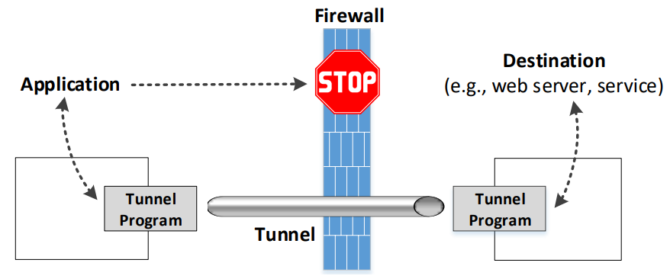
The General Ideas of Tunneling

Slide 4
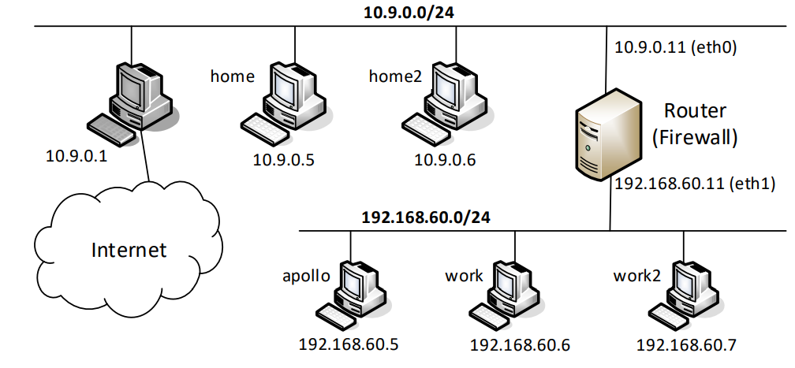
Experiment Setup: Network

Slide 5
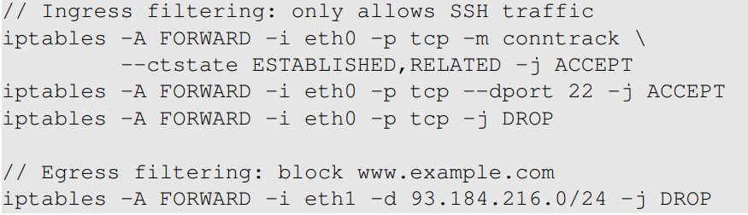
Setup: Firewall Rules
On Router

Slide 6
VPN Tunneling

Slide 7
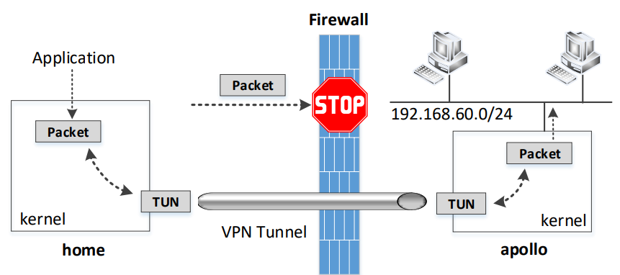
Bypassing Ingress Firewall Using VPN
Notes:
Use this diagram to explain the entire process: the theory part. In the next few slides, we will talk about how to actually do it (the practice part). The practice part do not list all the commands needed to run. Only the most important steps are included. Details can be found in the book.

Slide 8
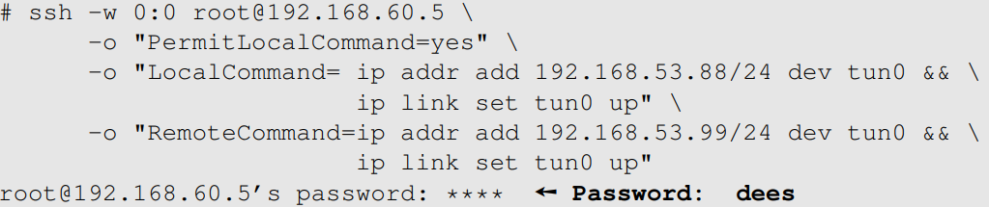
Set Up A VPN Tunnel
Client: Home
Server: Apollo
Run it on client
Notes:
Explain the purpose of the commands: local and remote commands

Slide 9
Configure the Client and Server
Client: Redirect packets
Server: Set up NAT

Slide 10
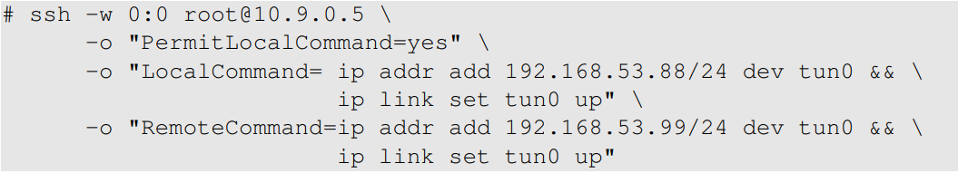
Bypassing Egress Firewall Using VPN
Client: Apollo
access to www.example.com is blocked by the firewall
Server: Home
Run it on client

Slide 11
Configure Client and Server
Client:
Server: Set up NAT

Slide 12
Port forwarding

Slide 13
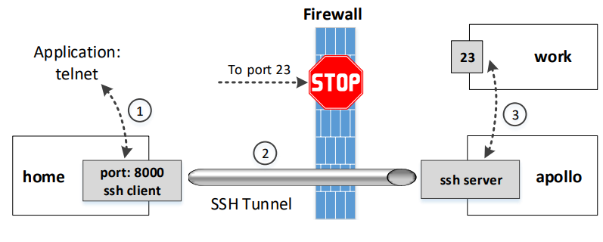
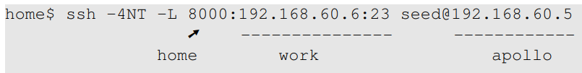
Evading Ingress Firewall
We want to access “work” from “home”
Notes:
-4: use IPv4 only, or we will see some error message.
-N: do not execute a remote command.
-T: disable pseudo-terminal allocation (save resources).

Slide 14
Comparison with VPN

Slide 15

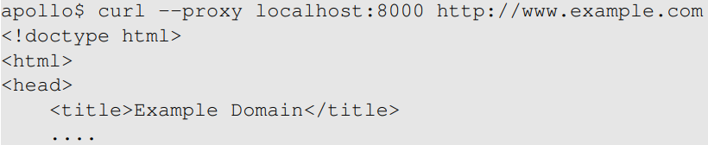
Evading Egress Firewalls
Create the tunnel
Access the blocked site (www.example.com)

Slide 16
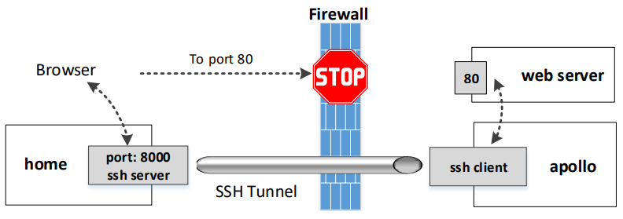

Reverse SSH Tunneling
Port forwarding from Server to Client (reverse)
SSH Server

Slide 17
Dynamic Port forwarding and SOCKS Proxy

Slide 18
Dynamic Port Forwarding
Static port forwarding
Destinations are fixed
One tunnel for each destination
Dynamic port forwarding
Destinations are NOT fixed
One tunnel for many destinations
Therefore, typically called Proxy

Slide 19

An Experiment
Create the tunnel
Use localhost:9000 as proxy

Slide 20
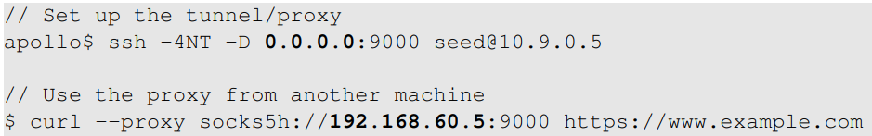
Use Another Host As Proxy
Apollo’s IP address: 192.168.60.5

Slide 21
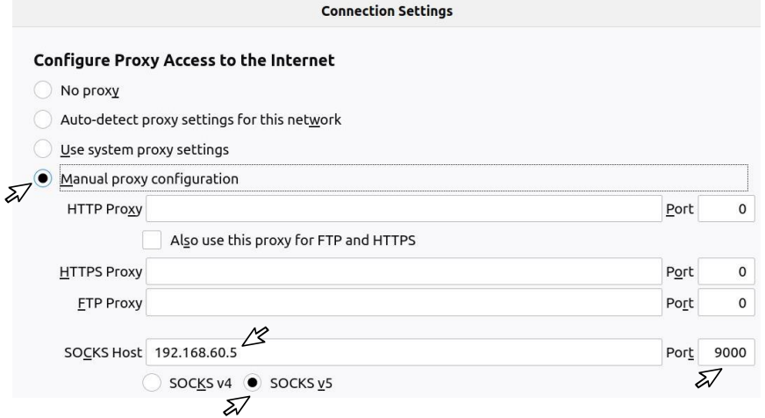
Configure Browser to Use Proxy

Slide 22
The SOCKS Protocol
How does the dynamic port forwarding work?
The destination is not specified
The client must tell the proxy the destination information
The client and proxy use a protocol for that purpose
SOCKS protocol
Socket secure, version 5 (SOCKS5)
The client must have a native support of SOCKS protocol

Slide 23


Implement a SOCKS Client: Setup
Start a server: we will access it via a proxy
Start a proxy on apollo

Slide 24
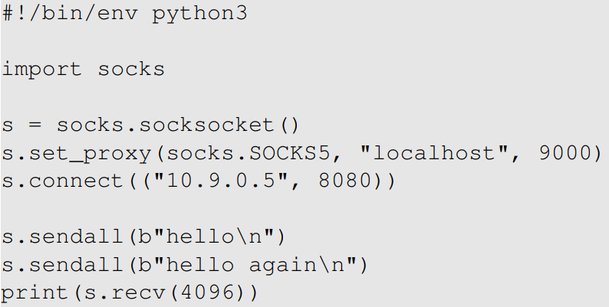
The SOCKS5 Client Program
Proxy
Target

Slide 25
What Happens Between Client and Proxy
Client and Proxy establish a TCP connection
Using the TCP connection, Client and Proxy initiate the SOCKS protocol.
Client tells Proxy the destination of the port forwarding (10.9.0.5:8080).
The port forwarding setup is complete
Proxy forwards the traffic from one end of the tunnel to the other end, from where the data will be further forwarded to the final destination (10.9.0.5:8080)

Slide 26
SOCKS5 Proxy vs. VPN
Both are widely used to create tunnel
Bypassing firewall
Protecting communication
Properties | SOCKS5 | VPN
Transparency | Not | Yes
Setup | Easy | More difficult
Application-specific | Each tunnel is tied to one client | Tunnel can be shared by many clients
Encryption | Depends | Yes

