Slide 1
OpenEDR Endpoint Detection and Response
Prepared By
1805098
1805103

Slide 2
What is the purpose of EDR?
Continuous monitoring of the endpoints
Vulnerability detection
Alert generation if it detects any vulnerable activity
Customized alert generation mechanism
Bookkeeping different event related log information
Can perform the activities of antivirus too

Slide 3
Different Kinds of Detection and Alert Generation
Suspicious PowerShell execution
Clear security log activities
Write fake system file

Slide 4
Detection of Suspicious PowerShell Execution
Script Launch from Program Data
Example of suspicious Script Launch:
Create a simple test script file in a known directory
Move the Script to ProgramData
Open a Command Prompt with administrative privileges and execute following command:
powershell.exe -ExecutionPolicy Bypass -File test_script.ps1
Monitor the EDR platform for any alerts related to script execution from the ProgramData directory.

Slide 5
Detection of Clearing Security Log
Open PowerShell with administrative privileges
Clear an event log using wevtutil.exe.
wevtutil cl Security
Verify the EDR detection.

Slide 6
Detection of writing fake system file
Open a command prompt or PowerShell window with administrative privileges.
Attempt to create a fake system file in a directory that the EDR platform is monitoring.
echo "Fake svch0st.exe" > C:\Windows\System32\svch0st.exe
This command creates a text file named "svch0st.exe" in the "C:\Windows\System32" directory.
After creating the fake system file, monitor the EDR platform for alerts related to suspicious file creations that match the file path "C:\Windows\System32\svchost.exe."

Slide 7
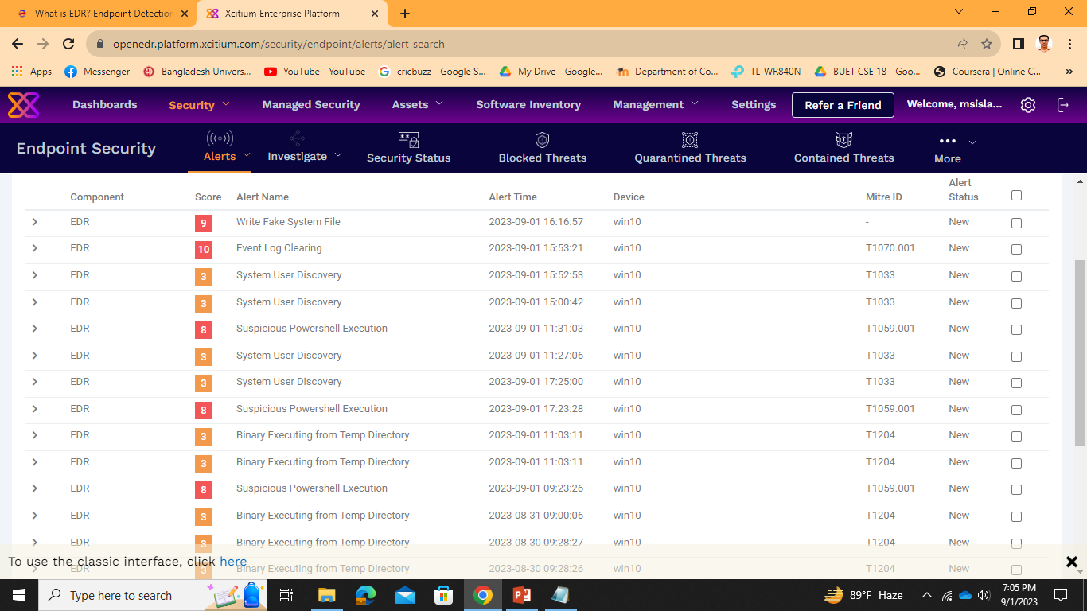
Alert Generated in OpenEDR

Slide 8
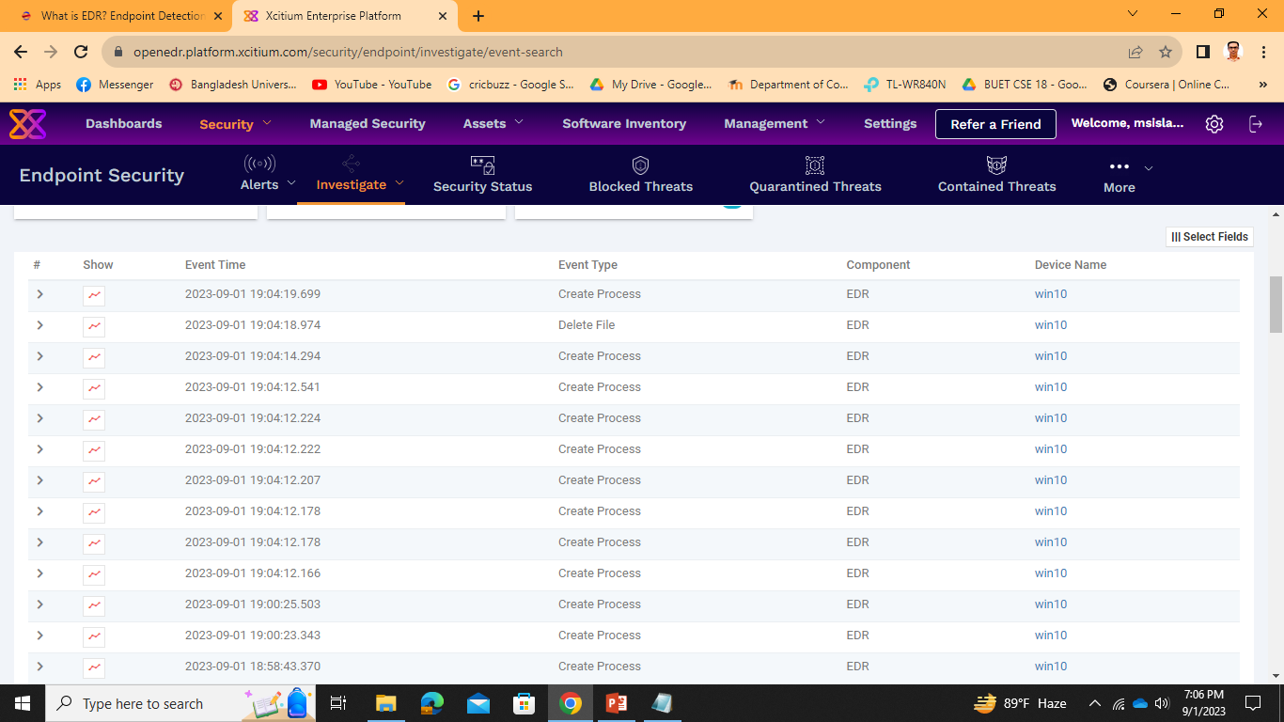
Event Related Log

Slide 9
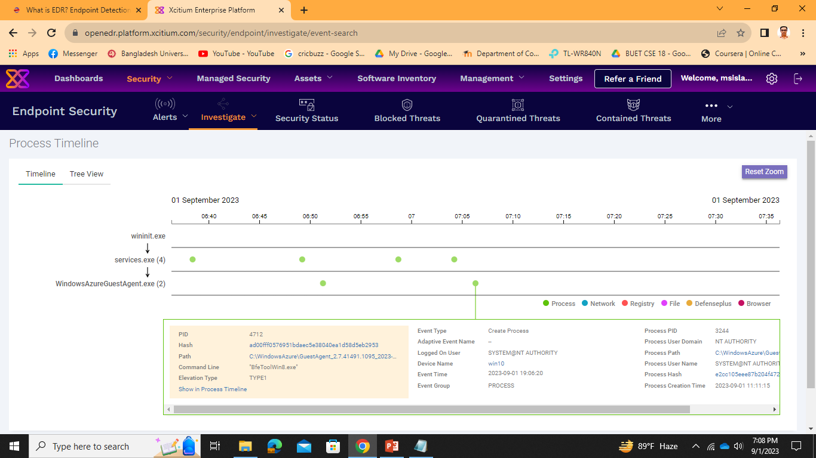
Event Details

Slide 10
Thank You

