Slide 1

IBM HACKATHON CHALLENGE
by Emerald Bit Team
(Tanmay Jain,
Amish Tandon,
Amber Saxena,
Aashutosh Chauhan)

Slide 2

PROBLEM STATEMENT : HELP ME WITH MY MOOD

Slide 3
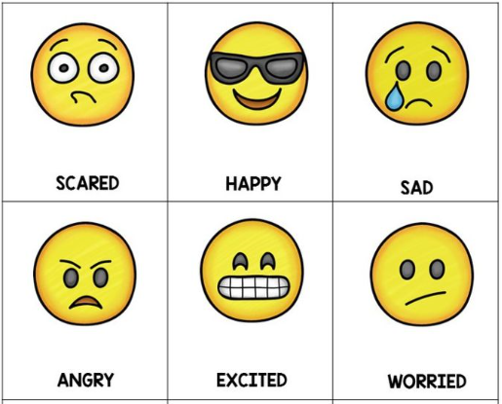
Every person daily crosses through many hurdles in their life. They crosses through time varying situations such as sad, angry, happy, joy, fear etc.
These type of emotions or moods have direct bearings on their daily activities.
To help them lead a better life, it is necessary to eliminate negative emotions.

Slide 4

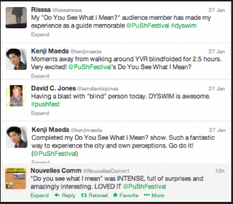

How can one analyze another person’s mood ?
Now a days, every person uses social media websites such as Twitter, Facebook, Instagram.
Whether a person has sad, happy, fear, joy, angry mood he tweets on social media expressing his/her emotions.
So, mood of that person can be reflected by his/her social content, like tweets, blogs, article, status updates etc.
Timely analysis of a user’s social media can be used to improve the feelings.

Slide 5


What can be done to eliminate the negative state of mind of any person?
provide the motivational songs, motivational quotes to that person if he/she has any negative state of mood.
Songs play very important role for soothing or calm down the mood of the person.
Motivational songs can motivate a person and also able to get rid of stresses he/she faces.
One can provide a joke or stand up comedy to calm down anger mood.
Some sort of tips can be provided to calm down the negative mood.

Slide 6

What we have done in the project ?
linked the user with his/her twitter account
extract the tweets of last 24 hours
make a paragraph of all the tweets received
pass that paragraph to ibm watson tone analyzer
various tones analyzed with their corresponding tone score.
choose that tone having maximum score and finally taken that tone for the consideration.
provide appropriate songs/ jokes/ stand up comedy/ motivational quotes in form of images/ suggestions on the basis of tone analyzed.
Included text to speech conversion module for suggestion
give the tweet which is most prominent sentiment

Slide 7
Mood | Recommendations
Sad | Songs/motivational quotes
Angry | jokes/Suggestions
Tentative | motivational quotes
Analytical | Analytical facts
Fear | Suggestions/stand up comedy
Joy | chilled out songs
Confident | Suggestions

Slide 8



Tools & Technologies used
IBM Watson : ibm watson tone analyzer is used for analyzing emotions and tones from tweets or reviews. It predicts whether they are happy, sad, confident, and more.
For using watson tone analyzer we used its api in our code for analyzing the tone.
Twitter APIs : For extracting tweets from twitter we have used twitter api’s and username.
Languages : Java, Python
Android Studio : platform for building android app
AWS S3 : Used for storing the database of songs/image quotes etc.

Slide 9

Work for future
Detecting sarcasm from tweets through machine learning algorithms.
Extract text from the images on twitter and analyze the tone from the images too.
Add up new features in the android app.

