Slide 1
Diffusion Model Acceleration on FPGA
Hongwu Peng¹, Amit Hasan¹, Xi Xie¹, Jiahui Zhao¹
¹University of Connecticut, Connecticut, USA

Slide 2
Outline
Background
Algorithm Design
Stable Diffusion Algorithm
Model Structure
Inference Iterations
Hardware Design
System Setup
Coarse Grained Pipelining Architecture
Fully Connected Layer Hardware Design
Convolutional Layer Hardware Design
Latency Evaluation
Conclusions

Slide 3
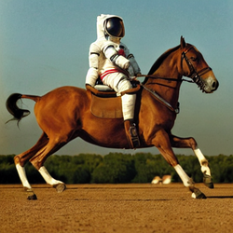
Background
Stable Diffusion is a deep learning, text-to-image model released in 2022. It is primarily used to generate detailed images conditioned on text descriptions, though it can also be applied to other tasks such as inpainting, outpainting, and generating image-to-image translations guided by a text prompt.
An image generated by Stable Diffusion based on the text prompt "a photograph of an astronaut riding a horse"

Slide 4
Background
Stable Diffusion uses a variant of diffusion model (DM), called latent diffusion model (LDM).
The typical stable diffusion model consists of 3 parts: the variational autoencoder (VAE), U-Net, and an optional text encoder. The VAE encoder compresses the image from pixel space to a smaller dimensional latent space, capturing a more fundamental semantic meaning of the image. Gaussian noise is iteratively applied to the compressed latent representation during forward diffusion. The U-Net block, composed of a ResNet backbone, denoises the output from forward diffusion backwards to obtain latent representation. Finally, the VAE decoder generates the final image by converting the representation back into pixel space.

Slide 5
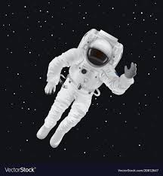

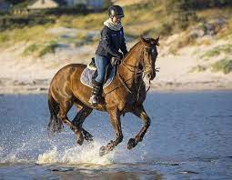
Stable Diffusion Algorithm
encoder
noise
denoise
decoder
latent space
latent space
+
+
astronaut
astronaut
encoder
noise
denoise
decoder
latent space
latent space
+
+
riding a horse
riding a horse
denoise
decoder
After training:
latent space
+
astronaut riding a horse

Slide 6
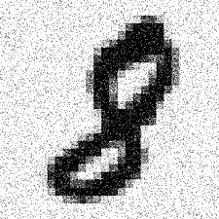


Conditional Stable Diffusion
Loop through the steps
Image with noise
Predicted noise
Subtract noise from input image with noise
Reconstructed image
Encoder
Decoder
Latent space
Image size: 28 x 28
Image size: 28 x 28
The digit to be generated
Condition

Slide 7



Training the Model
Training sample
generation
Add noise
Add noise
Add noise
Timestep, t = 0
Timestep, t = 1
Timestep, t = 2
Timestep, t = k
Image with noise
Predicted noise
Subtract noise from input image with noise
Reconstructed image
Skip connections
Latent space
Image size: 28 x 28
U-Net down
U-Net up
Image size: 28 x 28
Converted to embedding
The digit to be generated
8
Diffusion timestep
Convolution layer
Maxpool layer
Deconvolution layer

Slide 8
Inference Iterations
Loop through Diffusion timestep = K, K-1, K-2, …., 3, 2, 1
Image with noise
Predicted noise
Subtract noise from input image with noise
Reconstructed image
Skip connections
Latent space
Image size: 28 x 28
U-Net down
U-Net up
Image size: 28 x 28
Converted to embedding
The digit to be generated
8
Diffusion timestep
Convolution layer
Maxpool layer
Deconvolution layer

Slide 9
System Setup
System overview:
CPU controls the start of FPGA. The FPGA overlay signal an interrupt back to the CPU, indicating the job has finished.
CPU and FPGA have a system-on-chip architecture, so they have shared main memory resources.
CPU will allocate the necessary memory for FPGA to support computation.
CPU
AXI4 Interconnect
DRAM
Programable logic:
FPGA Overlay
Interrupt

Slide 10
Coarse Grained Pipelining Architecture
CPU
AXI4 Interconnect
Architecture overview:
Data Loader: Load the weight, activation, and bias data from DRAM to the on-chip buffer.
Process Element Group: Consists of process elements that conduct the general computation, such as (X·W+b).
Data Writer: Write the output from the on-chip buffer back to DRAM.
Double Buffer to organize between data transfer & compute
Data Loader
Input Buf0
Input Buf1
PE
PE
PE
PE
PE
PE
PE
PE
DRAM
PE
PE
PE
PE
PE
PE
PE
PE
Out Buf0
Out Buf1
Data Writer
Coarse-grained pipeline architecture

Slide 11
Coarse Grained Pipelining Architecture
if (pingpong)
{
load(in_buf0, DDR);
compute(in_buf1, out_buf1);
write(out_buf0, DDR);
pingpong = ~ pingpong;
{
load(in_buf0, DDR);
compute(in_buf1, out_buf1);
write(out_buf0, DDR);
pingpong = ~ pingpong;
}
Feature:
Use the double buffer to hide computation/communication latency and increase hardware utilization.
Carefully design the load and write sequence in an efficient way to reduce memory traffic.
Pseudo code for computation
Load0
Comp1
Write0
Load1
Comp0
Write1
Load0
Comp1
Write0
Time
Latency hiding with coarse-grained pipeline

Slide 12
Fully Connected Layer Hardware Design
X
W
b
Y
FC Layer computation:
Y = X·W + b
FC Layer hardware design:
Divided the vector-matrix multiplication into task blocks.
The memory load, compute, memory write scheduling between blocks follows the coarse-grained pipeline design
×
+
=
Fully connected layer operator
X₁
W₁
X₁
W₁
Y₁
Y₁
×
=
×
+
=
Conducted on device
X₁
W₂
X₁
W₂
Y₂
Y₂
×
=
×
+
=
Conducted on device
……
Task division

Slide 13
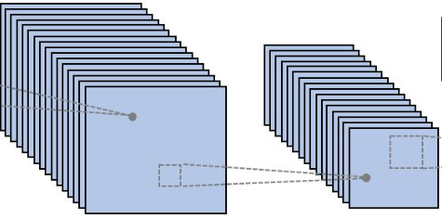
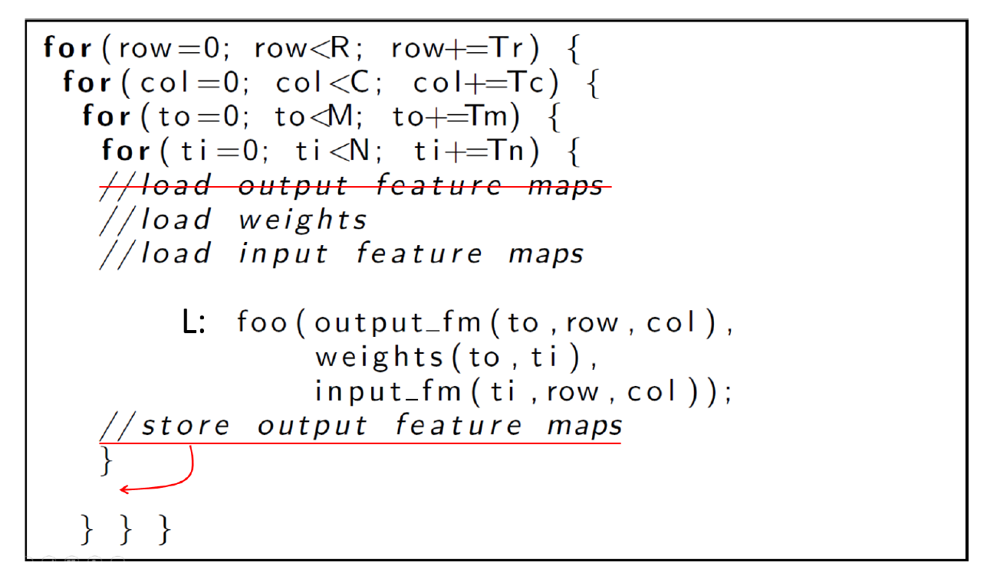
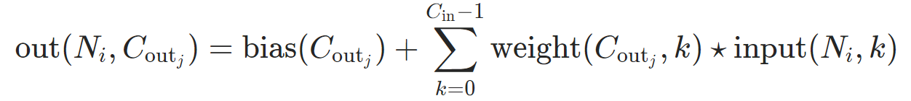
Convolutional Layer Hardware Design
Con2D Layer computation:
Input: X[C_{in}][H_{in}][W_{in}] (input), W[C_{in}][C_{out}][K][K]
Output: Y[C_{out}][H_{out}][W_{out}] (out)
Conv2D hardware design:
Divided the Conv2D into sub-task blocks.
The memory load, compute, memory write scheduling between blocks follows the coarse-grained pipeline design
Task division

Slide 14
Latency Evaluation
 | Alienware with RTX 3060 GPU | PYNQ-Z2
Platform Power | 150 W | 5 W
Time to generate singe image | 14 s | 127 mins
Efficiency | 2.1 k(W·s)/image | 38.1 k(W·s)/image
FPGA is still lower than GPU for regular computation.
Main reason:
Pynz-Z2 is an old version of the FPGA board, and the process technology is not as good as RTX 3060
FPGA needs a more dedicated design to boost performance.
In terms of regular computation, FPGA is not as good as GPU. FPGA is more suitable for irregular computation, such as sparse matrix multiplication.

Slide 15
Thank you!

