Slide 1
Emulators and Web Assembly
Dr. Charles R. Severance
online.dr-chuck.com

Slide 2
Outline
Start from our "two instruction CPU" from the previous section
Hexadecimal Notation
Review: What is Programming from PY4E
Real CPUs – Intel x86, ARM, and MOS 6502
The CDC6504 – Mostly 6502 with homage to CDC 6500
Architecture
Machine Language
Assembly Language

Slide 3
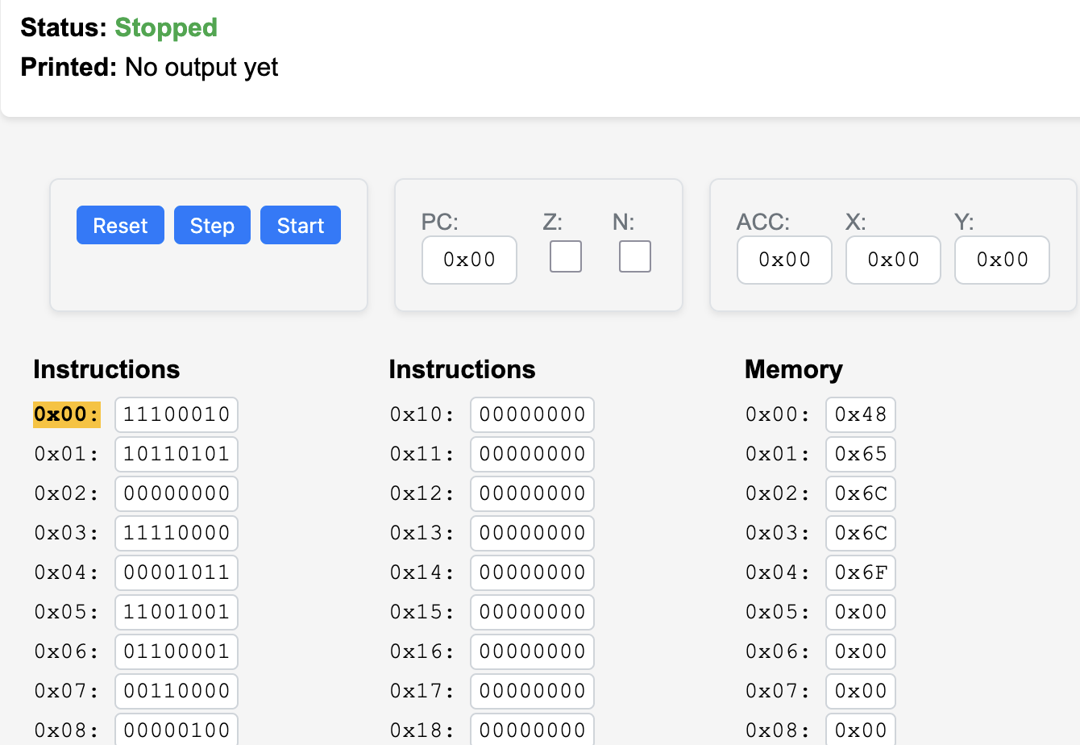
Uppercase a String
CLX
loop:
LDA $00,X
BEQ done
CMP #'a'
BMI cont
SBC #0x20
STA $00,X
cont:
INX
JMP loop
done:
BRK
DATA 'Hello'

Slide 4
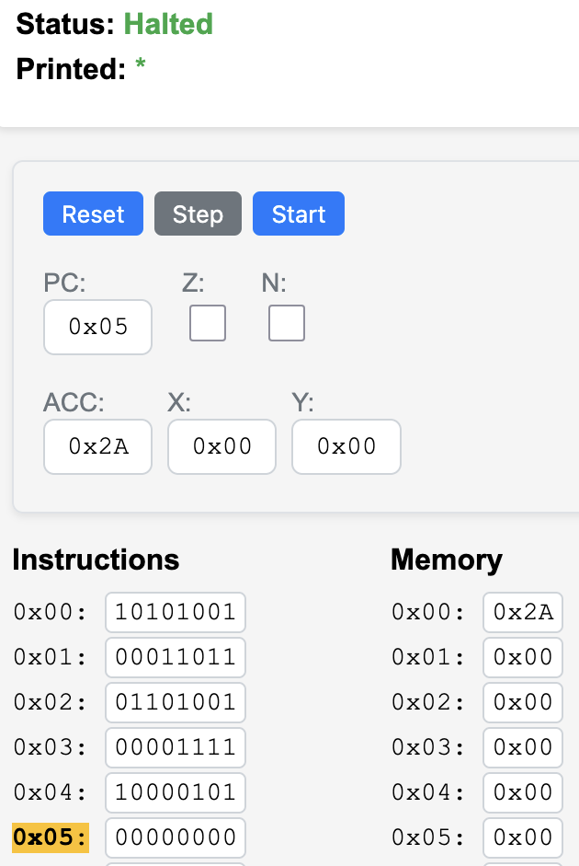
Looking at the CDC6504 Emulator code…
executeStep() {
// Read instruction from instruction memory
const instruction = this.cpu.instructions[this.cpu.pc];
// Decode 6502 opcodes
if (instruction === 0x00) { // BRK - Break/Halt
this.printString(); // Print data memory on BRK
this.running = false;
}
...
else {
console.log(`ERROR: unknown instruction - halting`);
this.running = false;
}
// Update PC (if not already updated by branch/jump)
if (pcIncrement > 0) {
this.cpu.pc = (this.cpu.pc + pcIncrement) & 0xFF;
}
}
Notes:
A screen shot of the CDC6504 Emulator halted after the program to add 27 + 15 and print out asterisk (ASCII code 42).

Slide 5
https://www.ca4e.com/tools/cdc6504/cpu-emulator.js
else if (instruction === 0xA9) { // LDA # - Load accumulator immediate
const immediate = this.cpu.instructions[this.cpu.pc + 1];
this.cpu.acc = immediate;
this.updateCompareFlags(this.cpu.x, immediate);
pcIncrement = 2;
} else if (instruction === 0xE9) { // SBC # - Subtract immediate
const immediate = this.cpu.instructions[this.cpu.pc + 1];
const diff = this.cpu.acc - immediate;
this.cpu.acc = diff & 0xFF;
this.updateStatusFlags(this.cpu.acc);
pcIncrement = 2;
} else if (instruction === 0xB5) { // LDA $nn,X - Load indexed by X
const baseAddr = this.cpu.instructions[this.cpu.pc + 1];
const xValue = Number(this.cpu.x);
const effAddr = (baseAddr + xValue) & 0xFF;
this.cpu.acc = this.cpu.memory[effAddr];
this.updateStatusFlags(this.cpu.acc);
pcIncrement = 2;
}
Notes:
https://www.ca4e.com/tools/cdc6504/cpu-emulator.js

Slide 6
Building Emulators for Historical CPUs
It is not all that difficult to build an emulator for an older CPU (emulator.js is 1300 lines of code – 6502 is 4528 transistors)
Modern processors on our phones and computers are so fast that JavaScript in a browser can emulate historical machine code faster than the original hardware
The computer / phone / browser graphics are also far better
And it can be great fun

Slide 7
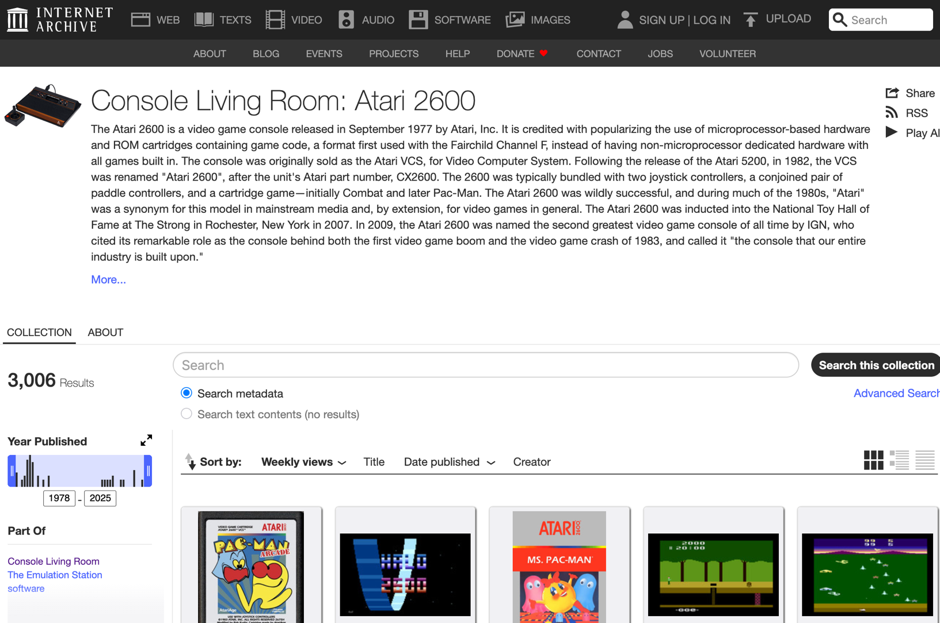
Archive.org: Internet Arcade

Slide 8
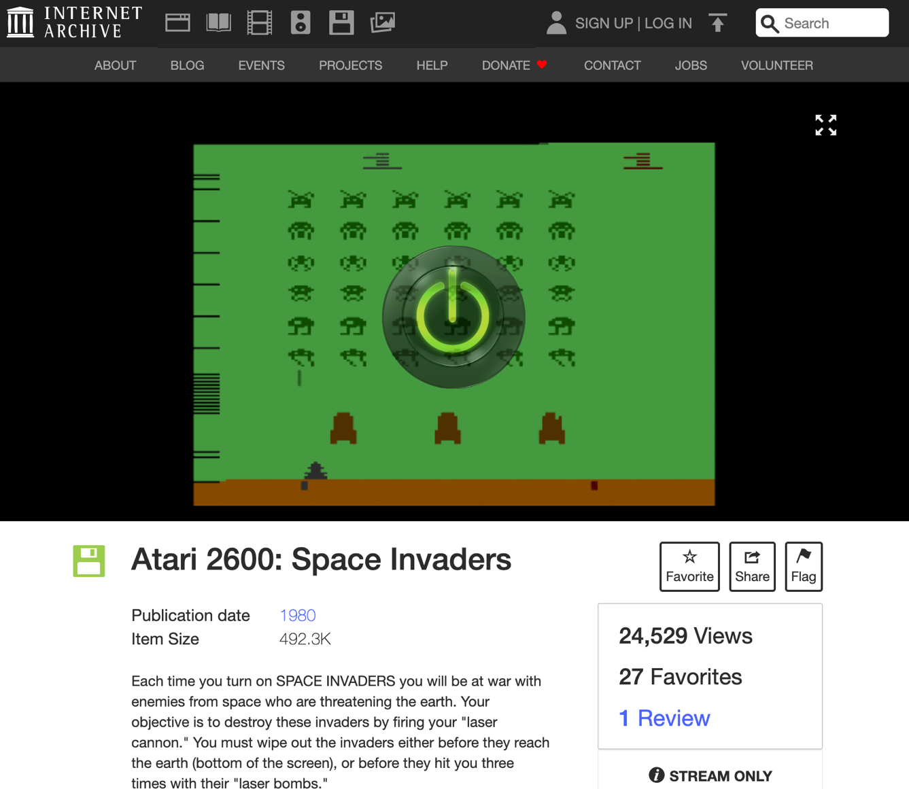
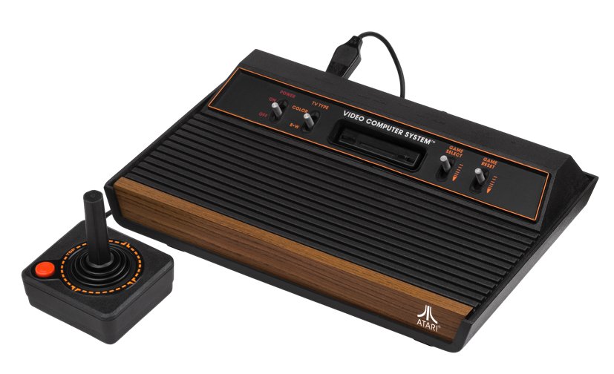
Atari 2600 Space Invaders
The Atari 2600 has a 6502 processor.
Notes:
https://archive.org/details/atari_2600_space_invaders_1980_atari_richard_maurer_-_sears_cx2632_-_49-75153
Press 2 to start game
Arrows Left right
Left Control fire

Slide 9
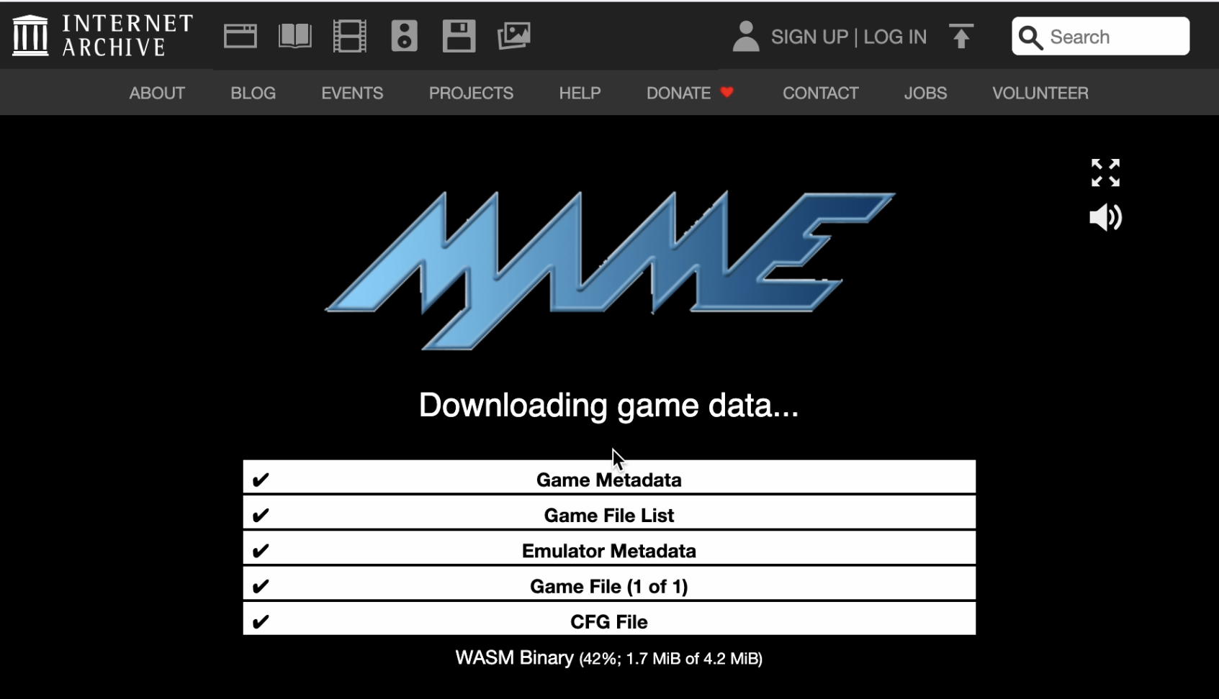
Space Invaders Startup – JSMAME Emulator

Slide 10
WASM – Web Assembly
There is a machine language emulator built into browsers called Web Assembly
For a wide range of software, compiling to WASM and running in JavaScript is enough
WASM is a different syntax than most Assembly languages – but it still compiles to a binary-machine code
C Programming for Everybody (www.cc4e.com) C Playground compiles C to WASM and then runs the WASM in the user's browser

Slide 11
WASM versus traditional Assembly
Sandboxed by design: Wasm runs in a strict sandbox with no direct access to memory, files, or OS — unlike native assembly which runs with full process privileges.
Safe execution model: Structured control flow, validated code, and no undefined jumps help prevent many classic crashes and exploits.
Portable bytecode: Same Wasm runs on any browser or runtime; traditional assembly is tied to a specific CPU (x86, ARM, etc.).
Abstract machine: Wasm targets a virtual stack machine, not real hardware — traditional assembly maps directly to CPU instructions.
Optimized by the host: Browsers and runtimes validate and compile Just In Time (JIT) - compile Wasm safely, while native assembly relies on machine code produced elsewhere with no validation.

Slide 12
WASM Hello World
;; Hello World WASM Example
(module
(import "console" "log" (func $log (param i32 i32)))
(memory 1)
(data (i32.const 0) "Hello, World!")
(func $main (result i32)
(call $log (i32.const 0) (i32.const 13))
(i32.const 42)
)
(export "main" (func $main))
)
00000000: 00 61 73 6d 01 00 00 00 01 0a 02 60 02 7f 7f 00 |.asm.......`....|
00000010: 60 00 01 7f 02 0f 01 07 63 6f 6e 73 6f 6c 65 03 |`.......console.|
00000020: 6c 6f 67 00 00 03 02 01 01 05 03 01 00 01 07 11 |log.............|
00000030: 02 06 6d 65 6d 6f 72 79 02 00 04 6d 61 69 6e 00 |..memory...main.|
00000040: 01 0a 0c 01 0a 00 41 00 41 0d 10 00 41 2a 0b 0b |......A.A...A*..|
00000050: 13 01 00 41 00 0b 0d 48 65 6c 6c 6f 2c 20 57 6f |...A...Hello, Wo|
00000060: 72 6c 64 21 |rld!|

Slide 13
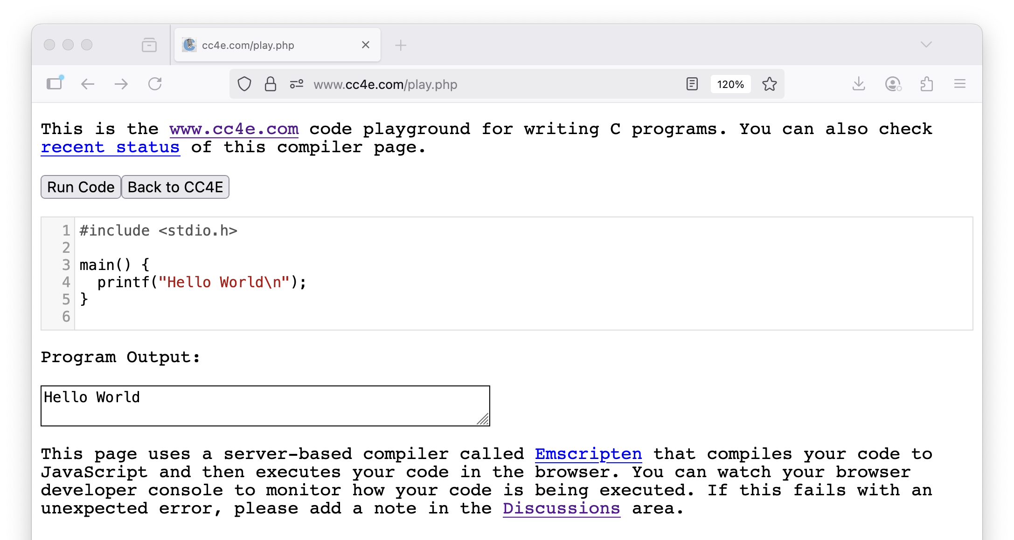
C Program for Everybody – C Coding Playground

Slide 14
From the 6502 to the Present
A lot has changed since the 6502 was available as a $25 microprocessor

Slide 15
Modern CPUs
Since the 1970's there have been about 50 distinct CPU families
Lots of research and innovation
Adoption and switching
Generational turn over
From CISC to RISC
From mainframe to microprocessor
Today there are two major CPU families in use (computers + phones)
ARM based processors (90%)
Intel x86 processors (10%)

Slide 16
Case Study: Apple Processors
MOS 6502 – Apple I / Apple II – 1977 - 1993
Motorola MC68000 – Macintosh 1984-1994
ARM – Apple Newton - 1993
IBM PowerPC – Macintosh 1994 – 2006
Intel x86 – Macintosh (2006-2020)
Samsung ARM – iPhone (2007-2009)
Apple ARM – iPhone (2010-Present)
Apple ARM – Macintosh (2020-Present)
Apple currently redesigns their CPUs based on workload over time – Image Processing / Audio / Video / Gaming / Artificial Intelligence
Notes:
The Intel Macs were introduced January 10, 2006
The iPhone was introduced June 9, 2007

Slide 17
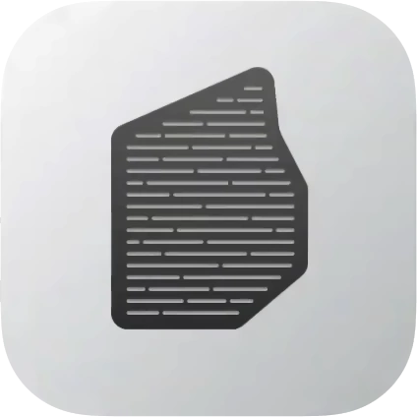
Fun Aside – Apple Built and Shipped Machine Code Translators
2005 Moved from PowerPC to Intel Processors – Rosetta 1
2020 Moved from Intel to Apple ARM Processors – Rosetta 2
Translated machine code as the application was launched
Greatly eases what would otherwise be a major upheaval for customers

Slide 18
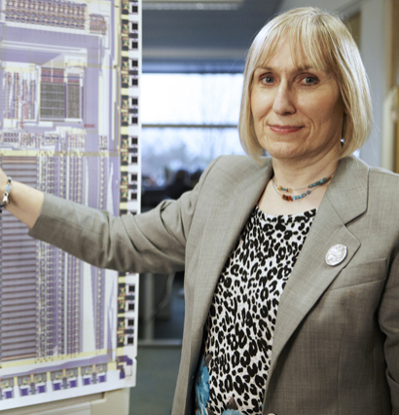
Fun Aside – the 6502 influenced ARM
Acorn's 6502-based BBC Micro
The ARM designers were 6502 experts
The BBC Micro was used to build and simulate the ARM design
ARM1 had ~25,000 transistors
Currently ARM based processors are the most widely used processors in the world.
AI: Describe the historical connection between the 6502, ARM, and Raspberry Pi
Sophie Wilson
Notes:
Sophie Wilson pointing at a large poster of the circuit lauout of an ARM processor.
Reference: https://en.wikipedia.org/wiki/Sophie_Wilson

Slide 19
Summary
CPU Evolution over time

Slide 20
Acknowledgements / Contributions
These slides are Copyright 2025- Charles R. Severance (online.dr-chuck.com) as part of www.ca4e.com and made available under a Creative Commons Attribution 4.0 License. Please maintain this last slide in all copies of the document to comply with the attribution requirements of the license. If you make a change, feel free to add your name and organization to the list of contributors on this page as you republish the materials.
Initial Development: Charles Severance, University of Michigan School of Information
Insert new Contributors and Translators here including names and dates
Continue new Contributors and Translators here

