Slide 1
Digital Logic
Dr. Charles R. Severance
www.ca4e.com
online.dr-chuck.com

Slide 2
Outline
What is Computer Architecture
What is a Central Processing Unit (CPU)
Start with gates - AND / OR / NOT / XOR …
Adding numbers with gates – half and full adders
Number representation – Base 2 and Base 10 (hexadecimal)
Storing data with gates – Latches and Flip-Flops

Slide 3
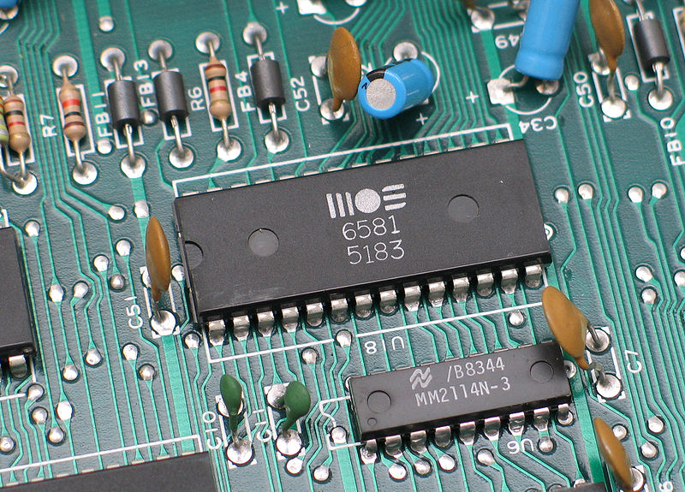
Computer Architecture
Within the computer data is moved using electric wires
Each wire generally has a voltage that is either a "0" or "1"
Wires connect components like the CPU, Memory, or other devices
A sound chip from a 1980's
Commodore 64 connected to the
motherboard
Notes:
Reference: https://en.wikipedia.org/wiki/Printed_circuit_board

Slide 4

Generic CPU
Software
What
Next?
Input
and Output
Devices
Central
Processing
Unit
Secondary
Memory
Main
Memory
Notes:
A block diagram of a CPU with I/O devices, a CPU, memory and secondary memory. Software is stored in the memory of the computer and then read from that main memory and executed by the CPU.
There is a thought bubble where the CPU is thinking, “What Next?”
This slide is from Lecture 1 / Chapter 1 of Python for Everybody (www.py4e.com)

Slide 5
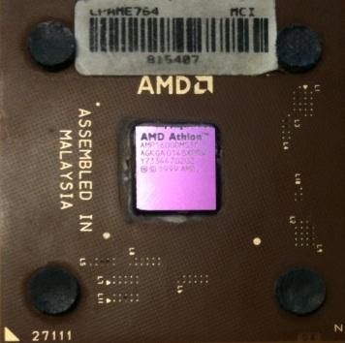
Definitions
What
Next?
Central Processing Unit: Runs the Program - The CPU is always wondering “what to do next”. Not the brains exactly - very dumb but very very fast
Input Devices: Keyboard, Mouse, Touch Screen
Output Devices: Screen, Speakers, Printer, DVD Burner
Main Memory: Fast small temporary storage - lost on reboot - aka RAM
Secondary Memory: Slower large permanent storage - lasts until deleted - disk drive / memory stick
Notes:
There is a thought bubble showing the chip in the center of the CPU package with the thought, “What Next?”
This slide is from Lecture 1 / Chapter 1 of Python for Everybody (www.py4e.com)

Slide 6
A Programmer
Software
What
Next?
Input
and Output
Devices
Central
Processing
Unit
Secondary
Memory
if x< 3: print
Main
Memory
Notes:
A block diagram of a CPU with I/O devices, a CPU, memory and secondary memory. Software is stored in the memory of the computer and then read from that main memory and executed by the CPU.
There is a thought bubble where the CPU is thinking, “What Next?”
Within the memory there is a stick figure of the programmer writing the instructions to provide to the CPU. In this case this instruction is in Python and is "if x<3: print"
This slide is from Lecture 1 / Chapter 1 of Python for Everybody (www.py4e.com)

Slide 7
Machine Language
Software
What
Next?
Input
and Output
Devices
Central
Processing
Unit
Secondary
Memory
01001001
00111001
Main
Memory
Notes:
A block diagram of a CPU with I/O devices, a CPU, memory and secondary memory. Software is stored in the memory of the computer and then read from that main memory and executed by the CPU.
There is a thought bubble where the CPU is thinking, “What Next?”
Within the memory there is a stick figure of the programmer writing the instructions to provide to the CPU. In this case this instruction has been translated into two machine language instructions and is "01001001
00111001"
This slide is from Lecture 1 / Chapter 1 of Python for Everybody (www.py4e.com)

Slide 8
Building Microprocessors

Slide 9
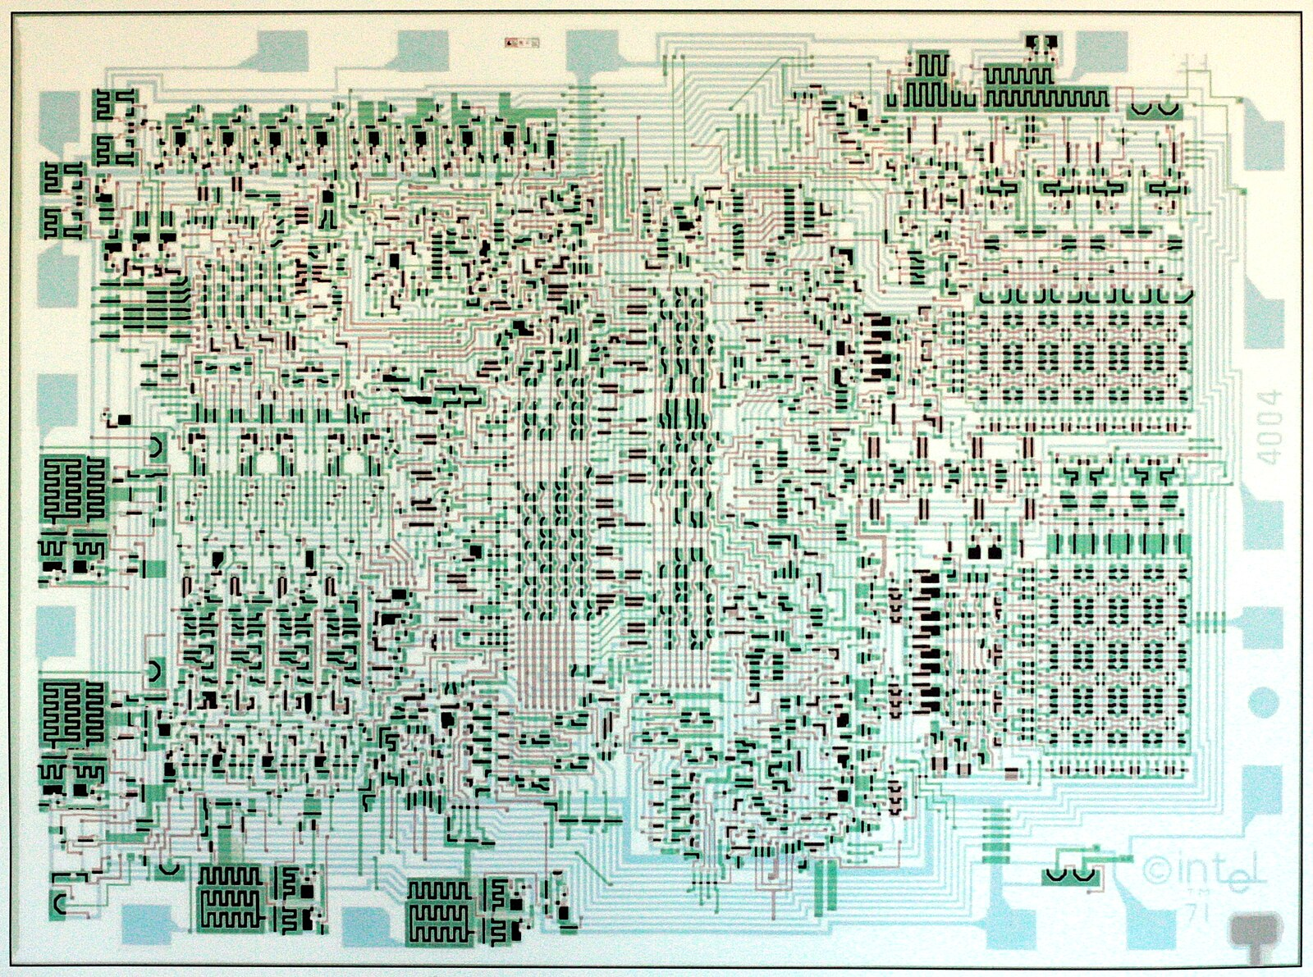
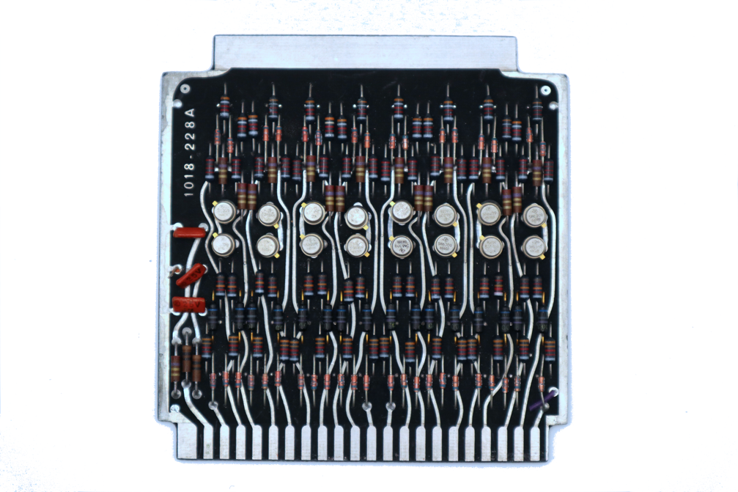
Very Large Scale Integration
We went from 16 transistors on a board 4 inches on a side to billions of transistors in a chip 0.5 inches on a side

Slide 10
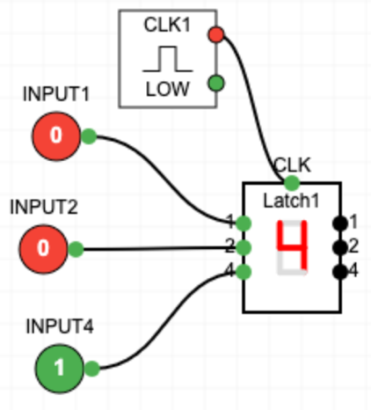
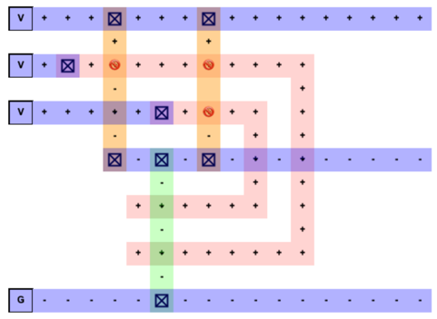
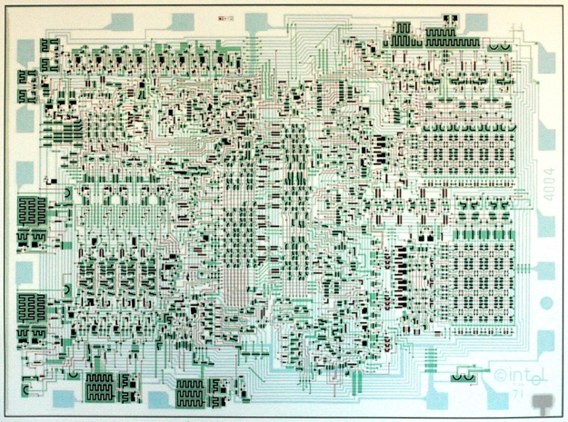
CPU Design Process
We start with gates and build reusable components and then combine those components to implement programmable digital logic
Software translates our abstract design into transistors and then creates an optimal layout for our chip
Photo lithography is then used to build the chip

Slide 11
Adding numbers with gates
Gates are now our low-level building blocks – we can combine them to solve problems

Slide 12




Classic Mathematical Logic Gates
Not
And
Or
Exclusive Or
A | B | Q
0 | 0 | 0
0 | 1 | 0
1 | 0 | 0
1 | 1 | 1
A | B | Q
0 | 0 | 0
0 | 1 | 1
1 | 0 | 1
1 | 1 | 1
A | B | Q
0 | 0 | 0
0 | 1 | 1
1 | 0 | 1
1 | 1 | 0
A | Q
0 | 1
1 | 0

Slide 13
Representing Numbers with 0's and 1's
If we are going to do significant computations, we will need a way to represent numbers as electrical values
"Normal" numbers are Base-10
We know the place values of Base-10 numbers
To manipulate numbers with gates, we use Base-2 numbers
Base-10
123₁₀ = 1 x 10² + 2 x 10¹ + 3 * 10⁰
= 1 x 100 + 2 * 10 + 3 * 1 = 123₁₀
Base-2
110₂ = 1 * 2² + 1 * 2¹ + 0*2⁰ =
= 4 + 2 + 0 = 6₁₀

Slide 14
Keep it simple for now
Base–2 to Base-10 for numbers less than 8
A.k.a. 3-bit numbers
Base-10 | Base-2
0 | 0
1 | 1
2 | 10
3 | 11
4 | 100
5 | 101
6 | 110
7 | 111
4s 2s 1s
1 1 0 = 6

Slide 15
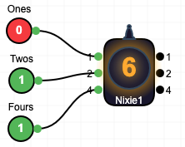
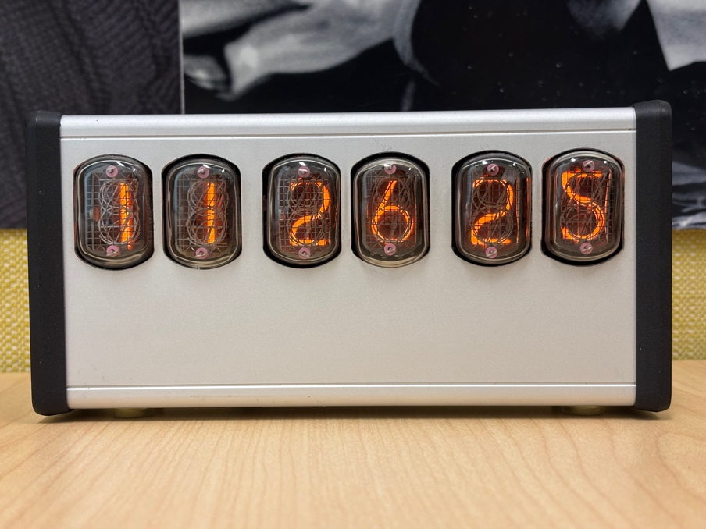
Nixie Tubes – Binary to Decimal Display
4 2 1
1 1 0 = 6
Notes:
Reference: https://en.wikipedia.org/wiki/Nixie_tube

Slide 16
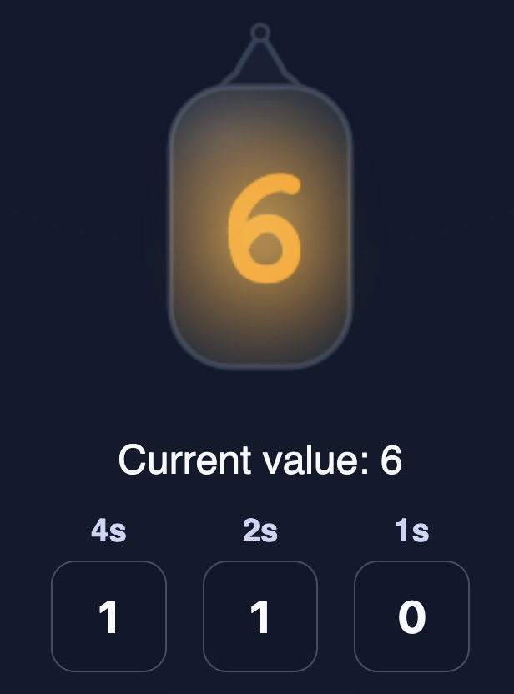
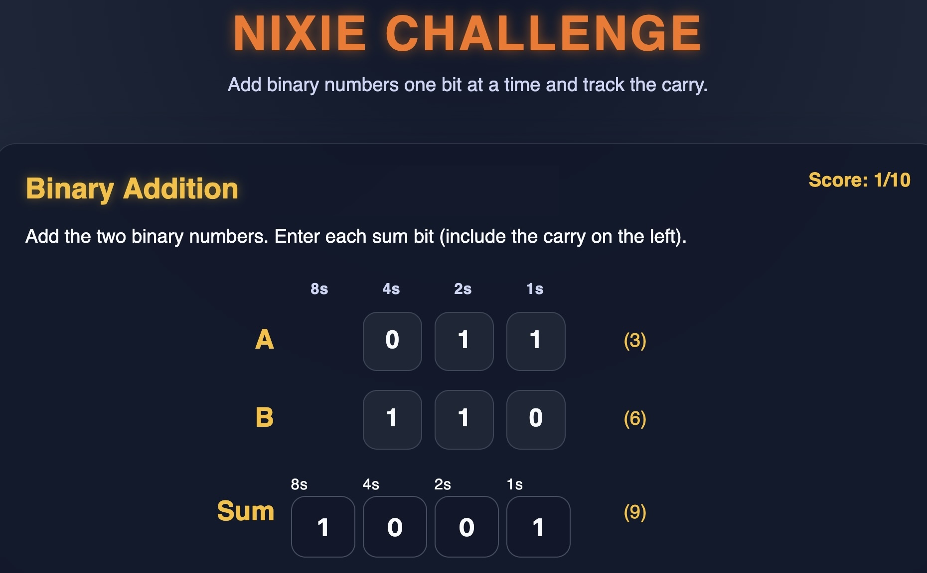
NIXIE Challenge
https://www.ca4e.com/tools/nixie/
Notes:
This shows a glowing Nixie tube showing a value of 6 with base 1 inputs of 110.
This shows a screen shot of the Nixie Challenge game adding two 3-bit base two numbers. The example shown is 011 + 110 = 1001 or in Base-10, 3 + 6 = 9

Slide 17
Base-2 Math
1 (1)
+ 1 (1)
1 0 (2)
1 0 (2)
+ 1 0 (2)
1 0 0 (4)
1 0 0 (4)
+ 1 0 0 (4)
1 0 0 0 (8)
1 1 (3)
+ 1 (1)
1 0 0 (4)
1 1 (3)
+ 1 0 (2)
1 0 1 (5)
1 1 1 (7)
+ 1 (1)
1 0 0 0 (8)
Notes:
This is showing base-2 1 + 1 = 10 or in Base 10 1 + 1 = 2
This is showing base-2 11 + 1 = 100 or in Base 10 3 + 1 = 4
This is showing base-2 10 + 10 = 100 or in Base 10 2 + 2 = 4
This is showing base-2 11 + 10 = 101 or in Base 10 3 + 2 = 5
This is showing base-2 100 + 100 = 1000 or in Base 10 4 + 4 = 8
This is showing base-2 111 + 1 = 1000 or in Base 10 7 + 1 = 8

Slide 18
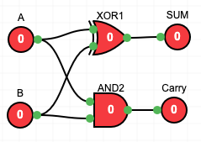
Half Adder
Compute the sum of two base-2 digits and produce a sum and carry.
A
HALF
Adder
SUM
A | B | Sum | Carry
0 | 0 | 0 | 0
0 | 1 | 1 | 0
1 | 0 | 1 | 0
1 | 1 | 0 | 1
B
Carry
Notes:
A screen shot of the half adder component from the gates layout tool from this course. It has A and B inputs as well as Sum and Carry outputs.
A half adder circuit made up of an XOR and AND gate with A and B inputs as sum and carry outputs. This is laid out using the gates tool from this course.

Slide 19
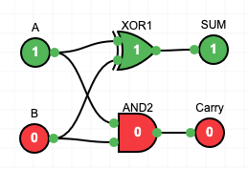
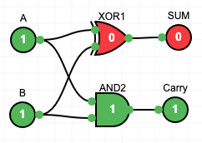
Half Adder – Change Inputs
Compute the sum of two base-2 digits and produce a sum and carry.
A | B | Sum | Carry
0 | 0 | 0 | 0
0 | 1 | 1 | 0
1 | 0 | 1 | 0
1 | 1 | 0 | 1
A
HALF
Adder
SUM
B
Carry
Notes:
A screen shot of the half adder component from the gates layout tool from this course. It has A and B inputs as well as Sum and Carry outputs.

Slide 20
Full Adder
Adds three 0/1 numbers for a sum/carry between 0 and 3
Carry in | A | B | Sum | Carry Out
0 | 0 | 0 | 0 | 0
0 | 0 | 1 | 1 | 0
0 | 1 | 0 | 1 | 0
0 | 1 | 1 | 0 | 1
1 | 0 | 0 | 1 | 0
1 | 0 | 1 | 0 | 0
1 | 1 | 0 | 0 | 1
1 | 1 | 1 | 1 | 1
1 (CIN)
1 (A)
+ 1 (B)
1 1 (3)
Carry In
FULL
Adder
SUM
A
Carry out
B
Notes:
A screen shot of the full adder component from the gates layout tool from this course. It has A, B, and Carry In inputs as well as Sum and Carry Out outputs.

Slide 21
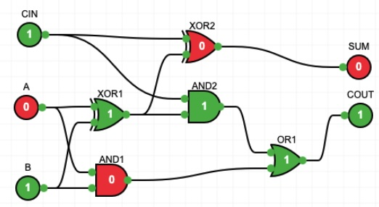
Full Adder Circuit
Adds three 0/1 numbers for a sum/carry between 0 and 3
1 (CIN)
0 (A)
+ 1 (B)
1 0 (2)
Notes:
A diagram of a full adder circuit with inputs A and B with a Carry-In of CIN. The output is single bit SUM and a single but Carry Out. The circuit consistes of two half adders connected and an OR gate to compute the carry out when all the inputs are 1. it is showing 1 + 0 + 1 = 2
A mathematical equation showing the sum of 1 (CIN) + 0 (A) + 1 (B) to be 1 0 base-2 or 2 base 10.

Slide 22
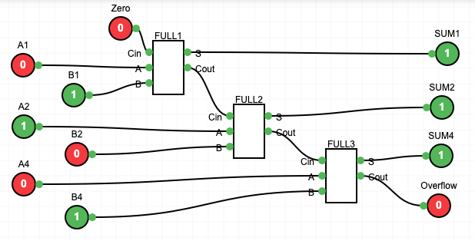
Chaining full adders
0 1 0 (2)
+ 1 0 1 (5)
1 1 1 (7)
Notes:
This is the addition of two 3-bit base 2 numbers 0 1 0 + 1 0 1 = 1 1 1 - or in base 10 2 + 5 = 7
This is an example from the gates tool showing building a three-bit adder using and connecting three one-bit full adder components and propagating the carry-out from each adder to the carry-in of the next adder.

Slide 23
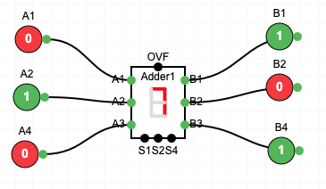
Three Bit Adder Component
0 1 0 (2)
+ 1 0 1 (5)
1 1 1 (7)
Once we know how to make something, add a component to our design system
Notes:
This is an addition showing showing 010 (2) + 101 (5) = 111 (7)
This is a circuit showing the use of the three-bit adder component from the gates tool.. It is showing 010 (2) + 101 (5) = 111 (7)

Slide 24
Storing data with gates
Latches and Flip-Flops

Slide 25
Storing Data Using Feedback Loops
The simplest latch is a "Set-Reset" latch using two NOR gates
The output of each NOR gate is connected to the one of the inputs of the other NOR gate
A | B | NOR
0 | 0 | 1
0 | 1 | 0
1 | 0 | 0
1 | 1 | 0
S | R | Q
0 | 0 | Maintain
0 | 1 | 0
1 | 0 | 1
1 | 1 | ???
Notes:
Reference: https://en.wikipedia.org/wiki/Flip-flop_%28electronics%29

Slide 26
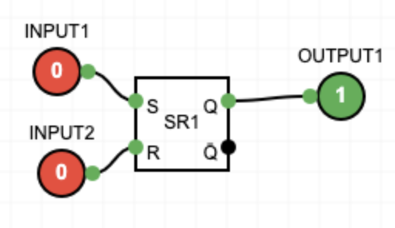
SR Flip-Flop / Latch
S | R | Q
0 | 0 | Maintain
0 | 1 | 0
1 | 0 | 1
1 | 1 | ???
When S and R are zero, the latch maintains its value
When S=0 and R=1 the internal value becomes 0
When S=1 and R=0 the internal value becomes 0
Setting both to 1 means output is undefined

Slide 27
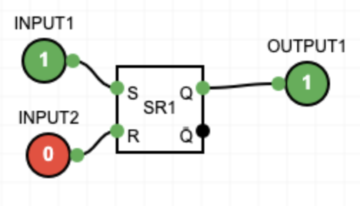
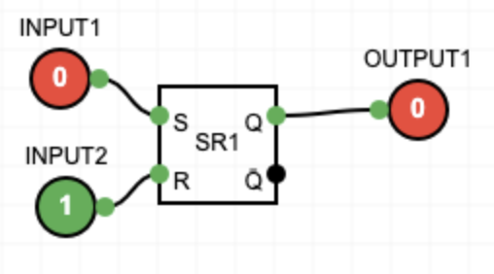
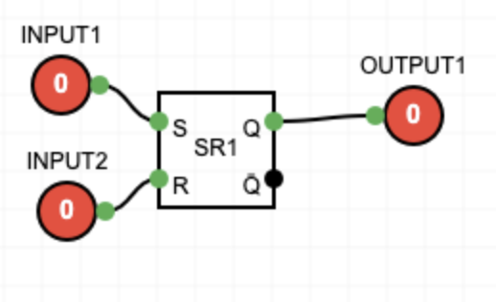
SR Flip-Flop
Set / Reset
Stored Value
S | R | Q
0 | 0 | Maintain
0 | 1 | 0
1 | 0 | 1
1 | 1 | ???

Slide 28
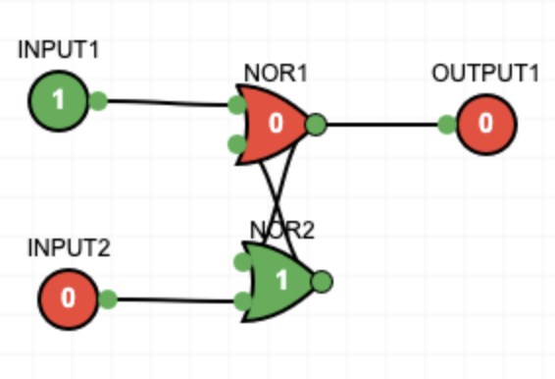
My Simulators Can't Build an SR Latch :(
My Digital Logic Builder does not handle feedback loops so you can't build a SR latch from two NOR gates (unless I fix it)
SR Circuit Fails ☹
SR Component Works

Slide 29
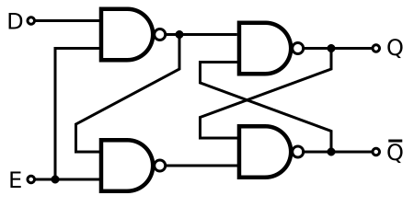
Gated D Latch
C | D | Q
0 | 0 | Maintain
0 | 1 | Maintain
1 | 0 | 0
1 | 1 | 1
The Gated D Latch has a D (data) and a C (clock) inputs.
If C is zero, D is ignored, and the output is the most recent stored value
If C is 1, D is copied into the internal state
C
Notes:
Image credit: https://en.wikipedia.org/wiki/Flip-flop_(electronics)

Slide 30
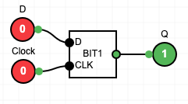
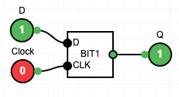
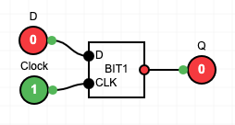
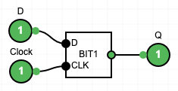
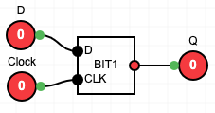
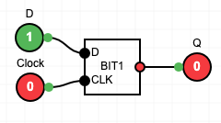
D Latch States
Ignore D
Store 0
Clock to 0
Clock to 0
Ignore D
Store 1

Slide 31
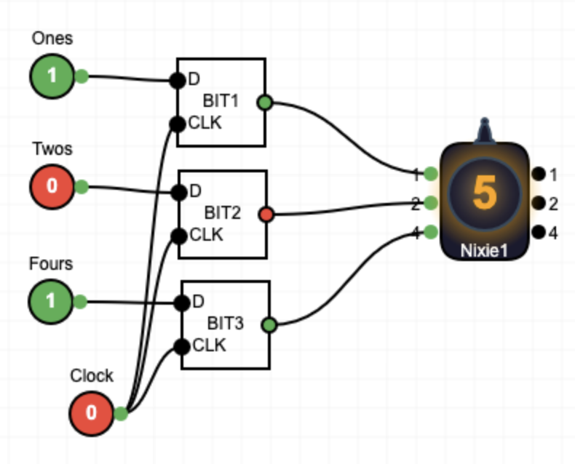
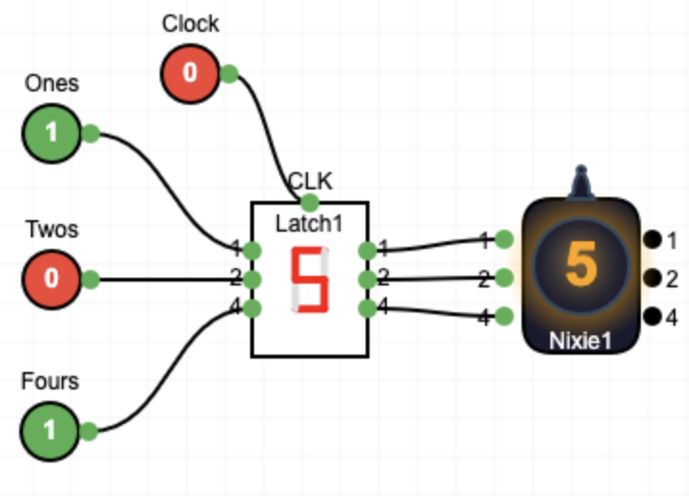
Stack D Latches to Make a 3-bit Register

Slide 32
Summary
In this lecture we started with simple gates like AND and OR
We built latches / registers for storage

Slide 33
Acknowledgements / Contributions
These slides are Copyright 2025- Charles R. Severance (online.dr-chuck.com) as part of www.ca4e.com and made available under a Creative Commons Attribution 4.0 License. Please maintain this last slide in all copies of the document to comply with the attribution requirements of the license. If you make a change, feel free to add your name and organization to the list of contributors on this page as you republish the materials.
Initial Development: Charles Severance, University of Michigan School of Information
Insert new Contributors and Translators here including names and dates
Continue new Contributors and Translators here

