Slide 1
A Short History of Computing
Dr. Charles R. Severance
www.ca4e.com
online.dr-chuck.com

Slide 2
Outline
Physical Computers (Abacus / Anthikera / Adders)
Analog (Ankithera / Slide Rule)
Digital (Adders / Pen/ Babbage Difference Engine)
Electromechanical Relays (Multipliers / Bomba / Pinball Machine)
Electronic Computers – Tubes (Colossus)
Solid State Computers – Thousands of transistors (PDP-1)
Modern Very Large Scale Integration (billions of transistors)

Slide 3
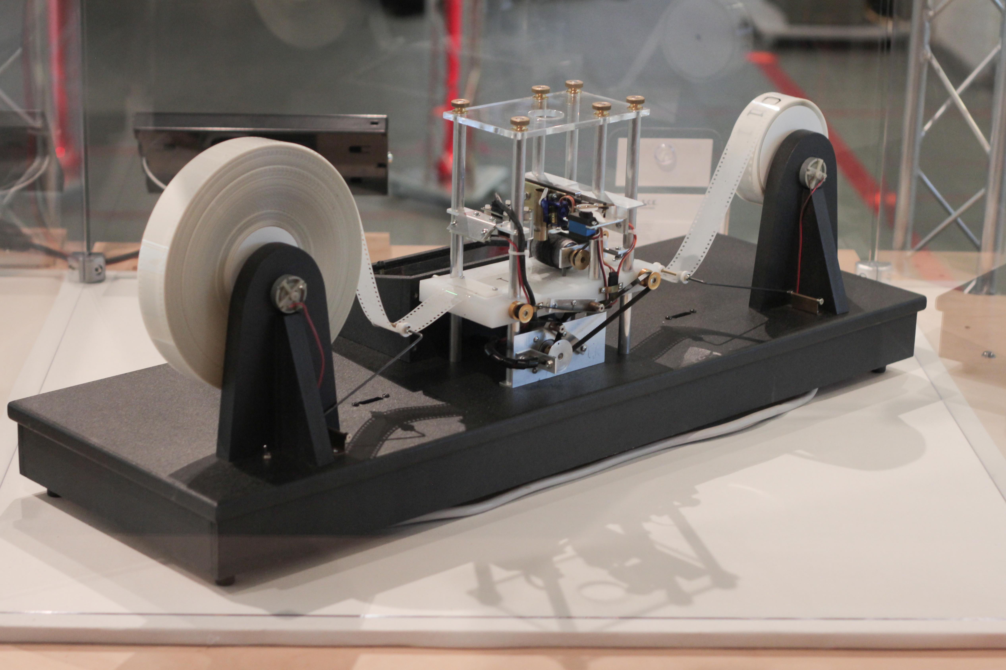
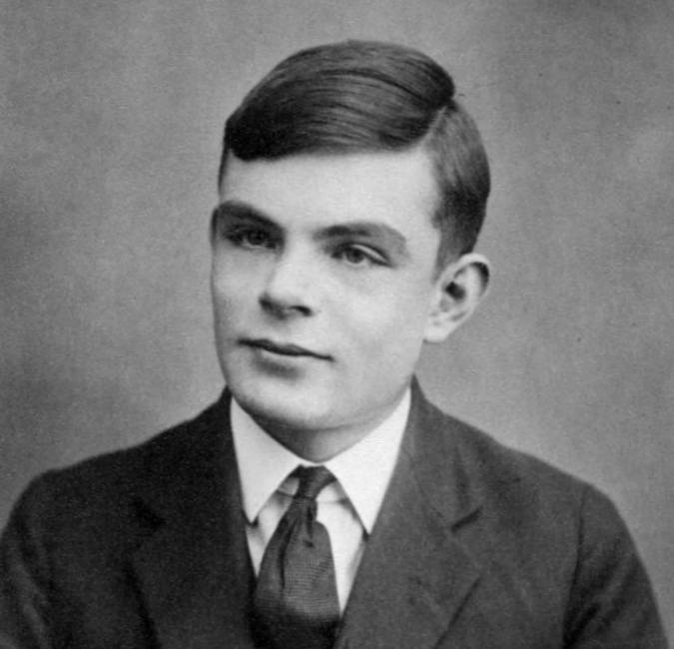
Turing Machine
Homage to the concept of a "Turing Machine"
Alan Turing did theoretical work as to what could be "computed"
Proposed a "Turing Machine" as the definition of foundation of "computability"
https://en.wikipedia.org/wiki/Alan_Turing
https://en.wikipedia.org/wiki/Turing_machine

Slide 4
"Touring Machine"
A highly simplified "Turing Machine" ☺
256 Characters of "tape memory"
Three instructions
Move left <
Move Right >
Store character 42
A Touring Machine Program:
42 > 114 > 105 > 97 > 110 < < < < 66
Output:
Brian

Slide 5
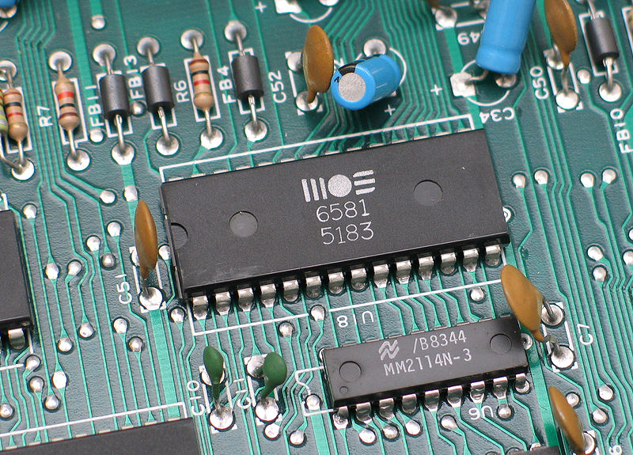
Computer Architecture
Within the computer data is moved using electric wires
Each wire generally has a voltage that is either a "0" or "1"
Wires connect components like the CPU, Memory, or other devices
A sound chip from a 1980's
Commodore 64 connected to the
motherboard
https://en.wikipedia.org/wiki/Printed_circuit_board

Slide 6
Wires transfer data
Central
Processor
Unit (CPU)
Registers
+ - * /
< > == !=
Memory
Instructions
Addresses
Load/Store Data

Slide 7
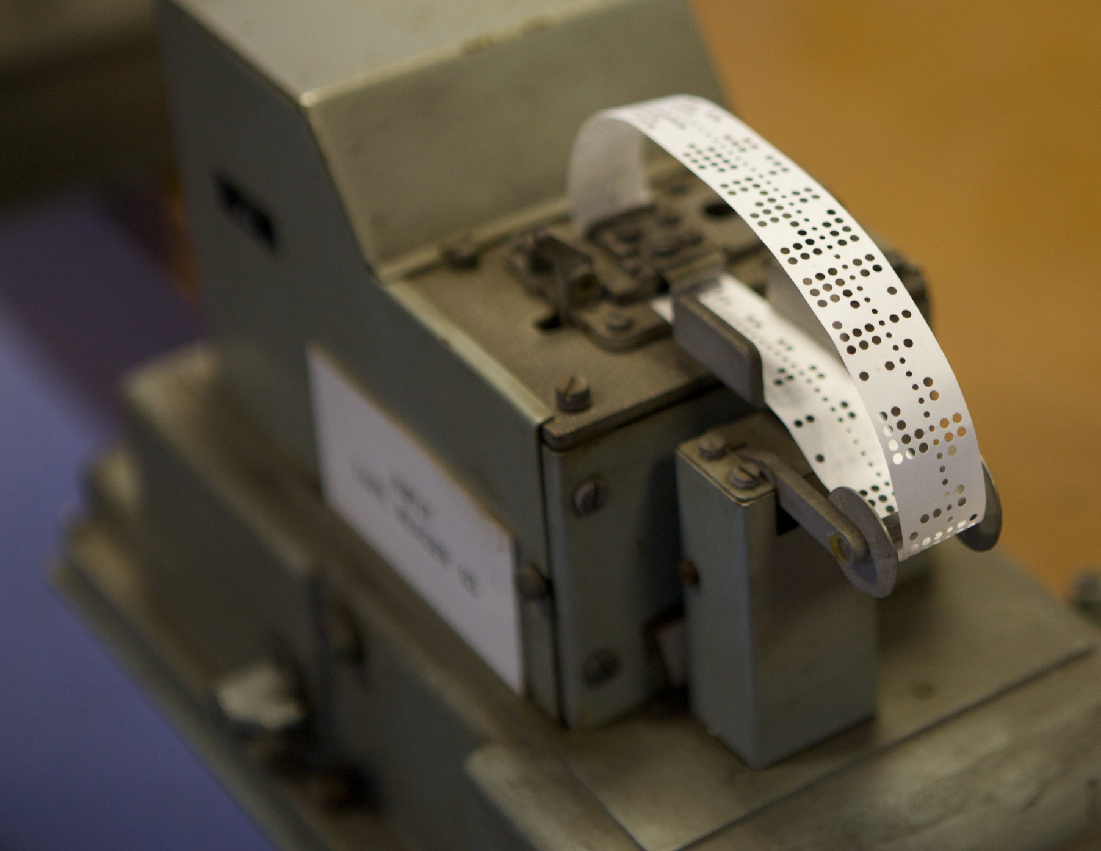
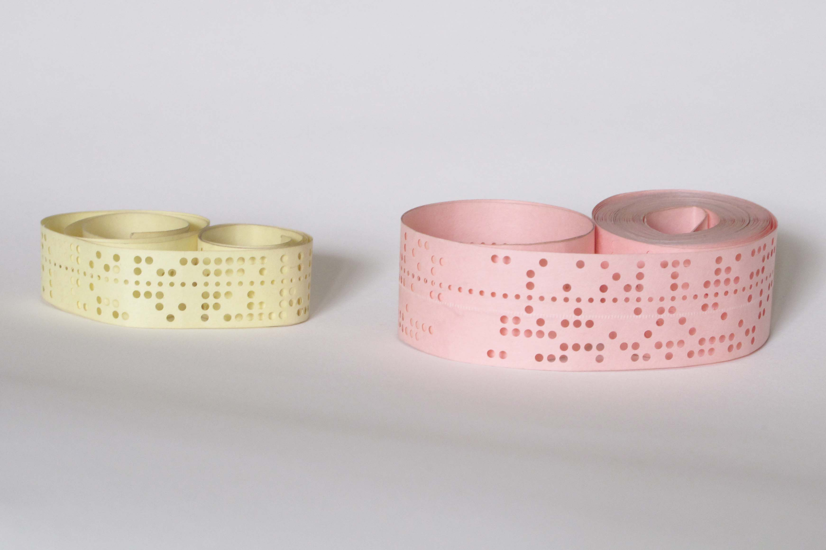
Writing Programs with Bits
In the old days, we encoded programs on paper tape
0
0
1
0
1
1
1
0
Hex: 2E
ASCII Period (.)
https://en.wikipedia.org/wiki/Punched_tape

Slide 8
Binary Touring Machine
char (big endian)
Code
Hex
0
0
0
0
0
0
0
0
42
>
114
>
105
>
97
>
110
<
<
<
<
66
2A
80
72
80
69
80
97
80
6E
C0
C0
C0
C0
66
Op Code
0
0
(0) Store this character
0
1
(1) Store this character
1
0
(2) Move right
1
1
(3) Move Left

Slide 9
6.7 Fields – Getting at the bits ☺
int main() {
union instruction {
char ch;
struct {
unsigned low : 6;
unsigned top : 2;
} parts;
} ;
union instruction inst;
inst.ch = 0xF1;
printf("%s %x %x\n",
ch2b2(inst.ch),
inst.parts.top,
inst.parts.low);
}
Using a struct with small unsigned integers we can allocate, arrange, and pack values as small as a single bit
Big endian – High to low layout
Little endian – Low to high layout
Big Endian Output
11110001 3 31
Little Endian Output
10001111 3 31
kr_06_11.c

