Slide 1
The CDC 8512 Microprocessor
Dr. Charles R. Severance
online.dr-chuck.com

Slide 2
About the CDC6500
60 bit words – Integer and floating point formats
6 bit characters - upper case only
Two kinds of registers - A0-A7 – Address and X0-X7 data
To load from memory you put the address in A1-A5 and the data from memory is loaded into the corresponding X1-X5
To store into memory you put the data in X6 or X7 and Set the corresponding A6 or A7 to the location where you want the memory stored

Slide 3
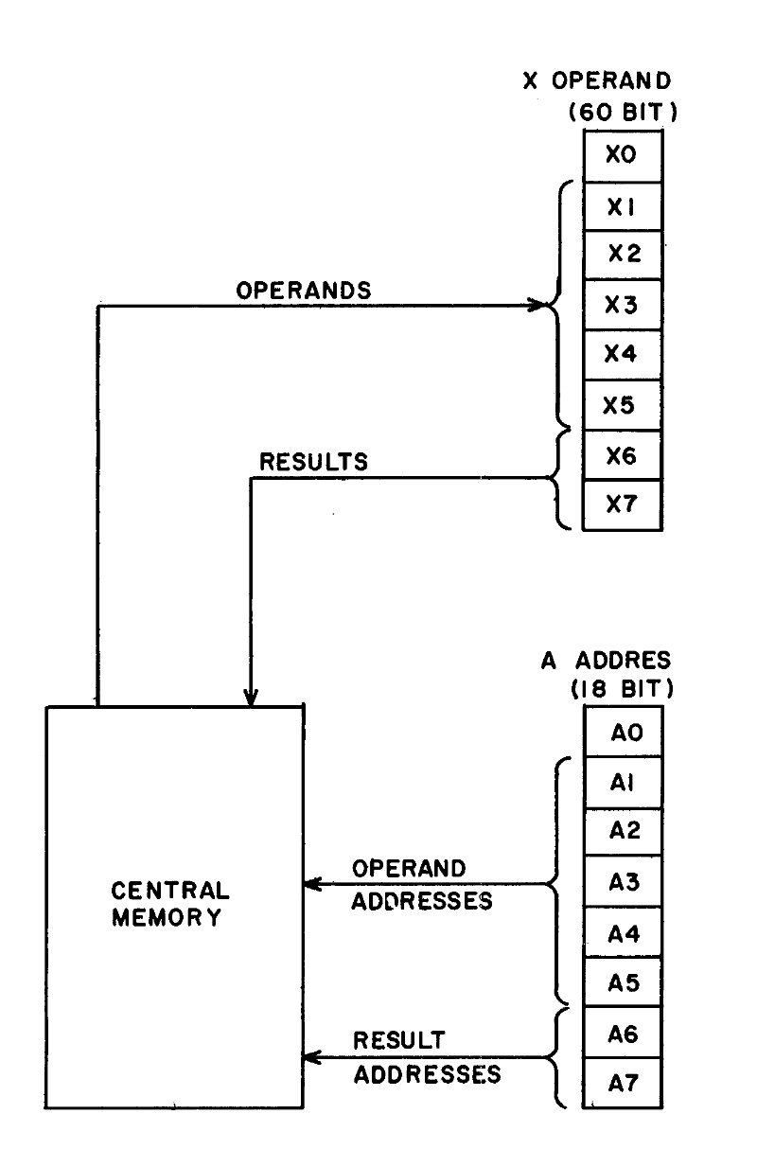
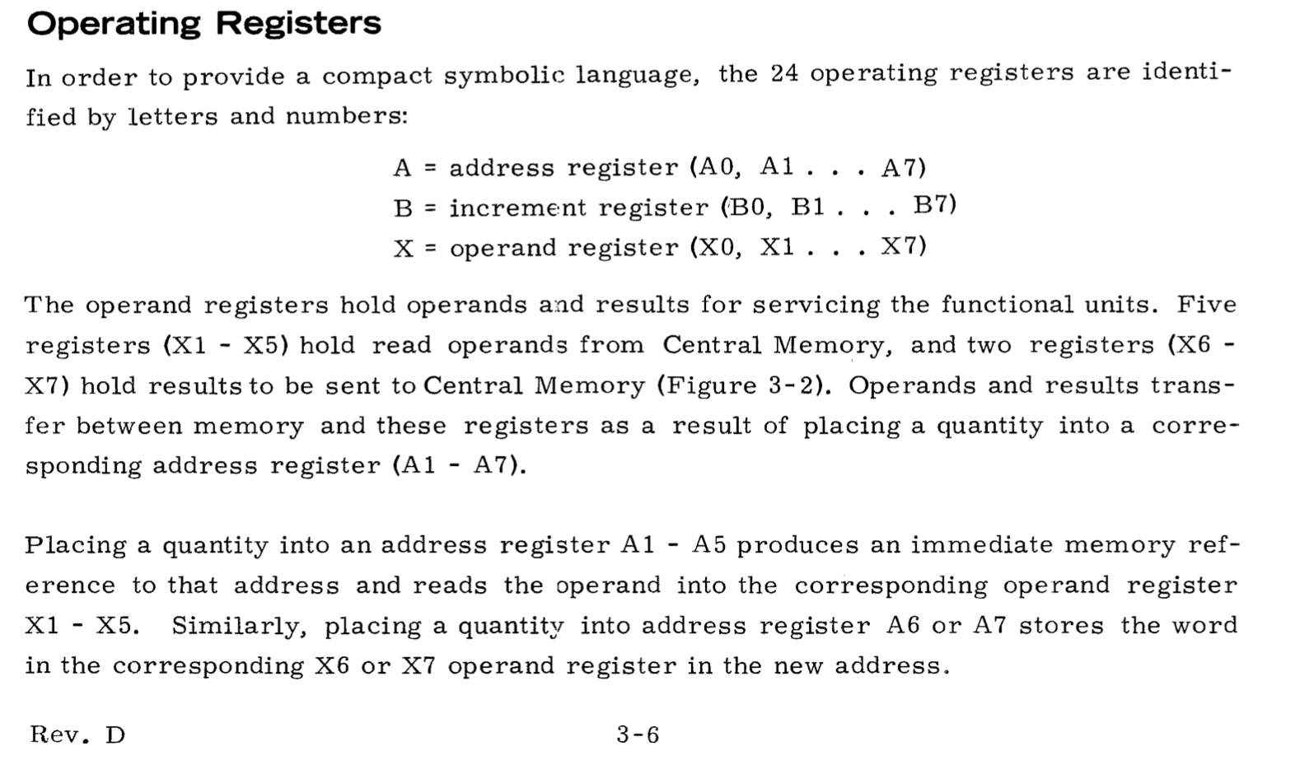
Operating Registers
In order to provide a more compact symbolic language, the 24 operating registers are identified by letters and numbers:
A = Address Register (A0, A1 .. A7)
B = increment register (B0, B1 … B7)
X = operand register (X0, X1 … X7)
The operand registers hold operands and results for servicing the functional units. Five registers (X1-X5)
Control Data 6400/6500/660 Computer Systems Reference Manuaal – Figure 3.2
http://ygdes.com/CDC/60100000D_6600refMan_Feb67.pdf

Slide 4
CDC8512 Architecture
Central Processing Unit
Instruction Memory
Data Memory
PC
255
CM
<=>
0x00
255
0x00
255
A0
255
255
0x01
255
0x01
255
L O A D
X0
A1
255
X1
255
0x02
255
0x02
255
0x03
255
0x03
255
S T O R E
A2
255
X2
255
0x04
255
0x04
255
A3
255
X3
255
0x05
255
0x05
255
…
…
0xFD
255
0xFD
255
0xFE
255
0xFE
255
0xFF
255
0xFF
255

Slide 5
Halt Instruction
HALT # Stop the CPU
0
0
0
0
0
0
0
0

Slide 6
Single Register Instruction
INC X2 # Add 1 to X2
Increment Register
Register
0
1
0
0
1
1
1
0
Register
Number
0 = A register
1 = X register

Slide 7
Two Byte Instruction
SX0 0x43 # Set X0
SX0 67 # Set X0
SC0 'C' # Set X0
1
0
0
0
1
1
0
0
0x43
Register
Number
0 = A register
1 = X register

Slide 8
Register to Register Copy
Register
Copy
Source
Register
Destination
Register
SX3 A1 # Copy A1 to X3
1
1
0
0
1
1
1
1
0 = A register
1 = X register
Register
Number
Register
Number
0 = A register
1 = X register

