Slide 1
Solid State Compting
Dr. Charles R. Severance
www.ca4e.com
online.dr-chuck.com

Slide 2
Outline
The transistor
Faster than a relay or tube
Far less heat and electricity
Far more reliable and long lasting
No moving parts
Replaced tubes for amplifiers
Transistor radios
Computing applications – PNP and NPN
NPN – Conduct with input is high
PNP – Stop conducting when input is high

Slide 3
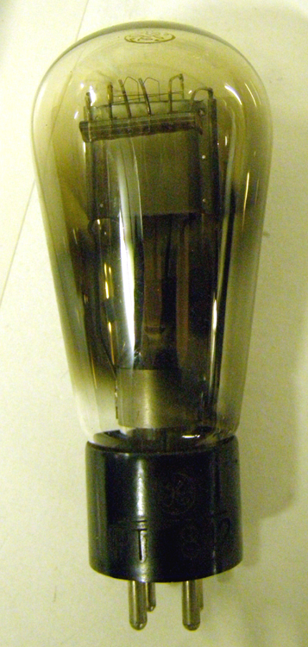
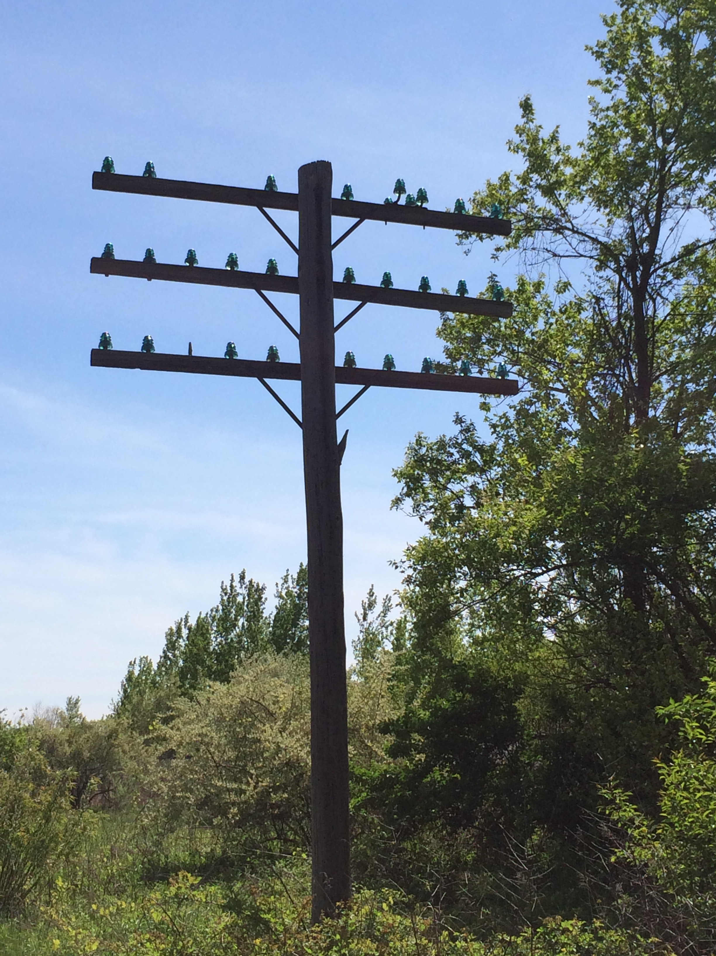
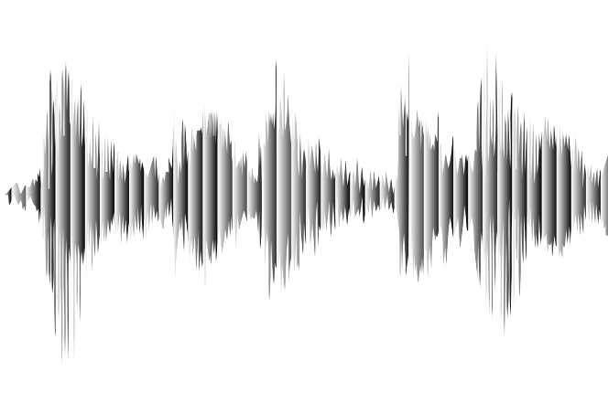
Valves / Tubes / Vacuum Tubes
The first purely electronic devices to store data and do computations were called "Valves" in the UK
About 1000 times faster than physical relays
Designed to amplify analog signals
Early application long distance analog telephone calls – needed an amplifier every 10 miles or so
Tube was invented in 1912 Dr. Lee Deforest
+
Output
Anode
Grid
Input
Cathode
⏚
https://en.wikipedia.org/wiki/Vacuum_tube

Slide 4
Building "Digital" Valves / Tubes
The design of tubes could be tweaked so to move quickly from low voltage to high voltage as the input voltage increased
Voltage low = off
Voltage high = on
With the correct design, a range of slightly lower input would be lifted on output
Transition
Digital
"Valve"
Audio
Amplifier
Output Voltage
Regenerate
Input Voltage

Slide 5
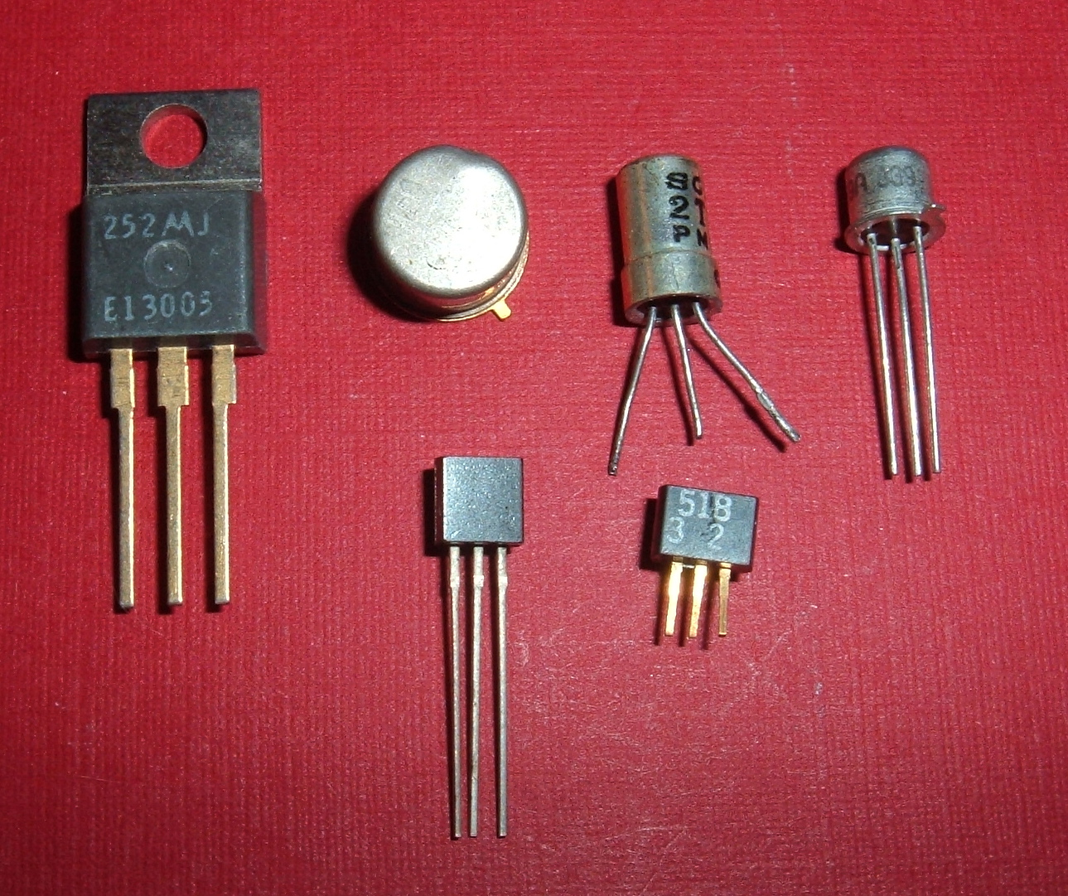
Transistors
Building a better Triode (Tube)

Slide 6
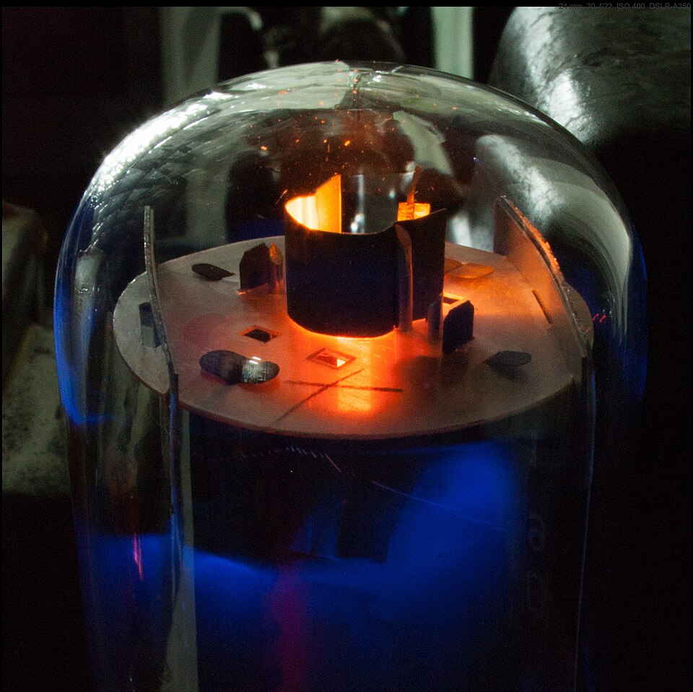
Flaws of Valves
Take lots of power per switch / bit
Lots of heat because each tube usually had a heater to make it easier to generate ions
Physically large
Expensive to manufacture
Made a comforting humming noise
Electronic glow in the dark
https://en.wikipedia.org/wiki/Valve_amplifier

