Slide 1
Computing with Transistors
Dr. Charles R. Severance
www.ca4e.com
online.dr-chuck.com

Slide 2
Outline
The transistor replacing tubes in digital applications
Faster than a relay or tube
Far less heat and electricity
More reliable and long lasting
No moving parts
Amplifiers, Tubes and Transistors – It's complicated
Transistor radios
Evolution of transistor technology and manufacturing
BJT -> PMOS -> NMOS -> CMOS
The "digital logic gate" abstraction
Notes:
BJT = Biploar Junction Transistor
PMOS = P-channel Metal-Oxide-Semiconductor
NMOS = N-channel Metal-Oxide-Semiconductor
CMOS = Complimentary Metal-Oxide-Semiconductor
VLSI = Very Lage Scale Integration

Slide 3
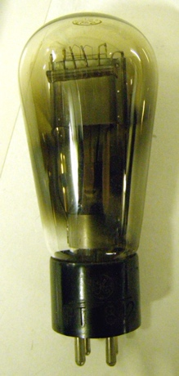

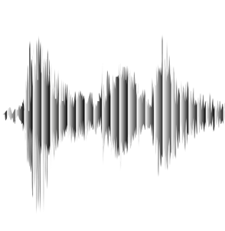

Valves / Tubes / Vacuum Tubes
The first purely electronic devices to store data and do computations were called "Valves" in the UK
About 1000 times faster than physical relays
Designed to amplify analog signals
Early application long distance analog telephone calls – needed an amplifier every 10 miles or so
Tube was invented in 1912 Dr. Lee De Forest
+
Output
Anode
Grid
Input
Cathode
⏚
Notes:
A telephone pole with 30 glass insulators for 30 wires. Photo by Dr. Chuck.
A close up of a vacuum tube.
This is a simple diagram of a vacuum tube with an Anode, Cathode, and Grid with some simple wave forms showing a small input signal and larger amplified signal.
Image: https://en.wikipedia.org/wiki/Vacuum_tube

Slide 4
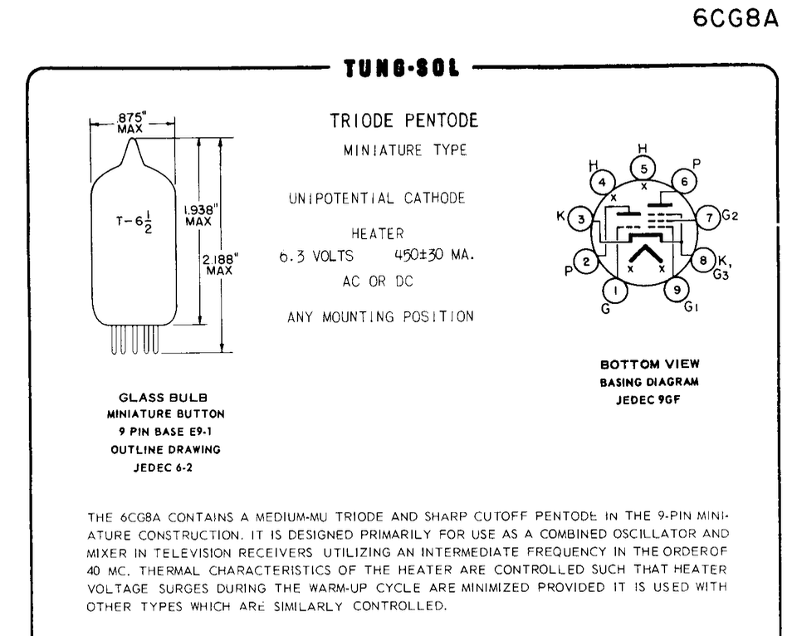
Triode Specification
https://frank.pocnet.net/sheets/127/6/6CG8A.pdf
Notes:
This is an image of the specification sheet of the Raytheon 6CG8A Vacuum Tube from https://frank.pocnet.net/sheets/127/6/6CG8A.pdf
It shows the first [page of the specification with the dimensions of the tube (2.188 inches tall) and the number of pins (8). The content of the text is not particularly relevant - it is more fun as a historical document.

Slide 5
Building "Digital" Valves / Tubes
The design of tubes could be tweaked so to move quickly from low voltage to high voltage as the input voltage increased
Voltage low = off
Voltage high = on
With the correct design, a range of slightly lower input would be lifted on output
Transition
Digital
"Valve"
Audio
Amplifier
Output Voltage
Regenerate
Input Voltage
Notes:
The diagram on this page shows a graph of input voltage and output voltage comparing the response of an amplifier type tube to a tube that is designed more for digital applications (0/1). The amplifier graph starts low and then is a curve going up almost linearly over the range of the input voltage. The digital curve stays low longer and then goes up more vertically before tapering off at the top of the output voltage. The concept is that the transition from low to high if gradual and almost linear for the amplifier and quick and almost vertical for the tube tuned for digital applications. The digital tube goes "vertical" at about the 1/3 point of the input voltage – this means that the tub "pulls up" low non-zero voltages like 0.3 to 1 on output.

Slide 6
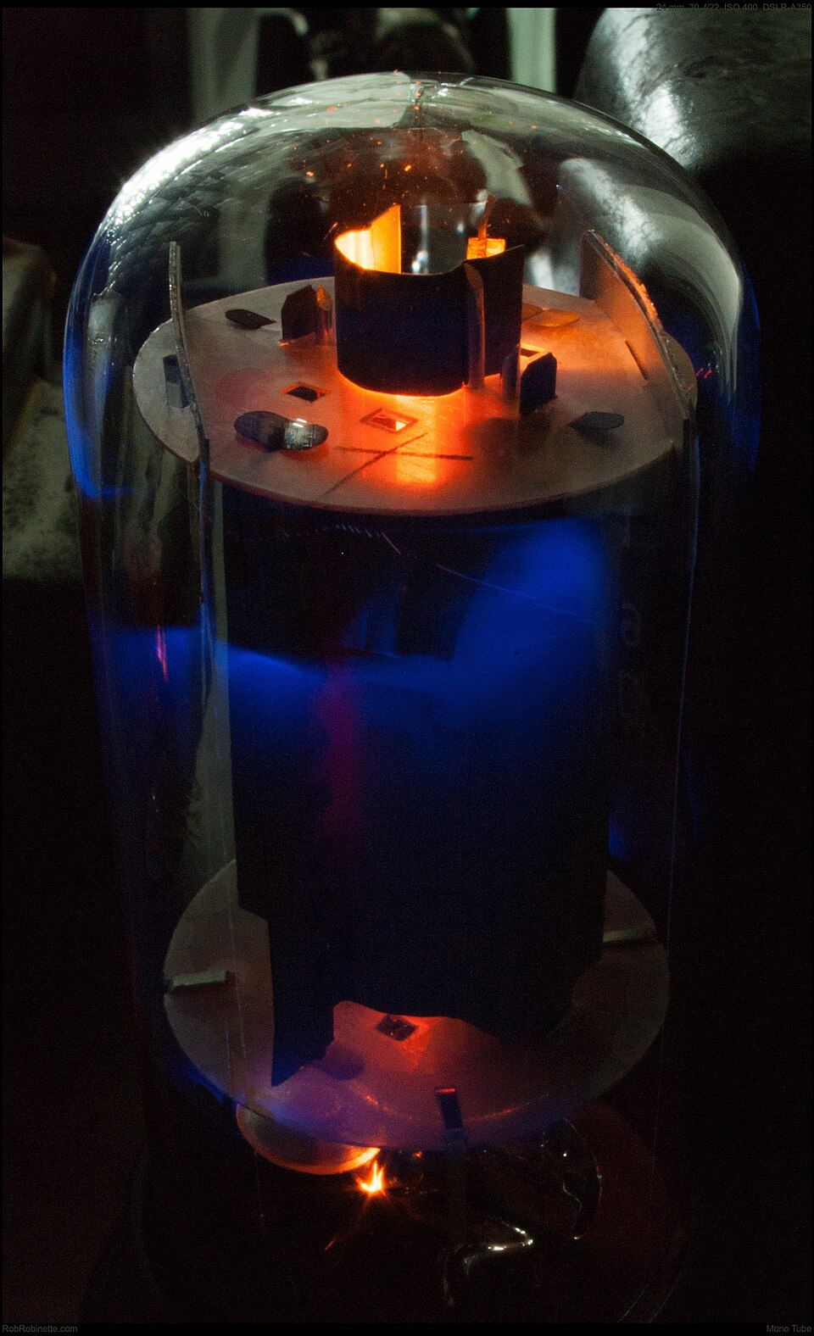
Flaws of Valves
Take lots of power
Lots of heat because tubes had an internal heater that helped release electrons from the cathode.
Physically large
Expensive to manufacture
Soft electronic glow in the dark
Notes:
Image: https://en.wikipedia.org/wiki/Valve_amplifier

Slide 7
Semi-Conductors

Slide 8
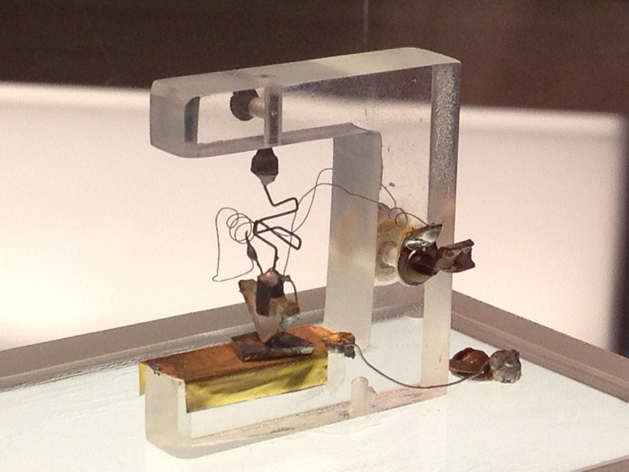
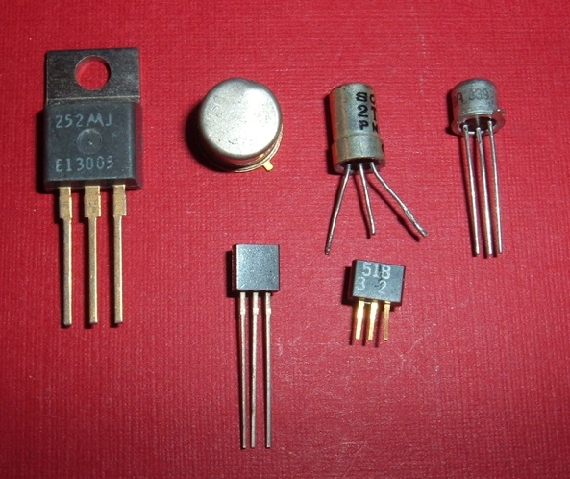
Transistors
Building a better Triode (Tube)
Three kinds of materials w.r.t electricity
Conducting like metal
Insulating like plastic
Semi-conductor
Certain crystalline materials like silicon can be modified by adding impurities (‘doping’) so they conduct electricity under certain conditions — hence, semiconductors.
Notes:
The first transistor ever made, built by John Bardeen, William Shockley and Walter H. Brattain of Bell Labs in 1947. Original exhibited in Bell Laboratories.
A few early manufactured transistors. Each transistor has three inputs.
Image: https://en.wikipedia.org/wiki/Transistor
Image: https://commons.wikimedia.org/wiki/File:1st-Transistor.jpg

Slide 9
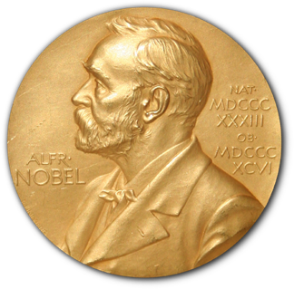

Nobel Prize!
+
Output
Anode
Transistors are constructed by layering crystals with carefully designed impurities
Silicon with N-Doping
Silicon with P-Doping
When voltages are applied to the crystals, sub-atomic stuff happens at the boundaries between the different types of crystals that affect the flow of electrons through the crystals
Grid
Input
Cathode
⏚
+
Output
Emitter
N
P
Base / Gate
Input
N
⏚
Collector
Notes:
The is a transistor version of a tube. it has an N-doped Emitter, P-doped Base and N-Doped Collector. We see low amplitude wave form connected to the Base and a higher amplitude wave form coming out of the emitter to show amplification.
Image: https://en.wikipedia.org/wiki/Nobel_Prize_in_Physics

Slide 10
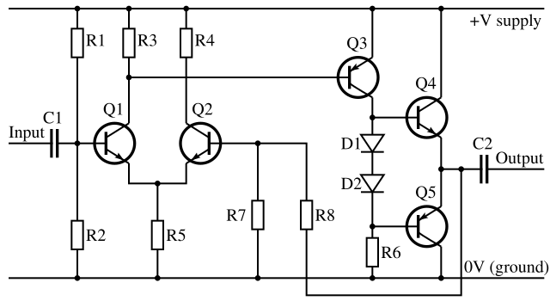
Transistor audio amplifiers – not so simple
A typical transistor amplifier (whether NMOS or BJT) inverts the signal — so an additional stage is used to restore phase.
A few more transistors improve the quality of the amplified signal.
Output
Input
Notes:
BJT – Bipolar Junction Tranistor
Image: https://en.wikipedia.org/wiki/Amplifier

Slide 11
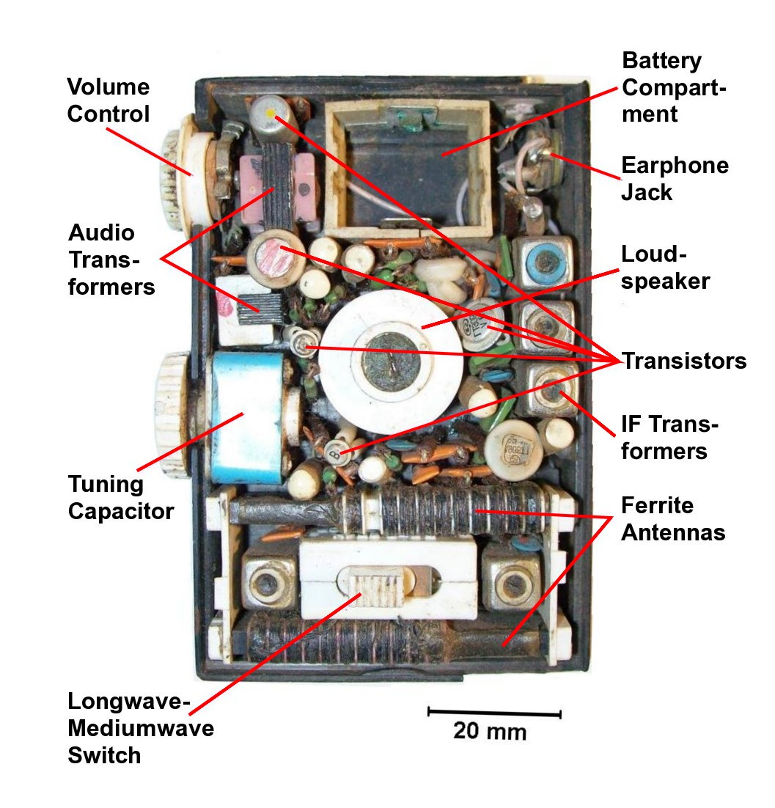

Transistor Radios
Once amplifier style transistors were available, during the 1940's there was an effort to build small, battery-powered "transistor radios"
Often the marketing included the number of transistors – "The Sony TR-826 radio has eight transistors!"
Notes:
Ebay photo of a Sony TR-826 vintage AM radio.
Pocket transistor radio, late 1960s to 1970s, with 7 germanium transistors, that received long wave and medium wave (AM broadcast) bands. View with back open, showing parts. Powered by 2 button cells supplying 3V (removed).
Image: https://en.wikipedia.org/wiki/Transistor_radio

Slide 12
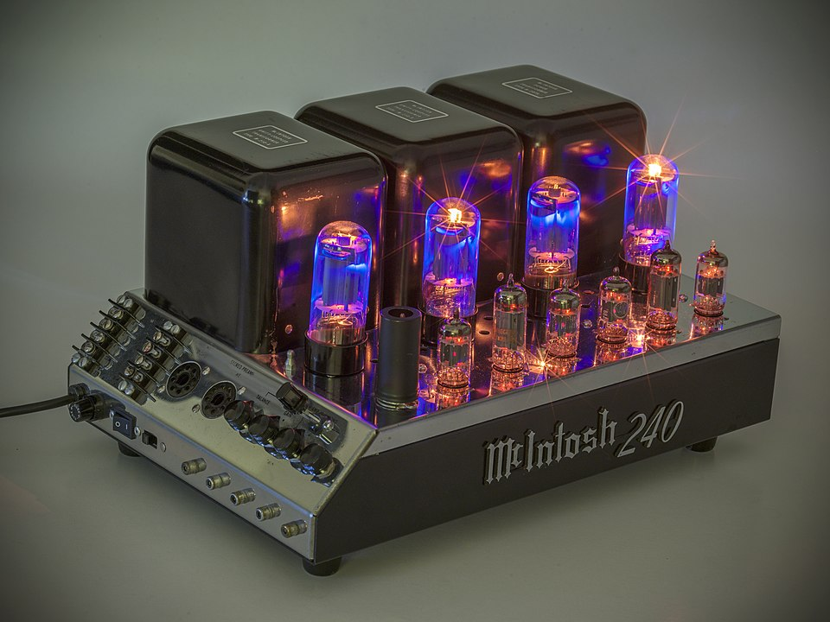
Hi End Tube-Based Audio Amplifiers
Many and professional musical performers feel that that amplifiers that use tubes produce better sound with less distortion
New high-end audio amplifiers can cost upwards of $50,000
This is not an audio class - so back to digital logic ☺
Macintosh MC240 - $3500
Notes:
MC240 tube amplifier (early version), manufactured by McIntosh Laboratories in 1961. It is powers on with 12 beautiful exposed tubes glowing a soft orange and blue. Costs about $3500 on eBay.
https://en.wikipedia.org/wiki/Valve_amplifier

Slide 13
Building "Digital" Transistors
The design of transistors could be tweaked to move quickly from high voltage to low voltage as the input voltage increased
Voltage low = off
Voltage high = on
With the right design, a range of slightly lower input would be corrected on output
AI: Difference between a Bipolar Junction Transistor and NMOS transistor
Transition
Output Voltage
Bipolar
Junction
Transistor
NMOS
Transistor
Input Voltage
Notes:
This is the transistor equivalent of the tube diagram a few slides back. The diagram on this page shows a graph of input voltage and output voltage comparing the response of an amplifier type transistor to a transistor that is designed more for digital applications (0/1). The amplifier graph starts low and then is a curve going up almost linearly over the range of the input voltage. The digital curve stays low longer and then goes up more vertically before tapering off at the top of the output voltage. The concept is that the transition from low to high if gradual and almost linear for the amplifier and quick and almost vertical for the transistor tuned for digital applications. The digital tube goes "vertical" at about the 1/3 point of the input voltage – this means that the transistor "pulls up" low non-zero voltages like 0.3 to 1 on output.

Slide 14
Two Kinds of "Digital" Transistors
Transition
PMOS
NMOS conducts when the input (gate) voltage is high
PMOS conducts when the input is low.
Modern chips use both
CMOS – Complementary Metal-Oxide-Semiconductor
Output Voltage
NMOS
Input Voltage
Notes:
PMOS (p-channel metal-oxide-semiconductor) refers to a type of field-effect transistor (FET) where the current flow is carried by positively charged "holes"
NMOS (n-type metal–oxide–semiconductor) refers to a type of field-effect transistor (FET) where the channel between the source and drain is made of n-type semiconductor material
The graph on this slide shows an PMOS S-curve going from low to high output voltage with an almost vertical transition at the 2/3 point in the input voltage. The 2/3 point helps pull up voltages that might not quite be 1 on input to 1 on output. The NMOS S-Curve goes from high to low with an almost vertical drop at about the 1/3 point in the input voltage. The 2/3 point helps pull down voltages that might not quite be 1 on input to be 0 on output.
Early logic used PMOS or NMOS depending on what was most effective to manufacture. But the mid 1980s – both NMOS and PMOS could be manufactured in one chip, leading the the use of both on modern chips – we called it CMOS – Complementary Metal-Oxide-Semiconductor. In short NMOS + PMOS = CMOS
Reference: https://en.wikipedia.org/wiki/MOSFET

Slide 15
The Four Eras of Transistor Manufacturing
Approx. Years | Dominant Technology | Key Feature | Processors | Limitation that Led to Next Step
1950s–1960s | Bipolar Junction Transistor (BJT) | Fast and well-understood |  | Power-hungry, hard to integrate
Late 1960s–early 1970s | PMOS | Easier to fabricate MOS logic | Intel 4004 | Slow, used negative voltages
1973–1983 | NMOS | Faster, simpler power supply | Intel 8080 Zilog Z-80 | Still wasted static power
1983–present | CMOS | Extremely low power, scalable | Intel 486 | Became universal
ChatGPT: Describe the historical timeline for the transition from Bipolar Junction Transistor (BPT) to Complementary Metal-Oxide-Semiconductor (CMOS) transistor technology.

Slide 16
From Transistors to Gates

Slide 17
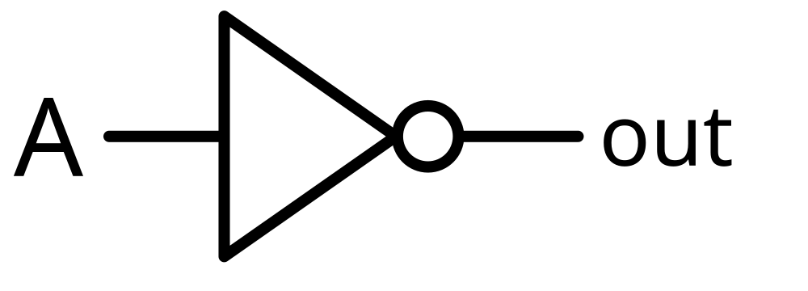
We use transistors to implement "gates"
When we build digital logic we think in terms of abstractions that we call "gates"
Gates let us think about in 1's and 0's instead of voltages
The simplest gate is a "not" gate where the output is the opposite of the input
It demonstrates a circuit that reacts – like a simple "if" statement
We will build more complex logic circuits
Input | Output
0 | 1
1 | 0
Notes:
Image: https://en.wikipedia.org/wiki/Inverter_(logic_gate)

Slide 18
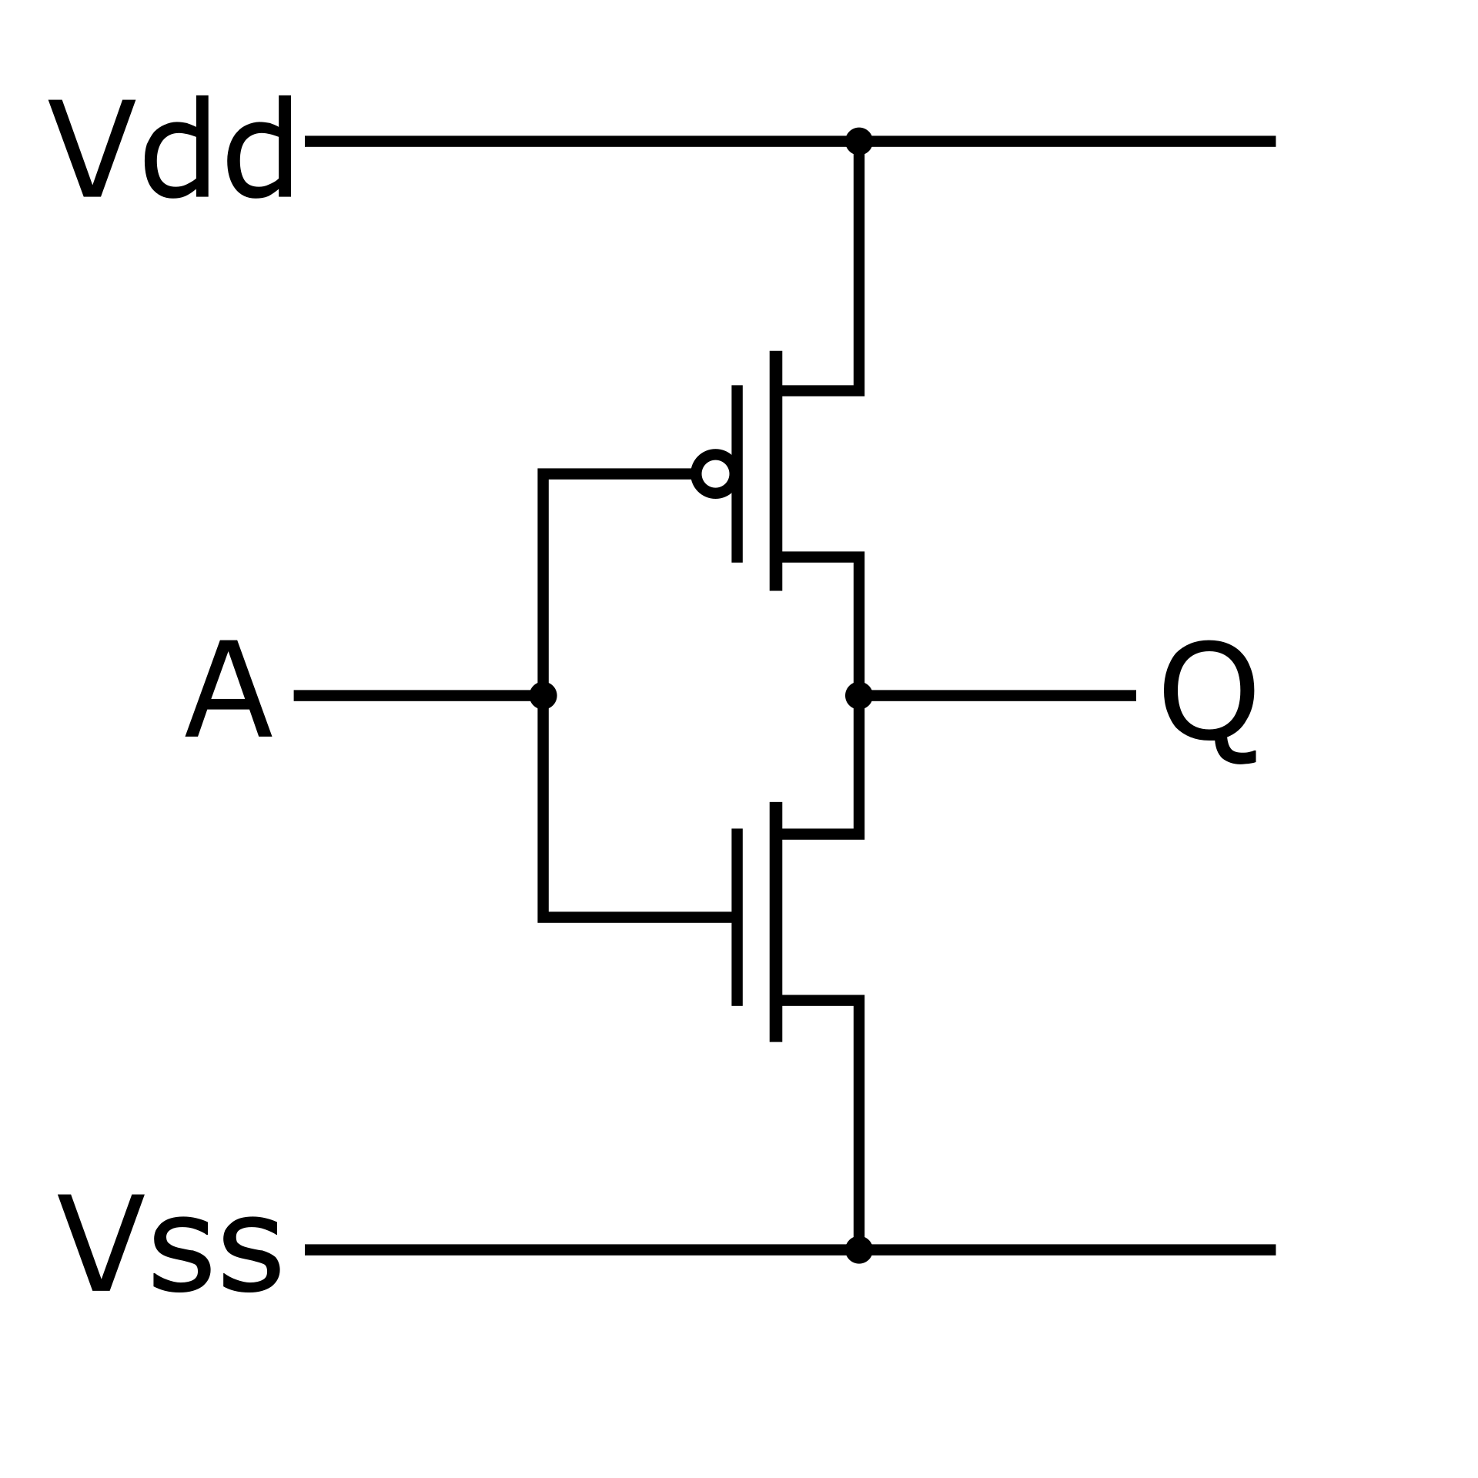
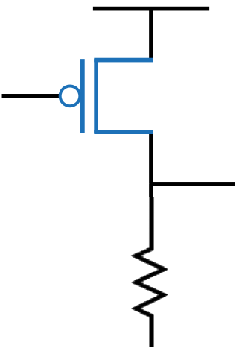
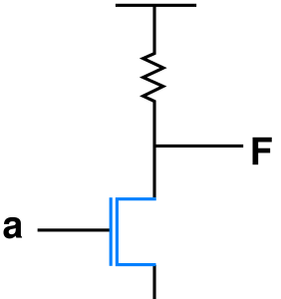
Not gate gate technology…
Vdd
Vdd
Vdd
A
out
out
A
out
A
⏚
⏚
⏚
PMOS - 1972
NMOS - 1978
CMOS - 1983
Notes:
These not gates show an evolution. In the early 1970s, were easier to manufacture but they were slow and had low density. When the input to a PMOS Not gate is 1 the gate closes, and the output voltage of the transistor is split between the output going to the next gate and the resistor connected to ground. Because of this, the output voltage needs to be "pulled up" by the next gate and the resistor generates heat if the PMOS input is 1. In the late 1970's when manufacturing improved, NMOS transistors could be built with much higher densities. When the input to a NMOS Not gate is 0, the transistor is open (not conducting) and the voltage flows from VCC to the output (1). When the input to the NMOS Not gate is 1, the transistor is closed (conducting) so the output is pulled to ground. Once the transistor is closed current flows directly from VCC to ground and to avoid a short circuit, there is a resistor to limit current from VCC to ground. While the input to the NMOS Not gate is 1, the resistor is using power and generating heat. In Complementary Metal-Oxide-Semiconductor (CMOS) there is both PMOS and NMOS transistors connected to the same input. If the CMOS Not input is zero, the PMOS transistor opens and the NMOS transistor closes and VCC is connected to output with no need for a resistor. When The CMOS Not input is 1, the PMOS transistor closes and the NMOS transistor opens, drawing the output down to (0). CMS Not gates consume very little power and generate very little heat when the input is not changing. There is some heat generated which the input is changing, but overall, the two-transistor CMOS approach uses far less power and generates far less hear than either of the single transistor Not gates. CMOS can handle far greater densities and switching speeds without damage and continues to be the dominate approach in modern chips.

Slide 19
Hot gate heat (input 0)
Vdd
Vdd
Vdd
A
❄
❄
0
out
out
A
out
1
1
1
0
♨️
A
🚫
🚫
0
⏚
⏚
⏚
PMOS - 1972
NMOS - 1978
CMOS - 1983
Notes:
These not gates show an evolution. In the early 1970s, were easier to manufacture but they were slow and had low density. When the input to a PMOS Not gate is 1 the gate closes, and the output voltage of the transistor is split between the output going to the next gate and the resistor connected to ground. Because of this, the output voltage needs to be "pulled up" by the next gate and the resistor generates heat if the PMOS input is 1. In the late 1970's when manufacturing improved, NMOS transistors could be built with much higher densities. When the input to a NMOS Not gate is 0, the transistor is open (not conducting) and the voltage flows from VCC to the output (1). When the input to the NMOS Not gate is 1, the transistor is closed (conducting) so the output is pulled to ground. Once the transistor is closed current flows directly from VCC to ground and to avoid a short circuit, there is a resistor to limit current from VCC to ground. While the input to the NMOS Not gate is 1, the resistor is using power and generating heat. In Complementary Metal-Oxide-Semiconductor (CMOS) there is both PMOS and NMOS transistors connected to the same input. If the CMOS Not input is zero, the PMOS transistor opens and the NMOS transistor closes and VCC is connected to output with no need for a resistor. When The CMOS Not input is 1, the PMOS transistor closes and the NMOS transistor opens, drawing the output down to (0). CMS Not gates consume very little power and generate very little heat when the input is not changing. There is some heat generated which the input is changing, but overall, the two-transistor CMOS approach uses far less power and generates far less hear than either of the single transistor Not gates. CMOS can handle far greater densities and switching speeds without damage and continues to be the dominate approach in modern chips.

Slide 20
Hot gate heat (input 1)
Vdd
Vdd
Vdd
♨️
❄
A
🚫
🚫
1
out
out
A
out
0
0
0
1
❄
A
1
⏚
⏚
⏚
PMOS - 1972
NMOS - 1978
CMOS - 1983
Notes:
These not gates show an evolution. In the early 1970s, were easier to manufacture but they were slow and had low density. When the input to a PMOS Not gate is 1 the gate closes, and the output voltage of the transistor is split between the output going to the next gate and the resistor connected to ground. Because of this, the output voltage needs to be "pulled up" by the next gate and the resistor generates heat if the PMOS input is 1. In the late 1970's when manufacturing improved, NMOS transistors could be built with much higher densities. When the input to a NMOS Not gate is 0, the transistor is open (not conducting) and the voltage flows from VCC to the output (1). When the input to the NMOS Not gate is 1, the transistor is closed (conducting) so the output is pulled to ground. Once the transistor is closed current flows directly from VCC to ground and to avoid a short circuit, there is a resistor to limit current from VCC to ground. While the input to the NMOS Not gate is 1, the resistor is using power and generating heat. In Complementary Metal-Oxide-Semiconductor (CMOS) there is both PMOS and NMOS transistors connected to the same input. If the CMOS Not input is zero, the PMOS transistor opens and the NMOS transistor closes and VCC is connected to output with no need for a resistor. When The CMOS Not input is 1, the PMOS transistor closes and the NMOS transistor opens, drawing the output down to (0). CMS Not gates consume very little power and generate very little heat when the input is not changing. There is some heat generated which the input is changing, but overall, the two-transistor CMOS approach uses far less power and generates far less hear than either of the single transistor Not gates. CMOS can handle far greater densities and switching speeds without damage and continues to be the dominate approach in modern chips.

Slide 21
TL;DR – Not Gates Over Time
Before the 1980's, logic gates built from transistors were slow, had low density, took a lot of heat and took a lot of power.
When CMOS was practical in the 1980s, CPUS went from the size of large cabinets to single chips
As size reduced things got much faster
From now on we will only speak of CMOS ☺
VDD
A
OUT
GND
Notes:
A CMOS Not gate - it has a PMOS transistor at the top connected between VDD and the common OUT line. It has an NMOS transistor at the bottom connected between the common OUT line and the ground. The Input (A) is connected to the gate input of both transistors.

Slide 22
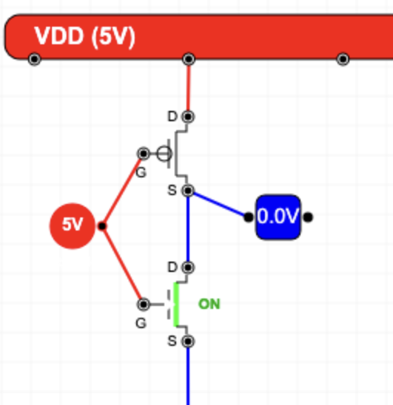
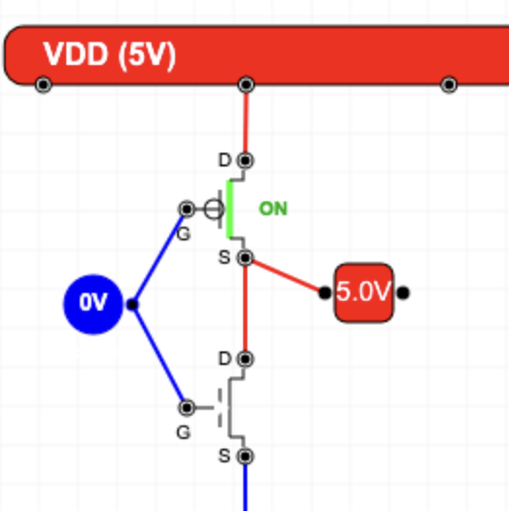
Layout a CMOS NOT Gate (Demo)
VDD
A
OUT
GND
Notes:
A CMOS Not gate - it has a PMOS transistor at the top connected between VDD and the OUT line. It has an NMOS transistor at the bottom connected between the common OUT line and the ground. The Input (A) is connected to the gate input of both transistors.
Image: https://www.ca4e.com/tools/cmos/

Slide 23
Digital Logic
To design more complex circuits from half-adders to CPUs it is much easier to think in terms of gates than transistors
Gates are an abstraction
On / OFF or 1 / 0
The basic gates come from mathematical logic (and IF statements)
Not / And / Or / Exclusive Or
We also talk about gates that can be built with fewer transistors
NAND / NOR

Slide 24




Classic Mathematical Logic Gates
Not
And
Or
Exclusive Or
A | B | Q
0 | 0 | 0
0 | 1 | 0
1 | 0 | 0
1 | 1 | 1
A | B | Q
0 | 0 | 0
0 | 1 | 1
1 | 0 | 1
1 | 1 | 1
A | B | Q
0 | 0 | 0
0 | 1 | 1
1 | 0 | 1
1 | 1 | 0
A | Q
0 | 1
1 | 0
Two transistors
Six transistors
Six transistors
Eight transistors

Slide 25
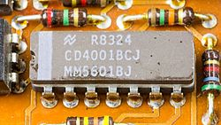


NAND and NOR Fewer transistors
NAND
NOR
VDD
VDD
VDD
A | B | Q
0 | 0 | 1
0 | 1 | 1
1 | 0 | 1
1 | 1 | 0
A
B
A | B | Q
0 | 0 | 1
0 | 1 | 0
1 | 0 | 0
1 | 1 | 0
A
OUT
B
A
OUT
B
A
B
GND
GND
GND
Four transistors
Four transistors
Notes:
This is a NAND gate with two PMOS transistors in parallel at the top connecting to the OUT wire. On the bottom there are two series NMOS transistors connected between the OUT wire and the ground.
This is a NOR gate with two PMOS transistors in series at the top connecting to the OUT wire. On the bottom there are two parallel NMOS transistors connected between the OUT wire and the ground.

Slide 26
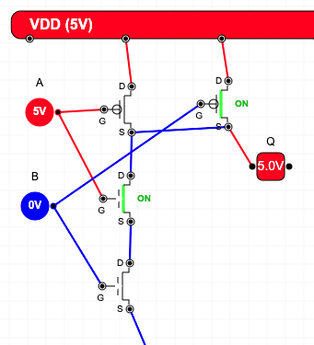
Layout a CMOS NAND Gate
VDD
VDD
A | B | Q
0 | 0 | 1
0 | 1 | 1
1 | 0 | 1
1 | 1 | 0
A
B
OUT
A
B
GND
Notes:
This is a NAND gate with two PMOS transistors in parallel at the top connecting to the OUT wire. On the bottom there are two series NMOS transistors connected between the OUT wire and the ground.

Slide 27
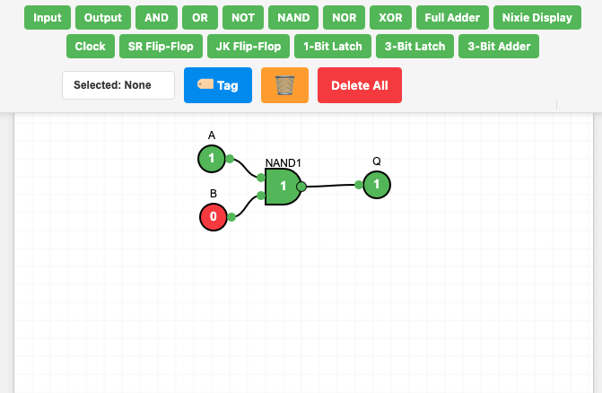
Sneak Peek: Digital Logic Design

Slide 28
Summary
Semiconductors
Tuning tubes and transistor for digital applications (as compared to amplifier applications)
Building gates from transistors
Transistor technology evolution PMOS, NMOS and CMOS logic

Slide 29
Acknowledgements / Contributions
These slides are Copyright 2025- Charles R. Severance (online.dr-chuck.com) as part of www.ca4e.com and made available under a Creative Commons Attribution 4.0 License. Please maintain this last slide in all copies of the document to comply with the attribution requirements of the license. If you make a change, feel free to add your name and organization to the list of contributors on this page as you republish the materials.
Initial Development: Charles Severance, University of Michigan School of Information
Insert new Contributors and Translators here including names and dates
Continue new Contributors and Translators here

