Slide 1
Digital Logic
Dr. Charles R. Severance
www.ca4e.com
online.dr-chuck.com

Slide 2
Outline
Special Purpose
Mechanical Multipliers
Babbage Difference Engine
Electromecha
Electronic Computers – Tubes (Colossus)
Computers (a.k.a. "one who computes")
Solid State Computers – Thousands of transistors (PDP-1)
Modern Very Large Scale Integration (billions of transistors)

Slide 3
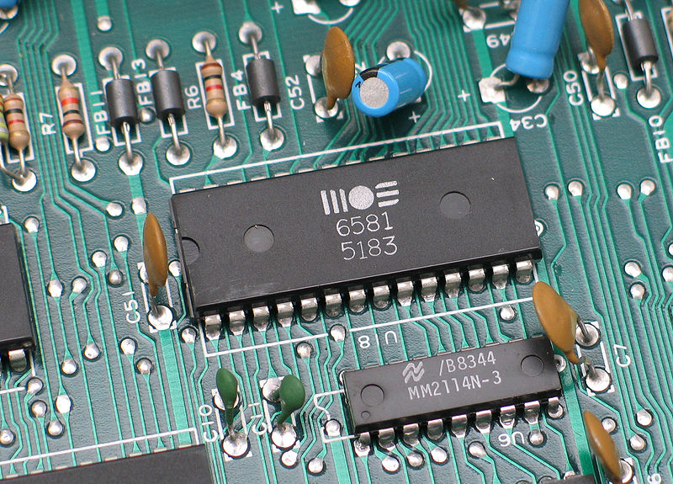
Computer Architecture
Within the computer data is moved using electric wires
Each wire generally has a voltage that is either a "0" or "1"
Wires connect components like the CPU, Memory, or other devices
A sound chip from a 1980's
Commodore 64 connected to the
motherboard
https://en.wikipedia.org/wiki/Printed_circuit_board

