Slide 1
Basics of Advanced Multimedia
Dr. Charles Severance

Slide 2
Raw Audio
Formats
  .au - 8Khz - 8 bit samples = 64000 bps
  One second = 3 seconds download
  CD mono - 44kHz - 16 bit samples = 704000 bps
  One second = 30 seconds download
Simple to record and play
Notes:
Early audio was not practical ot use over dial-up access to the web. Its long download time made it unusable.

Slide 3
Raw Video
Massive Bandwidth
  Broadcast Quality 90Mb/sec - 40GB/Hour
  VHS Quality 16Mb/Sec - 7GB/Hour
  Quarter Frame 4Mb/Sec - 1.8GB/Hour
We generally don’t work with raw video with general purpose computers

Slide 4
Compressed Audio
  Requires encoder and decoder
  Audio does not naturally compress
  Must “extract features” - “listen”
  Encoding takes powerful CPU
  Voice quality 6000 bps
    Can play in real-time on 14.4 modem
    1.44Mb floppy can hold hour of audio
  MP3 “FM-Quality” 64000 bps
Notes:
Raw audio samples appear to be random data to a compression program so there are no parrterns which the compression program can identify. Because of this typical compression techniques such as ZIP are useless when dealing with audio.

Slide 5
Compressed Video
Quicktime / AVI
MPEG - Motion Picture Experts Group
MJPEG - Motion JPEG
RealVideo - Low Bandwith Internet Video
  Compression in software - loss of quality - low bandwidth

Slide 6
Compression
Choose any 2 with a general purpose processor
  High Quality
  Low Bitrate
  Fast Encode (CPU Usage)
If you want all three, buy/build hardware

Slide 7
Early QuickTime
Quicktime - .qt .mov
  Earliest format for audio and video
    Used for Macintosh with slow CPUs
    Designed for CD-ROM
    Simple compression for slow CPUs
    Simple playback for slow CPUs
  Poor quality - high bit rate
Notes:
There are pseudo-streaming Quicktime players but they are best suited to use over high speed (non-dialup) connections to the Internet.

Slide 8
Quicktime in Transition
Focused on high-end broadcast quality
Non-linear video editing
2-4 MB/sec 5 min = 2GB

Slide 9
Quicktime 4.0
Quicktime is a “container”
  Audio, Video, Vectors, Images, URLs …
  Audio and Video have CODECs
    Uncompressed (Waste lots of disk)
    MJPEG (Desktop Video Editing)
    Sorensen (Web-based streaming)
  Different CODECs allow quicktime to support Web through the high-end

Slide 10
Early AVI
The native video format for Windows
  Software compression and decompression
  Compression designed to be played on slower CPUs
  Not a very dense format (CD-ROM = 1 Hour)
Poor quality high bitrate

Slide 11
Today’s AVI
Has become a container format like Quicktime
  CODECs allow support from the low-bitrate up through the desktop video editing

Slide 12
Real Media
Unlike AVI and Quicktime, evolved “post-Internet”
  Focus - modem delivery as low as 14.4 kbps with as good quality as possible
  Tools for anyone to use
RealNetworks has encoder and player
  Both are free
  Small streaming server is free

Slide 13
Real Media
Several different speeds
  Audio 5Kb/sec - 56Kb/sec
  Video 28Kb/sec -128Kb/sec
More bits = better quality
G2 has excellent encoding and compression performance on a PIII
Great web experience but lacks “archival quality” or recompression

Slide 14
Video CODECs
MPEG - Motion Picture
MJPEG - Motion JPEG
PJPEG - Photo JPEG
Intel Indeo
H.263
Cinepack
See ClipBoard web site for samples

Slide 15
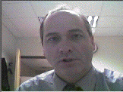
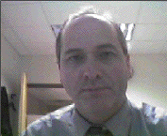

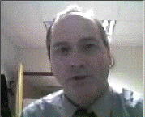
Uncompressed - 8000 kbps
PJPEG - 8fps 240kbps
Sorensen 20kbps 30fps
Sorensen 30kbps 6fps

Slide 16
Media over the Web
First media must be sufficiently compressed to download faster than it is played
Then it must be delivered and then played
  Download - then play
  Pseudo-Streaming or http streaming
  Streaming

Slide 17
Sound
Down
load
Network
Time -->
Pseudo
Stream
Sound
Network
Time -->
Stream
Sound
Network
Time -->

Slide 18
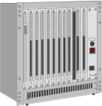

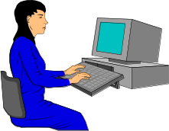
View locally
Down
load
Copy to cache
http protocol
View while loading
Pseudo
Stream
http protocol
View while loading
Stream
Special Protocol
Notes:
Some of the comanies which work with streaming media, develop their own protocol which allows them to adapt to changing network conditions. Often the company makes their money selling server licenses while giving away the viewer and encoder. More recently companies (www.vivo.com) areusing standard protocols to stream their data which is much more cost effective.
Often while companies feel that a proprietary protocol has some inherent advantages, often there are disadvantages as well. Given that the use of a proprietary protocol often has a cost factor involved, usually approaches which use a standard protocol will be more successful in the long run.

Slide 19
Download Then Play
Advantages
  Does not need to happen in real-time (go get a cup of coffee)
  Uses http protocols (passes firewall)
  User can get a local copy
Disadvantages
  It might be hours before sound starts

Slide 20
Playing Media in Real-Time
In order to compensate for network delays, player must buffer data ahead before playing it.
After 2-15 second delay, can keep up in real time
First successful real-time media was (www.real.com)
Notes:
An advantage of real-time audio delivery over the internet is the concept of “narrowcasting”. A perfect example is the broadcast of Colege sports to alumni across the globe. On any given weekend there may be hundresd of college sporting events, with only 2-3 on national Television. With the Internet people can have access to all of the events without using broadcast television.

Slide 21
Pseudo Streaming
In pseudo-streaming the plug-in is told to make a standard http connection to retrieve the data. It begins to retrieve the data onto disk. Once it has gotten ahead it begins to play off the disk. Hopefully it can download fast enough that the playing never catches up.

Slide 22

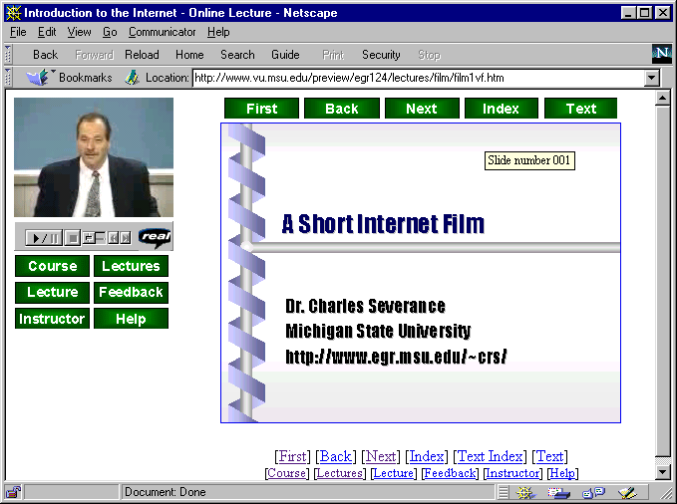

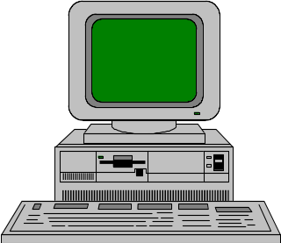
Entire file is copied to disk across the Internet as quickly as possible using
HTTP/TCP
Once sufficient data has been buffered, play begins from the disk - playing continues unless the player “catches up” to the download

Slide 23
Pseudo-Streaming
Advantages
  Works on ANY web server
  Works across firewalls that pass web traffic
  May be good when network is congested
Disadvantages
  Cannot move around randomly
  Skip ahead might take 20 minutes while all of the intervening data is downloaded

Slide 24
Streaming
Requires streaming server
  RealServer
  Apple Server
  IBM VideoCharger
  Microsoft NetShow
Quick start-up and random access
Uses special protocol - pnm: or rtsp:

Slide 25
Data is sent from the server to the player in packets. Depending on the performance of the connection, more or less data is sent. Data is played a short time after it arrives.
When you skip around, the player sends a message BACK to the server to begin sending packets from the new location of the file. After a brief moment the player begins playing from the new location.

Slide 26
Streaming
Advantages
  Quick startup
  Random Access
  Sophisticated players can alter data rates
Disadvantages
  Firewalls may block special protocol
  Networks with a lot of loss

Slide 27
Producing Internet Video
Better quality hardware and faster processors improve quality
You end up with plenty of “studio” problems
  Bad audio levels
  Lousy lighting
  Wires everywhere

Slide 28
Producing RealVideo on PC
Can digitize live straight from Camera or VCR to RealVideo PII/300 or faster
For a slower computer, either sacrifice frame rate or use two-step process
  Capture to AVI (lots of disk)
  Batch convert to RealVideo
  Gives excellent quality on slower systems

Slide 29
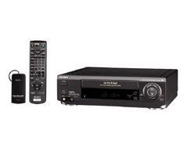
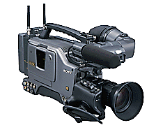
Real Encoder
AVI Capture

Slide 30
Producing QuickTime on Mac
Not currently capable of web-bitrate compression in real-time for video
  May be possible with Sorensen Pro and 400Mhz+ system
Two Step process
  Digitize/Quick Compress such a PJPEG
  Recompress to Web bit rate using Sorensen off-line

Slide 31
Quicktime JPEG Capture
Quicktime Sorensen Recompress

Slide 32
QuickTime Advantages
In this process, the intermediate file is partially compressed (PJPEG 8fps) and reasonably high quality
It can be used to produce RealVideo or Microsoft Netshow video
In many ways, QuickTime is the Rosetta stone of video - good for repository materials

Slide 33
What about Microsoft?
I have not gotten around to dissecting MS Media yet
Cursory evaluation
  Lags Real and Quicktime in feature set
  Strong web-bitrate CODEC
  A lot like RealPlayer 5.0
I won’t be ignoring it for long :)

Slide 34
Conclusion
To deliver audio or video effectively using the Internet, it must be compressed and there are many many choices
Producing Internet video requires some skill with audio and video equipment
But it is kind of fun...

