Slide 1
Basic Sync-O-Matic 3000 Documentation
Dr. Charles Severance
http://www.netfact.com/crs/projects/syncomat/

Slide 2
This Documentation
Reference manual - not a HowTo
  Main Screen
  Menu Layout
  Options | Preferences
  Lecture Menu
    AudioFlip/VideoFlip/FlipIT!
    TimeIT!
    Make Lecture

Slide 3
Introduction
Sync-O-Matic 3000 is a powerful and extremely flexible tool. Once you understand it, you can do many things.
It does have a bit of a learning curve at the beginning
It works best when someone invests the time to understand it and provides local help and support for the product

Slide 4
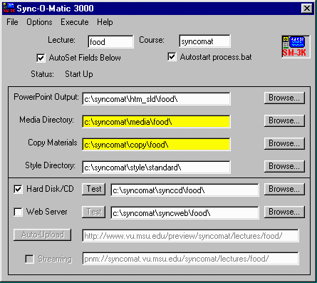
User Interface

Slide 5
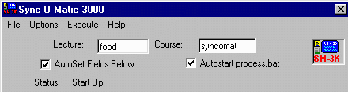
Main Screen
Lecture Name - This is used to form PowerPoint file names, directory names, URLs, and file names - keep it less than 5 characters - In this lecture we will use “food” as the example
Course - Allows multiple courses

Slide 6
The Sync-O-Mat Logo
Clicking here is the same as the Execute | Make Lecture
Just a short-cut and an excuse to reuse the nifty icon :)

Slide 7
Check Boxes
Autoset Fields - When checked the fill-in fields are updated based on preferences as lecture name and course are changed
Autostart process.bat - When checked, the second half of “Make Lecture” is done automatically - uncheck for debug

Slide 8
Starting PROCESS.BAT
When a lecture is being made, there are two phases
  first SM-3000 creates a bunch of files in the destination directory
  then it produces process.bat which contains commands to merge audio and events, copy files, etc.

Slide 9
PROCESS.BAT
Normally once SM-3000 has made all the files, the batch job is started automatically. For debugging, you can do this step manually
While this job is running, SM-3000 tracks and displays its progress on the status bar.

Slide 10
Directories
Syncomat uses a number of directories
Input directories
Style directory
Output directories

Slide 11
Directory Naming Convention
Path name is made up of the course, type of material, and the lecture name
Path naming convention is configurable using preferences
c:\cse230\htm_sld\lec21\
Course
Material - HTML Slides
Lecture Name

Slide 12

PowerPoint Output
This is where we will save the HMTL version of your PowerPoint presentation
Read in and parsed by Sync-O-Mat
In PPT-97, Save as HTML to C:\syncomat\htm_sld - PowerPoint adds the “lecture name” / “PowerPoint file name”

Slide 13
Media Directory
Contains RealMedia and timing
  food1.rm, food1.txt
The “1” means “part 1” - Syncomat supports multi-part lectures - a feature which is not commonly used
These files can be created using FlipIT! Or by hand
Yellow means
“directory empty”

Slide 14
Copy Materials
The contents are copied into the destination directory after the lecture is produced. Use this to add necessary files or even replace files in the final output.
This is an advanced feature

Slide 15

Style Directory
Sync-O-Mat is very flexible using a style directory for its look and feel
You can use on of the provided styles or make your own
You can make the lectures look like a course management system.

Slide 16
Destination Information
You must choose the destination(s) for your lecture.
  Hard Disk or CD-ROM - Useful for testing and off-line demonstrations
  A standard web server (pseudo streaming)
  A web server which supports RealNetworks streaming protocols (pnm:)

Slide 17
VERY Important!!!
Because of confusion between browsers, plugins, and some bad design on the part of the Real …
You different versions of the files
  When you move from the HD to the Web
  When you move the lecture from one URL to another
  When you switch from streaming to pseudo-streaming (or vice versa)

Slide 18
One More Time
According to support personnel ...
The most common user mistake is uploading the contents of the synccd (Hard disk output) directory to the web and wondering why it won’t work
Hint: Look at a .rpm file (file: means HD only) (http: means pseudostream) (pnm: means streaming)

Slide 19
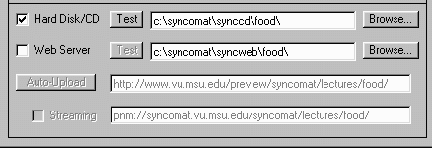
Hard Disk or CD-ROM
All references in the HTML are relative to the local directory - for this reason, the material must be viewed using the plug-in and frames format
Execute | Make Lecture then press “test” - to
launch
browser

Slide 20
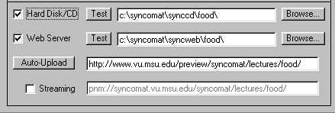
Check Boxes
Can make Hard Disk or Web Version or both at the same time by setting check boxes
Default is to only make the Hard Disk version - good first step

Slide 21
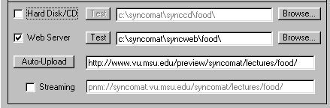
Web Server
When you are creating a web version, you must specify the base URL at which all of the lecture materials will be stored.
This is necessary so that the plug-in can find the media and find the slides across the network
Base URL

Slide 22
Web Server (cont.)
Just checking the box is NOT enough - you must also do a Execute | Make Lecture
Test button only useful after lecture has been made and data has been uploaded to
the web
Test Button

Slide 23
Pseudo Streaming
You do not need a streaming server
If you do not select streaming, all the materials will still work but they will use pseudo-streaming (http streaming)
This means that you can put these lectures on any web
server
Leave
Unchecked

Slide 24
Directory syncweb
syncweb is where files are assembled for upload to a web server
  Make this a path to a network drive
  Use an FTP client to upload files
  Use Auto-Upload
Will NOT play from the hard disk
Web
files

Slide 25
AutoUpload
AutoUpload is very convenient once it is configured properly
Preferences are important to get set properly or it is very hard to use (later)
(1) Make Lecture (2) Auto Upload
(3) Test

Slide 26
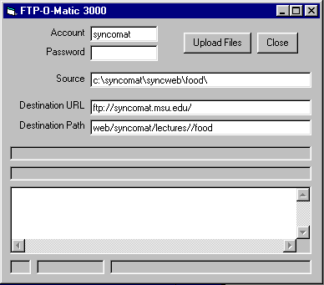
Ftp account and password
Click to upload
Click when done
Data to upload from local disk (leave alone)
Server host name - do not include any path information
Destination path on server (this is the tricky part)
Debugging message area

Slide 27
Destination Path for Upload
Use FTP to connect to the web server
Log in with the password and account
Use CD to navigate to the directory which will hold the files
Use the PWD command to find the working directory - this is the destination path - You can use either a path relative to the login directory or absolute path starting with / (preferred)

Slide 28
Using a Streaming Server
Often a completely different machine
  Must move the .rm files to the Real Server manually :(
May be on the same server in a different hierarchy
  Must move the .rm files manually :(
  Friendly sysadmin might make a soft-link :)

Slide 29
Streaming Server
You will need to communicate with the sysadmin - this is not trivial
  Where do I store the files? Server? Path?
    Server Example: real.msu.edu
    Path Example: /usr/real/docs/stuff/cps230
  What URL do I use for my files?
    rtsp://real.msu.edu/stuff/cps230/food1.rm
    pnm://real.msu.edu/stuff/cps230/food1.rm
Test manually first - then automate

Slide 30
One Step at a Time
First, do hard disk/CD only - test until it works
Second, do pseudo-streaming - Upload and test until it works
Finally, enable streaming and re-upload and re-test
If hard disk/CD fails, streaming will definitely not work

Slide 31
Preferences
There are three basic areas of preferences
  Control of the main screen of SM-3000
  Control of the FlipIT! Operation
  Control of the Make Lecture Operation
Preferences are stored in the Registry

Slide 32
Menu Options
File | Open Save Save As Exit
  Files saved are *.som and contain all of the main screen settings
Options | Preferences
Execute - Runs TimeIT! FlipIT! and makes the lecture when you are ready
Help is pretty useless except for the version when you send me mail

Slide 33
Options | Preferences
Sync-O-Matic has a number of user configurable behaviors
Like Windows, you can completely break Sync-O-Matic by confusing the preferences

Slide 34
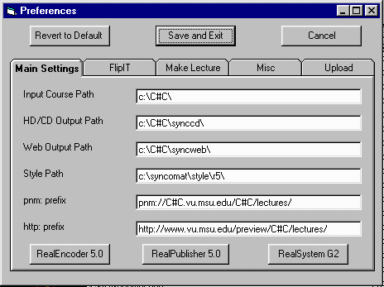
Main Settings Settings

Slide 35
Main Input Preferences
Input Root Path - Used to autoset PowerPoint Output, media, and copy paths
Style Path - Sets default style
Output Root Path - Sets the synccd and syncweb paths
You can also set default roots for http and pnm prefixes

Slide 36
Main Input (cont.)
C#C is replaced by course name
Lecture name is appended to the end of each string except for style
The three buttons set several preferences to the proper defaults for Real 5.0, G2, and RealProducer

Slide 37
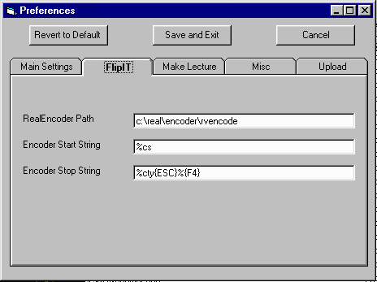
FlipIT! Preferences

Slide 38
FlipIt! Preferences
The path for the encoder program to use is specified
The key sequence to start and stop the encoder is settable - %c is ALT-C
These are usually set by the buttons on the main screen and no other changes are necessary
But… as Real changes the key sequences used by the various encoders you may have to adjust these values :(

Slide 39
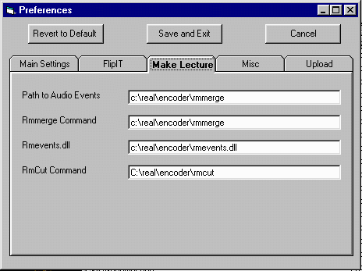
Make Lecture Preferences

Slide 40
Make Lecture Preferences
This screen sets the preferences for the Execute | Make Lecture process
Generally these are set automatically by the buttons on the first screen
These strings are used in the PROCESS.BAT script which is run as part of the Make Lecture Process

Slide 41
Make Lecture Prefs (cont)
Path to program for audio events - can either be to rmmerge(>3.0) or to cevent32 (2.0)
Path to the rmmerge program - used for the video
Path to the rmevents.dll file for video or >3.0 audio
rmcut not currently used

Slide 42
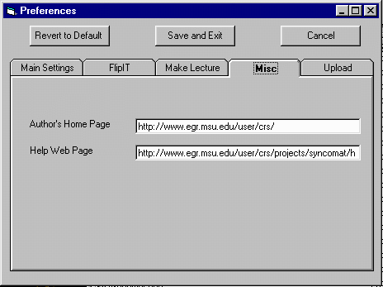
Miscellaneous Prefs

Slide 43
Miscellaneous Preferences
These are used to configure the Help menus
In case the author changes jobs :)

Slide 44
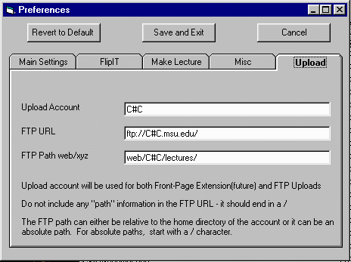
Upload Preferences

Slide 45
Upload Preferences
Sets default FTP account
Sets default FTP hostname
Sets default FTP path - can be relative or absolute
Can use C#C for course name in any of these fields
Lecture name is appended to FTP path

Slide 46
Preferences Conclusion
Experiment - there is always the “reset to defaults” button
Getting preferences set right makes it so that lectures can be produced, tested, and uploaded with minimal effort.
Getting preferences right is part of the learning curve

Slide 47
Execute Menu
VideoFlip! - Simple version of FlipIT!
AudioFlip! - Simple version of FlipIT!
FlipIT! - Record and time a lecture (with too many options)
TimeIT! - Edit the lecture timing values
Make Lecture - Produce the synccd/syncweb files

Slide 48
VideoFlip and AudioFlip
As we will see later, FlipIT! Is way too flexible to be useful - so VideoFlip is a simplified version with all the right defaults set the way you want
VideoFlip! Makes .rm files
AudioFlip! Makes .ra files
Most of the modern styles assume .rm files so you should use VideoFlip for audio too..

Slide 49
VideoFlip Steps
Pop up a notice box telling you what to do with the encoder
Start the encoder
Bring up the slide flip window
Wait for you to setup the encoder
When you advance to the first slide - VideoFlip! starts the encoder
When you exit the slide tool - VideoFlip stops the encoder

Slide 50
VideoFlip! Notes
While this works surprisingly well, there is some “duct tape” involved
You must follow the steps (on the previous slide) carefully or your audio/video will not record successfully
It is important to be familiar with the use and operation of the encoder BEFORE you try using VideoFlip!

Slide 51
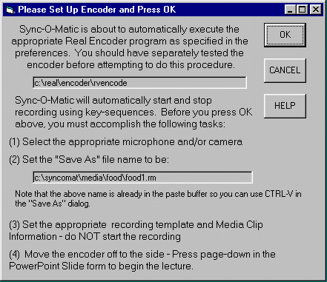
VideoFlip! Reminder
Please read every single word of this dialog box before pressing “OK”. After the second or third time, you will ignore it.
You are about to enter a complex process and this dialog is trying to guide you through it :)

Slide 52
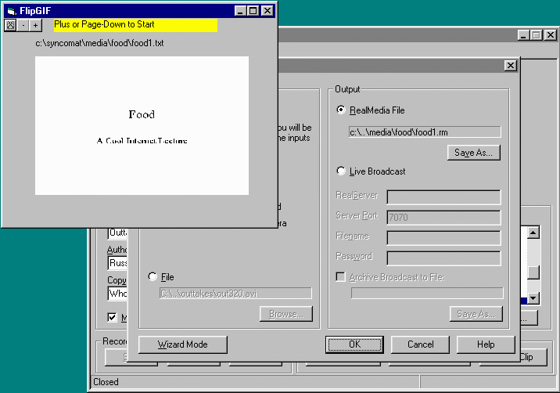
After you press OK lots of boxes pop up
Slide Flip Window
RealEncoder Setup Window
RealEncoder
Window

Slide 53
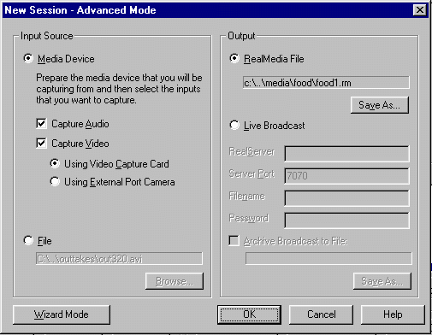
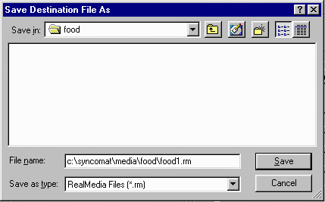
(1) Setup Media Device
(2) Set Media File Name
(3) Use CTRL-V (paste) to get right name
(4) Press Save then OK

Slide 54
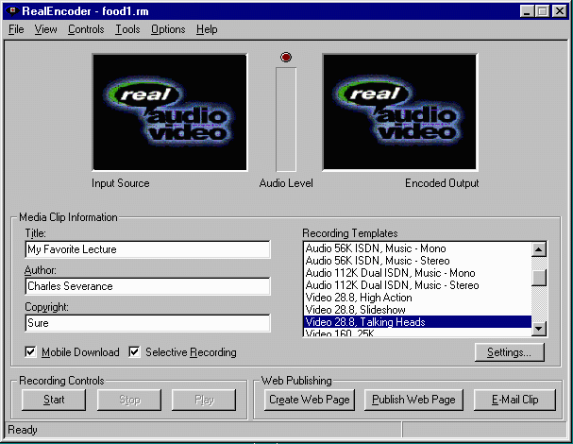
Set all of these values - remember you are already supposed to be a RealEncoder expert :)
Do NOT press the Start Button
At this screen, you do everything except press the start button- in a moment, the start button will be pressed automatically but Sync-O-Mat as the timers are started.

Slide 55
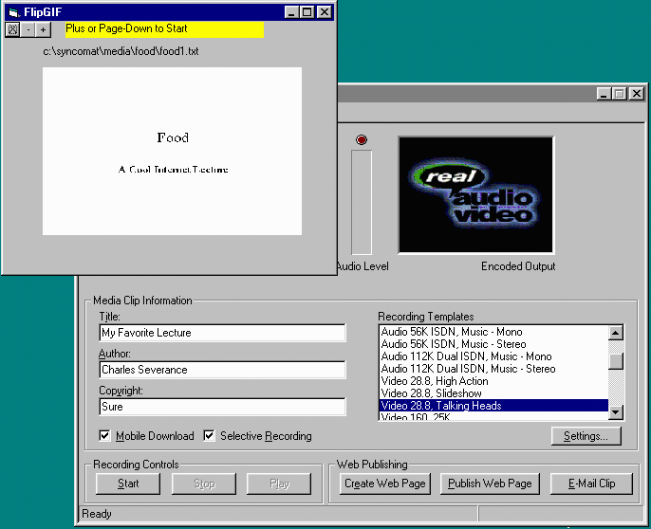
Ready to Lecture

Slide 56
Time to Lecture!
Press the “+” button
  Brings up the first slide in FlipGIF
  Send keystrokes to start Encoder
  Starts Internal Timer
To go to the next slide press “+”
  Advances slide in FlipGIF
  Stores elapsed time \syncomat\media\food\food1.txt

Slide 57
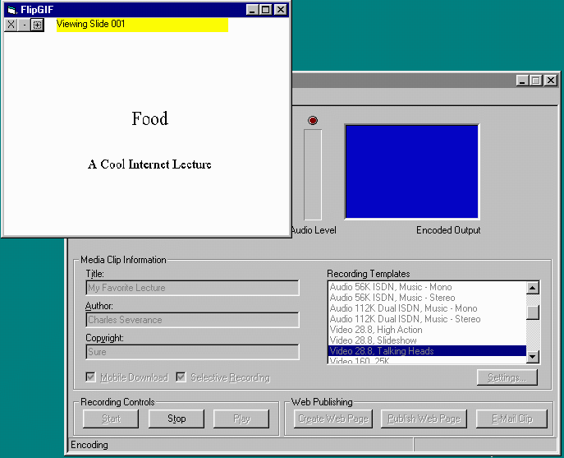
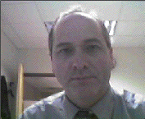
While Lecturing

Slide 58
More Lecturing
Don’t use “-” it is not well implemented
On the last slide, when done, either press the + or the X
  Records the elapsed time for last slide
  Turns off internal timer
  Stops the Encoder software

Slide 59
FlipIT!
As complex as the “simple” VideoFlip is, FlipIT! Is more complex and powerful. It supports multipart lectures from a single set of PowerPoint slides, numerous viewing modes, etc…
It is documented in “Advanced Syncomat Documentation”

Slide 60
TimeIT!
TimeIT! Is basically a tiny time-aware spreadsheet which allows you to alter the timings for your lecture
Sometimes when you use Syncomat in a studio, or are working from a tape, you simply write the time of each slide flip on a piece of paper. TimeIT allows those to be easily typed in.

Slide 61
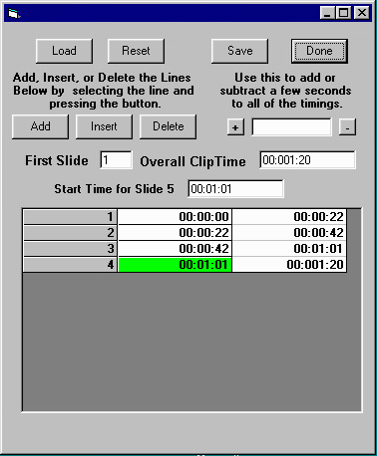
TimeIT!
User
Interface

Slide 62
TimeIT! Features
Load - Retrieve and event file from disk
Reset - Start over to create new file
Save - Save the file - name food1.txt, food2.txt, etc….
Done - Exit the program
Includes a simple time trimmer to add or subtract a few seconds from all times

Slide 63
TimeIT!
At the bottom, TimeIT! Shows the current timing data for a slide.
  Green is used to indicate the “current row”
  Red indicates - something is wrong such as start time > end time or incomplete entry
You can highlight the row you want to operate on

Slide 64
Editing in TimeIT!
Add creates a new row below the selected row
Insert creates a new row above the selected row
Delete deletes the selected row
To modify the value in the selected row, enter the new value in the “Start Time for Slide 5” and press enter

Slide 65
Editing in TimeIT!
TimeIT! is continuously resequencing the slides as new slides are inserted - you can change the First Slide number at any time to resequence the slides
You also must specify the overall clip time so the end time of the last slide is known

Slide 66
TimeIT! Shortcomings
TimeIT! Could use some more work
  Allow for out of order slides - FlipIT! Does this but TimeIT! will mess it up on a Load/Save
  Allow the specification of something other than a slide. Allow a URL instead.

Slide 67
Help Menu
Check out Help | About
Plenty of people helped define Sync-O-Mat
On-Line help - as always a work in progress :)

Slide 68
Conclusion
It takes a while to understand all of the features of this software
The more you understand about streaming audio, video, synchronized events, HTML, etc, the more it will make sense
If you take some time up front, you can produce a lot of lectures quickly

